Slide 1
Training Materials
WP5: Capacity Building in Municipalities
Legal Framework
© Copyright CERTUS Project 2017 - All Rights Reserved Grant agreement no.: 620906

Slide 2
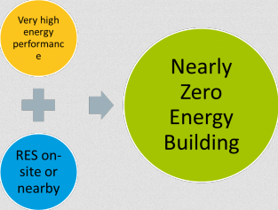
Legal Framework
nZEB – Definition and Implementation
European policies recognise the importance of building renovation as a key element to reach the long term energy and climate goals, as well as a positive economic impact.
Higher energy efficiency in new and existing buildings is a crucial aspect and nearly zero energy buildings should become the norm in the near future.
According to the roadmap for moving to a competitive low-carbon economy in 2050, the EU is committed to reduce greenhouse gas emissions to 80-95% below 1990 levels by 2050.
© Copyright CERTUS Project 2017 - All Rights Reserved

Slide 3
Legal Framework
nZEB – Definition and Implementation
Definition
According to the Energy Performance of Buildings Directive (EPBD):
Article 2.2. “‘nearly Zero-Energy Building’ means a building that has a very high energy performance, as determined in accordance with Annex I.
The nearly zero or very low amount of energy required should be covered to a very significant extent by energy from renewable sources, including energy from renewable sources produced on-site or nearby”
© Copyright CERTUS Project 2017 - All Rights Reserved

Slide 4
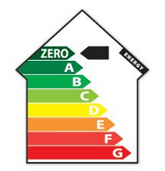
Legal Framework
nZEB – Definition and Implementation
Definition
Annex I, article 1 stipulates that “The energy performance of a building shall be determined on the basis of the calculated or actual annual energy that is consumed in order to meet the different needs associated with its typical use and shall reflect the heating energy needs and cooling energy needs (energy needed to avoid overheating) to maintain the envisaged temperature conditions of the building, and domestic hot water needs.”
Article 9.1 regulates that “Member States shall ensure that by 31 December 2020, all new buildings are nearly zero-energy buildings and after 31 December 2018, new buildings occupied and owned by public authorities are nearly zero-energy buildings.”
© Copyright CERTUS Project 2017 - All Rights Reserved

Slide 5
Legal Framework
nZEB – Definition and Implementation
Implementation
Member States have the responsibility to include in their national plans, the detailed definition in practice of nearly zero energy buildings, reflecting their national, regional and local conditions.
More than half of the Member States already implemented a definition, some are under approval.
The exemplary role of the public sector has been emphasised by several Member States, including Italy, through the establishment of specific intermediate targets for this sector, while only few member States, mainly from Northern Europe, established targets for the refurbishment of the existing building stock.
© Copyright CERTUS Project 2017 - All Rights Reserved

Slide 6
Legal Framework
nZEB – Definition and Implementation
Member States reported a wide range of policies and measures in support to nZEB objectives in their National Energy Efficiency Action Plans (NEEAPs), although it is not often clear to what extent these measure specifically target nZEBs.
The most prevalent measure for stimulating refurbishment into nZEB is the implementation of financial schemes.
Other policy measures are awareness raising and education, training and energy performance certificates.
© Copyright CERTUS Project 2017 - All Rights Reserved

Slide 7
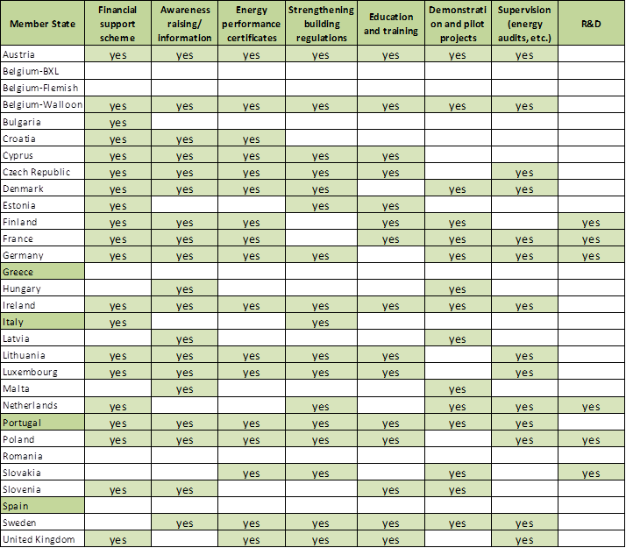
Legal Framework
nZEB – Definition and Implementation
Main policies in renovation to nZEB in Member States
© Copyright CERTUS Project 2017 - All Rights Reserved

Slide 8
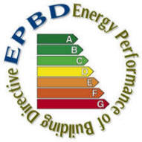
Legal Framework
Regulation Overview - Portugal
The Directive on Energy Performance of Buildings allowed the development of a legislative package in Portugal, which created a National System of Energy Certification and Indoor Air Quality in the Buildings (SCE), and revised building codes for residential and non-residential buildings.
The European Directive 2002/91/EC was transposed to the Portuguese national law on April 4th 2006 by means of a legislative package composed of three Decree-Law.
This Decree-law only made a partial application on the Directive, but in January 2009, the Portuguese Energy Performance Certification scheme comprised the full implementation of the EPBD.
© Copyright CERTUS Project 2017 - All Rights Reserved

Slide 9
Legal Framework
Regulation Overview - Portugal
The Directive on Energy Performance of Buildings allowed the development of a legislative package in Portugal, which created a National System of Energy Certification and Indoor Air Quality in the Buildings (SCE), and revised building codes for residential and non-residential buildings.
The European Directive 2002/91/EC was transposed to the Portuguese national law on April 4th 2006 by means of a legislative package composed of three Decree-Laws:
Decree-law 78/2006 - National Energy Performance Certification System and Indoor Air Quality in Buildings (SCE) partially applies the Directive 2002/97/CE of the European Parliament and of the Council, of 16th December 2002, regarding buildings energy efficiency;
Decree-law 79/2006 - Regulation of Temperature Control Systems in Buildings (RSECE);
Decree-law 80/2006 - Regulation of Thermal Behaviour Characteristics in Buildings (RCCTE).
Since January 2009, the Portuguese Energy Performance Certification scheme comprises the full implementation of the EPBD, meaning that all the required buildings are now included (new buildings, major renovations, public buildings and all buildings when sold or rented).
© Copyright CERTUS Project 2017 - All Rights Reserved

Slide 10
Legal Framework
Regulation Overview - Portugal
About 80% of these EPCs took place after January 2009, for existing buildings, upon sale or rent.
With the publication of the European Directive 2010/31/EU from May 19th 2010 on the energy performance of buildings, the regime established by Directive 2002/91/EC was reformulated. The transposition into national law of this Directive created an opportunity to improve and systematize the scope of energy certification system and respective regulations as well as to align the national requirements with impositions of the Directive.
The Decree-Law 118/2013 from August 20th 2013:
Ensured not only the transposition of the Directive, but also the revision of the national legislation to include, in a single law which includes the System for Energy Certification of Buildings (SCE), the Regulation on the Energy Performance of Residential Buildings (REH), and the Regulation on the Energy Performance of Services Buildings (RECS).
In general, the requirements for new buildings were tightened, promoting efficient envelops and introducing technical systems requirements.
The contribution of renewable energy systems (RES) was also detailed and stimulated. It also defines nZEB and its requirements and transposes to the national legislation the aim to have nZEB in all new buildings after December 31st 2020 or after December 31st 2018 in the case of public buildings.
© Copyright CERTUS Project 2017 - All Rights Reserved

Slide 11
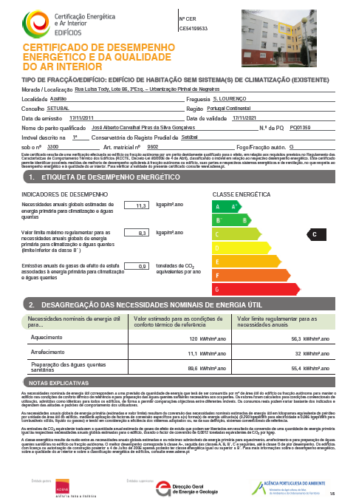
Legal Framework
Regulation Overview - Portugal
Such Directive clarifies some of the principles of the original text and introduces new provisions aimed at strengthening the framework for promoting energy efficiency in buildings, in the light of the goals and challenges agreed by the Member States for 2020.
By December 2013, more than 600,000 Energy Performance Certificates were issued on a web based central registration system that qualified experts must access and use to issue certificates.
© Copyright CERTUS Project 2017 - All Rights Reserved

Slide 12
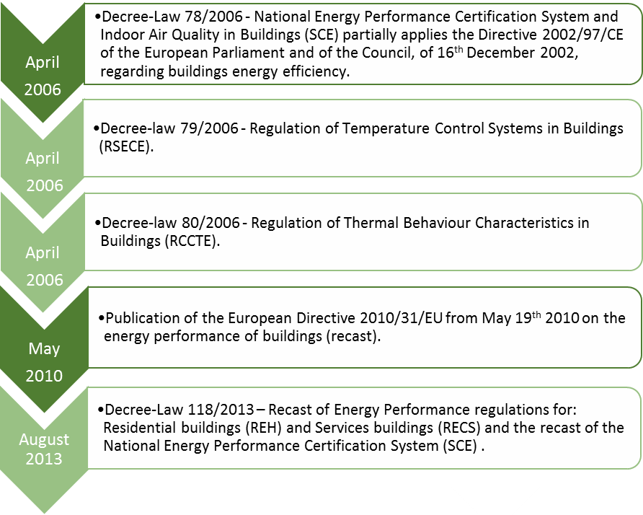
Legal Framework
Regulation Overview - Portugal
SCE timeline and an overview on its implementation in Portugal
© Copyright CERTUS Project 2017 - All Rights Reserved

Slide 13
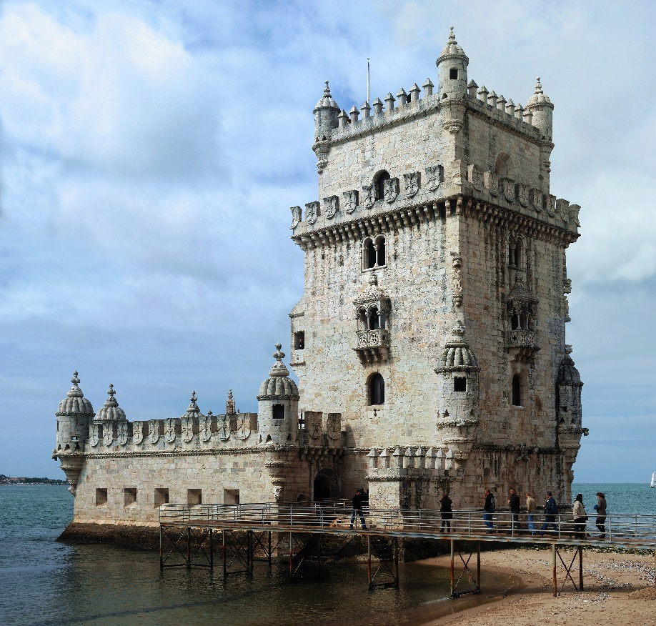
Legal Framework
Regulation Overview - Portugal
Protection Rules of Historic Buildings
According to its relative value, the immovable cultural heritage may be listed as bearing national interest, public interest or municipal interest.
Any national interest property, be it a monument, a group of buildings or a site, is deemed to be a “national monument”.
An asset shall be considered of public interest when its protection and enhancement, though representing a cultural value of national importance, prove to be disproportionate under the protection system inherent to national interest classification.
© Copyright CERTUS Project 2017 - All Rights Reserved

Slide 14
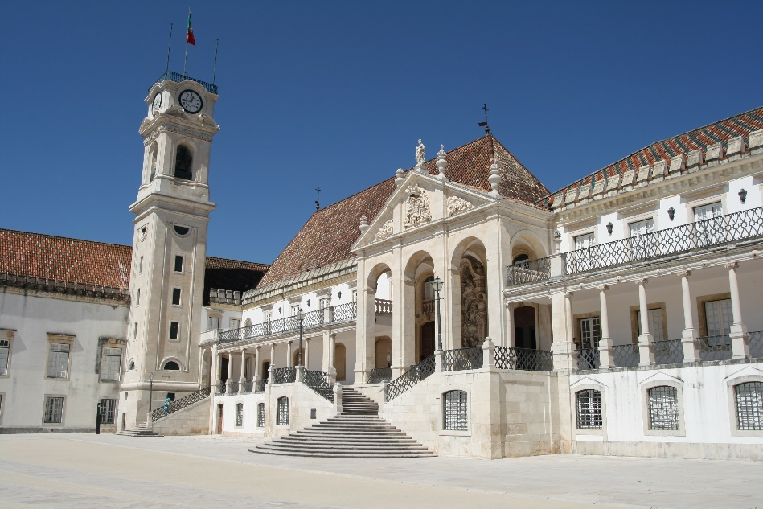
Legal Framework
Regulation Overview - Portugal
Protection Rules of Historic Buildings
Assets shall be considered of municipal interest where their protection and enhancement, in whole or in part, represent a prevailing cultural value within the scope of a municipality.
The administrative procedure for listing an immovable property is set in motion by the DGPC (Directorate General for Cultural Heritage) in liaison with the cultural directorates for culture (according to their respective operation area).
The listing of a cultural property as of national interest is a responsibility of the competent State authorities (the Council of Ministers) who will, for that purpose, issue a Government decree.
© Copyright CERTUS Project 2017 - All Rights Reserved

Slide 15
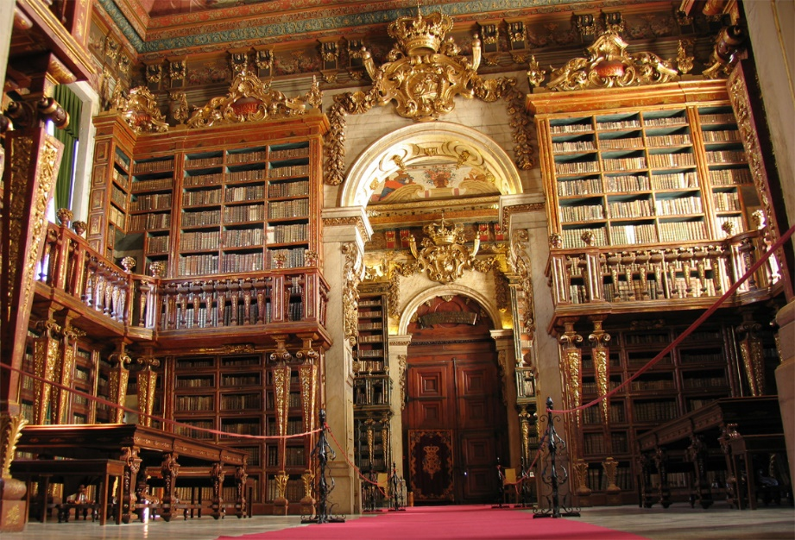
Legal Framework
Regulation Overview - Portugal
Protection Rules of Historic Buildings
Municipal interest properties are the responsibility of the municipalities even though the DGPC needs to issue a favorable report.
In mainland Portugal, it is up to the DGPC to propose to the Government the listing of national interest and public interest assets.
When the administrative procedure is set in motion, DGPC is to apply the definition of relevant cultural interest required for any national cultural heritage in pursuance with no. 3 of article 2 of Law no. 107/2001 of 8 September and the general criteria laid out in article 17 therewith.
© Copyright CERTUS Project 2017 - All Rights Reserved

Slide 16
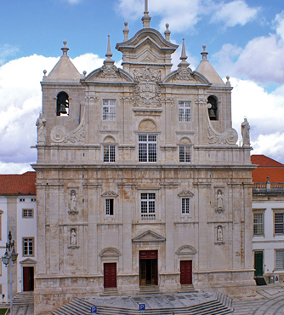
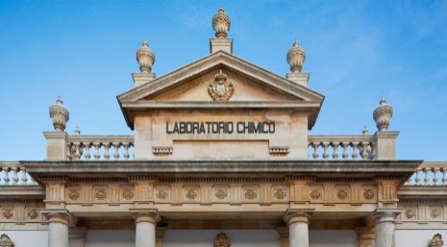
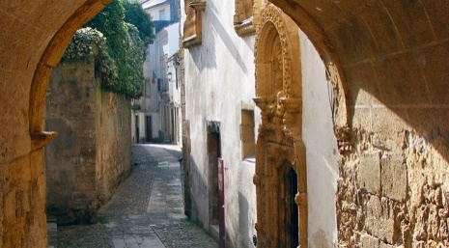
Legal Framework
Regulation Overview - Portugal
Protection Rules of Historic Buildings
Heritage listing extends its strategic scope through the creation of general and special protection zones, i.e., protection areas where no building works are authorized without prior consent from the competent cultural heritage authority.
Listed immovable properties may benefit from a special protection zone (ZEP), to be established by an ordinance, which is laid out at the time of the final decision for listing or within a period of 18 months from the date of publication of the final decision.
The effects of establishing a general protection zone or a provisional special protection zone on a listed property, for a national interest or a public interest property, will remain in force until the publication of the special protection zone.
The special protection zone ensures the landscape and visual integration of a given property including the green areas that are relevant to the context.
© Copyright CERTUS Project 2017 - All Rights Reserved

Slide 17
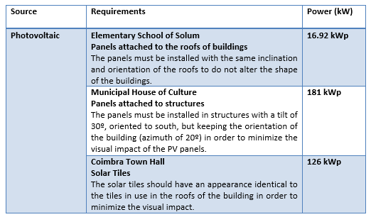
Legal Framework
Current Status of Renewable Energy
Type of RES, Requirements and Power of CERtuS Buildings in Portugal
© Copyright CERTUS Project 2017 - All Rights Reserved

Slide 18
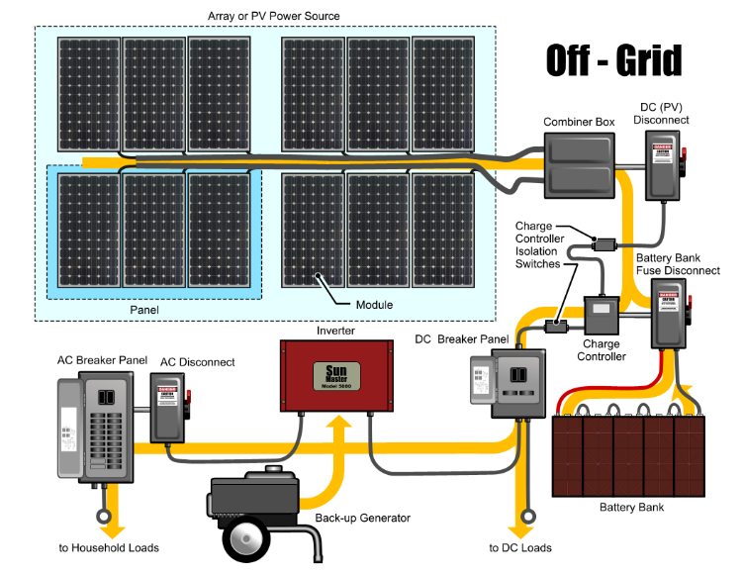
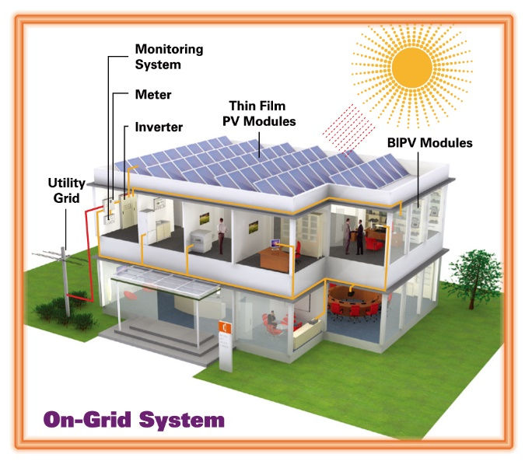
Legal Framework
Current Status of Renewable Energy
Authorization procedures and division of competencies in Portugal
For off-grid renewable energy (RE) systems there is no regulation enforced at the moment;
The authorization procedures for on-grid RE systems installation are presented in the next figure.
© Copyright CERTUS Project 2017 - All Rights Reserved

Slide 19
Legal Framework
Current Status of Renewable Energy
Authorization procedures and division of competencies in Portugal
Despite of looking to be rather complicated, the process runs with little or almost no problems;
The procedures are quite transparent and all players known exactly what their role is;
The process starts with the online registration of the RE system into a web platform (www.renovaveisnahora.pt) where the RE system and energy source are registered;
Afterwards, the systems owner must pay a fee to validate the registration, this fee includes all costs with permits, system inspection and certification;
Later the process supervisor – DGEG (General Directorate for Energy and Geology) analyses the registration request according to the local electrical grid technical features.
© Copyright CERTUS Project 2017 - All Rights Reserved

Slide 20
Legal Framework
Current Status of Renewable Energy
Authorization procedures and division of competencies in Portugal
If accepted (otherwise the registration data must be corrected) the process moves forward to power allocation stage where the nominal power of system is considered in the national balance of power generation.
After this stage and considering the system is already installed by a qualified company, using the certified and authorized equipment according to the Portuguese technical rules for electrical installations, the system is ready to be inspected by an independent entity.
In this stage there are two possibilities: system is reproved and corrections or changes are in order or it is approved and ready to be commissioned.
© Copyright CERTUS Project 2017 - All Rights Reserved

Slide 21
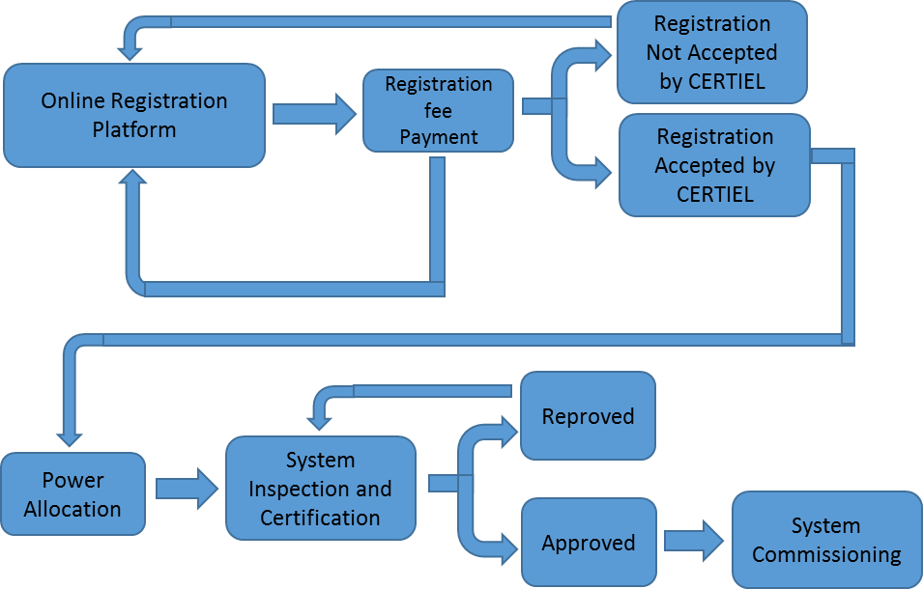
Legal Framework
Current Status of Renewable Energy
Authorization procedures and division of competencies in Portugal
© Copyright CERTUS Project 2017 - All Rights Reserved

Slide 22
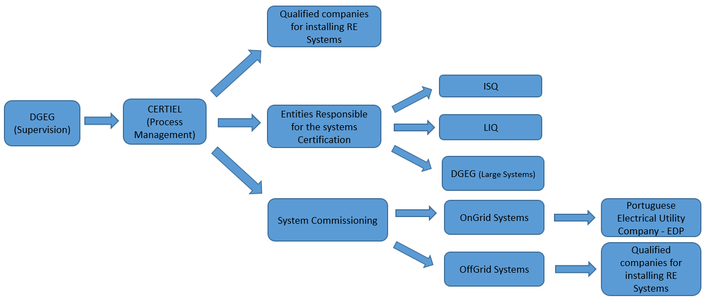
Legal Framework
Current Status of Renewable Energy
Authorization procedures and division of competencies in Portugal
The division of competencies between the different entities involved in the process is represent in the following figure:
© Copyright CERTUS Project 2017 - All Rights Reserved

Slide 23
Legal Framework
Current Status of Renewable Energy
Authorization procedures and division of competencies in Portugal
DGEG supervises the process and CERTIEL (Association for the certification of electrical installations) is the communication channel between entities;
CERTIEL also makes the bridge with the systems owner or the companies who installs the system. CERTIEL also recognizes which companies are qualified for installing RE Systems (according to their technical capability), which entities are qualified to perform system inspection and certification (ISQ - Institute of Welding and Quality and LIQ - Laboratory Quality Industrial);
© Copyright CERTUS Project 2017 - All Rights Reserved

Slide 24
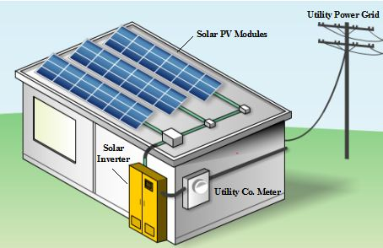
Legal Framework
Current Status of Renewable Energy
Authorization procedures and division of competencies in Portugal
In large systems (above 5.75 kW) DGEG sends its own technicians to perform the inspections and certifications;
The system commissioning for on-grid systems CERTIEL makes the connection between the system owner and the Portuguese Electrical Utility Company - EDP to connect the system to the national grid;
In off-grid systems the installation company is responsible for the commissioning.
© Copyright CERTUS Project 2017 - All Rights Reserved

Slide 25
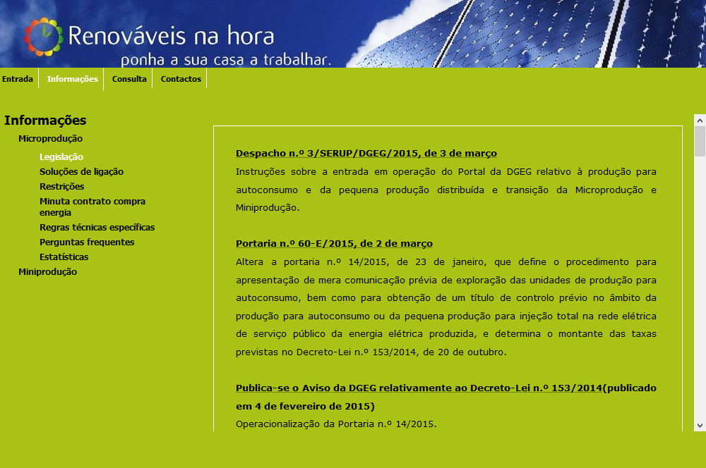
Legal Framework
Current Status of Renewable Energy
Relevant Regulations in Portugal
The legislation for RE systems can be found at the same website where the systems registration is made, but the direct link is:
http://www.renovaveisnahora.pt/web/srm/legislacao
Relevant legislations is available (only in Portuguese) for the following RE sources: Solar, wind, biomass, biogas and hydro.
© Copyright CERTUS Project 2017 - All Rights Reserved

Slide 26
Legal Framework
Current Status of Renewable Energy
Relevant Regulations in Portugal
The legislation is presented in different types of documents: Decree-Law, Regional Decree-law (for Madeira Islands), Ordinances and DGEG official statements.
Some examples of such legislation are presented below:
Decree-Law 363/2007 from 2 of November – First definition of legal regime applicable to production of electricity from renewable sources;
Regional Decree-Law 16/2008/M from 6 of June – Adapts to the Madeira Island the Decree-Law 363/2007 legal regime for the production of electricity through small production units;
Decree-Law 118A/2010 (Recast of Decree-Law 363/2077) from 25 of October – Simplified the legal regime applicable to the production of electricity through small production units;
Decree-Law 34/2011 from 8 of March – defines the legal regime applicable for the production of electricity through medium production units (up to 250kW).
© Copyright CERTUS Project 2017 - All Rights Reserved

Slide 27
Legal Framework
Current Status of Renewable Energy
Relevant Regulations in Portugal
Decree-Law 153/2014 from 20 of October – Established the legal regime applicable to production of electricity designed for self-consumption and grid injection from renewable source, through small production units;
Ordinance 15/2015 from 23 of January – Defines de tariff for On-grid RE production systems whose sources are: solar, wind, biomass, biogas and hydro;
Ordinance 60-E/2015 from 2 of March – Defines de communication procedure regarding off-grid systems, to be reported to DGEG and determines the rates mentioned in Decree-law 153/2014.
Other forms of regulation are enforced in the Portuguese electric sector such as:
Technical regulations for low voltage electrical installations
(http://www.certiel.pt/web/certiel/instalacoes-de-utilizacao)
DGEG Approved connection schemes for On- grid renewable energy systems
(http://www.renovaveisnahora.pt/web/srm/solucoes-de-ligacao)
© Copyright CERTUS Project 2017 - All Rights Reserved

Slide 28
Legal Framework
Issues with regulations, standards and administrative procedures
Environmental obstacles and gaps in the regulatory frame
Description:
There are no major environmental obstacles or gaps (for instance opposition of environmental groups) to the installation of energy efficiency technologies and renewable energy in buildings.
Recommendations:
None
© Copyright CERTUS Project 2017 - All Rights Reserved

Slide 29
Legal Framework
Issues with regulations, standards and administrative procedures
Renewable Energy technologies obstacles and gaps in the regulatory frame
In classified buildings the protection rules usually impose strong limitations to the installation of renewable energy technologies.
Example:
The regulation for the buildings inscribed on the World Heritage List of UNESCO in the property called University of Coimbra — Alta and Sofia (where the Coimbra Town Hall is included) allows the use of PV panels if integrated into the roof, but limits it to a maximum area of 3 m² by building.
This maximum area is adequate for the small residential buildings in this property, but it is not adequate for large buildings such as the Town Hall, since this very small area of PV is not enough to have a relevant impact on the building’s energy performance and with such restriction it is not possible to achieve a nZEB level.
© Copyright CERTUS Project 2017 - All Rights Reserved

Slide 30
Legal Framework
Issues with regulations, standards and administrative procedures
Renewable Energy technologies obstacles and gaps in the regulatory frame
Other restriction to the large scale installation of renewable energy technologies is the tariff. Nowadays the tariffs intend to promote the self-consumption of electricity, being the generation used to avoid consumption from the electrical grid. When the energy is injected into the electrical grid the tariff is very low and reduces the cost-effectiveness of the generation facility.
In buildings with a high installed capacity in renewables the real-time generation can often be larger than the consumption and in this situation the surplus of energy must be injected into the grid with a low tariff (about 4 €c/kWh).
Therefore, in buildings with enough RES generation to be considered a ZEB the cost effectiveness of the RES generation technologies will be low.
© Copyright CERTUS Project 2017 - All Rights Reserved

Slide 31
Legal Framework
Issues with regulations, standards and administrative procedures
Renewable Energy technologies obstacles and gaps in the regulatory frame
Recommendations:
Integration of PV panels in classified buildings: The maximum area should be defined in a percentage of the total roof area and not using a fix area to all buildings. The maximum area should also not be very restrictive if solutions to minimize its visual impact (such as solar tiles) are adopted.
Tariffs for the PV generation: The energy injected into the grid will cause an increase of the costs of the grid management. Therefore, the actual solution to pay such energy with a price lower than the average price in the wholesale market is correct. Otherwise the extra costs in the grid management would be paid by the users without PV generation, creating an unfair cross-subsidisation.
The solution to such problem is not a change in the actual tariffs, but a promotion of energy storage solutions to ensure a better local generation and consumption matching to avoid the injection of energy into the grid (in periods when the grid do not needed).
Since such solutions still present very high costs, there is a need of financial support to energy storage technologies.
© Copyright CERTUS Project 2017 - All Rights Reserved

Slide 32
Legal Framework
Issues with regulations, standards and administrative procedures
Technology – specific obstacles and gaps in the regulatory frame for application and use in urban areas
There are no relevant specific obstacles and gaps to the use of efficient technologies (e.g. lighting or HVAC) in urban areas.
Recommendations:
None
© Copyright CERTUS Project 2017 - All Rights Reserved

Slide 33
Legal Framework
Issues with regulations, standards and administrative procedures
Technology specific obstacles and gaps in the regulatory frame concerning the deep renovation of building envelope
In classified buildings the protection rules usually impose strong limitations to the renovation of the building envelop and openings.
Example:
The regulation for the buildings inscribed on the World Heritage List of UNESCO in the property called University of Coimbra — Alta and Sofia (where the Coimbra Town Hall is included) does not allow the replacement of the windows by double glazed windows using standard solutions;
Because the original frame must be kept (the usual solution is to implement other window in the interior).Since these frames have to be specifically designed to this building, this cannot be ensured with standard solutions available in the market, and would have a high cost.
© Copyright CERTUS Project 2017 - All Rights Reserved

Slide 34
Legal Framework
Issues with regulations, standards and administrative procedures
Technology specific obstacles and gaps in the regulatory frame concerning the deep renovation of building envelope
Recommendations:
The protection rules should allow the replacement of frames in order to ensure double glazed windows if the original material and design is kept.
© Copyright CERTUS Project 2017 - All Rights Reserved

Slide 35
Legal Framework
Overlap with other directives / legislations
In Portugal there are no legislation at regional or local level with impact on the implementation of energy efficiency technologies and renewable energy in buildings.
There are also no major overlaps between the European and national legislation.
When overlaps exist they are just temporary, during the process of transposition of the European legislation into the national law.
© Copyright CERTUS Project 2017 - All Rights Reserved

Slide 36
Legal Framework
Conclusions and Final Recommendations
In Portugal there are no relevant environmental obstacles or regulatory gaps to the installation of energy efficiency technologies and renewable energy in buildings and its use in urban areas;
The major obstacles to the use of renewable energy technologies and to the deep renovation of the building envelope are the protection rules in classified buildings.
Some regulations allow the use of PV panels if integrated into the roof, but limit it to a very small area by building. It is recommended to define the maximum area in a percentage of the total roof area and not to use a fix area to all buildings.
The maximum area should also not be very restrictive if solutions to minimize its visual impact are adopted.
© Copyright CERTUS Project 2017 - All Rights Reserved

Slide 37
Legal Framework
Conclusions and Final Recommendations
It is also recommended to allow the implementation of changes in the building envelope using solutions to minimize the visual impact (using the original material and design).
Other restriction to the large scale installation of renewable energy technologies is the tariff, since the energy injected into the grid is penalized with a very low tariff.
This tariff scheme is correct in order to avoid an unfair cross-subsidisation between consumers, but it is recommended the promotion of energy storage solutions to ensure a better local generation and consumption matching to avoid the injection of energy into the grid.
© Copyright CERTUS Project 2017 - All Rights Reserved

Slide 38
Training Materials
WP5: Capacity Building in Municipalities
Legal Framework
© Copyright CERTUS Project 2017 - All Rights Reserved Grant agreement no.: 620906

