Slide 1



Training Materials
WP5: Capacity Building in Municipalities
Technologies - Renewable Energy Sources
© Copyright CERTUS Project 2015 - All Rights Reserved Grant agreement no.: 620906

Slide 2
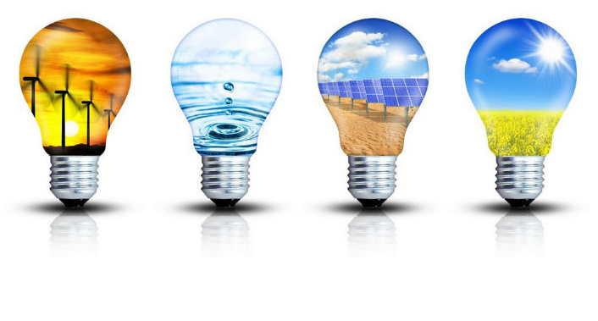

Renewable Energy Sources (RES)
© Copyright CERTUS Project 2017 - All Rights Reserved

Slide 3
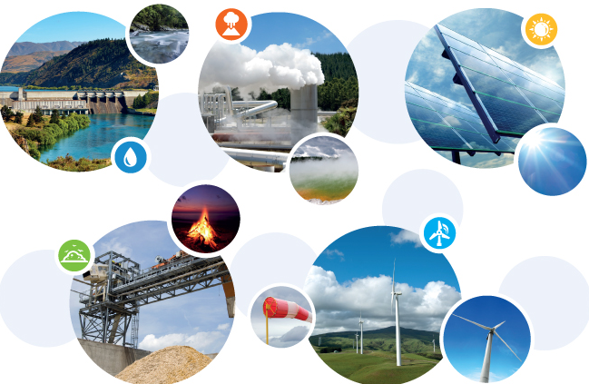
Renewable Energy Sources (RES)
Introduction
Renewable energy (RE) is generally defined as energy that comes from resources which are naturally replenished on a human timescale, such as sunlight, wind, rain, tides, waves, and geothermal heat. RE replaces conventional fuels in four distinct areas: electricity generation, air and water heating/cooling, motor fuels, and rural (off-grid) energy services.
© Copyright CERTUS Project 2017 - All Rights Reserved

Slide 4
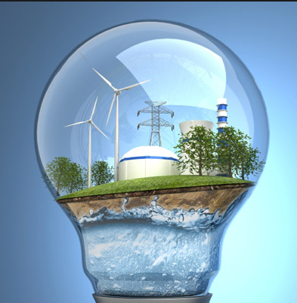
Renewable Energy Sources (RES)
Introduction
Renewable energy resources exist over wide geographical areas, in contrast to other energy sources, which are concentrated in a limited number of countries. Rapid deployment of RE and energy efficiency is resulting in significant energy security, climate change mitigation, and economic benefits. In international public opinion surveys there is strong support for promoting RES such as solar power and wind power.
At the national level, at least 30 nations around the world already have renewable energy contributing more than 20% of energy supply. While many renewable energy projects are large-scale, renewable technologies are also suited to rural and remote areas and developing countries, where energy is often crucial in human development. UN Secretary-General Ban Ki-moon has said that renewable energy has the ability to lift the poorest nations to new levels of prosperity.
© Copyright CERTUS Project 2017 - All Rights Reserved

Slide 5
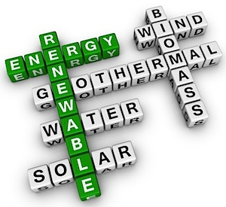
Renewable Energy Sources (RES)
Examples
© Copyright CERTUS Project 2017 - All Rights Reserved

Slide 6
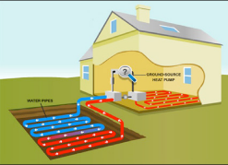
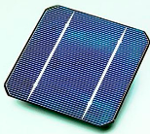
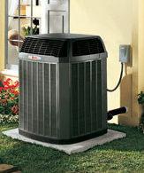
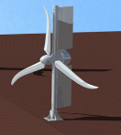
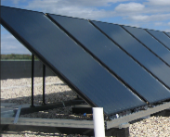
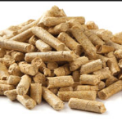
Renewable Energy Sources (RES)
Examples – RES used in Buidings
Geothermal
Geothermal Heat
Solar Energy
Radiation
Photovoltaic
Heating of the earth’s surface and atmosphere
Heat pumps
Wind
Small Wind Turbines
Solar Thermal Collectors
Plant or Animal byproduct
Biomass
© Copyright CERTUS Project 2017 - All Rights Reserved

Slide 7
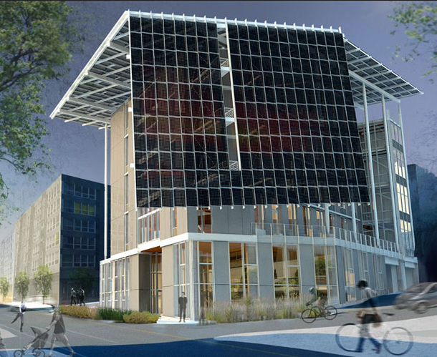
Renewable Energy Sources (RES)
Energy Sources
1. Solar PV
1.1 PV Roof Mounted/Facade
1.2 PV Shingles
1.3 PV Glass
2. Solar Thermal
2.1 PV Solar Water Heaters
Source: Washington State Magazine
© Copyright CERTUS Project 2017 - All Rights Reserved

Slide 8
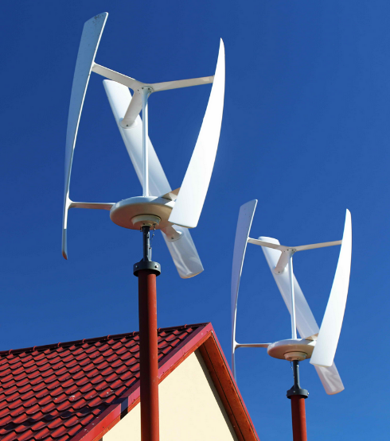
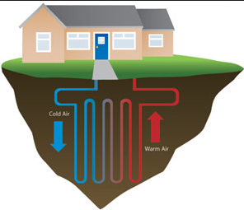
Renewable Energy Sources (RES)
Energy Sources
3. Hybrid PV/T Panels
4. Wind Power – Small Wind Turbines for Rooftops
5. Geothermal – Geothermal Heat pumps
6. Fuel Cells – Fuel cells for CHP in buildings
7. Biomass – Biomass for CHP in buildings
8. Energy Storage Systems
8.1 - Aquifer Thermal and Borehole Energy Storage
8.2 - Batteries
8.3 - Hot Water Tanks
8.4 - Phase Change Materials
© Copyright CERTUS Project 2017 - All Rights Reserved

Slide 9
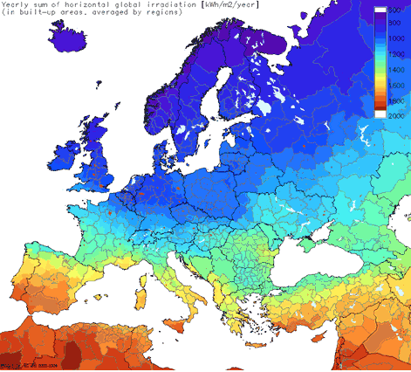
Renewable Energy Sources (RES)
1. Solar PV
The countries involved in CERtuS project are all located in the zones with high levels of radiation making this technology a good choice.
Solar systems prices are dropping since 2011.
Solar systems efficiency is now at good levels.
Source: Idealsol Italy
© Copyright CERTUS Project 2017 - All Rights Reserved

Slide 10
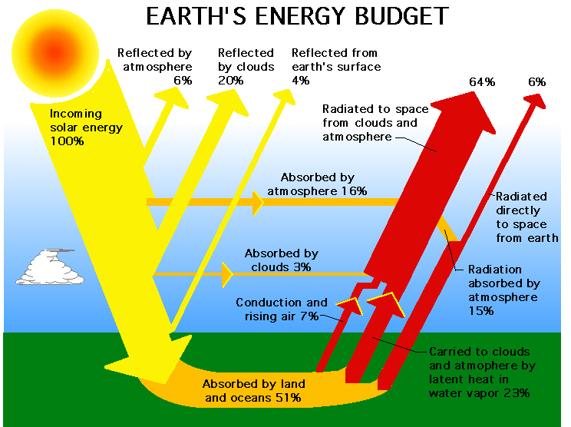
Renewable Energy Sources (RES)
1. Solar PV
The energy flows of the Earth are fed from various sources, from which the solar energy has a share of more than 99.9%.
© Copyright CERTUS Project 2017 - All Rights Reserved

Slide 11
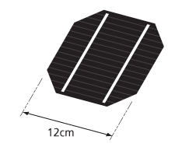
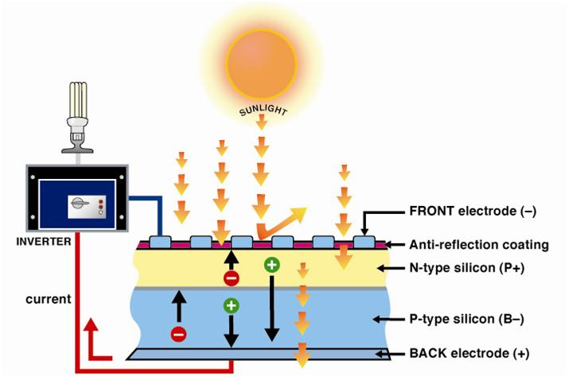
Renewable Energy Sources (RES)
1. Solar PV
History and Operation
Photovoltaics is the direct conversion of light into electricity at the atomic level. Some materials exhibit a property known as the photoelectric effect that causes them to absorb photons of light and release electrons. When these free electrons are captured, an electric current results that can be used as electricity.
When the sunlight is incident upon a material surface, the electrons present in the valence band absorb energy and, being excited, jump to the conduction band and become free. The chemical bonds of the material are vital for the process to work, as crystallized atoms are ionized and creates a chemical electric imbalance, driving the electrons. These highly excited, non-thermal electrons diffuse, and some reach a junction where they are accelerated into a different material by a built-in potential.
© Copyright CERTUS Project 2017 - All Rights Reserved

Slide 12
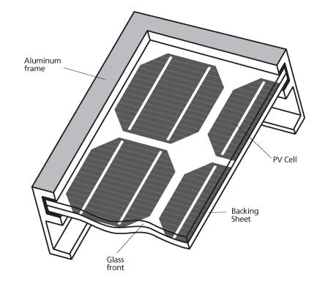
Renewable Energy Sources (RES)
1. Solar PV
Physical structure
Solar cells are made of the same kind of semiconductor materials, such as silicon, used in the microelectronics industry. For solar cells, a thin semiconductor wafer is specially treated to form an electric field, positive on one side and negative on the other.
A number of solar cells electrically connected to each other and mounted in a support structure or frame is called a photovoltaic module. Modules are designed to supply electricity at a certain voltage. The current produced is directly dependent on how much radiation strikes the module.
Multiple modules can be wired together to form an array. In general, the larger the area of a module or array, the more electricity that will be produced. Photovoltaic modules and arrays produce direct-current (DC) electricity. They can be connected in both series and parallel electrical arrangements to produce any required voltage and current combination. To produce AC electricity the array must be connected to an inverter (DC-AC converter).
© Copyright CERTUS Project 2017 - All Rights Reserved

Slide 13
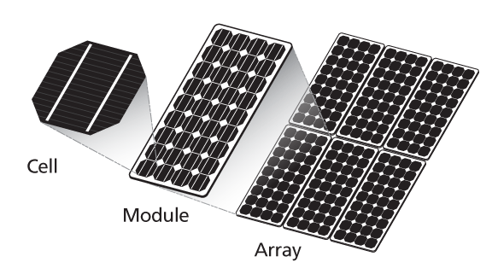
Renewable Energy Sources (RES)
1. Solar PV
© Copyright CERTUS Project 2017 - All Rights Reserved

Slide 14
Renewable Energy Sources (RES)
1. Solar PV – Cell Technology
© Copyright CERTUS Project 2017 - All Rights Reserved

Slide 15
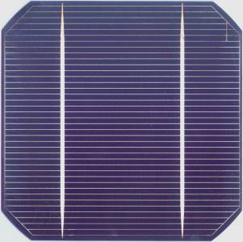
Renewable Energy Sources (RES)
1. Solar PV – Cell Technology
Crystalline Silicon
Wafer-based – also know as Crystalline silicon (c-Si) - is the dominant technology and presents the highest efficiency.
Cells are made of highly purified silicon (5 grams per watt), which accounts for at least a quarter of their costs.
A potential junction is created, and an anti-reflective coating and metal contacts are added.
The cells are then grouped into modules, resulting in a slight loss of efficiency.
Modules usually have:
  Transparent glass on the front
  A weatherproof material on the back (usually a think polymer)
  A frame
© Copyright CERTUS Project 2017 - All Rights Reserved

Slide 16
Renewable Energy Sources (RES)
1. Solar PV – Cell Technology
Crystalline Silicon
© Copyright CERTUS Project 2017 - All Rights Reserved

Slide 17
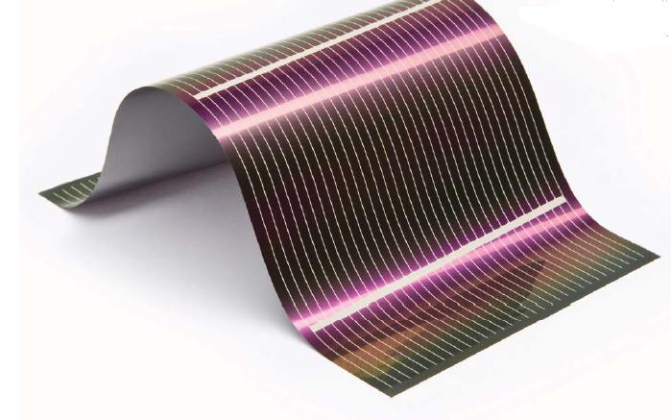
Renewable Energy Sources (RES)
1. Solar PV – Cell Technology
Thin Film
Thin-film technologies include a range of absorber semi-conductor material systems:
  Amorphous Silicon (a-Si), with efficiencies that range from 4 to 8%;
  Multi-junction thin-film silicon (a-Si/ μc-Si), which can absorb more light, increasing the efficiency by up to 10% compared with a-Si;
  Cadmium Telluride (CdTe) thin-film solar cells have lower produaction costs and reach efficiencies of up to 16.7%;
  Copper-indium-(gallium)-(di)selenide (CIS-CIGS) have very high efficiencies, in the range 7 to 16%, and have achieved efficiency levels of up to 20.3% under laboratory conditions.
These films are then deposited on low-cost backings, such as glass, metal or plastic substrates
© Copyright CERTUS Project 2017 - All Rights Reserved

Slide 18
Renewable Energy Sources (RES)
1. Solar PV – Cell Technology
Thin Film
© Copyright CERTUS Project 2017 - All Rights Reserved

Slide 19
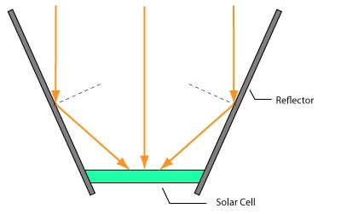
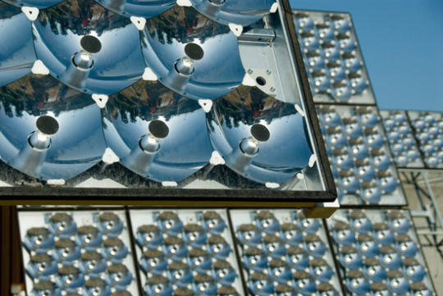
Renewable Energy Sources (RES)
1. Solar PV – Cell Technology
Concentrated PV (CPV)
CPV uses mirrors or lenses to concentrate and focus solar radiation on high-efficiency cells.
As in CSP, several concentrator technologies can be used, either linear or point focus, mainly parabolic mirrors, Fresnel lenses, reflectors and luminescent concentrators.
Ultra-efficient Solar Cells (up to 50%) composed of different materials in several layers are used to capture most of the solar light spectrum.
One assumption is that the higher cost of these cells is outweighed by their higher efficiency.
© Copyright CERTUS Project 2017 - All Rights Reserved

Slide 20
Renewable Energy Sources (RES)
1. Solar PV – Cell Technology
Concentrated PV (CPV)
Contrary to PV, CPV requires:
  Direct sunlight rather than scattered light, and is thus geographically limited (high direct normal irradiance areas, space)
  Sun-tracking systems (more or less accurate)
  Cooling (active if a fluid is needed, passive if not)
As with concentrating solar power (CSP), CPV is well suited to steam uses such as desalinization due to heat production.
© Copyright CERTUS Project 2017 - All Rights Reserved

Slide 21
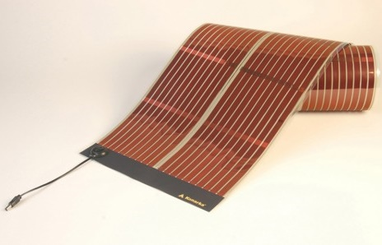
Renewable Energy Sources (RES)
1. Solar PV – Cell Technology
Emerging Technologies
Emerging technologies include advanced, low-cost thin films and organic solar cells.
Organic solar cells are either:
  Full organic cells: organic photovoltaic (OPV);
  Hybrid: dye-sensitised solar cells (DSSC).
OPV cells use stacked solid organic semiconductors, either polymers or small organic molecules.
They hold the promise of a substantial module price reduction (over thin-film silicon), but their efficiency is very low.
They have a place in niche markets such as consumer devices, but are still unproven.
Research is under way on novel devices that may offer the possibility of breaking efficiency records (quantum dots and wells, and thermo-electric cells) to overcome the Shockley-Queisser 31% efficiency limit.
© Copyright CERTUS Project 2017 - All Rights Reserved

Slide 22
Renewable Energy Sources (RES)
1. Solar PV – Cell Technology
Emerging Technologies
© Copyright CERTUS Project 2017 - All Rights Reserved

Slide 23
Renewable Energy Sources (RES)
1. Solar PV – Cell Technology
Technology Stages of Maturity
© Copyright CERTUS Project 2017 - All Rights Reserved

Slide 24
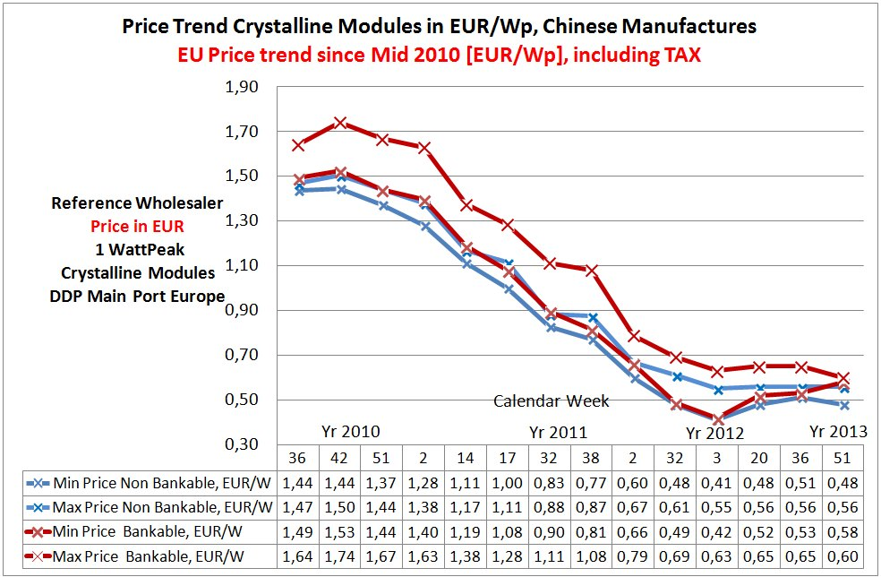
Renewable Energy Sources (RES)
1. Solar PV – Modules Cost
Recent reduction in the cost of the modules
© Copyright CERTUS Project 2017 - All Rights Reserved

Slide 25
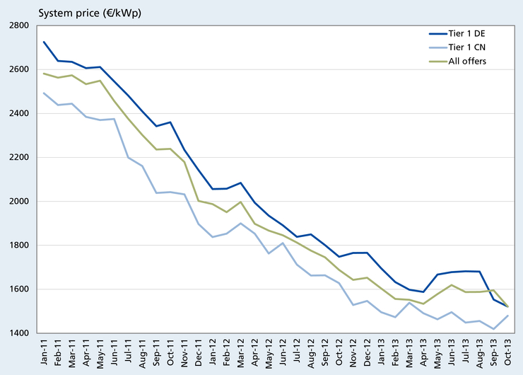
Renewable Energy Sources (RES)
1. Solar PV – System Cost
Evolution of the system global cost
© Copyright CERTUS Project 2017 - All Rights Reserved

Slide 26
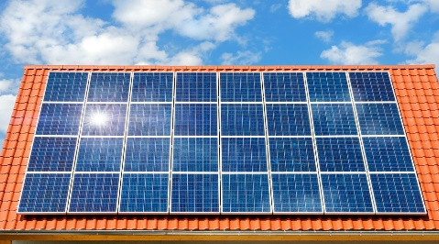
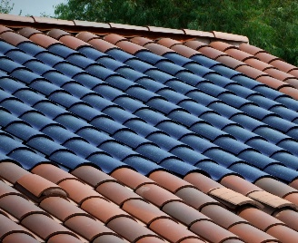


Renewable Energy Sources (RES)
1. Solar PV
Rooftops
Shingles
Glass
Facades
© Copyright CERTUS Project 2017 - All Rights Reserved

Slide 27
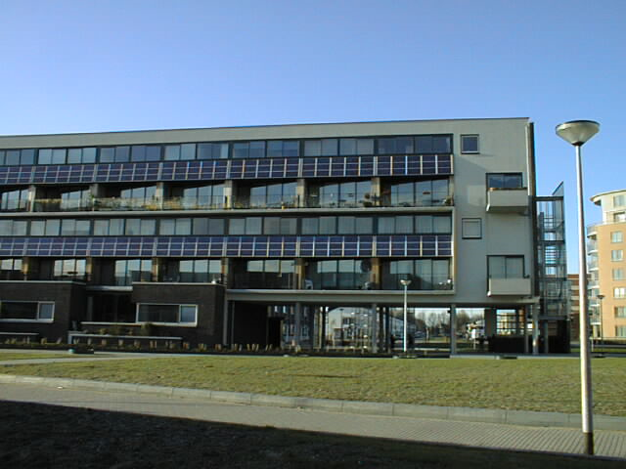
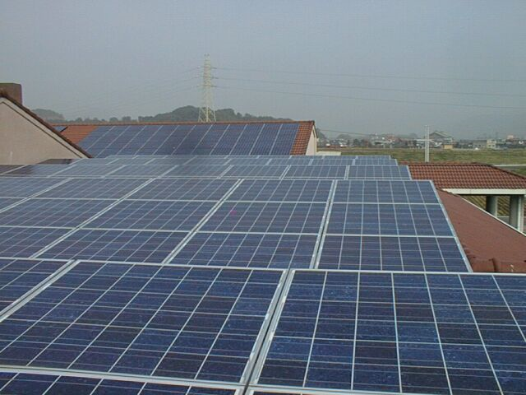
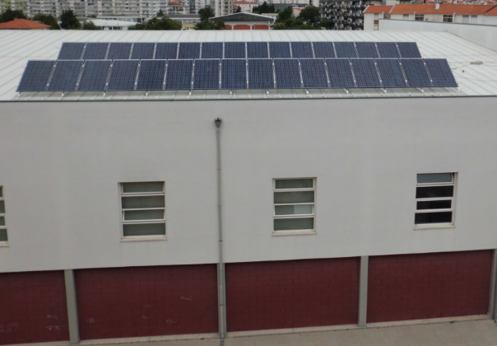
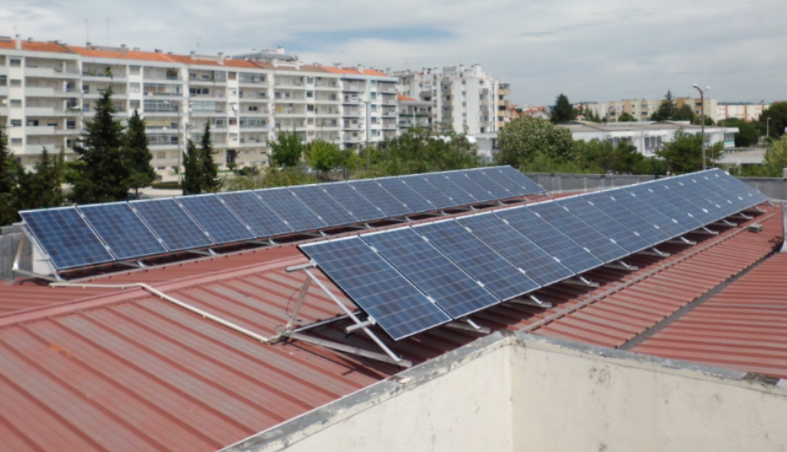
Renewable Energy Sources (RES)
1.1 PV Solar - Roof Mounted/Facades
Advantages:
PV systems provide an improvement in the buildings insulation (specially in facades) by reducing the incident radiation in buildings rooftops and facades and producing energy at the same time;
Systems can be tailor made according to each buildings needs.
Disadvantages:
Roofs and facade need to have conditions to support the PV system weight ( 15 kg for square meter);
Possible system visual impact (special for roof mounted systems).
Constraints:
Roof areas and orientation;
Buildings in protected areas (e.g. Municipality of Coimbra in Unesco area).
© Copyright CERTUS Project 2017 - All Rights Reserved

Slide 28
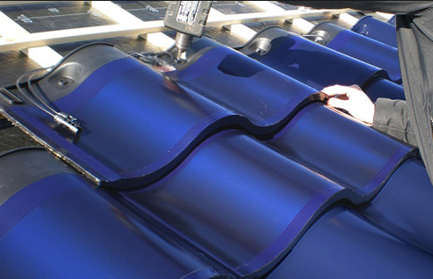

Renewable Energy Sources (RES)
1.2 PV Solar - Shingles
Advantages:
Reduced visual impact, the roof stays close to is original design;
Possible of using this product in protected areas.
Disadvantages:
Small number of companies manufacturer this type of product
Low market demand on this product makes it still very expensive;
Needs large roof areas with good orientation (south for Northern hemisphere);
Low efficiency product comparing it to the standard PV modules.
Constraints:
Roof areas and orientation;
Low cost-effectiveness.
© Copyright CERTUS Project 2017 - All Rights Reserved

Slide 29
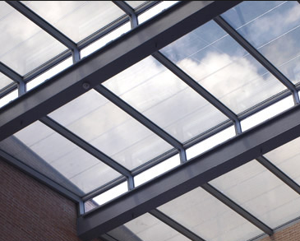
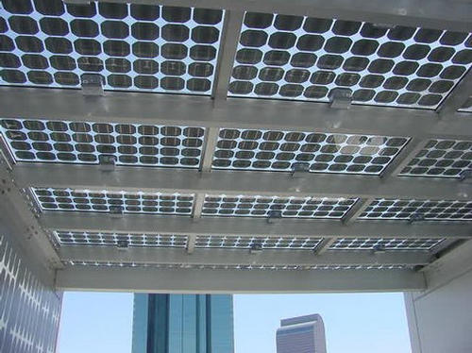
Renewable Energy Sources (RES)
1.3 PV Solar - Glass
Advantages:
No visual impact, allows sunlight entrance, avoiding UV and infrared radiation;
Produces energy and at the same time allows seeing through the glass;
Existence of products with different levels of transparency.
Disadvantages:
Low market demand on this product makes it still very expensive;
Low efficiency product comparing it to the standard PV modules.
Constraints:
Roof areas and orientation;
Low cost-effectiveness.
© Copyright CERTUS Project 2017 - All Rights Reserved

Slide 30
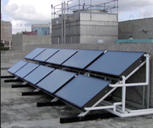
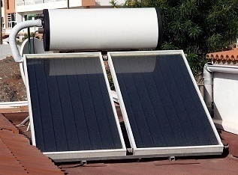
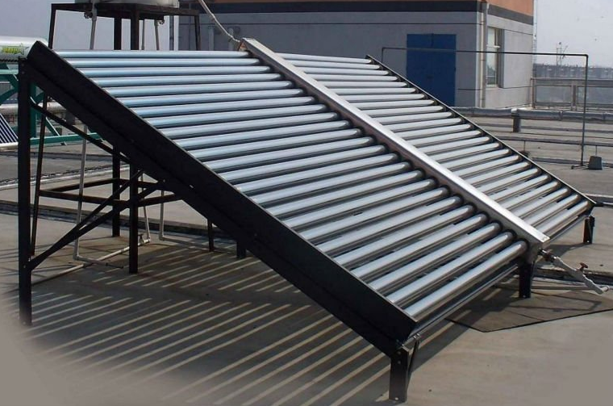
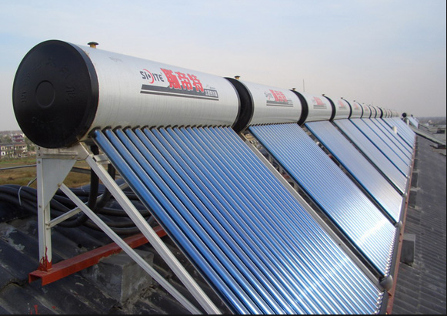
Renewable Energy Sources (RES)
2. Solar Thermal – Solar Water Heaters
Flat collector with separated storage
Flat collector with storage
Evacuated tubes collector with separated storage
Evacuated tubes collector with storage
© Copyright CERTUS Project 2017 - All Rights Reserved

Slide 31
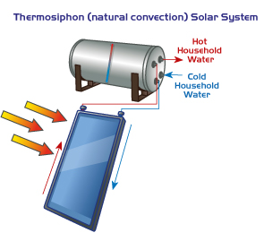
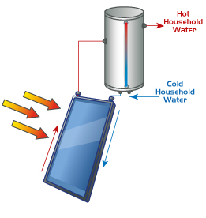
Renewable Energy Sources (RES)
2. Solar Thermal – Solar Water Heaters
Solar water heating (SWH) results from the conversion of sunlight into renewable energy in the form of hot water by using a solar thermal collector. SWH systems comprise various technologies that are used worldwide.
In a "close-coupled" SWH system the storage tank is horizontally mounted immediately above the collector(s) on the roof. No pumping is required as the hot water naturally rises into the tank through thermosiphon flow.
In a "pump-circulated" system the storage tank is ground- or floor-mounted and is below the level of the collectors. A circulating pump moves heat transfer fluid between the tank and the collectors.
SWH systems are designed to deliver hot water for most of the year. However, in winter there sometimes may not be sufficient solar heat gain to deliver sufficient hot water. In this case gas or electric are used as a backup to heat the water.
© Copyright CERTUS Project 2017 - All Rights Reserved

Slide 32
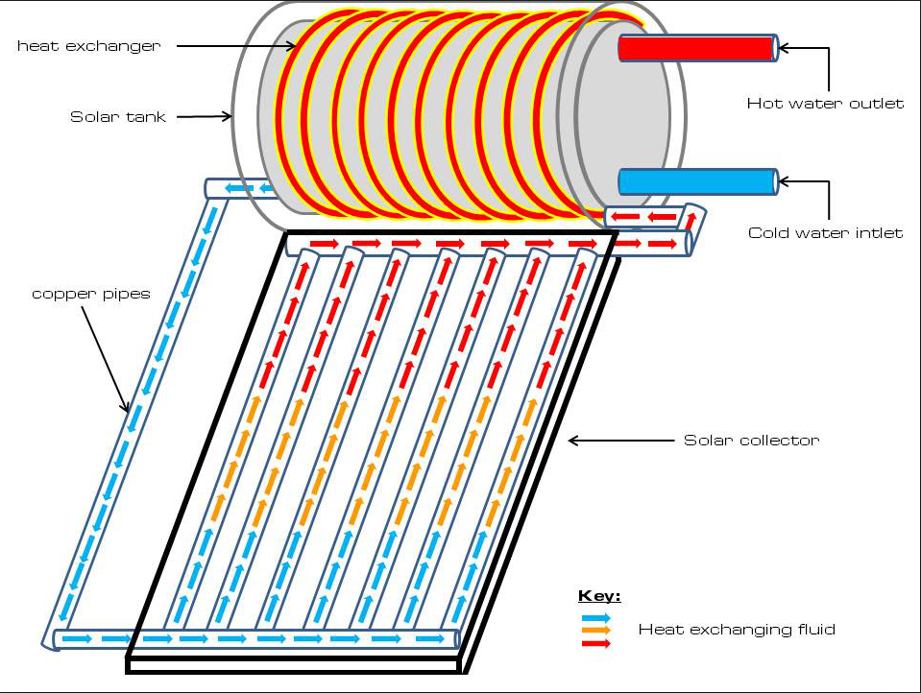
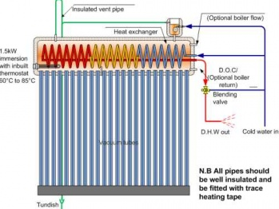
Renewable Energy Sources (RES)
2. Solar Thermal – Solar Water Heaters
Flat collector system
Evacuated Tubes system
© Copyright CERTUS Project 2017 - All Rights Reserved

Slide 33
Renewable Energy Sources (RES)
2. Solar Thermal – Flat Collectors
Operation
They are the most common type, using a transfer fluid from were heat is extracted and transferred to water;
They consist of a dark flat-plate absorber, a transparent cover that reduces heat losses, a heat-transport fluid (antifreeze) to remove heat from the absorber and a heat insulating backing;
The absorber consists of a thin absorber sheet (of thermally stable polymers, aluminum, steel or copper to which a matte black or selective coating is applied) often backed by a grid or coil of fluid tubing placed in an insulated casing with a glass or polycarbonate cover.
Applications
The main use of this technology is in residential buildings where the demand for hot water has a large impact on energy bills. Commercial applications include laundromats, car washes, military laundry facilities and eating establishments also used this technology. It can also be used for space heating if the building is located off-grid or if utility power is subject to frequent outages.
SWH systems are most likely to be cost effective for facilities with operations such as laundries, kitchens or industrial processes that require large quantities of hot water.
Constraints
The visual impact these systems cause is the main problem (specially when the storage tank is coupled with the collectors). In buildings inside protective areas the visual impact, weight overload and the necessary pipe passage construction can also be an issue
© Copyright CERTUS Project 2017 - All Rights Reserved

Slide 34
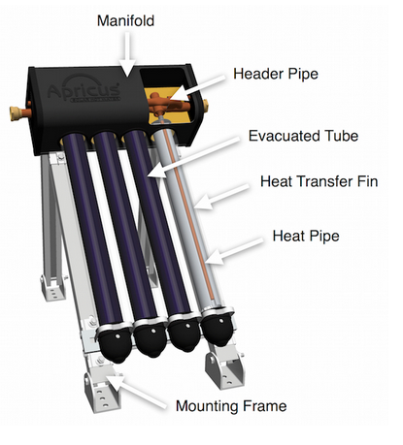
Renewable Energy Sources (RES)
2. Solar Thermal – Evacuated Tubes
Operation
Evacuated heat pipe tubes (EHPTs) are composed of multiple evacuated tubes each containing an absorber plate fused to a heat pipe.
The heat is transferred to the transfer fluid (water or an antifreeze mix—typically glycol) of a domestic hot water or hydronic space heating system in a heat exchanger called "manifold". The manifold is wrapped in insulation and covered by a protective sheet metal or plastic casing. The vacuum that surrounds the outside of the tube greatly reduces convection and conduction heat loss, therefore achieving greater efficiency than flat-plate collectors, especially in colder conditions.
This advantage is largely lost in warmer climates, except in those cases where very hot water is desirable, e.g., for commercial processes. The high temperatures that can occur may require special design to prevent overheating.
© Copyright CERTUS Project 2017 - All Rights Reserved

Slide 35
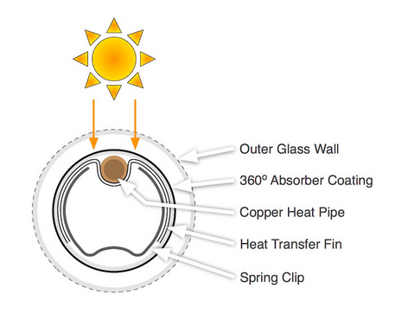
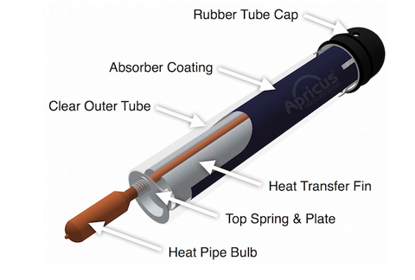
Renewable Energy Sources (RES)
2. Solar Thermal – Evacuated Tubes
© Copyright CERTUS Project 2017 - All Rights Reserved

Slide 36
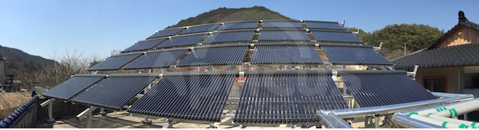
Renewable Energy Sources (RES)
2. Solar Thermal – Evacuated Tubes
Applications
Most used in countries with lower levels of radiation (northern Europe) due to its higher efficiency and to the fact that evacuated tubes lose less heat to the environment.
These systems are not recommend to high temperature climate and should be carefully design due to their tendency to overheat.
Constraints
The visual impact caused by these systems is the main problem (specially when the storage tank is coupled with the collectors). In buildings inside protective areas the visual impact and also the necessary pipe passage can also be an issue.
© Copyright CERTUS Project 2017 - All Rights Reserved

Slide 37
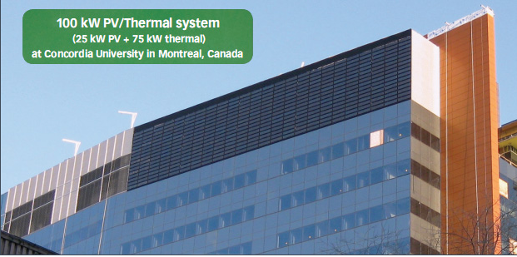
Renewable Energy Sources (RES)
3. Hybrid PV/T Panels
© Copyright CERTUS Project 2017 - All Rights Reserved

Slide 38
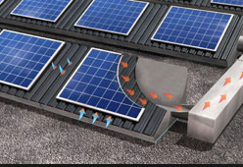
Renewable Energy Sources (RES)
3. Hybrid PV/T Panels
The objective of PV/T Panels is to address some of the problems inherent with conventional photovoltaics, and to develop a solution that would further enhance PV as a viable renewable energy solution for regular commercial and industrial buildings.
Typical PV modules have a solar conversion efficiency up to 19%. What happens to the rest of the sun’s energy that shines on the panels?
Most of it is converted into heat energy, which normally is lost and provides no value to the system owner. As well, the heat build-up behind PV modules reduces the electrical output by 0.4-0.5% for every 1°C above its rated output temperature, which is 25°C. For every 1°C above 25°C, the electrical output drops by 0.4 to 0.5 percent.
A PV/T system lowers the photovoltaic temperature by 10 to 20°C, which increases the electrical output by five to 10 per cent, or an extra 0.5 to 1 kW for a 10-kW array.
© Copyright CERTUS Project 2017 - All Rights Reserved

Slide 39
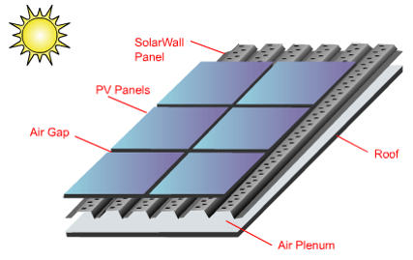
Renewable Energy Sources (RES)
3. Hybrid PV/T Panels
Adding the SolarWall thermal component to a PV array boosts the total solar efficiency to over 50%, compared with 10 to 15% efficiency for most PV modules alone. The heat from the PV panels, captured by the SolarWall perforated absorber, was documented to be three times more than the electrical energy generated from the PV modules. This means that by being able to uniformly capture and utilize the excess heat, it becomes possible to realize an energy output improvement in the range of 200-300%, depending on air flow and other design considerations. The test data also showed that the temperature gain from the PV modules is between 6°C
Operation:
The heat energy captured from the PV modules is ducted into the building’s HVAC system where it is used to displace the conventional heating load.
The secondary benefit is to provide PV cooling by reducing the operating temperature of the PV modules, which improves the electrical performance. Excess heat buildup behind PV panels is a common problem, and for every 1°C above 25°C , the electrical output drops by 0.4 to 0.5 percent.
© Copyright CERTUS Project 2017 - All Rights Reserved

Slide 40

Renewable Energy Sources (RES)
3. Hybrid PV/T Panels – SolarWall example
PV modules are mounted on top of the SolarWall® panels, which act as the PV racking system. The heat is drawn off the back of the PV modules and is ducted into the building's conventional HVAC system where it offsets the heating load.
The SolarWall system keeps the air circulating evenly around the PV modules, which can cool the PV modules by as much as 20 degrees C. This can increase the electrical output by 10%.
In warmer weather, dampers are used to direct the heat away from the building if the energy is not required.
© Copyright CERTUS Project 2017 - All Rights Reserved

Slide 41

Renewable Energy Sources (RES)
3. Hybrid PV/T Panels
Applications:
These systems can provide electricity for the buildings necessities, hot water and heating;
All buildings with conditions to install these systems are candidates to its application, such as: schools, hospitals, sports facilities, shopping centers, residential and non-residential buildings, etc.
© Copyright CERTUS Project 2017 - All Rights Reserved

Slide 42




Renewable Energy Sources (RES)
3. Hybrid PV/T Panels
Examples:
© Copyright CERTUS Project 2017 - All Rights Reserved

Slide 43

Renewable Energy Sources (RES)
3. Hybrid PV/T Panels
Constraints:
The investment is high;
Buildings needs a large area (rooftop or facade) with good conditions (orientation and available free space).
© Copyright CERTUS Project 2017 - All Rights Reserved

Slide 44


Renewable Energy Sources (RES)
4. Wind power
Energy that results from the conversion from the kinetic energy of wind into electrical energy (30-45% efficiency)
This conversion is done in "three steps"
Kinetic Energy
(moving air)
Mechanical Energy
(blade rotation)
Electrical Energy
© Copyright CERTUS Project 2017 - All Rights Reserved

Slide 45



Renewable Energy Sources (RES)
4. Wind power –Small Turbines for rooftops
© Copyright CERTUS Project 2017 - All Rights Reserved

Slide 46

Renewable Energy Sources (RES)
4. Wind power –Small Turbines for rooftops
A wind turbine is a device that converts kinetic energy from the wind into electrical power. Turbine blades are placed in a circular orientation around a central hub. The wind pushes these blades in succession, rotating the central hub and the shaft it is connected to. This shaft is surrounded by a ring of coiled wire and two magnets. When the shaft rotates, the magnets push electrons down the length of the wire generating an electrical current.
Wind turbines need to be pushed by a consistent wind of 16 Kph or greater to start producing an electrical current. Wind at roof top levels is rarely this high for any extended period of time, specially in an urban environment. Winds don’t start reaching a consistent energy producing level until they are about 9 meters higher than the highest tree or roof top in the area and at least 90 meters away from any obstructions. This would necessitate a pole mounted turbine on at least a free acre of land, which is almost impossible to achieve in a city.
© Copyright CERTUS Project 2017 - All Rights Reserved

Slide 47



Renewable Energy Sources (RES)
4. Wind power –Small Turbines for rooftops
These equipments can be divided in to large groups:
Horizontal Axis Turbines
Are the most common type
Are generally rated from 250 W to 6 kW
These turbine have guidance mechanism to orient the turbine directly into the wind direction
Causes high visual impact
© Copyright CERTUS Project 2017 - All Rights Reserved

Slide 48




Renewable Energy Sources (RES)
4. Wind power –Small Turbines for rooftops
2) Vertical Axis Turbines
Such turbines cause less visual impact and the turbine does not need to be pointed into the wind to be effective, which is very important on sites where the wind direction is highly variable.
The key disadvantages include the relatively low rotational speed with the consequential higher torque and hence higher cost of the drive train, the inherently lower power coefficient.
When such turbine is mounted on a rooftop the building generally redirects wind over the roof and this can double the wind speed at the turbine. If the height of a rooftop mounted turbine tower is approximately 50% of the building height it is near the optimum for maximum wind energy and minimum wind turbulence.
Noise may be a concern and an existing structure may not adequately resist the additional stress.
© Copyright CERTUS Project 2017 - All Rights Reserved

Slide 49


Renewable Energy Sources (RES)
4. Wind power –Small Turbines for rooftops
Operation
Turbine blades are placed in a circular orientation around a central hub. The wind pushes these blades in succession, rotating the central hub and the shaft it is connected to. This shaft is surrounded by a ring of coiled wire and two magnets. When the shaft rotates, the magnets push electrons down the length of the wire generating an electrical current.
Wind turbines need to be pushed by a consistent wind of 2 m/s or greater to start producing an electrical current. The wind at roof top levels is rarely this high for any extended period of time. They only start reaching a consistent energy producing level until they are about 9.15 higher than the highest tree or roof top in the area and at least 91.5 feet away from any obstructions. This would necessitate a pole mounted turbine on at least an acre of land.
© Copyright CERTUS Project 2017 - All Rights Reserved

Slide 50


Renewable Energy Sources (RES)
4. Wind power –Small Turbines for rooftops
Applications
Small wind turbines may be used for a variety of applications including on- or off-grid applications in buildings, communication towers, public lighting, offshore platforms, rural schools and clinics and remote monitoring. Small wind turbines may be as small as 50 W generator for boat or caravan use.
Hybrid solar and wind powered units are increasingly being used for traffic signage, particularly in rural locations, as they avoid the need to lay long cables from the nearest main connection points.
© Copyright CERTUS Project 2017 - All Rights Reserved

Slide 51

Renewable Energy Sources (RES)
4. Wind power –Small Turbines for rooftops
Constraints
Visual impact specially in historic areas;
Buildings are not prepared to be subject to the stress that turbines may cause;
Turbines operation noise;
Safety problems related to turbine mounting;
To make wind power cost-effective, turbines need access to strong and sustained winds, which are not community available in rooftops.
© Copyright CERTUS Project 2017 - All Rights Reserved

Slide 52

Renewable Energy Sources (RES)
5. Geothermal Heat Pumps
A geothermal heat pump or ground source heat pump (GSHP) is a central heating and/or cooling system that transfers heat to or from the ground.
It uses the earth as a heat source (in the winter) or a heat sink (in the summer). This design takes advantage of the moderate temperatures in the ground to boost efficiency and reduce the operational costs of heating and cooling systems, and may be combined with solar heating to form a geosolar system with even higher efficiency.
GSHP harvest heat absorbed at the Earth's surface from the sun. The temperature in the ground below 6 meters is roughly equal to the annual medium surface air temperature at that specific latitude.
© Copyright CERTUS Project 2017 - All Rights Reserved

Slide 53

Renewable Energy Sources (RES)
5. Geothermal Heat Pumps
Depending on latitude, the temperature beneath the upper 6 meters of ground maintains a nearly constant temperature between 10 and 16 °C. These systems use a heat pump to force the transfer of heat from the ground.
Heat pumps can transfer heat from a cool space to a warm space, against the natural direction of flow, or they can enhance the natural flow of heat from a warm area to a cool one. The core of the heat pump is a loop of refrigerant pumped through a vapor-compression refrigeration cycle that moves heat.
Air-source heat pumps are typically more efficient at heating than pure electric heaters, even when extracting heat from cold winter air, although efficiencies begin dropping significantly as outside air temperatures drop below 5 °C.
A GSHP exchanges heat with the ground. This is much more energy-efficient because underground temperatures are more stable than air temperatures through the year.
© Copyright CERTUS Project 2017 - All Rights Reserved

Slide 54

Renewable Energy Sources (RES)
5. Geothermal Heat Pumps
Like a cave, the shallow ground temperature is warmer than the air above during the winter and cooler than the air in the summer. A GSHP extracts ground heat in the winter (for heating) and transfers heat back into the ground in the summer (for cooling).
Geothermal pump systems reach fairly high coefficient of Performance (CoP), 3 to 6, on the coldest of winter nights, compared to 1.75-2.5 for air-source heat pumps on cool days. GSHP are among the most energy efficient technologies for providing HVAC and water heating.
© Copyright CERTUS Project 2017 - All Rights Reserved

Slide 55

Renewable Energy Sources (RES)
5. Geothermal Heat Pumps
Operation
Most closed-loop geothermal heat pumps circulate an antifreeze solution through a closed loop -- usually made of plastic tubing -- that is buried in the ground or submerged in water. A heat exchanger transfers heat between the refrigerant in the heat pump and the antifreeze solution in the closed loop. The loop can be in a horizontal, vertical, or pond/lake configuration.
One variant of this approach, called direct exchange, does not use a heat exchanger and instead pumps the refrigerant through copper tubing that is buried in the ground in a horizontal or vertical configuration. Direct exchange systems require a larger compressor and work better in moist soils, but it should be avoided in soils corrosive to the copper tubing.
Because these systems circulate refrigerant through the ground, local environmental regulations may prohibit their use in some locations.
© Copyright CERTUS Project 2017 - All Rights Reserved

Slide 56

Renewable Energy Sources (RES)
5. Geothermal Heat Pumps
Types of GHPS
There are four basic types of ground loop systems. Three of these - horizontal, vertical, and pond/lake - are closed-loop systems. The fourth type of system is the open-loop option. Which one of these is best depends on the climate, soil conditions, available land, and local installation costs at the site. All of these approaches can be used for residential and commercial building applications.
Horizontal – Closed Loop System
This type of installation is generally most cost-effective for residential installations, particularly for new construction where the area of installation is not an issue.
It requires trenches at least 1.2 meters deep. The most common layouts either use two pipes, one buried at 1.8 meters, and the other at 0.8 meters, or two pipes placed side-by-side at 1.5 meters deep in the ground.
The Slinky™ method of looping pipe allows more pipe in a shorter trench, which cuts down on installation costs and makes horizontal installation possible in areas it would not be with conventional horizontal Applications.
© Copyright CERTUS Project 2017 - All Rights Reserved

Slide 57

Renewable Energy Sources (RES)
5. Geothermal Heat Pumps
Vertical – Closed Loop System
Large commercial buildings and schools often use vertical systems because the land area required for horizontal loops would be prohibitive.
Vertical loops are also used where the soil is too shallow for trenching, and they minimize the disturbance to existing landscaping.
For a vertical system, holes (approximately 10 cm in diameter) are drilled about 6 meters apart and 30 to 120 meters deep.
Into these holes go two pipes that are connected at the bottom with a U-bend to form a loop. The vertical loops are connected with horizontal pipe (i.e., manifold), placed in trenches, and connected to the heat pump in the building..
© Copyright CERTUS Project 2017 - All Rights Reserved

Slide 58

Renewable Energy Sources (RES)
5. Geothermal Heat Pumps
Pond/Lake – Closed Loop System
If the site has an adequate water body, this may be the lowest cost option. A supply line pipe is run underground from the building to the water and coiled into circles at least 2.5 meters under the surface to prevent freezing. The coils should only be placed in a water source that meets minimum volume, depth, and quality criteria.
© Copyright CERTUS Project 2017 - All Rights Reserved

Slide 59

Renewable Energy Sources (RES)
5. Geothermal Heat Pumps
Open Loop System
This type of system uses well or surface body water as the heat exchange fluid that circulates directly through the GHSP system. Once it has circulated through the system, the water returns to the ground through the well, a recharge well, or surface discharge. This option is obviously practical only where there is an adequate supply of relatively clean water, and all local codes and regulations regarding groundwater discharge are met.
© Copyright CERTUS Project 2017 - All Rights Reserved

Slide 60

Renewable Energy Sources (RES)
5. Geothermal Heat Pumps
Hybrid System
Hybrid systems using several different geothermal resources, or a combination of a geothermal resource with outdoor air (i.e., a cooling tower), are another technology option.
Hybrid approaches are particularly effective where cooling needs are significantly larger than heating needs.
Where local geology permits, the "standing column well" is another option. In this variation of an open-loop system, one or more deep vertical wells is drilled. Water is drawn from the bottom of a standing column and returned to the top. During periods of peak heating and cooling, the system can bleed a portion of the return water rather than reinjecting it all, causing water inflow to the column from the surrounding aquifer. The bleed cycle cools the column during heat rejection, heats it during heat extraction, and reduces the required bore depth.
© Copyright CERTUS Project 2017 - All Rights Reserved

Slide 61

Renewable Energy Sources (RES)
5. Geothermal Heat Pumps
Application:
Locations who prove to have interesting temperature differentials that could justify this systems implementation.
Constraints
Most of the buildings may have problems concerning the surrounding areas making the installations of such systems not viable.
Creating passage for these pipes and other components makes the installation in historic areas/buildings rather difficult.
The main constraints are still the initial investment in the system and also the need to perform the necessary geological surveys and associated costs.
© Copyright CERTUS Project 2017 - All Rights Reserved

Slide 62



Renewable Energy Sources (RES)
6. Fuel Cells for CHP in buildings
© Copyright CERTUS Project 2017 - All Rights Reserved

Slide 63
Renewable Energy Sources (RES)
6. Fuel Cells for Chp in buildings
Fuel cells are devices that convert the energy of a chemical reaction, typically between hydrogen and oxygen, directly into low-voltage DC electricity and into heat. There are over twenty fuel cell technologies of which some five are developed to the point where they have reliable products in the market place (in some cases third generation products) and they seem certain to play a large part in providing CHP in the hydrogen economy.
For building applications, fuel cell systems offer modularity, high efficiency
across a wide range of loads, minimal environmental impact and opportunities for use as CHP systems. Stationary fuel cells are ideal for power generation, either connected to the electricity grid to provide supplemental power and backup for critical areas, or installed as a grid-independent generator for on-site services.
Since fuel cells operate virtually silently, they reduce noise pollution as well as air pollution and the waste heat from a fuel cell can be used to provide hot water or space heating. They are highly efficient and have relatively low maintenance requirements.
© Copyright CERTUS Project 2017 - All Rights Reserved

Slide 64

Renewable Energy Sources (RES)
6. Fuel Cells for Chp in buildings
Technology
A fuel cell operates like a battery. However, unlike a battery, a fuel cell does not run down or require recharging. It will produce energy in the form of electricity and heat as long as fuel is supplied. A fuel cell consists of an electrolyte sandwiched between two electrodes. Oxygen (or air) passes over one electrode (the cathode) and hydrogen over the other (the anode), generating electricity, water and heat.
Encouraged by a catalyst, the hydrogen atom splits into a proton and an electron, which take different paths to the cathode.
© Copyright CERTUS Project 2017 - All Rights Reserved

Slide 65

Renewable Energy Sources (RES)
6. Fuel Cells for Chp in buildings
Technology (cont.)
The proton passes through the electrolyte. The electrons create separate current that can be utilized before they return to the cathode, to be reunited with the hydrogen and oxygen in a molecule of water. This whole process can be thought of as electrolysis in reverse, hydrogen and oxygen being combined rather than splitting. Typically, individual fuel cells generate power outputs of a few tens or hundreds of watts. Cells are therefore assembled in modules known as stacks to provide a larger voltage and current.
When supplied by hydrogen or a large range of biofuels, fuel cells have zero CO₂ emissions. Currently, hydrogen is not cost effectively available whereas natural gas has a supply infrastructure in place. Fuel cells can be fired on a variety of fuels e.g. natural gas, LPG and biofuels.
© Copyright CERTUS Project 2017 - All Rights Reserved

Slide 66

Renewable Energy Sources (RES)
6. Fuel Cells for Chp in buildings
Applications
There are a wide variety of uses for fuel cells. cells are powering buses, cars, boats and trains. Miniature fuel cells for cellular phones, laptop computers and portable electronics are on their way to market.
Hospitals, leisure centers, call centers, large commercial, retail and industrial buildings, Universities, police stations, and banks are already using fuel cells to provide power and heat to their facilities.
Waste-water treatment plants and landfills are using fuel cells to convert the methane gas they produce into electricity.
© Copyright CERTUS Project 2017 - All Rights Reserved

Slide 67
Renewable Energy Sources (RES)
6. Fuel Cells for Chp in buildings
There are several different types of fuel cells, each using different chemistry. Fuel cells are usually classified by the type of electrolyte they use. Some types of fuel cells work well for use in stationary power generation plants, others for domestic use (1.5 kWe) or Non domestic use (200 kWe).
Types of Fuel Cells
Proton exchange membrane fuel cell (PEMFC) - one of the most promising technologies. This type of fuel cell will probably end up powering cars, buses and stationary applications like buildings.
Solid Oxide Fuel Cells (SOFCs) - Significant progress has been made with SOFCs in recent years and they remain one of the most promising fuel cell systems for stationary power and (CHP) applications. However, work remains to develop fully engineered systems. These fuel cells are best suited for large-scale stationary power generators that could provide electricity for whole factories or towns. High operating temperatures (around 1000°C) allow steam to be produced that can be fed to turbines to generate even more electricity.
Solid Polymer Fuel Cells (SPFCs) - The SPFC is very promising for automotive and stationary applications. There is a massive global effort to develop commercial systems. SPFCs are now being demonstrated in a range of commercial applications including buses, cars, CHP and distributed power.
© Copyright CERTUS Project 2017 - All Rights Reserved

Slide 68
Renewable Energy Sources (RES)
6. Fuel Cells for Chp in buildings
Types of Fuel Cells (cont.)
Phosphoric Acid Fuel Cells (PAFCs) - The PAFC is more developed than the SOFC and SPFC; over 400 commercial systems have been sold worldwide (total capacity around 44 MWe). Demonstrated in the bus sector, it has been pursued as a candidate for CHP and distributed power applications. Increasingly, it is being marketed as a technology for uninterruptible power supplies (UPS) and premium power applications. It operates at a higher temperature than PEM fuel cells, so it has a longer warm-up time making it less applicable in some vehicles.
Alkaline Fuel Cells (AFCs) - A relatively simple device, the AFC is still the preferred system for applications in space and remains a candidate for mobile applications, particularly in captive fleet vehicles. The AFC is very susceptible to contamination, so it requires pure hydrogen and oxygen. It is also very expensive, so this type of fuel cell is less likely to be commercialized.
Molten Carbonate Fuel Cells (MCFCs) - The MCFC is successfully applied in stationary power and CHP applications in sizes up to 11 MWe. They operate at around 600°C, so they also generate steam that can be used to generate more power. They have a lower operating temperature than the SOFC, which means they don't need such exotic materials. This makes the design a little less expensive.
© Copyright CERTUS Project 2017 - All Rights Reserved

Slide 69
Renewable Energy Sources (RES)
6. Fuel Cells for Chp in buildings
Efficiency
Fuel cells have a heat to power ratio between 0.8 and 1.8 with overall efficiencies of around 90% when fired on hydrogen. Fuel cells powered with pure hydrogen have potential power efficiencies up to 51%. However, a reformer is added to convert other fuels to hydrogen, this can drop significantly. Fuel cell systems can maintain high efficiencies at loads as low as 50%, exhibiting characteristics that are ideal for use in buildings where much of the time is spent at low load.
Constraints
Initial investment is high and there is no Hydrogen supply network.
In areas where there is no natural gas supply, or historic buildings where gas can not be installed make this solution impossible.
Despite its low regular maintenance costs and its 20 years lifetime (for the fuel cell) the stack needs to be replaced between five to ten years depending on the technology used. And the cost is high.
© Copyright CERTUS Project 2017 - All Rights Reserved

Slide 70

Renewable Energy Sources (RES)
7. Biomass – Biomass for CHP in Buildings
© Copyright CERTUS Project 2017 - All Rights Reserved

Slide 71

Renewable Energy Sources (RES)
7. Biomass – Biomass for CHP in Buildings
© Copyright CERTUS Project 2017 - All Rights Reserved

Slide 72

Renewable Energy Sources (RES)
7. Biomass – Biomass for CHP in Buildings
Biomass is defined as living or recently dead organisms and any byproducts of those organisms, plant or animal. The term is generally understood to exclude coal, oil, and other fossilized remnants of organisms, as well as soils.
In this strict sense, biomass encompasses all living things. In the context of biomass energy, however, the term refers to those crops, residues, and other biological materials that can be used as a substitute for fossil fuels in the production of energy and other products.
Living biomass takes in carbon as it grows and releases this carbon when used for energy, resulting in a carbon-neutral cycle that does not increase the atmospheric concentration of greenhouse gases.
© Copyright CERTUS Project 2017 - All Rights Reserved

Slide 73

Renewable Energy Sources (RES)
7. Biomass – Biomass for CHP in Buildings
Biomass is a versatile energy source that can be used for production of heat, electricity, transport fuels and biomaterials, apart from making a significant contribution to climate change mitigation.
Currently, biomass-driven combined heat and power, co-firing, and combustion plants provide reliable, efficient, and clean power and heat. Feedstock for biomass energy plants can include residues from agriculture, forestry, wood processing, and food processing industries, municipal solid wastes, industrial wastes and biomass produced from degraded and marginal lands.
Biomass energy resources are readily available in rural and urban areas of all countries. Biomass-based industries can provide appreciable employment opportunities and promote biomass re-growth through sustainable land management practices.
© Copyright CERTUS Project 2017 - All Rights Reserved

Slide 74

Renewable Energy Sources (RES)
7. Biomass – Biomass for CHP in Buildings
Biomass can be transformed in solid, liquid or gaseous biofuels and finally in final forms of energy - thermal, mechanical and electrical.
© Copyright CERTUS Project 2017 - All Rights Reserved

Slide 75

Renewable Energy Sources (RES)
7. Biomass – Biomass for CHP in Buildings
The most common technique for producing both heat and electrical energy from biomass wastes is direct combustion. Thermal efficiencies as high as 80 – 90% can be achieved by advanced gasification technology with greatly reduced atmospheric emissions.
Combined heat and power (CHP) systems, ranging from small-scale technology to large grid-connected facilities, providing significantly higher efficiencies than systems that only generate electricity. Biochemical processes, like anaerobic digestion and sanitary landfills, can also produce clean energy in the form of biogas and producer gas which can be converted to power and heat using a gas engine.
Bioenergy systems offer significant possibilities for reducing greenhouse gas emissions due to their immense potential to replace fossil fuels in energy production. Biomass reduces emissions and enhances carbon sequestration since short-rotation crops or forests established on abandoned agricultural land accumulate carbon in the soil.
© Copyright CERTUS Project 2017 - All Rights Reserved

Slide 76


Renewable Energy Sources (RES)
7. Biomass – Biomass for CHP in Buildings
Every region has its own locally generated biomass feedstocks from agriculture, forest, and urban sources. Some of the most common (and/or most promising) biomass feedstocks are:
Forestry materials – Logging residues, forest thinnings, etc. It’s the most common in Portugal;
Grains and starch crops – sugar cane, corn, wheat, sugar beets, industrial sweet potatoes, etc.
Agricultural residues – Corn Stover, wheat straw, rice straw, orchard prunings, etc.
Food waste – waste produce, food processing waste, etc.
Animal byproducts – Tallow, fish oil, manure, etc.
Energy crops – Switchgrass, miscanthus, hybrid poplar, willow, algae, etc.
Urban and suburban wastes – municipal solid wastes (MSW), lawn wastes, wastewater treatment sludge, urban wood wastes, disaster debris, trap grease, yellow grease, waste cooking oil, etc.
© Copyright CERTUS Project 2017 - All Rights Reserved

Slide 77

Renewable Energy Sources (RES)
7. Biomass – Biomass for CHP in Buildings
Operation:
The most common systems used for CHP in Buildings are Biomass boilers. These equipments can provide centralized or local heating and hot water (when combined with a hot water storage tank). Biomass boilers are very similar to conventional gas boilers providing space heating and hot water, but instead of using gas (or oil) to produce the heat, they combust sustainably sourced wood pellets.
A biomass boiler works in a very similar way to conventional boilers, combusting the fuel to produce heat that is then used to heat water.
© Copyright CERTUS Project 2017 - All Rights Reserved

Slide 78

Renewable Energy Sources (RES)
7. Biomass – Biomass for CHP in Buildings
Efficiency – Biomass Vs. conventional boilers
Biomass boilers run at an efficiency of 89 – 91% (e.g. Trianco Greenflame – 91%; Angus Orlingo 500 – 92%), while the top rated gas boilers similarly run between 88 – 91% efficiency (e.g. Baxi Duo-tec HEA 91%; Vaillant Ecotec Plus series over 91%), therefore biomass boilers are comparable to conventional gas boilers.
© Copyright CERTUS Project 2017 - All Rights Reserved

Slide 79

Renewable Energy Sources (RES)
7. Biomass – Biomass for CHP in Buildings
The increasing interest in biomass energy and biofuels has been the result of the following associated benefits:
Potential to reduce GHG emissions;
Energy security benefits;
Substitution for diminishing global oil supplies;
Potential impacts on waste management strategy;
Capacity to convert a wide variety of wastes into clean energy;
Technological advancement in thermal and biochemical processes for waste-to-energy transformation.
© Copyright CERTUS Project 2017 - All Rights Reserved

Slide 80



Renewable Energy Sources (RES)
7. Biomass – Biomass for CHP in Buildings
Applications:
Buildings heating and water heating (residential and non residential)
District heating (large biomass plants)
Industrial process
© Copyright CERTUS Project 2017 - All Rights Reserved

Slide 81

Renewable Energy Sources (RES)
7. Biomass – Biomass for CHP in Buildings
Constraints:
Require maintenance – it needs to be feed of fuel and cleared of ash on a regular basis;
Require a greater amount of room since the units are larger and the fuel must be stored somewhere close to the boiler;
Investment is still high ( over 5000€ for heating and hot water for a three bedroom house, while a gas boiler price is at least 50% lower and much cleaner regarding fuel storage.
© Copyright CERTUS Project 2017 - All Rights Reserved

Slide 82





Renewable Energy Sources (RES)
8. Energy Storage Systems
© Copyright CERTUS Project 2017 - All Rights Reserved

Slide 83
Renewable Energy Sources (RES)
8.1 Energy Storage – Aquifer Thermal Energy Storage and Borehole Thermal Energy Storage
Aquifer thermal energy storage (ATES) is the storage and recovery of thermal energy in the subsurface. ATES is applied to provide heating and cooling to buildings. Storage and recovery of thermal energy is achieved by extraction and injection of groundwater from aquifers using groundwater wells (or boreholes).
Systems commonly operate in a seasonal mode. The groundwater that is extracted in summer, is used for cooling by transferring heat from the building to the groundwater by means of a heat exchanger. Subsequently, the heated groundwater is injected back into the aquifer or borehole, which creates a storage of heated groundwater. In wintertime, the flow direction is reversed such that the heated groundwater is extracted and can be used for heating. Very often this system is combined with a heat pump).
© Copyright CERTUS Project 2017 - All Rights Reserved

Slide 84

Renewable Energy Sources (RES)
8.1 Energy Storage – Aquifer Thermal Energy Storage and Borehole Thermal Energy Storage
Types of underground Thermal Storage
© Copyright CERTUS Project 2017 - All Rights Reserved

Slide 85
Renewable Energy Sources (RES)
8.1 Energy Storage – Aquifer Thermal Energy Storage and Borehole Thermal Energy Storage
An ATES system uses the subsurface as a temporal storage to buffer seasonal variations in heating and cooling demand. When replacing traditional fossil fuel dependent heating and cooling systems, ATES can serve as a cost-effective technology to reduce the primary energy consumption of a building and the associated CO₂ emissions.
Operation
In its basic form, an ATES system consists of two wells (called a doublet). One well is used for heat storage, and the other for cold storage. Because each well serves both as an extraction and injection well, these systems are called bi-directional. There are also mono-directional systems. These systems do not switch pumping direction, such that groundwater is always extracted at the natural aquifer temperature. Although thermal energy is stored in the subsurface, there is usually no intention to retrieve the stored energy.
Thermal energy storage can also be achieved by circulating a fluid through a buried heat exchanger, that usually consists of a horizontal or vertical pipeline. As these systems do not extract or inject groundwater, they are called closed systems and are known as borehole thermal energy storage or GSHP. Another thermal application that uses the subsurface to provide thermal energy is geothermal energy production, which commonly uses the deeper subsurface where temperature is higher.
© Copyright CERTUS Project 2017 - All Rights Reserved

Slide 86

Renewable Energy Sources (RES)
8.1 Energy Storage – Aquifer Thermal Energy Storage and Borehole Thermal Energy Storage
Efficiency
Compared to other (renewable) methods for heating buildings, the investment costs for these systems systems are generally a bit higher. But the difference in costs can be compensated through significant energy savings. The systems can achieve energy savings of 50 per cent and in some cases even up to 80 per cent. The efficiency and amount of energy savings reach through these systems depends on the temperature differential.
Low temperature heat sources with temperatures below 40°C frequently require additional heat from a heat pump. On the other hand high temperature heat sources with temperatures above 40°C not necessarily rely on heat pumps. Furthermore, open systems usually have a higher heat transfer capacity compared to closed systems and hence are more efficient.
© Copyright CERTUS Project 2017 - All Rights Reserved

Slide 87

Renewable Energy Sources (RES)
8.1 Energy Storage – Aquifer Thermal Energy Storage and Borehole Thermal Energy Storage
Constraints
The availability of (underground) storage in the vicinity;
The geological and hydrological conditions on location ;
The thermal characteristics of the storage method as well as the distribution network;
The type of the heat source used, which determines;
The difference between low or high temperature heat source;
The amount of heat (and heat flow) and its distribution in time;
The degree of required temperature and its distribution in time,
The amount of heat demanded and the storage;
The initial investment.
© Copyright CERTUS Project 2017 - All Rights Reserved

Slide 88
Renewable Energy Sources (RES)
8.2 Energy Storage – Batteries
Battery storage was used in the early days of DC electric power. Where AC grid power was not readily available, isolated lighting plants run by wind turbines or internal combustion engines provided lighting and power to small motors.
The battery system could be used to run the load without starting the engine or when the wind was calm. A bank of lead-acid batteries in glass jars both supplied power to illuminate lamps, as well as to start an engine to recharge the batteries.
Traditional batteries are generally expensive, have high maintenance (depending on the technology), and have limited lifespans, mainly due to pure chemical crystals that form inside the cells during the charge and discharge cycles.
These crystals usually can not be re-dissolved back into the electrolyte. They can grow large enough to apply significant mechanical pressure to interior structures inside the battery to bend plates, bulge battery casings, and short out individual cells.
© Copyright CERTUS Project 2017 - All Rights Reserved

Slide 89

Renewable Energy Sources (RES)
8.2 Energy Storage – Batteries
Types of Batteries and their characteristics
© Copyright CERTUS Project 2017 - All Rights Reserved

Slide 90
Renewable Energy Sources (RES)
8.2 Energy Storage – Batteries
Types of Batteries and their characteristics (cont.)
© Copyright CERTUS Project 2017 - All Rights Reserved

Slide 91
Renewable Energy Sources (RES)
8.2 Energy Storage – Batteries
Constraints:
For large system storage the prices are still to high making the energy storage not very cost-effective;
The batteries lifetime still needs to be improved, specially in batteries for solar applications, the number of charging/discharging cycles is still very low;
Also for large storage systems the necessary space to accommodate the batteries and the room climate control are also an issue.
Applications:
Batteries have a wide range of applications, which from daily use in cell phones, power tools and small ITC equipment to electric and hybrid vehicles, data centers, UPS, buildings supply, PV off-grid systems, etc.
Batteries are the most common energy storage systems, traditionally batteries for large energy storage systems are generally expensive, have high maintenance, and have limited lifespans (depending on its operation and technology).
© Copyright CERTUS Project 2017 - All Rights Reserved

Slide 92








Renewable Energy Sources (RES)
8.2 Energy Storage – Batteries
Applications:
© Copyright CERTUS Project 2017 - All Rights Reserved

Slide 93
Renewable Energy Sources (RES)
8.3 Energy Storage – Hot Water Tanks
A hot water storage tank (also called hot water cylinder) is a water tank that is used for storing hot water for space heating or domestic use.
A heavily insulated tank can retain heat for days. Water is a convenient heat storage medium, because it has a high specific heat capacity, compared with other substances it can store more heat per unit of weight and volume.
A hot water storage tank is wrapped in heat insulation to reduce heat loss and energy consumption.
© Copyright CERTUS Project 2017 - All Rights Reserved

Slide 94

Renewable Energy Sources (RES)
8.3 Energy Storage – Hot Water Tanks
Hot water tanks may have a built-in gas or oil burner system, or electric immersion heaters, or may use an external heat exchanger to heat water from another energy source such as a wood-burning stove or a district heating system if available.
Types of Hot Water Tanks:
Conventional Storage Water Heaters offer a ready reservoir (storage tank) of hot water;
Tankless or Demand-type Water Heaters heat water directly without the use of a storage tank;
Heat Pump Water Heaters move heat from one place to another instead of generating heat directly for providing hot water;
Solar Water Heaters use the sun's heat to provide hot water;
Tankless Coil and Indirect Water Heaters use a home's space heating system to heat water.
© Copyright CERTUS Project 2017 - All Rights Reserved

Slide 95
Renewable Energy Sources (RES)
8.3 Energy Storage – Hot Water Tanks
Water Heater options by fuel or energy source:
Electricity – the most common type, used to fuel conventional storage, tankless or demand-type, and heat pump water heaters. It also can be used with combination water and space heating systems, which include tankless coil and indirect water heaters;
Fuel oil – Used in some areas of the USA, not very usual in Europe;
Geothermal Energy – Usually use by those who have geothermal heat pump system installed in their homes for space heating and cooling;
Natural Gas – Used to fuel conventional storage and demand (tankless or instantaneous) water heaters, as well as combination water and space heating systems, which include tankless coil and indirect water heaters.
Propane – Used to fuel conventional storage and demand (tankless or instantaneous) water heaters, as well as indirect combination water and space heating systems.
Solar Energy – This storage tank is used with solar thermal collectors.
© Copyright CERTUS Project 2017 - All Rights Reserved

Slide 96

Renewable Energy Sources (RES)
8.3 Energy Storage – Hot Water Tanks
Applications:
Water heaters for washing, bathing, or laundry have thermostat controls to regulate the temperature, in the range of 40 to 60 °C, and are connected to the domestic cold water supply.
These systems can be connect with solar thermal collector in order to heat from the solar collectors.
Constraints:
Fuel type and its availability in your area may narrow your water heater choices.
In Portugal for example the prices of this tank are still a bit high (except the ones fueled by electricity).
© Copyright CERTUS Project 2017 - All Rights Reserved

Slide 97
Renewable Energy Sources (RES)
8.4 Energy Storage – Phase Change Materials (PCM)
A Phase-change material (PCM) is a substance with a high heat of fusion which, melting and solidifying at a certain temperature, is capable of storing and releasing large amounts of energy. Heat is absorbed or released when the material changes from solid to liquid and vice versa; thus, PCMs are classified as latent heat storage (LHS) units.
They have been used since the late 19th century as a medium for the thermal storage applications. They have been used in such diverse applications as refrigerated railroad transportation (ice transportation) and road applications.
© Copyright CERTUS Project 2017 - All Rights Reserved

Slide 98

Renewable Energy Sources (RES)
8.4 Energy Storage – Phase Change Materials (PCM)
Operation
Unlike the ice storage system, the PCM systems can be used with any conventional water chiller both for a new or alternatively retrofit application. The positive temperature phase change allows centrifugal and absorption chillers as well as the conventional reciprocating and screw chiller systems or even lower ambient conditions utilizing a cooling tower or dry cooler for charging.
The most commonly used PCMs are salt hydrates, fatty acids and esters, and various paraffins. Recently also ionic liquids were investigated as novel PCMs. As most of the organic solutions are water-free, they can be exposed to air, but all salt based PCM solutions must be encapsulated to prevent evaporation.
© Copyright CERTUS Project 2017 - All Rights Reserved

Slide 99


Renewable Energy Sources (RES)
8.4 Energy Storage – Phase Change Materials (PCM)
Operation (cont.):
PCMs latent heat storage can be achieved through liquid–solid, solid–liquid, solid–gas and liquid–gas phase change. However, the only phase change used for PCMs is the solid–liquid change. Liquid-gas phase changes are not practical for use as thermal storage due to the large volumes or high pressures required to store the materials when in their gas phase.
Initially, the solid–liquid PCMs behave like sensible heat storage (SHS) materials; their temperature rises as they absorb heat. Unlike conventional SHS, however, when PCMs reach the temperature at which they change phase (melting temperature) they absorb large amounts of heat at an almost constant temperature.
The PCM continues to absorb heat without a significant rise in temperature until all the material is transformed to the liquid phase.
When the ambient temperature around a liquid material falls, the PCM solidifies, releasing its stored latent heat.
© Copyright CERTUS Project 2017 - All Rights Reserved

Slide 100

Renewable Energy Sources (RES)
8.4 Energy Storage – Phase Change Materials (PCM)
A large number of PCMs are available in any required temperature range from −5 up to 190 °C.. Within the human comfort range between 20–30 °C, some PCMs are very effective. They store 5 to 14 times more heat per unit volume than conventional storage materials such as water, masonry or rock.
Types of PCM
Organic - Paraffin and fatty acids;
Inorganic - Salt hydrates;
Eutectics - Organic-organic, organic-inorganic, inorganic-inorganic compounds;
Hygroscopic Materials - Many natural building materials are hygroscopic, that is they can absorb (water condenses) and release water (water evaporates).
© Copyright CERTUS Project 2017 - All Rights Reserved

Slide 101







Renewable Energy Sources (RES)
8.4 Energy Storage – Phase Change Materials (PCM)
© Copyright CERTUS Project 2017 - All Rights Reserved

Slide 102

Renewable Energy Sources (RES)
8.4 Energy Storage – Phase Change Materials (PCM)
Applications:
The temperature range offered by the PCM technology provides a new horizon for the building services and refrigeration engineers regarding medium and high temperature energy storage applications.
The scope of this thermal energy application is wide ranging of solar heating, hot water, heating rejection, i.e. cooling tower and dry cooler circuitry thermal energy storage applications.
Since PCMs transform between solid–liquid in thermal cycling, encapsulation naturally become the obvious storage choice.
© Copyright CERTUS Project 2017 - All Rights Reserved

Slide 103
Training Materials
WP5: Capacity Building in Municipalities
Technologies - Renewable Energy Sources
© Copyright CERTUS Project 2015 - All Rights Reserved Grant agreement no.: 620906

