Slide 1



Training Materials
WP5: Capacity Building in Municipalities
Technologies – HVAC Systems
© Copyright CERTUS Project 2015 - All Rights Reserved Grant agreement no.: 620906

Slide 2
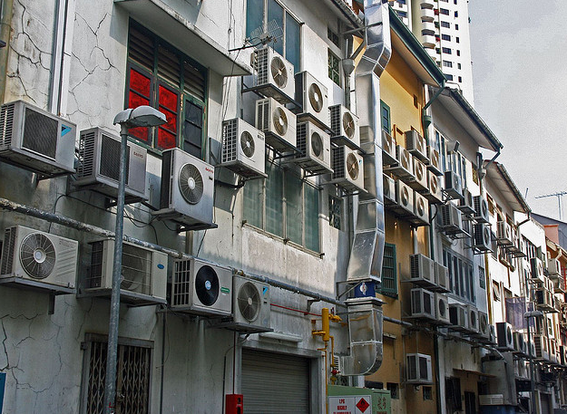

HVAC – Heat Ventilation and Air Conditioning
© Copyright CERTUS Project 2017 - All Rights Reserved

Slide 3
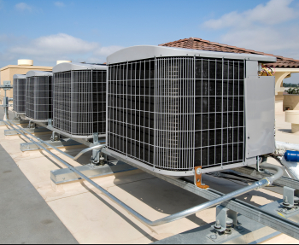
HVAC – Heat Ventilation and Air Conditioning
Introduction
HVAC (Heating, Ventilating, and Air Conditioning) is the technology of indoor and vehicular environmental comfort. Its goal is to provide thermal comfort and acceptable indoor air quality.
The three central functions of heating, ventilation, and air-conditioning are interrelated, especially with the need to provide thermal comfort and acceptable indoor air quality within reasonable installation, operation, and maintenance costs. HVAC systems can provide ventilation, reduce air infiltration, and maintain pressure relationships between spaces.
© Copyright CERTUS Project 2017 - All Rights Reserved

Slide 4
HVAC – Heat Ventilation and Air Conditioning
Introduction
HVAC Heating - Such a system contains a boiler, furnace, or heat pump to heat water, steam, or air in a central location such as a furnace room in a home, or a mechanical room in a large building.
Heaters exist for various types of fuel, including solid fuels, liquids, and gases. Another type of heat source is electricity, typically heating ribbons made of high resistance wire. Heat pumps can extract heat from various sources, such as environmental air, exhaust air from a building, or from the ground. Initially, heat pump HVAC systems were used in moderate climates, but with improvements in low temperature operation and reduced loads due to more efficient homes, they are increasing in popularity in other climates.
Heat distribution can be made through water/steam or air. In the case of heated water or steam, piping is used to transport the heat to the rooms. Most modern hot water boiler heating systems have a circulator, which is a pump, to move hot water through the distribution system. The heat can be transferred to the surrounding air using radiators, hot water coils (hydro-air), or other heat exchangers. The use of water as the heat transfer medium is known as hydronics. The heated water can also supply an auxiliary heat exchanger to supply hot water for bathing and washing.
© Copyright CERTUS Project 2017 - All Rights Reserved

Slide 5
HVAC – Heat Ventilation and Air Conditioning
Introduction
Warm air systems distribute heated air through duct work systems of supply and return air through metal or fiberglass ducts. Many systems use the same ducts to distribute air cooled by an evaporator coil for air conditioning. The air supply is typically filtered through air cleaners to remove dust and pollen particles.
HVAC Ventilating - Ventilation is the process of changing or replacing air in any space to control temperature or remove any combination of moisture, odors, smoke, heat, dust, airborne bacteria, or carbon dioxide, and to replenish oxygen.
Ventilation includes both the exchange of air with the outside as well as circulation of air within the building. It is one of the most important factors for maintaining acceptable indoor air quality in buildings. Methods for ventilating a building may be divided into mechanical/forced and natural types
© Copyright CERTUS Project 2017 - All Rights Reserved

Slide 6
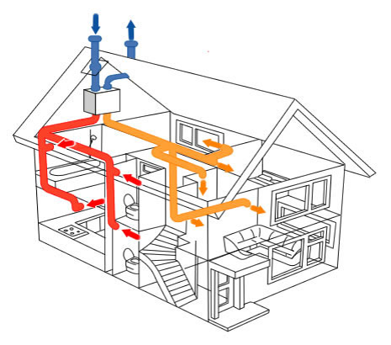
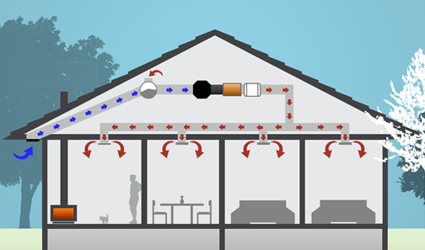
HVAC – Heat Ventilation and Air Conditioning
Introduction
HVAC Mechanical/Forced ventilation - is provided by an air handler and used to control indoor air quality. Excess humidity, odors, and contaminants can often be controlled via dilution or replacement with outside air.
© Copyright CERTUS Project 2017 - All Rights Reserved

Slide 7
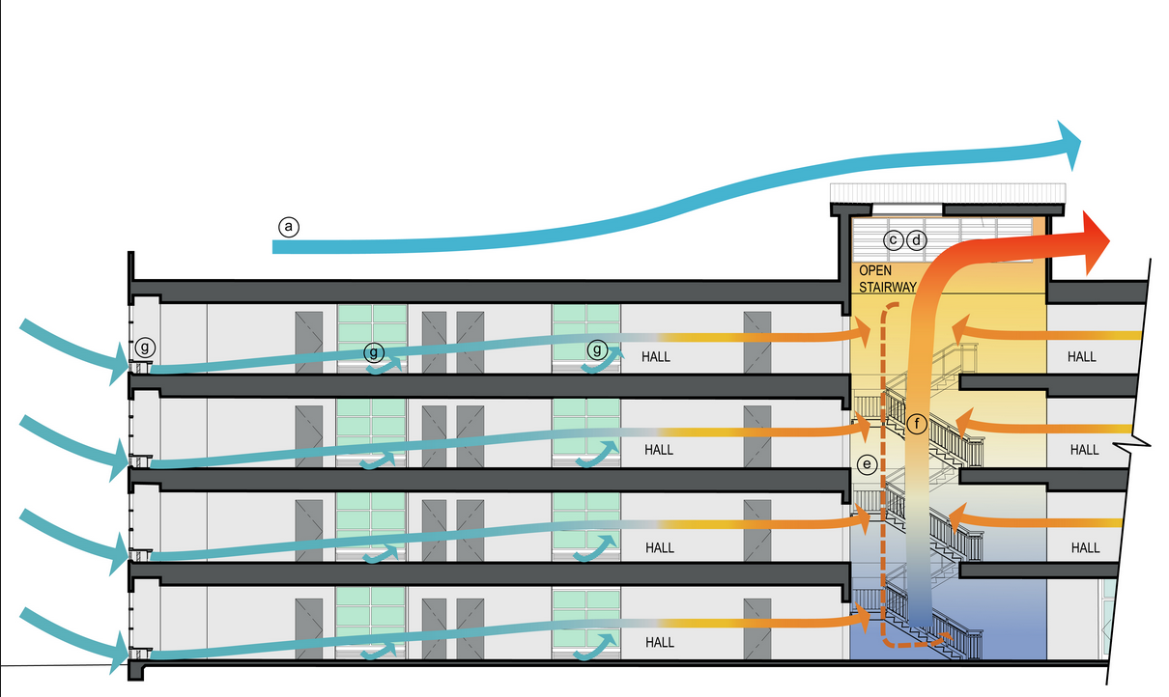
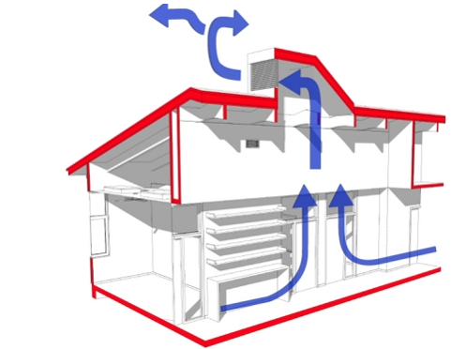
HVAC – Heat Ventilation and Air Conditioning
Introduction
HVAC Natural ventilation - is the ventilation of a building with outside air without using fans or other mechanical systems. It can be via operable windows, louvers, or trickle vents when spaces are small and the architecture permits. In more complex schemes, warm air is allowed to rise and flow out high building openings to the outside, causing cool outside air to be drawn into low building openings. Natural ventilation schemes can use very little energy, but care must be taken to ensure comfort.
© Copyright CERTUS Project 2017 - All Rights Reserved

Slide 8
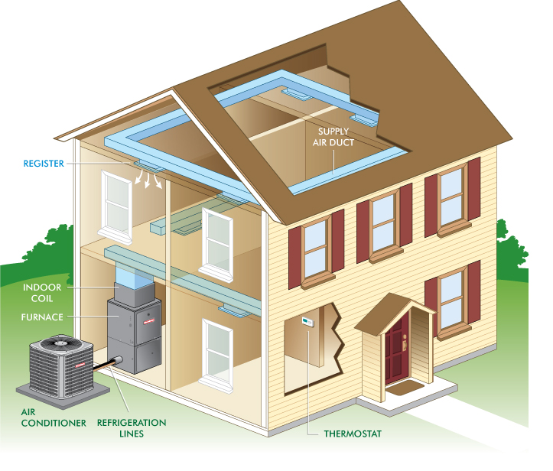
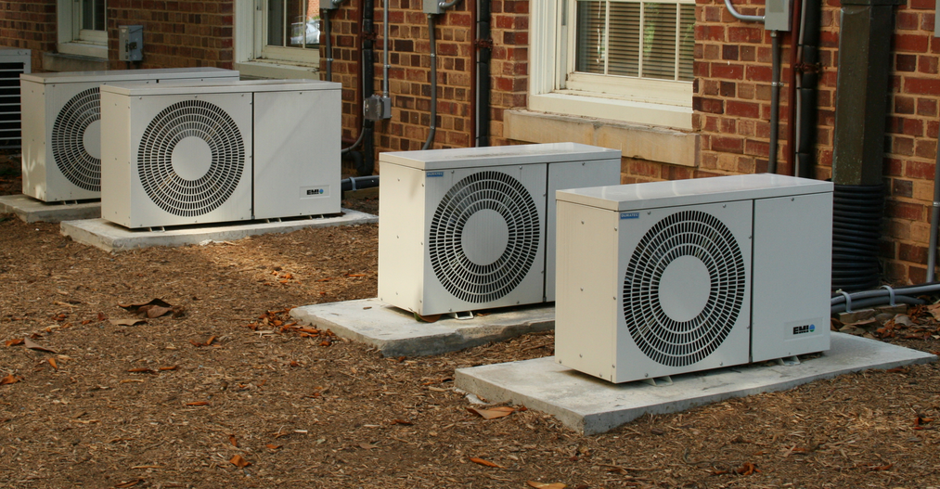
HVAC – Heat Ventilation and Air Conditioning
Introduction
HVAC Air Conditioning – A central air conditioning system, or a standalone air conditioner, provides cooling and humidity control for all or part of a building. Air conditioned buildings often have sealed windows, because open windows would work against the system intended to maintain constant indoor air conditions. Outside, fresh air is generally drawn into the system by a vent into the indoor heat exchanger section, creating positive air pressure. The percentage of return air made up of fresh air can usually be manipulated by adjusting the opening of this vent. Typical fresh air intake is about 10%.
© Copyright CERTUS Project 2017 - All Rights Reserved

Slide 9
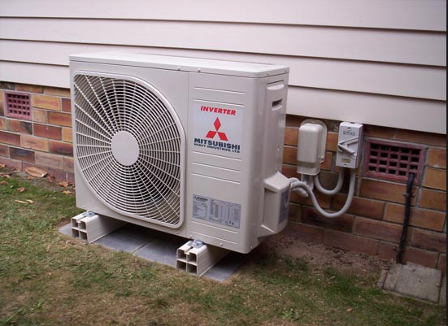
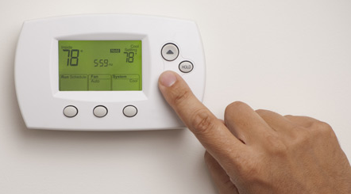
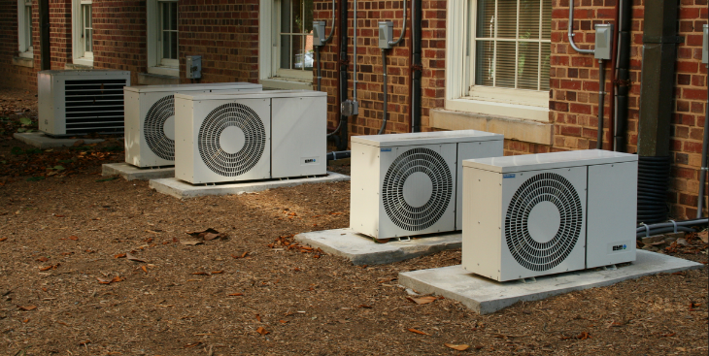
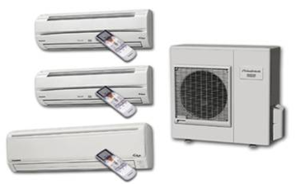
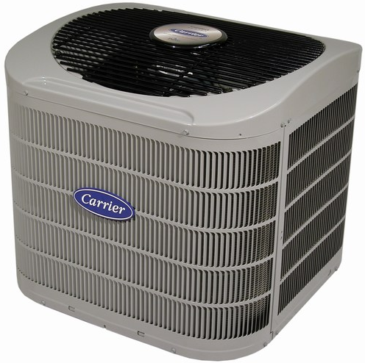
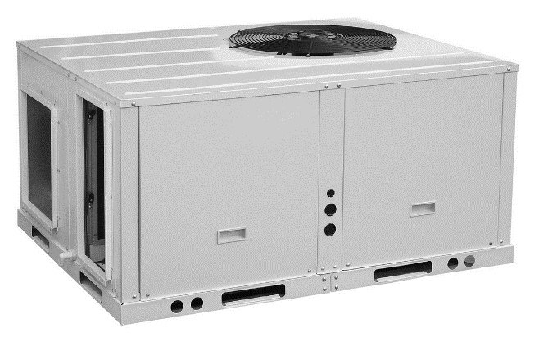
HVAC – Heat Ventilation and Air Conditioning
© Copyright CERTUS Project 2017 - All Rights Reserved

Slide 10
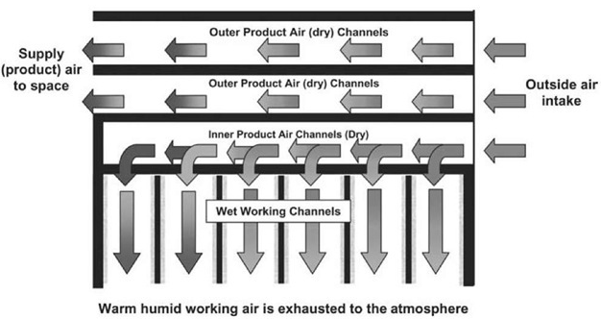
HVAC – Heat Ventilation and Air Conditioning
HVAC Systems – Evaporative Cooler Utilizing the Maisotsenko Cycle (M-Cycle)
An evaporative cooler is a device that cools air through the evaporation of water. Evaporative cooling differs from typical air conditioning systems which use vapor-compression or absorption refrigeration cycles. Evaporative cooling works by employing water's large enthalpy of vaporization. The temperature of dry air can be dropped significantly through the phase transition of liquid water to water vapor (evaporation), which can cool air using much less energy than refrigeration.
© Copyright CERTUS Project 2017 - All Rights Reserved

Slide 11
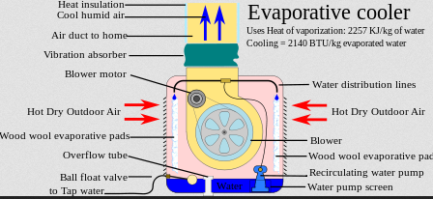
HVAC – Heat Ventilation and Air Conditioning
HVAC Systems – Evaporative Cooler Utilizing the Maisotsenko Cycle (M-Cycle)
Evaporative cooler example:
© Copyright CERTUS Project 2017 - All Rights Reserved

Slide 12
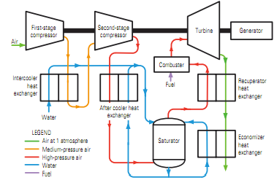
HVAC – Heat Ventilation and Air Conditioning
HVAC Systems – Evaporative Cooler Utilizing the Maisotsenko Cycle (M-Cycle)
The Maisotsenko Cycle (M-Cycle) - can produce power with fuel efficiencies above 60 percent without a bottoming cycle steam turbine. The MCTC is similar to the Humid Air Turbine (HAT) cycle, but it uses far less equipment with much higher heat transfer rates and less pressure drop.
© Copyright CERTUS Project 2017 - All Rights Reserved

Slide 13
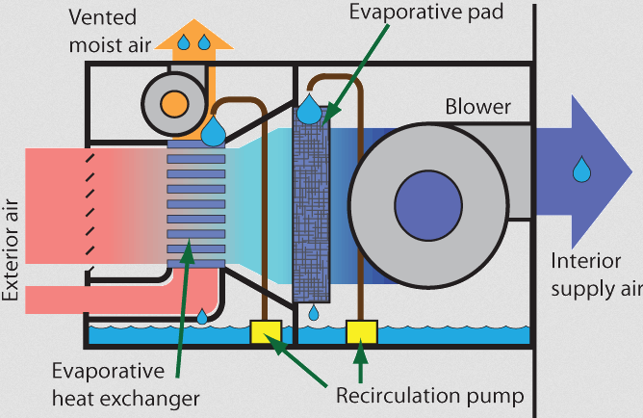
HVAC – Heat Ventilation and Air Conditioning
HVAC Systems – Evaporative Cooler Utilizing the Maisotsenko Cycle (M-Cycle)
Operation
Evaporative coolers lower the temperature of air using the principle of evaporative cooling, unlike typical air conditioning systems which use vapor-compression refrigeration or absorption refrigerator. Evaporative cooling is the addition of water vapor into air, which causes a lowering of the temperature of the air. The energy needed to evaporate the water is taken from the air in the form of sensible heat, which affects the temperature of the air, and converted into latent heat, the energy present in the water vapor component of the air, whilst the air remains at a constant enthalpy value.
This conversion of sensible heat to latent heat is known as an adiabatic process because it occurs at a constant enthalpy value. Evaporative cooling therefore causes a drop in the temperature of air proportional to the sensible heat drop and an increase in humidity proportional to the latent heat gain.
© Copyright CERTUS Project 2017 - All Rights Reserved

Slide 14
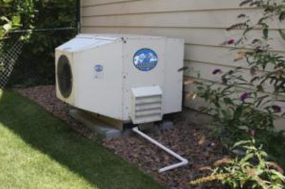
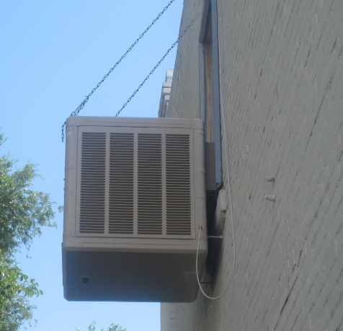
HVAC – Heat Ventilation and Air Conditioning
HVAC Systems – Evaporative Cooler Utilizing the Maisotsenko Cycle (M-Cycle)
Applications
Evaporative cooling is most effective when the relative humidity is on the low side, limiting its popularity to dry climates. Evaporative cooling raises the internal humidity level significantly, which desert inhabitants may appreciate as the moist air re-hydrates dry skin and sinuses.
The three most important climate considerations are dry-bulb temperature, wet-bulb temperature, and wet-bulb depression during the summer design day. It is important to determine if the wet-bulb depression can provide sufficient cooling during the summer design day. By subtracting the wet-bulb depression from the outside dry-bulb temperature, it is possible to estimate the approximate air temperature leaving the evaporative cooler. It is important to consider that the ability for the exterior dry-bulb temperature to reach the wet-bulb temperature depends on the saturation efficiency. A general recommendation for applying direct evaporative cooling is to implement it in places where the wet-bulb temperature of the outdoor air does not exceed 22 °C.
© Copyright CERTUS Project 2017 - All Rights Reserved

Slide 15
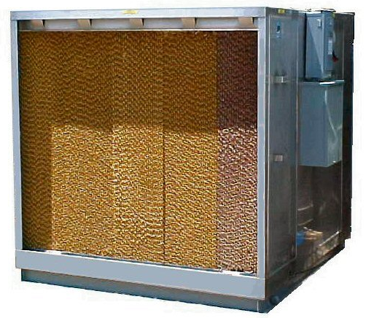
HVAC – Heat Ventilation and Air Conditioning
HVAC Systems – Evaporative Cooler Utilizing the Maisotsenko Cycle (M-Cycle)
Applications (cont.)
In locations with moderate humidity there are many cost-effective uses for evaporative cooling, in addition to their widespread use in dry climates. For example, industrial plants, commercial kitchens, laundries, dry cleaners, greenhouses, localized cooling spots (loading docks, warehouses, factories, construction sites, athletic events, workshops and garages) often employ evaporative cooling.
Constraints
In highly humid climates, evaporative cooling may have little thermal comfort benefit beyond the increased ventilation and air movement it provides.
© Copyright CERTUS Project 2017 - All Rights Reserved

Slide 16
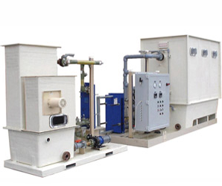
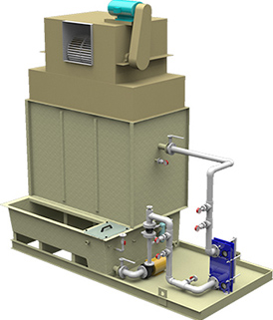
HVAC – Heat Ventilation and Air Conditioning
HVAC Systems – Open Absorption Cycle-Liquid Dessicant Cooling Systems
© Copyright CERTUS Project 2017 - All Rights Reserved

Slide 17
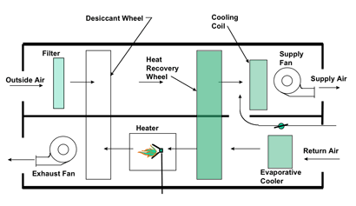
HVAC – Heat Ventilation and Air Conditioning
HVAC Systems – Open Absorption Cycle-Liquid Dessicant Cooling Systems
Desiccant cooling systems are basically open cycle systems, using water as refrigerant in direct contact with air. The thermally driven cooling cycle is a combination of evaporative cooling with air dehumidification by a desiccant, i.e. a hygroscopic material.
© Copyright CERTUS Project 2017 - All Rights Reserved

Slide 18
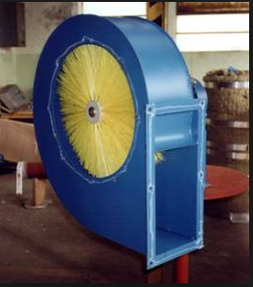
HVAC – Heat Ventilation and Air Conditioning
HVAC Systems – Open Absorption Cycle-Liquid Dessicant Cooling Systems
For this purpose, liquid or solid materials can be employed. The term ‘open’ is used to indicate that the refrigerant is discarded from the system after providing the cooling effect and new refrigerant is supplied in its place in an open-ended loop. Therefore, only water is possible as refrigerant with direct contact to the surrounding air. The common technology applied today uses rotating desiccant wheels, equipped either with silica gel or lithium-chloride as sorption material.
Open absorption systems are, theoretically, simple to build, require driving energy at relatively low temperatures (flat-plate solar collectors, co-generation effluents, district heating, etc.), and are efficient air dehumidifiers.
So, why are they not ubiquitous? The problem is corrosion. Almost all me tall alloys are corroded by the most effective liquid desiccants, e.g. aqueous solutions of lithium chloride, particularly in the presence of oxygen.
© Copyright CERTUS Project 2017 - All Rights Reserved

Slide 19
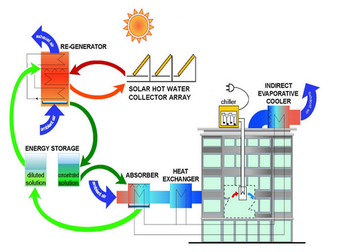
HVAC – Heat Ventilation and Air Conditioning
HVAC Systems – Open/Closed Absorption Cycle-Liquid Dessicant Cooling Systems
Example: In this air conditioning system, the air is dehumidified and cooled by its direct contact with a liquid desiccant. In contrast to conventional air conditioning technologies, this system is heat driven. Because the heat required is of low temperature, the system incorporates 10 m² solar thermal collectors. The solar thermal system has been generously donated by REHAU, while some individual components of the hydraulic system have also been generously donated by WILO. The open cycle air conditioning with liquid desiccants is ideal for energy intensive buildings with high latent loads
Installation Year: 2013
Air Flow Rate: 2000 m3/h
Dehumidification Capacity 0,008 kgH2O / kg dry air
Desiccant solution LiCl
Heat source: Solar thermal system
© Copyright CERTUS Project 2017 - All Rights Reserved

Slide 20
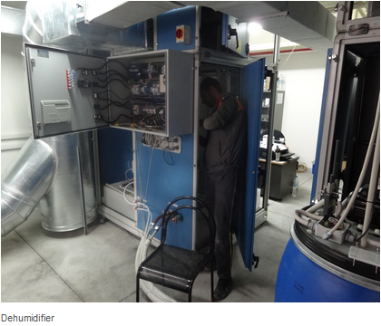
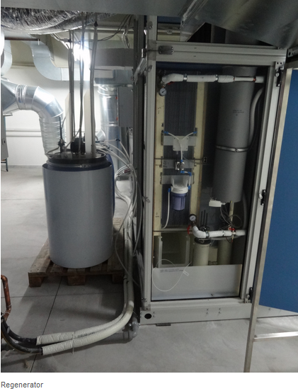
HVAC – Heat Ventilation and Air Conditioning
HVAC Systems – Open/Closed Absorption Cycle-Liquid Dessicant Cooling Systems
Example (cont.)
© Copyright CERTUS Project 2017 - All Rights Reserved

Slide 21
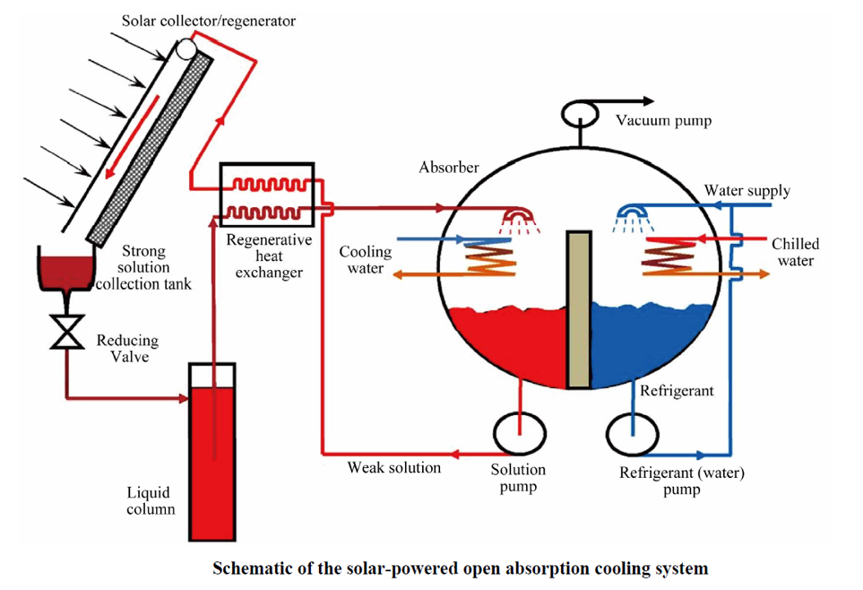
HVAC – Heat Ventilation and Air Conditioning
HVAC Systems – Open/Closed Absorption Cycle-Liquid Dessicant Cooling Systems
Example (cont.)
© Copyright CERTUS Project 2017 - All Rights Reserved

Slide 22
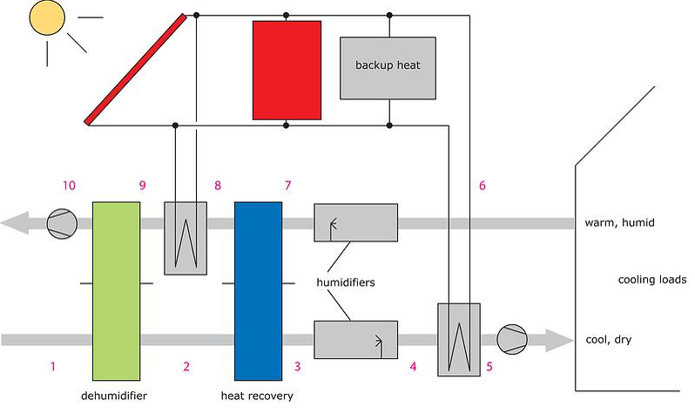
HVAC – Heat Ventilation and Air Conditioning
HVAC Systems – Open/Closed Absorption Cycle-Liquid Dessicant Cooling Systems
The main components of a solar assisted desiccant cooling system are shown in the figure below.
Operation
Warm and humid air enters the slowly rotating desiccant wheel and is dehumidified by adsorption of water (1-2).
Since the air is heated up by the adsorption heat, a heat recovery wheel is passed (2-3), resulting in a significant pre-cooling of the supply air stream.
The air is humidified and thus further cooled by a controlled humidifier (3-4) according to the set-values of supply air temperature and humidity.
The exhaust air stream of the rooms is humidified (6-7) close to the saturation point to exploit the full cooling potential in order to allow an effective heat recovery (7-8).
The sorption wheel has to be regenerated (9-10) by applying heat in a comparatively low temperature range from 50 °C-75 °C and to allow a continuous operation of the dehumidification process.
© Copyright CERTUS Project 2017 - All Rights Reserved

Slide 23
HVAC – Heat Ventilation and Air Conditioning
HVAC Systems – Open/Closed Absorption Cycle-Liquid Dessicant Cooling Systems
Operation (cont.)
Cooling systems using a liquid water-lithium chloride solution as sorption material show several advantages like higher air dehumidification at the same driving temperature range of solid desiccant cooling systems, and the possibility of high energy storage by storing the concentrated solution.
This technology is a promising option for a further increase in exploitation of solar thermal systems for air conditioning.
Applications
Currently, a few systems of this type are installed in Germany in pilot and demonstration applications, driven either with solar thermal heat or other heat sources.
Constraints
A special design of the desiccant cycle is needed in case of extreme outdoor conditions such as e.g. coastal areas of the Mediterranean region. Due to the high humidity of ambient air, a standard configuration of the desiccant cooling cycle is not able to reduce the humidity down to a level that is low enough to employ direct evaporative cooling. More complex designs of the desiccant air handling unit employing for instance another enthalpy wheel or additional air coolers supplied by chilled water can overcome this problem.
© Copyright CERTUS Project 2017 - All Rights Reserved

Slide 24
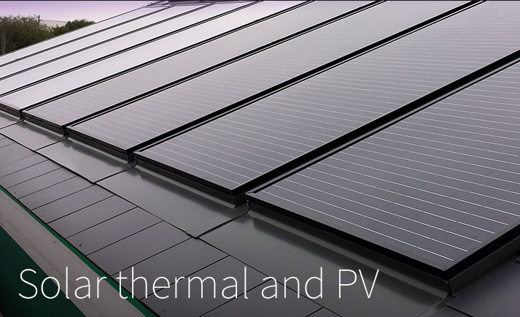
HVAC – Heat Ventilation and Air Conditioning
HVAC Systems – Combined Solar Power and Heat Generation (Pv-T)
© Copyright CERTUS Project 2017 - All Rights Reserved

Slide 25
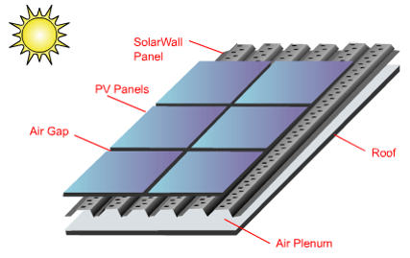
HVAC – Heat Ventilation and Air Conditioning
HVAC Systems – Combined Solar Power and Heat Generation (PV-T)
Adding the Solar thermal component to a PV array boosts the total solar efficiency to over 50%.
The heat from the PV panels, captured by the thermal collector perforated absorber is three times more than the electrical energy generated from the PV modules. This means that by being able to uniformly capture and utilize the excess heat, it becomes possible to realize an energy output improvement in the range of 200-300%, depending on air flow and other design considerations. The test data also showed that the temperature gain from the PV modules is between 6°C
Operation:
The heat energy captured from the PV modules is ducted into the building’s HVAC system where it is used to displace the conventional heating load. The secondary benefit is to provide PV cooling by reducing the operating temperature of the PV modules, which improves the electrical performance.
In warmer climate areas, dampers are used to direct the heat away from the building if the energy is not required.
© Copyright CERTUS Project 2017 - All Rights Reserved

Slide 26
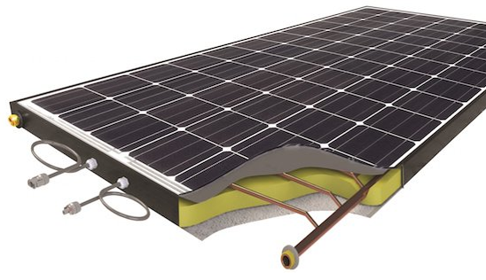
HVAC – Heat Ventilation and Air Conditioning
HVAC Systems – Combined Solar Power and Heat Generation (Pv-T)
Examples:
© Copyright CERTUS Project 2017 - All Rights Reserved

Slide 27
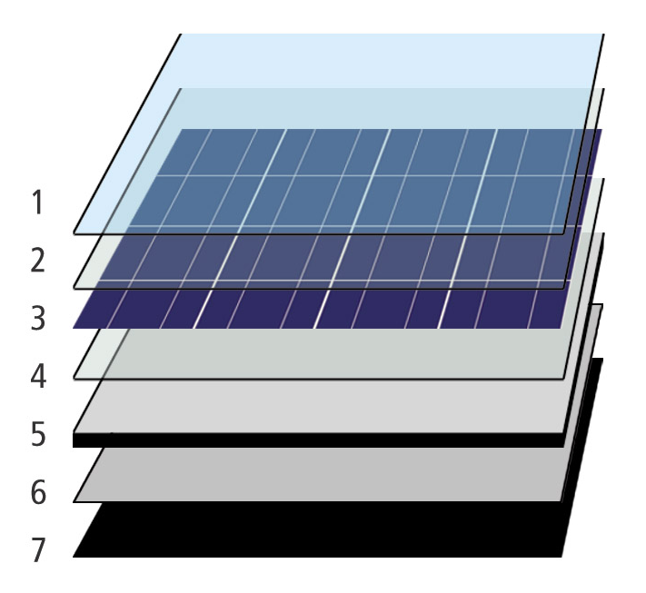
HVAC – Heat Ventilation and Air Conditioning
HVAC Systems – Combined Solar Power and Heat Generation (Pv-T)
Constraints:
The investment is hig;
Buildings needs a large area (rooftop or facade) with good conditions (orientation and available free space).
    Scheme of a PV-T solar collector:
      Anti-reflective glass
      EVA encapsulant
      Solar PV Cells
      EVA encapsulant
      Backsheet (PVF)
      Heat exchanger (cooper)
      Insulation (polyurethane)
© Copyright CERTUS Project 2017 - All Rights Reserved

Slide 28
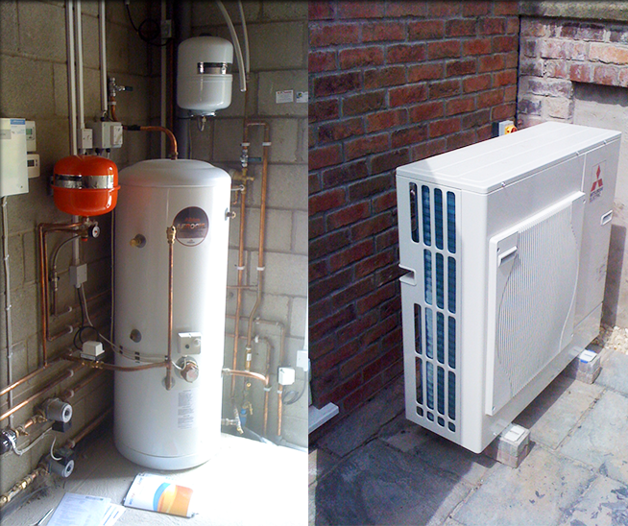
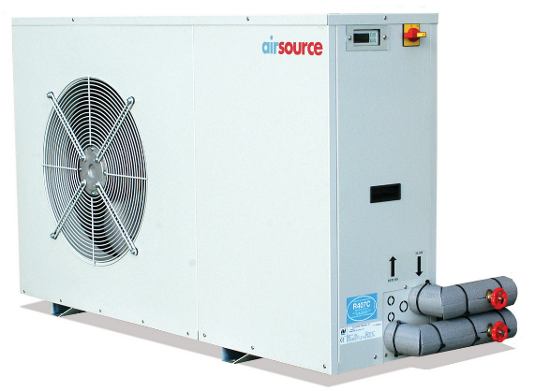
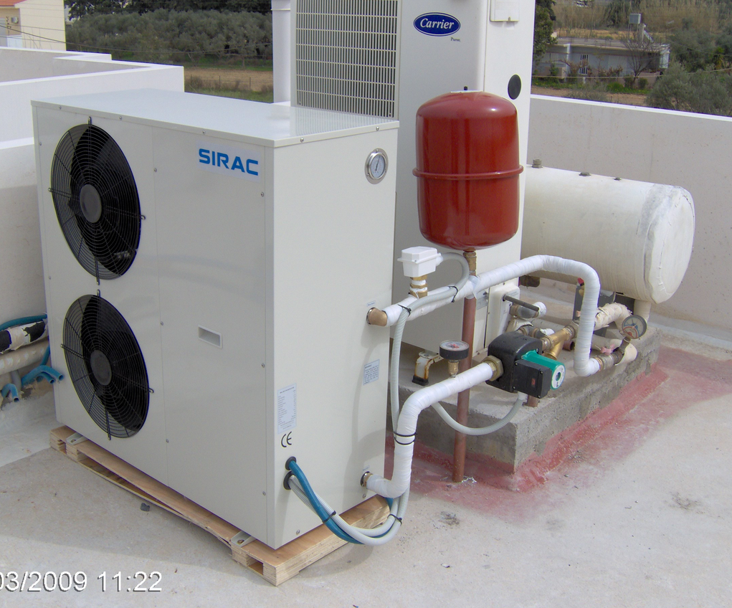
HVAC – Heat Ventilation and Air Conditioning
HVAC Systems – Air to Water Heat Pumps
© Copyright CERTUS Project 2017 - All Rights Reserved

Slide 29
HVAC – Heat Ventilation and Air Conditioning
HVAC Systems – Air to Water Heat Pumps
Air-to-water Heat Pumps use an energy source which does not need to be taped first. These equipments use free energy, the outside air in a highly efficient and high-performance way in the temperature range between +35 °C and –25 °C.
Air-to-water Heat Pumps combine the general advantages of using outdoor air as a heat source with the specific benefits of the split design. In this design, the air heat exchanger (evaporator) is installed separately outdoors and connected via refrigerant pipes to the hydraulic unit, which is installed in an indoor room.
The split air-to-water heat pumps have a maximum flow temperature of 55 °C and enable domestic hot water preparation and domestic heating with low-temperature heating systems. The outdoor component can be installed in front of the external wall, thus saving space. The hydraulic unit with integrated controller is installed inside the building. The inverter control adjusts the heat pump's heat output to match the heat consumption of the building.
© Copyright CERTUS Project 2017 - All Rights Reserved

Slide 30
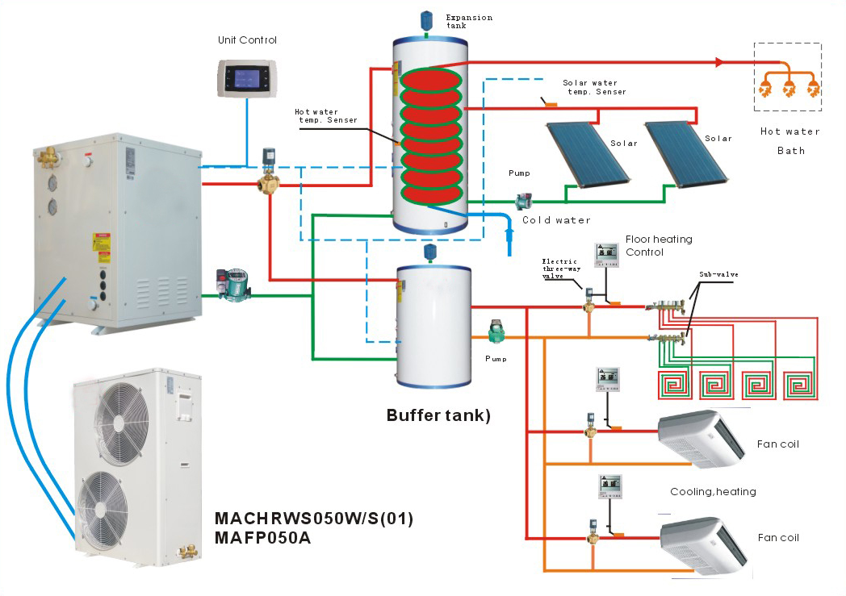
HVAC – Heat Ventilation and Air Conditioning
HVAC Systems – Air to Water Heat Pumps
Examples:
© Copyright CERTUS Project 2017 - All Rights Reserved

Slide 31
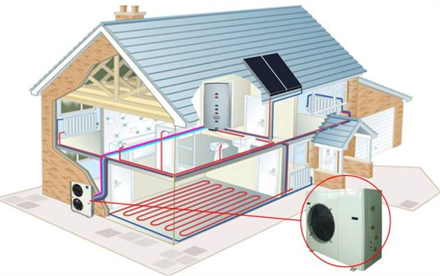
HVAC – Heat Ventilation and Air Conditioning
HVAC Systems – Air to Water Heat Pumps
Examples (cont.)
© Copyright CERTUS Project 2017 - All Rights Reserved

Slide 32
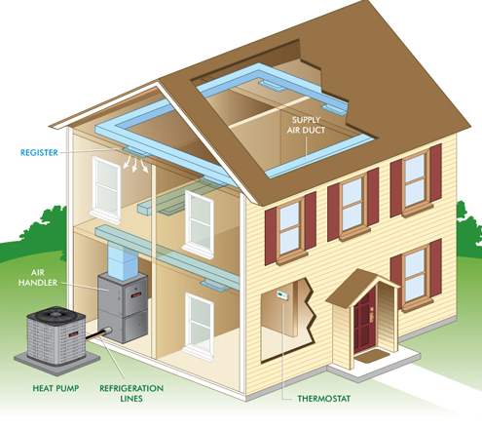
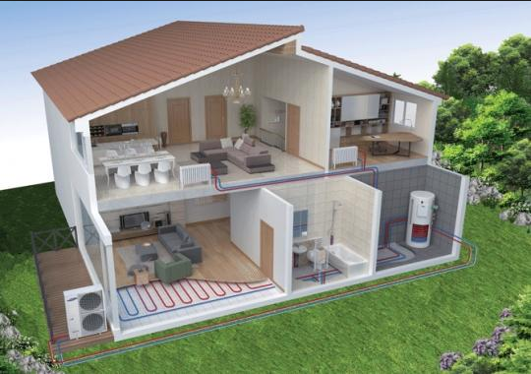
HVAC – Heat Ventilation and Air Conditioning
HVAC Systems – Air to Water Heat Pumps
Examples (cont.)
© Copyright CERTUS Project 2017 - All Rights Reserved

Slide 33
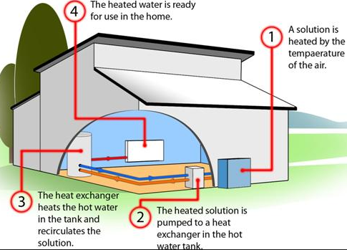
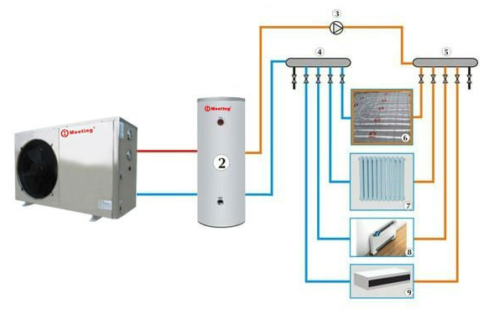
HVAC – Heat Ventilation and Air Conditioning
HVAC Systems – Air to Water Heat Pumps
Operation
© Copyright CERTUS Project 2017 - All Rights Reserved

Slide 34
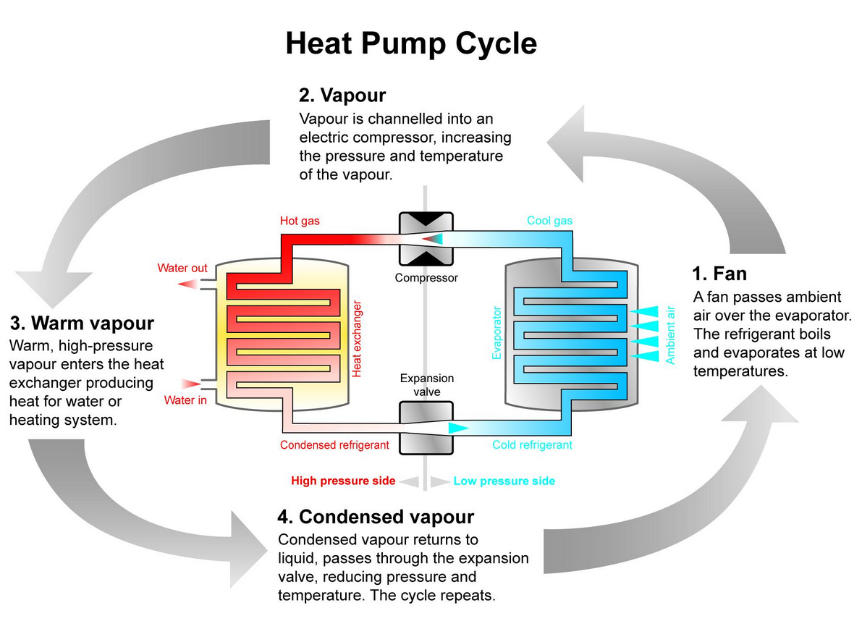
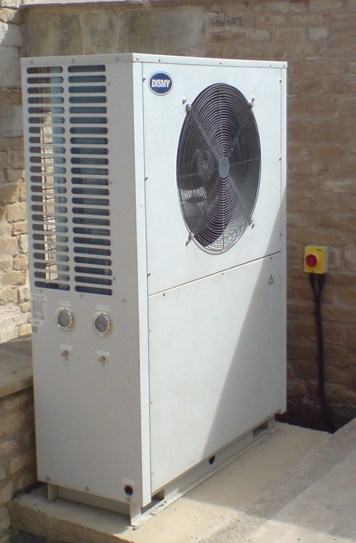
HVAC – Heat Ventilation and Air Conditioning
HVAC Systems – Air to Water Heat Pumps
Operation (cont.)
© Copyright CERTUS Project 2017 - All Rights Reserved

Slide 35
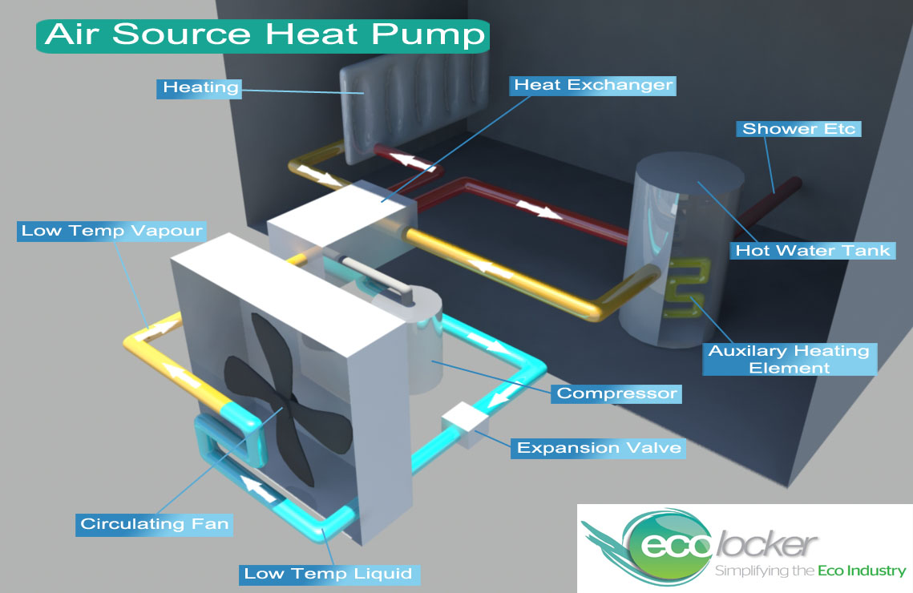
HVAC – Heat Ventilation and Air Conditioning
HVAC Systems – Air to Water Heat Pumps
System Components
© Copyright CERTUS Project 2017 - All Rights Reserved

Slide 36
HVAC – Heat Ventilation and Air Conditioning
HVAC Systems – Air to Water Heat Pumps
Application
Air source heat pumps (ASHP) are used to provide interior space heating and cooling even in colder climates, and can be used efficiently for water heating in milder climates. A major advantage of some ASHPs is that the same system may be used for heating in winter and cooling in summer.
ASHPs are often paired with auxiliary or emergency heat systems to provide backup heat when outside temperatures are too low for the pump to work efficiently, or in the event the pump malfunctions. Since ASHPs have high capital costs, and efficiency drops as temperature decreases, it is generally not cost-effective to size a system for the coldest possible temperature scenario, even if an ASHP could meet the entire heat requirement at the coldest temperatures expected.
In heating use, an ASHP absorbs heat from outside air and releases it inside the building, as hot air, hot water-filled radiators, underfloor heating and/or domestic hot water supply.
The same system can often do the reverse in summer, cooling the inside of the building. When correctly specified, an ASHP can offer a full central heating solution and domestic hot water up to 80°C.
© Copyright CERTUS Project 2017 - All Rights Reserved

Slide 37
HVAC – Heat Ventilation and Air Conditioning
HVAC Systems – Air to Water Heat Pumps
Application
Thermal storage solutions incorporating resistance heating can be used in conjunction with ASHPs. Storage may be more cost-effective if down at hours with low electricity rates.
Heat is stored in high density ceramic bricks contained within a thermally-insulated enclosure.
There are ASHP designed for residential, commercial or industrial use, depending on the buildings necessities.
Constraints
The cost of installation is generally high, it is less than the cost of a ground source heat pump, because a ground source heat pump requires excavation to install its ground loop. The advantage of a ground source heat pump is that it has access to the thermal storage capacity of the ground which allows it to produce more heat for less electricity in cold conditions.
© Copyright CERTUS Project 2017 - All Rights Reserved

Slide 38
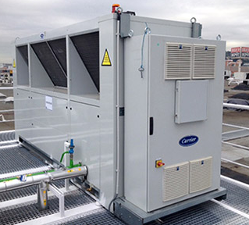
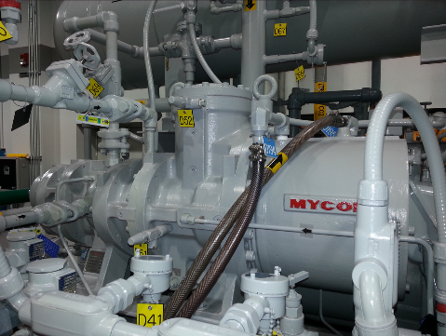
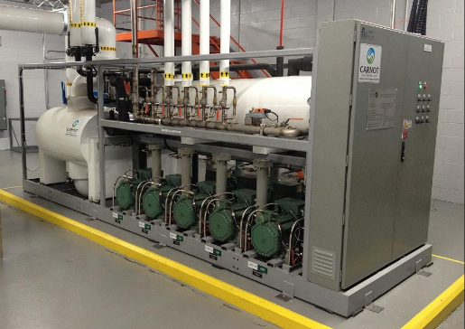
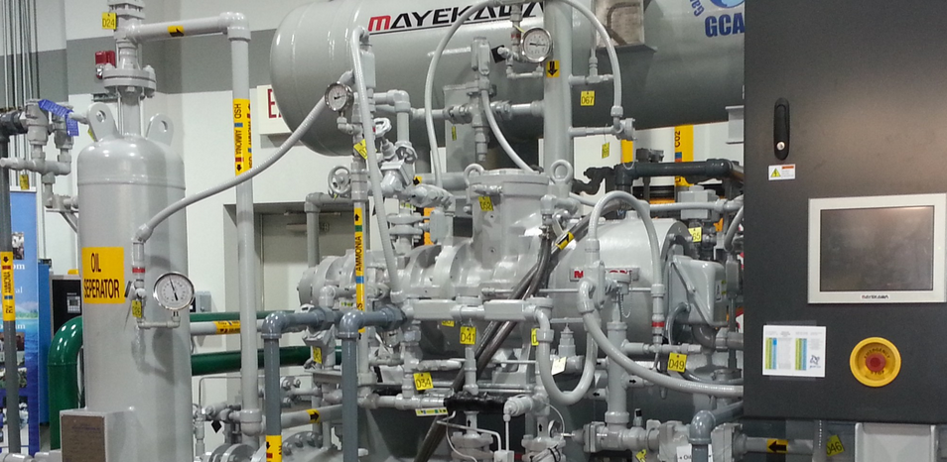
HVAC – Heat Ventilation and Air Conditioning
HVAC Systems – CO2 (R744) Refrigeration Systems
© Copyright CERTUS Project 2017 - All Rights Reserved

Slide 39

HVAC – Heat Ventilation and Air Conditioning
HVAC Systems – CO2 (R744) Refrigeration Systems
© Copyright CERTUS Project 2017 - All Rights Reserved

Slide 40




HVAC – Heat Ventilation and Air Conditioning
HVAC Systems – CO2 (R744) Refrigeration Systems
Over the last few decades, synthetic refrigerants such as CFCs and HCFCs are being phased out by regulation. Increasing concern and regulatory actions related to the environmental impact of hydro fluorocarbon (HFC) refrigerants has prompted a re-emergence of carbon dioxide (CO₂) based refrigeration systems and other low GWP solutions around the world. CO₂ based refrigeration is of interest due to low global warming potential, low price, potential for energy reduction, non-toxicity and a positive safety rating.
© Copyright CERTUS Project 2017 - All Rights Reserved

Slide 41

HVAC – Heat Ventilation and Air Conditioning
HVAC Systems – CO2 (R744) Refrigeration Systems
R744 (CO₂) is a leading option for environmental reasons, and it can be a winner for power consumption as developments of component technology and application methods continue to reveal potential performance gains. Good experience has been gained with different system configurations over many years, particularly in central and northern Europe. The confidence resulting from this experience ensures that CO₂ will be a long-term option in the foreseeable future.
© Copyright CERTUS Project 2017 - All Rights Reserved

Slide 42

HVAC – Heat Ventilation and Air Conditioning
HVAC Systems – CO2 (R744) Refrigeration Systems
CO₂ is termed a “Natural Refrigerant” because it exists in the natural environment. Release into the atmosphere from refrigeration systems has a negligible effect compared to other CO₂ sources that are driving the global warming debate. As a refrigerant, it is a manufactured product that conforms to strict purity specifications. Its physical properties require special handling. The system pressures are much higher than in conventional systems, and all the components are designed accordingly.
High investment costs were characteristic of early CO₂ projects, but these costs are now on a downward trend. The refrigerant itself is a fraction of the cost of some HFCs systems.
Dry ice (solid R744) is formed when the pressure and temperature of R744 is reduced to below the triple point. This will not occur within a properly working refrigeration system.
© Copyright CERTUS Project 2017 - All Rights Reserved

Slide 43

HVAC – Heat Ventilation and Air Conditioning
HVAC Systems – CO2 (R744) Refrigeration Systems
Examples:
Sports Center/arena System
© Copyright CERTUS Project 2017 - All Rights Reserved

Slide 44

HVAC – Heat Ventilation and Air Conditioning
HVAC Systems – CO2 (R744) Refrigeration Systems
Examples (cont.)
Commercial Refrigeration Unit
© Copyright CERTUS Project 2017 - All Rights Reserved

Slide 45

HVAC – Heat Ventilation and Air Conditioning
HVAC Systems – CO2 (R744) Refrigeration Systems
Examples (cont.)
Commercial Refrigeration Units
© Copyright CERTUS Project 2017 - All Rights Reserved

Slide 46
HVAC – Heat Ventilation and Air Conditioning
HVAC Systems – CO2 (R744) Refrigeration Systems
Examples (cont.)
Industrial Refrigeration Unit
© Copyright CERTUS Project 2017 - All Rights Reserved

Slide 47
HVAC – Heat Ventilation and Air Conditioning
HVAC Systems – CO2 (R744) Refrigeration Systems
Examples (cont.)
Custom made solution for a specific client
© Copyright CERTUS Project 2017 - All Rights Reserved

Slide 48
HVAC – Heat Ventilation and Air Conditioning
HVAC Systems – CO2 (R744) Refrigeration Systems
Different System Designs
Just like all other refrigeration systems, refrigeration systems with CO₂ can be designed in many, different ways. Generally, There are three type of system designs: 1-step systems, Two-step systems and booster system, depending on the application concerned.
1-step system - direct expansion (DX) are used for air conditioning, cold storage and process cooling at temperatures between -20°C to +10°C. The design of the system mostly resembles the traditional refrigeration system, but a so-called medium pressure receiver with gas by-pass is used. A high pressure valve controls the pressure in the gas cooler/condenser and a constant pressure valve holds the receiver at the required medium pressure by constantly directing flash gas from the receiver to the suction pipe.
Therefore, saturated liquid will always be in the receiver. With stagnation, "pump-down" is made for the receiver which secures the pressure at 90 bar. Low pressure receiver systems and systems with flooded evaporators provide a good utilization of the evaporator area and, for example, are used with heat pumps and liquid cooling units. The main part of the system filling is on the LT side, which means that, for example, the system must be secured to 90 bar.
© Copyright CERTUS Project 2017 - All Rights Reserved

Slide 49
HVAC – Heat Ventilation and Air Conditioning
HVAC Systems – CO2 (R744) Refrigeration Systems
Different System Designs (cont.)
Two-step economizer and booster system with CO₂ - For freezing systems it is necessary to install two compressor levels, e.g. through the utilization of cascade systems, systems with intermediary coolers (open and closed) or by using the booster principle, where the low temperature system supplies the pressurizing gas to the suction section of the high pressure compressors.
With compression at several levels, the economizers can be advantageously used. Fluid for the economizer is extracted from an intermediate pressure receiver and is expanded to the compressor's intermediate pressure and evaporates in the economizer and thus cools the high pressure gas from the gas cooler.
This can provide an efficiency improvement of 10-20%. The system with an economizer can also be simplified so that there is suction directly from the intermediate pressure receiver, by which the remaining fluid in the receiver is cooled with evaporation of the fluid.
© Copyright CERTUS Project 2017 - All Rights Reserved

Slide 50
HVAC – Heat Ventilation and Air Conditioning
HVAC Systems – CO2 (R744) Refrigeration Systems
Operation
CO₂ is a high-pressure refrigerant where high operating pressures are required for efficient operation. During standstill, the ambient temperature can reach and exceed the critical temperature and the pressure can exceed the critical pressure. Hence systems are typically designed to withstand pressures up to 90 bar, or sometimes even equipped with a small standstill condensing unit to keep pressures low.
At the same time, CO₂ has a low compression pressure ratio (20 to 50% less than HFCs and ammonia), which improves volumetric efficiency. With evaporation temperatures in the range of -55 ºC to 0 ºC, the volumetric performance of CO₂ is for example four to twelve times better than that of ammonia, which allows compressors with smaller swept volumes to be used.
The triple point and critical point of CO₂ are very close to the working range. The critical point may be reached during normal system operation. During system service, the triple point may be reached, as indicated by the formation of dry ice when liquid containing parts of the systems are exposed to atmospheric pressure. Special procedures are necessary to prevent the formation of dry ice during service venting.
© Copyright CERTUS Project 2017 - All Rights Reserved

Slide 51
HVAC – Heat Ventilation and Air Conditioning
HVAC Systems – CO2 (R744) Refrigeration Systems
Operation (cont.)
From its pure thermo dynamical properties CO₂ is not very well suited as refrigerant. However, CO₂ has several unique thermo physical properties:
Very good heat transfer coefficient
Relatively insensitive to pressure losses
Very low viscosity
In practical applications, the CO₂ systems deliver very high performance, the main reasons being better heat exchange, very low pumping power when CO₂ is used as a secondary fluid, and in cold climate the possibility of operating with a very low condensing pressure in the winter.
© Copyright CERTUS Project 2017 - All Rights Reserved

Slide 52
HVAC – Heat Ventilation and Air Conditioning
HVAC Systems – CO2 (R744) Refrigeration Systems
Application
The efficiency of systems with CO₂ depends more on the application and the climate than with other refrigerants. For all refrigerants there is a decline in system efficiency with increasing condensing temperatures, and CO₂ is among the refrigerants with the steepest drop. The good thermo-physical properties of CO₂ can compensate to some extent, but there is a limit. CO₂ has high energy content at higher temperatures, and when this heat can be reclaimed for heating sanitary water or similar application, the efficiency of the total system becomes very high.
From an environmental perspective, CO₂ is a very attractive refrigerant with zero ODP and a GWP of 1. It is a naturally occurring substance and abundant in the atmosphere.
Unlike most other refrigerants, CO₂ is used in practice in three different refrigeration cycles:
  Subcritical (cascade systems)
  Transcritical (CO₂-only systems)
  Secondary fluid (CO₂ used as a volatile brine)
© Copyright CERTUS Project 2017 - All Rights Reserved

Slide 53

HVAC – Heat Ventilation and Air Conditioning
HVAC Systems – CO2 (R744) Refrigeration Systems
Application (cont.)
The technology used depends on the application and the intended location of the system. There are a several applications where CO₂ is attractive and already widely used today:
Industrial/Commercial refrigeration. CO₂ is generally used in combination with ammonia, either in cascade systems or as a volatile brine
Food/retail refrigeration
Heat pumps
Transport refrigeration
© Copyright CERTUS Project 2017 - All Rights Reserved

Slide 54





HVAC – Heat Ventilation and Air Conditioning
HVAC Systems – Hydronic Radiant Systems
© Copyright CERTUS Project 2017 - All Rights Reserved

Slide 55

HVAC – Heat Ventilation and Air Conditioning
HVAC Systems – Hydronic Radiant Systems
Radiant heating systems supply heat directly to the floor or to panels in the wall or ceiling of a house.
The systems depend largely on radiant heat transfer - the delivery of heat directly from the hot surface to the people and objects in the room via infrared radiation.
Radiant heating is the effect you feel when you can feel the warmth of a hot stovetop element from across the room.
When radiant heating is located in the floor, it is often called radiant floor heating or simply floor heating.
© Copyright CERTUS Project 2017 - All Rights Reserved

Slide 56
HVAC – Heat Ventilation and Air Conditioning
HVAC Systems – Hydronic Radiant Systems
Types of Radiant Systems (floors, panels in walls or ceilings) :
Air-heated systems - Air cannot hold large amounts of heat, so radiant air systems are not cost-effective in residential applications. Although they can be combined with solar air heating systems;
Electric radiant systems - Typically consist of electric cables built into the floor. Due to the electricity cost, these systems are usually only cost-effective if they include a significant thermal mass such as a thick concrete floor and if the electric utility company offers time-of-use rates. Time-of-use rates allow to "charge" the concrete floor with heat during off-peak hours (approximately 9 p.m. to 6 a.m.). If the floor's thermal mass is large enough, the heat stored in it will keep the house comfortable for eight to ten hours without any further electrical input.
Hydronic (liquid) systems - Are the most popular and cost-effective radiant heating systems. These systems pump heated water from a boiler through tubing laid in a pattern under the floor. In some systems, controlling the flow of hot water through each tubing loop by using zoning valves or pumps and thermostats regulates room temperatures. The cost of installing a hydronic radiant floor varies by location and depends on the size of the home, but typically the cost is high.
© Copyright CERTUS Project 2017 - All Rights Reserved

Slide 57


HVAC – Heat Ventilation and Air Conditioning
HVAC Systems – Hydronic Radiant Systems
Examples
© Copyright CERTUS Project 2017 - All Rights Reserved

Slide 58

HVAC – Heat Ventilation and Air Conditioning
HVAC Systems – Hydronic Radiant Systems
Examples
© Copyright CERTUS Project 2017 - All Rights Reserved

Slide 59

HVAC – Heat Ventilation and Air Conditioning
HVAC Systems – Hydronic Radiant Systems
Examples
© Copyright CERTUS Project 2017 - All Rights Reserved

Slide 60

HVAC – Heat Ventilation and Air Conditioning
HVAC Systems – Hydronic Radiant Systems
Examples
© Copyright CERTUS Project 2017 - All Rights Reserved

Slide 61

HVAC – Heat Ventilation and Air Conditioning
HVAC Systems – Hydronic Radiant Systems
Examples
© Copyright CERTUS Project 2017 - All Rights Reserved

Slide 62

HVAC – Heat Ventilation and Air Conditioning
HVAC Systems – Hydronic Radiant Systems
Operation
Hydronic (liquid-based) systems can use a wide variety of energy sources to heat the liquid, including standard gas- or oil-fired boilers, wood-fired or biomass boilers, solar water heaters, or a combination of these sources.
Despite its name, radiant floor heating depends heavily on convection, the natural circulation of heat within a room as air warmed by the floor rises.
© Copyright CERTUS Project 2017 - All Rights Reserved

Slide 63

HVAC – Heat Ventilation and Air Conditioning
HVAC Systems – Hydronic Radiant Systems
Operation - Schematics
© Copyright CERTUS Project 2017 - All Rights Reserved

Slide 64

HVAC – Heat Ventilation and Air Conditioning
HVAC Systems – Hydronic Radiant Systems
Applications and advantages
This heating system is suited for almost any space used by people, such as: homes, schools, offices, etc.
People with allergies often prefer radiant heat because it does not distribute allergens like forced air systems can.
It is more efficient than baseboard heating and usually more efficient than forced-air heating because it eliminates duct losses.
Constraints
The main constraint beside the necessary construction work is the initial investment in the system.
© Copyright CERTUS Project 2017 - All Rights Reserved

Slide 65



HVAC – Heat Ventilation and Air Conditioning
HVAC Systems – Solar Cooling Systems
© Copyright CERTUS Project 2017 - All Rights Reserved

Slide 66

HVAC – Heat Ventilation and Air Conditioning
HVAC Systems – Solar Cooling Systems – Thermal collectors
Solar Thermal Energy collectors for cooling
Solar absorption chillers are very low in operating and maintenance costs, and consume little or no electrical energy.
The only parts that use any electricity are low consumption fan motors, control boards, and small pumps that move the thermal transfer fluid from the collectors to the chiller and then back up to the collectors.
Inside the unit is another small pump that circulates the refrigerant. There is no "compressor" to consume power.
All of these small electrical loads can run from a small solar PV panel setup if desired, meaning zero energy costs for the solar air conditioning system.
© Copyright CERTUS Project 2017 - All Rights Reserved

Slide 67
HVAC – Heat Ventilation and Air Conditioning
HVAC Systems – Solar Cooling Systems – Thermal collectors
Operation
As paradoxical as it may seem, cooling using solar energy is feasible using solar thermal energy. Solar chillers use thermal energy provided by the sun or other backup sources to produce cold and/or dehumidification.
Few people realize that besides heating water and other fluids, solar thermal technology can reduce air-conditioning and industrial cooling costs.
Solar cooling systems use concentrating solar collectors and absorption chillers to drive the cooling process. These systems are ideal for cooling hotels, office buildings, data centers and other large commercial buildings.
Solar cooling systems save money for building owners because electricity rates are often tiered, meaning that the more electricity a building uses during peak hours, the higher the rate charged for that electricity. Peak hours often occur on hot sunny days when the air conditioning load is highest. Installing a solar cooling system can result in big savings since the system reduces electricity use during peak hours.
The same concentrating solar collectors used for cooling can also heat water for the facility.
© Copyright CERTUS Project 2017 - All Rights Reserved

Slide 68
HVAC – Heat Ventilation and Air Conditioning
HVAC Systems – Solar Cooling Systems – Thermal collectors
Solar Cooling Processes
Closed cycles - where thermally driven absorption chillers produce chilled water for use in space conditioning equipment .
Open cycles - also referred to as desiccant evaporative cooling systems (DEC), which typically use water as the refrigerant and a desiccant as the sorbent for direct treatment of air in a ventilation system.
Solar Cooling Advantages
It can help reduce the electricity peak demand associated with conventional cooling, as maximum solar radiation usually occurs when cooling is needed. Solar thermal cooling can also operate in the evening by using thermal storage.
When summer is over, solar cooling systems can be used for heating purposes such as domestic hot water preparation or space heating.
© Copyright CERTUS Project 2017 - All Rights Reserved

Slide 69


HVAC – Heat Ventilation and Air Conditioning
HVAC Systems – Solar Cooling Systems – Thermal collectors
Examples:
© Copyright CERTUS Project 2017 - All Rights Reserved

Slide 70
HVAC – Heat Ventilation and Air Conditioning
HVAC Systems – Solar Cooling Systems – Thermal collectors
Operation
Concentrating solar collectors use mirrors to focus the sun’s energy on a tube containing fluid. The mirrors follow the sun, heating the fluid to very high temperatures. Absorption chillers operate by using this solar-heated fluid, rather than fossil fuels or electricity, to drive the refrigeration process.
Using solar energy with absorption chillers reduces site-generated greenhouse gases as well as the emissions created when fossil fuels are burned to create electricity.
There are multiple alternatives to compressor-based chillers that can reduce energy consumption, with less noise and vibration. Solar thermal energy can be used to efficiently cool in the summer, and also heat domestic water and buildings in the winter.
Single, double or triple iterative absorption cooling cycles are used in different solar thermal cooling system designs. The more cycles, the more efficient these systems are.
© Copyright CERTUS Project 2017 - All Rights Reserved

Slide 71

HVAC – Heat Ventilation and Air Conditioning
HVAC Systems – Solar Cooling Systems – Thermal collectors
© Copyright CERTUS Project 2017 - All Rights Reserved

Slide 72


HVAC – Heat Ventilation and Air Conditioning
HVAC Systems – Solar Cooling Systems
Commercial Solar Air Conditioners
Absorption chiller air conditioners are not a newly developed technology. In fact, they have been commercially used since the early 20th century.
Absorption chiller AC units are also very popular in Asian countries like Japan, where the high cost of electricity make them very desirable.
Chillers constitute up to 40% of all installed commercial air conditioning tonnage. They are simple and dependable, using no harmful CFC (Freon, etc.) and some units actually operate without any moving parts.
© Copyright CERTUS Project 2017 - All Rights Reserved

Slide 73
HVAC – Heat Ventilation and Air Conditioning
HVAC Systems – Solar Cooling Systems
Applications
These systems are ideal for cooling hotels, office buildings, data centers and other large commercial buildings.
Solar cooling systems save money for building owners because electricity rates are often tiered, meaning that the more electricity a building uses during peak hours, the higher the rate charged for that electricity. Peak hours often occur on hot sunny days when the air conditioning load is highest. Installing a solar cooling system can result in large savings since the system reduces electricity use during peak hours.
Constraints
The available rooftop area/orientation for the solar thermal collectors is typically the main constraint, because buildings typically do not have large areas freely available for the thermal collectors.
The investment in the chiller is not considered to be an issue because it is on of the most energy efficient systems used for cooling buildings.
© Copyright CERTUS Project 2017 - All Rights Reserved

Slide 74

HVAC – Heat Ventilation and Air Conditioning
HVAC Systems – Geothermal Heat Pumps
Geothermal heating an cooling solutions are prized for their efficiency. These all-in-one 'forced-air' or 'water-to-air' systems can provide comfort more efficiently than any other type of ordinary system.
A geothermal heat pump or ground source heat pump (GSHP) is a central heating and/or cooling system that transfers heat to or from the ground-
When connected into a buildings HVAC system boosts its efficiency and reduces the operational costs of traditional heating and cooling systems.
A GSHP exchanges heat with the ground. This is much more energy-efficient because underground temperatures are more stable than air temperatures through the year.
© Copyright CERTUS Project 2017 - All Rights Reserved

Slide 75

HVAC – Heat Ventilation and Air Conditioning
HVAC Systems – Geothermal Heat Pumps
Geothermal pump systems reach fairly high coefficient of Performance (CoP), 3 to 6, on the coldest of winter nights, compared to 1.75-2.5 for air-source heat pumps on cool days.
GSHP are among the most energy efficient technologies for providing HVAC and water heating for buildings.
© Copyright CERTUS Project 2017 - All Rights Reserved

Slide 76

HVAC – Heat Ventilation and Air Conditioning
HVAC Systems – Geothermal Heat Pumps
Example: Benefits of Geothermal heat Pumps (video)
© Copyright CERTUS Project 2017 - All Rights Reserved

Slide 77

HVAC – Heat Ventilation and Air Conditioning
HVAC Systems – Geothermal Heat Pumps
Example:
© Copyright CERTUS Project 2017 - All Rights Reserved

Slide 78

HVAC – Heat Ventilation and Air Conditioning
HVAC Systems – Geothermal Heat Pumps
Operation
The components of a geothermal heating and cooling system include air delivery system, heat pump and heat exchanger. The system exploits the fact that no matter how the atmospheric temperatures fluctuate, the temperature a few feet below the earth’s surface remain steady within a range of 7°C to 21°C.
In the system layout, the heat exchanger is buried underground. During winter when the surface temperatures drop significantly, the heat exchanger gets heat from the ground and channels it to the building using the installed indoor delivery system. This process is reversed in summer and the system functions by pulling hot air from the building to the heat exchanger. Some systems also offer free hot water.
© Copyright CERTUS Project 2017 - All Rights Reserved

Slide 79

HVAC – Heat Ventilation and Air Conditioning
HVAC Systems – Geothermal Heat Pumps
Application:
Locations who prove to have interesting temperature differentials that make the investment have a good cost-effectiveness.
Constraints
Most of the buildings may have problems concerning the surrounding areas making the installations of such systems not viable or very difficult.
The main constraints are still the initial investment in the system and also the need to perform the necessary geological surveys and associated costs.
© Copyright CERTUS Project 2017 - All Rights Reserved

Slide 80



HVAC – Heat Ventilation and Air Conditioning
HVAC Systems – CO₂ Sensors
The most common principles for CO₂ sensors are infrared gas sensors (NDIR-Nondispersive Infrared)) and chemical gas sensors. Measuring carbon dioxide is important in monitoring indoor air quality, reduce HVAC consumption, and many industrial processes.
NDIR sensors are spectroscopic sensors to detect CO₂ in a gaseous environment by its characteristic absorption.
Key components are an infrared source, a light tube, an interference (wavelength) filter, and an infrared detector. The gas is pumped or diffuses into the light tube, and the electronics measures the absorption of the characteristic wavelength of light.
© Copyright CERTUS Project 2017 - All Rights Reserved

Slide 81


HVAC – Heat Ventilation and Air Conditioning
HVAC Systems – CO₂ Sensors
Chemical CO₂ gas sensors with sensitive layers based on polymer or heteropolysiloxane have the principal advantage of a very low energy consumption, and can be reduced in size to fit into microelectronic-based systems.
On the downside, short- and long term drift effects as well as a rather low overall lifetime are major obstacles when compared with the NDIR measurement principle.
Most CO₂ sensors are fully calibrated prior to shipping from the factory. Over time, the zero point of the sensor needs to be calibrated to maintain the long term stability of the sensor.
© Copyright CERTUS Project 2017 - All Rights Reserved

Slide 82

HVAC – Heat Ventilation and Air Conditioning
HVAC Systems – CO₂ Sensors
High levels of CO₂ can cause drowsiness and create an inefficient work environment for building occupants. To combat this problem, building managers may choose to run the ventilation system continuously, but this is an inefficient, costly practice.
With CO₂ sensors in place, the ventilation system can do its job appropriately and efficiently either in commercial/offices or residential spaces.
The sensor measures the CO₂ concentration in the ventilated space or duct. These sensors are used in ventilation and air conditioning systems to control the amount of fresh outdoor air supplied to maintain acceptable levels of CO₂ in the space.
© Copyright CERTUS Project 2017 - All Rights Reserved

Slide 83

HVAC – Heat Ventilation and Air Conditioning
HVAC Systems – CO₂ Sensors
Operation:
© Copyright CERTUS Project 2017 - All Rights Reserved

Slide 84

HVAC – Heat Ventilation and Air Conditioning
HVAC Systems – Humidity Sensors
Humidity measurement instruments usually rely on measurements of some other quantity such as temperature, pressure, mass or a mechanical or electrical change in a substance as moisture is absorbed.
By calibration and calculation, these measured quantities can lead to a measurement of humidity.
Modern electronic devices use temperature of condensation (the dew point), or changes in electrical capacitance or resistance to measure humidity differences.
© Copyright CERTUS Project 2017 - All Rights Reserved

Slide 85

HVAC – Heat Ventilation and Air Conditioning
HVAC Systems – Humidity Sensors
There are various devices used to measure and regulate humidity.:
  1. Psychrometer or Hygrometer.
  2. Humidistat is a humidity-triggered switch, often used to control a dehumidifier.
Combining the use of these sensors with smart thermostats is essential to ensure higher levels of energy savings.
© Copyright CERTUS Project 2017 - All Rights Reserved

Slide 86


HVAC – Heat Ventilation and Air Conditioning
HVAC Systems – Smart Thermostat
Smart thermostats are home automation devices responsible for controlling HVAC systems. They allow the user to control the temperature throughout the day using a schedule, such as setting a lower temperature at night.
As they are connected to the Internet, they allow users to adjust settings from other internet-connected devices, such as smartphones, tablets, etc. This allows users to easily switch on/off their HVAC systems when the building is empty.
These actions are essential for ensuring energy savings, but it is essential that the programming is done correctly in order to ensure an effective reduction in consumption.
© Copyright CERTUS Project 2017 - All Rights Reserved

Slide 87

HVAC – Heat Ventilation and Air Conditioning
HVAC Systems – Smart Thermostat
Smart thermostats can be divided in three groups:
Learning Thermostats
Some smart thermostats can automatically learn when the building is likely to be occupied, and when it is likely to be empty.
This allows it to automatically pre-heat or pre-cool the house, so that it's at a comfortable temperature when a people arrive. If the building usage profile changes, these smart thermostats will gradually adjust the schedule, maintaining energy savings and comfort. The Nest thermostat (in the right) is a well known example.
© Copyright CERTUS Project 2017 - All Rights Reserved

Slide 88

HVAC – Heat Ventilation and Air Conditioning
HVAC Systems – Smart Thermostat
L
Zoned Systems
Rather than controlling the temperature of the whole building, zoned systems can control individual rooms or areas.
This can increase energy savings, for example by heating or cooling only a areas that are constantly being used and not other areas rarely used.
© Copyright CERTUS Project 2017 - All Rights Reserved

Slide 89

HVAC – Heat Ventilation and Air Conditioning
HVAC Systems – Smart Thermostat
L
Zoned Systems
Learning zoned systems
The most advanced smart thermostats combine the previous two types of thermostats. They are able to learn when each room/area of a building is normally occupied and automatically schedule the heating or cooling for that area appropriately.
© Copyright CERTUS Project 2017 - All Rights Reserved

Slide 90
Training Materials
WP5: Capacity Building in Municipalities
Technologies – HVAC Systems
© Copyright CERTUS Project 2015 - All Rights Reserved Grant agreement no.: 620906

