Slide 1
Training Materials
WP5: Capacity Building in Municipalities
Technologies – Lighting Systems
© Copyright CERTUS Project 2015 - All Rights Reserved Grant agreement no.: 620906

Slide 2
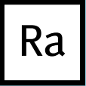
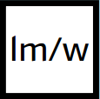
Lamp Characteristics
LED > 25.000 h
Fluo < 22.000 h
Halo < 2.000 h
LED [2700, 6000] K
Fluo [3200, 6000] K
Halo [2700] K
Halo 100
LED < 95
Fluo < 90
Average Lifetime of the lamp
Number of hours after which at least 50% of the lamps are fully functional
Colour Temperature (Kelvin)
Light appearence colour. Warm (yellow < 3200K), Neutral (white > 4000K), Cold (blue > 4500K)
Colour Rendering Index (CRI)
Indicates how good a specific lamp shows the different colours of the objects
Light output (lumen)
Indicates the quantity of light that is emitted by the lamp
Wattage (Watt)
Indicates how much the lamp consumes per hour
=
Lamp Efficacy
LED A+
Fluo A
Halo B
© Copyright CERTUS Project 2017 - All Rights Reserved

Slide 3
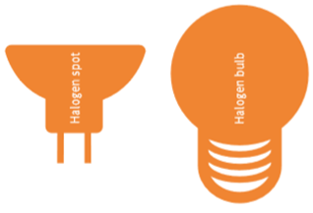
Lamp Technologies
Halogen
Halogen lamps are, basically, advanced incandescent lamps. Its technology is also based on a heated filament that emits light.
However, they contain a halogen gas inside under high pressure that will allow a higher temperature. Also, by reacting with the vapours of the filament, it will extend its durability, hence the lamp´s lifetime.
Even though its (massive) use is not recomended, there are several types of halogen lamps used in public buildings.
• Bulb | used in direct retrofit of incandescent lamps
• Spot | for high-voltage (GU10) and low-voltage (GU5.3) application
• Linear | typically used in uplighters. Normally has higher powers.
Some Specific Characteristics
Colour Temperature Only warm (“yellow colour”)
Colour Rendering Index Maximum (100)
Energy Efficiency At best can only be Class B
Halogen lamps are the least efficient lighting
technology available in the European market
© Copyright CERTUS Project 2017 - All Rights Reserved

Slide 4
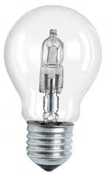
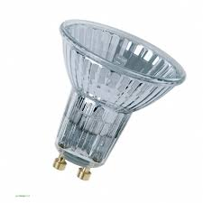
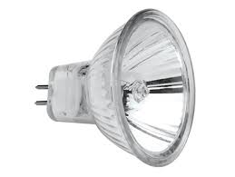
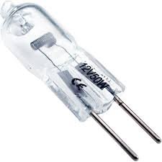
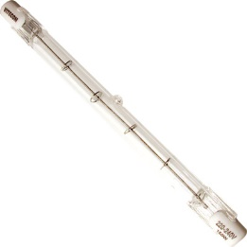
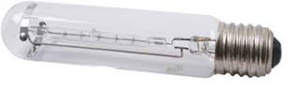
Lamp Technologies
Halogen
UPs | • Bright light. • Excellent colour rendering. • No warm-up time untill maximum flux is reached. • Dimmable lamps (from 0 to 100% of the lighting flux).
DOWNs | • Poor efficiency, hence high consumption (2 to 4 times higher than other technologies). • Small lifetime (normally between 2.000 to 3.000 hours). • High lamp surface temperature (it might burn at touch). • Despite its smaller initial price, it will cost a lot more to the end-user, when compared throughout other technologies’ lifetimes.
© Copyright CERTUS Project 2017 - All Rights Reserved

Slide 5
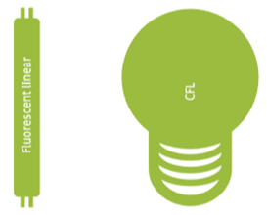
Lamp Technologies
Fluorescent
Two different families of fluorescent lamps can be defined: linear and compact.
Linear Fluorescent Lamps (LFL) have a tubular format and an external ballast (device used to control the lamp). Compact Fluorescents are not linear and can either have an external ballast and be pin-based; or they will have an integrated ballast and an Edison (E) socket. In this case they all called Compact Fluorecent Lamp (CFL), comonly refered as “energy saving lamp”.
All types emit light according the same principle. They all have mercury inside and a fluorescent layer, with several types of phosphorous, on the inner side of the envelope. When a voltage is applied, the mercury vapourizes and emits ultraviolet radiation that will become white light as soon as it goes through the fluorescent layer. The lamp´s colour temperature will depend on the layer’s composition.
© Copyright CERTUS Project 2017 - All Rights Reserved

Slide 6
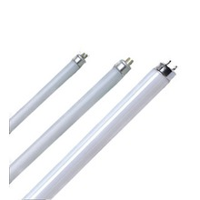
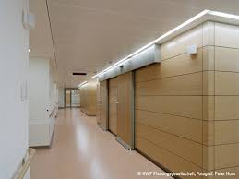
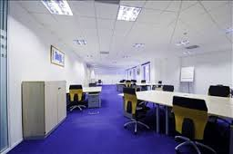
Lamp Technologies
Fluorescent
Linear Fluorescent Lamps are largely used in the service buildings. Given their indirect light distribution and high luminous flux, they are built in the ceilings, thus properly lighting a wide open area.
According to the tube´s diameter they can be:
• T5 | 16 mm (these are the most efficient ones)
• T8 | 26 mm
• T10 | 33,5 mm (least efficient of last three)
• T12 | 38 mm (was banned from the market due its innefficiency)
Some Specific Characteristics
Colour Temperature Mostly cold (“blue-white”)
Ballast Always external to the lamp
Light dispersion Very wide
Luminous Flux Normally high lumen values
© Copyright CERTUS Project 2017 - All Rights Reserved

Slide 7
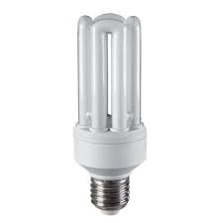
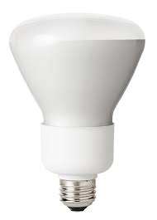
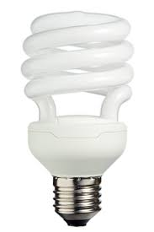
Lamp Technologies
Fluorescent
Compact Fluorescent Lamps (CFLs) are a great solution when the objective is to achieve high efficiency at low cost, with a low lumen output, thus being applied where modest levels of lighting are acceptable. The electronic ballast is already incorporated in the lamp, making it a quick retrofit solution.
Some Specific Characteristics
Colour Temperature Can go from yellow to blue
Ballast Integrated in the lamp
Socket E family (e.g. E14, E27)
Dimension Smaller lamps
There are four common shapes of CFLs:
• Bulb
• Stick
• Spiral
• Candle
There is also a CFL with a reflector (PAR type) so it can concentrate the light flux, thus having a less difuse light distribution. But nowadays, with LEDs, this type of lamp is becoming obsolete as it is less efficient.
Excellent inicial price/power consumption ratio
© Copyright CERTUS Project 2017 - All Rights Reserved

Slide 8
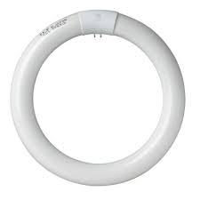
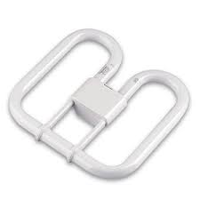
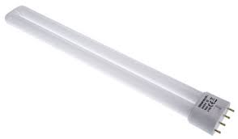
Lamp Technologies
Fluorescent
Other Fluorescent Lamps are mainly used in the service sector, especially in office buildings. But despite this, they are far less used than any other fluorescent lamps. These lamps are sold without the ballast in two separate pieces. This way, maintenance costs are reduced, since the ballast´s lifetime is up to five times higher than the lamp itself.
Some Specific Characteristics
Socket Pin based (normally 2 or 4)
Ballast Always external to the lamp
Retrofit Does not allow halogen lamps to replace it
This type of fluorescent lamp has the following shapes:
• Stick
• Circular | the T9 (29 mm) is the most common example
• Square
© Copyright CERTUS Project 2017 - All Rights Reserved

Slide 9
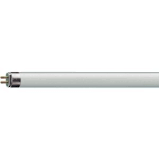
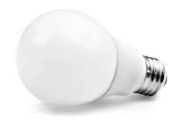
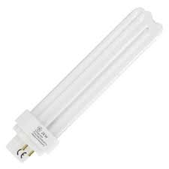
Lamp Technologies
Fluorescent
UPs | • Greater lifetime than halogen lamps. • Energy efficiency class A. • Economic lamp at a cheaper price than LEDs.
DOWNs | • Contains mercury. • Needs a warm-up time to get full brightness. • Does not start immediately. • Not the best colour rendering index (CRI). • Not the best technology for dimming purposes.
© Copyright CERTUS Project 2017 - All Rights Reserved

Slide 10
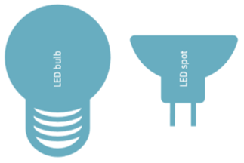
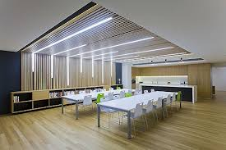
Lamp Technologies
LEDs
Some Specific Characteristics
Colour Can have any and can even change using controls
Colour Temperature All, from warm to cold
Light output Directional with several available beam angles
Dimming Possible, but must pay attention to its driver
Colour Rendering Index Can be higher than 90
A Light Emiting Diode (LED), also referred to as SSL (Solid State Lighting), is an electronic device (chip) that produces light when an electrical current is passed through it (diode). A diode is a semi-conductor that will, once excited, allow electrons to move thus emitting UV radiation, which, in turn, will become visible light passing through the LED coating. LEDs are undoubtedly the most efficient lighting technology on the market.
© Copyright CERTUS Project 2017 - All Rights Reserved

Slide 11
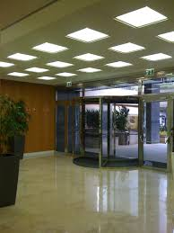
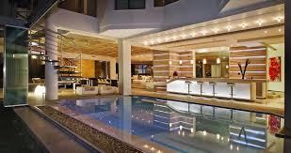
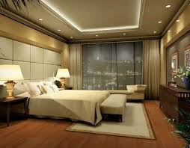
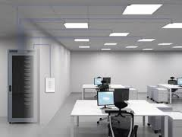
Lamp Technologies
Technologies | LEDs
Types of LED lamps:
• Bulb | For retrofit purposes of CFLs and halogen light bulbs
• Spot | where its directionality property is best applied
• Tube | for lighting wide open areas, replacing LFLs
• Strip | taking advantage of LED´s flexibility for aesthetic purposes
LEDs can also be integrated in luminaires. One particular design is the LED flat panel to be built in the ceiling.
© Copyright CERTUS Project 2017 - All Rights Reserved

Slide 12
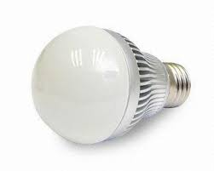
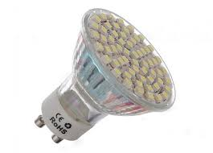
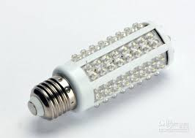
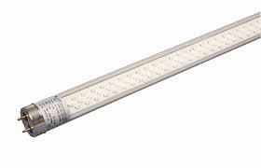
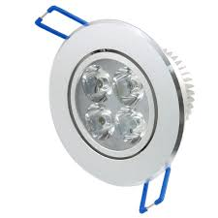
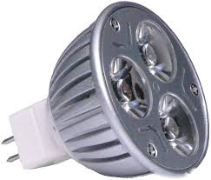
Lamp Technologies
LEDs
UPs | • Only technology that can, at least, have efficiency Class A+ • LEDs have, by far, the longest lifetime of all lighting technologies • Lowest cost of ownership. In the end it is cheaper than any other technology • Extremely flexible technology for aesthetic and controling purposes. • Low temperature when functioning avoids any possibility of burning at touch. • Regarding CFLs, LEDs withstand many more switching cycles and light up immediately.
DOWNs | • Its initial cost is somewhat higher than other technologies (but we see the prices getting lower and lower each year). • LEDs are temperature sensitive. Efficacy and lifetime is strongly reduced if lamps are overheated.
© Copyright CERTUS Project 2017 - All Rights Reserved

Slide 13
Lamp Technologies
Choosing a Lamp
A very good lamp should fulfil the following criteria.
© Copyright CERTUS Project 2017 - All Rights Reserved

Slide 14
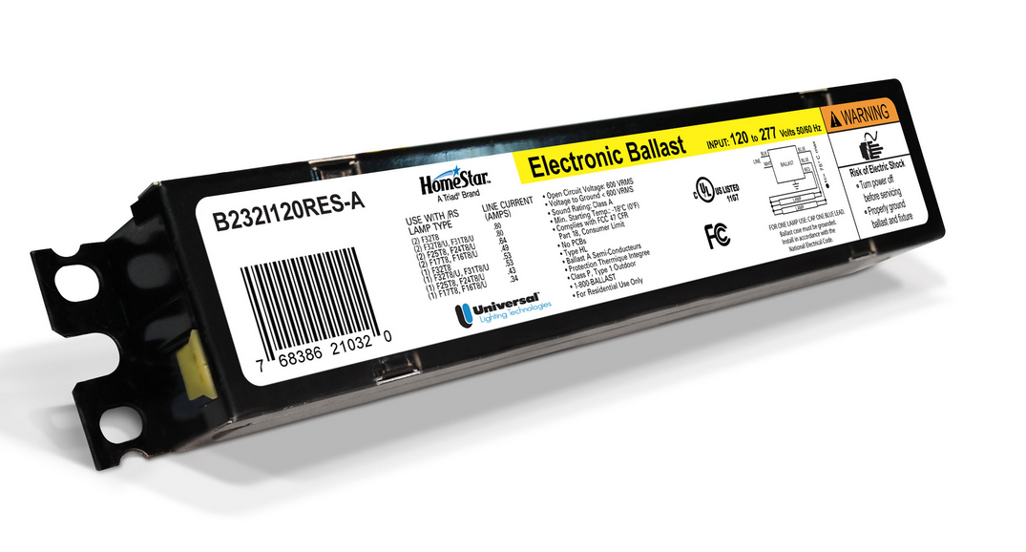
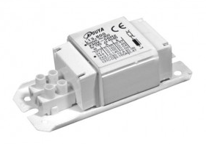
Control Systems
Ballasts
A ballast has two main functions. It starts the lamp and it controls lamp operation. Depending on their characteristics tey can also: transform the voltage, dimming the lamp and correct power factor.
All fluorescent lamps need a ballast to work.
© Copyright CERTUS Project 2017 - All Rights Reserved

Slide 15
Control Systems
Ballasts
There are two types of ballasts: magnetic and electronic. These can be compared by some important parameters, such as:
Ballast Factor (BF)
Indicates the ratio of the light
output between the operating
ballast and the reference one.
Ballast Efficacy Factor (BEF)
Compares the lighting system
according to the light output
and the input power (Pin).
Power Factor (PF)
Measures the effectiveness
of the operation converting
supply voltage (V) and current
(I) into power (P) for the lamp.
$$BF=\frac{∅_{lamp+operating ballast}}{∅_{lamp+reference ballast}}$$
$$BEF=\frac{BF}{P_{in}}×100$$
$$PF=\frac{P}{V.I}$$
It is not good having a very high (1,5) nor a very low (0,73) value
The higher the better
Ideal is to have 1
© Copyright CERTUS Project 2017 - All Rights Reserved

Slide 16
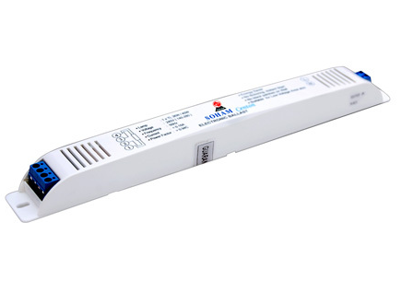
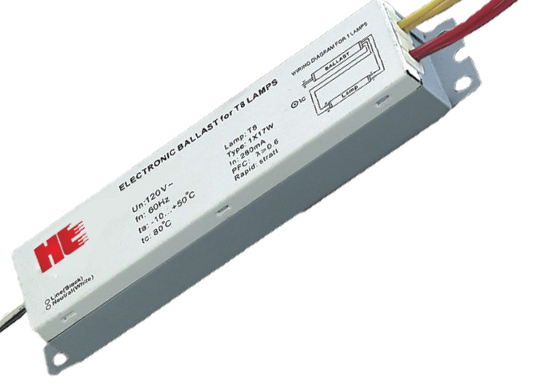
Control Systems
Ballasts
Ballasts Classes of Efficiency
Class A1 Dimmable electronic ballasts
Class A2 Electronic ballasts with reduced losses
Class A3 Electronic ballasts
Class B1 Magnetic ballasts with very low losses
Class B2 Magnetic ballasts with low losses
Electronic ballasts use solid-state technology to operate at much higher frequency (thousands of Hz) resulting in energy conservation through lower power loss and higher lamp efficacy for fluorescent lights. Additionally, these ballasts can also improve the power factor.
© Copyright CERTUS Project 2017 - All Rights Reserved

Slide 17
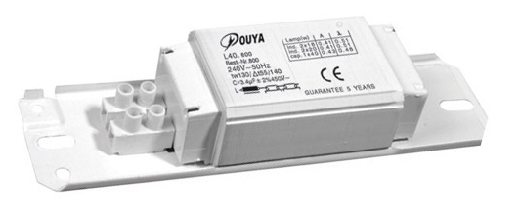
Control Systems
Control Systems | Ballasts
Ballasts Classes of Efficiency
Class A1 Dimmable electronic ballasts
Class A2 Electronic ballasts with reduced losses
Class A3 Electronic ballasts
Class B1 Magnetic ballasts with very low losses
Class B2 Magnetic ballasts with low losses
Magnetic ballasts are the older technology, with a core of steel plates wrapped in copper windings. Joule losses that occur on copper, and hysteresis losses in the nucleolus, reduce lamp input power between 5 and 25%. This value will depend on ballast dimension and construction. The most efficient magnetic ballasts are the low losses ones. These are also known as hybrid ballasts.
© Copyright CERTUS Project 2017 - All Rights Reserved

Slide 18
Control Systems
Ballasts
UPs | • The output of the lamps degrades more slowly • Lamp flicker is eliminated • Multiple lamp operation (1 to 4) • Longer lifetime | UPs | • The materials can easily be recycled • Small initial cost
Electronic Ballast |  | Magnetic Ballast
DOWNs | • They can originate harmonic distortion | DONWs | • Less energy efficient • Heavier than electric ballasts • Noisier than electric ballasts
© Copyright CERTUS Project 2017 - All Rights Reserved

Slide 19
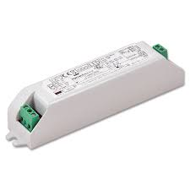
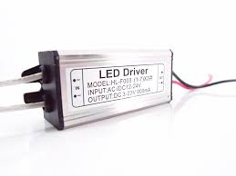
Control Systems
Drivers
LED drivers are low-voltage devices that convert the line-voltage power to the low-voltage needed for the LEDs. LED drivers come in either constant current or constant voltage depending on the LED load.
.
LED drivers bring additional benefits, such as operational flexibility, efficiency, reliability, controllability and intelligence to the system.
Electronic drivers are important components in most LED-based systems. Relatively small improvements on the driver efficiency often result in big improvements in the system’s efficiency.
The selection of the most appropriate topology to drive LEDs depends on the application requirements (e.g., operation environment conditions, system input voltage, number of LEDs, etc.), standards and specifications.
© Copyright CERTUS Project 2017 - All Rights Reserved

Slide 20
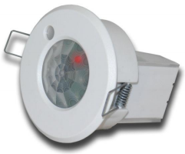
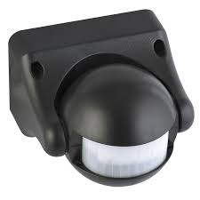
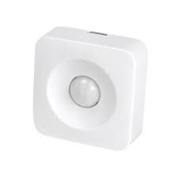
Control Systems
Sensors
Lighting sensors help to achieve a high quality energy efficient lighting system. When electric lighting controls (including sensors) are used properly, energy will be saved and the life of lamps and ballasts can be extended.
Lighting controls will help reduce energy by:
• Reducing the amount of power used during the peak demand period by automatically dimming lights or turning them off when not needed;
• Reducing the number of hours per year that the lights are on;
• Allowing occupants to use controls to lower light levels and save energy.
© Copyright CERTUS Project 2017 - All Rights Reserved

Slide 21
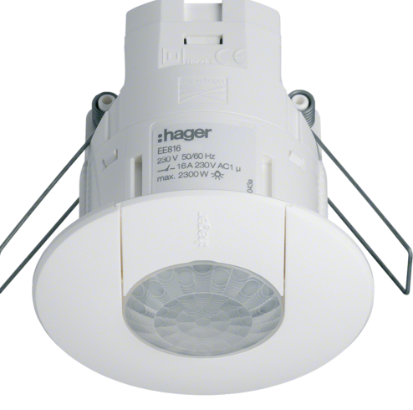
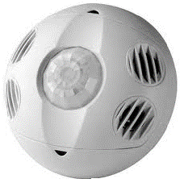
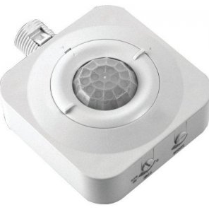
Control Systems
Sensors - Occupancy detectors
The ability of a lighting control system to match the lighting in use to the numbers of staff present is a very valuable input.
Examples:
© Copyright CERTUS Project 2017 - All Rights Reserved

Slide 22
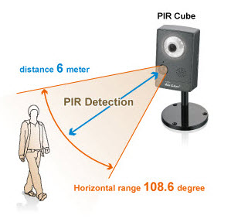
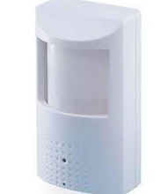
Control Systems
Sensors - Occupancy detectors
Often referred to as ‘presence ‘ or ‘occupancy’ detection the current sensors on the market rely on one of three methods of movement detection:
Passive Infra Red (PIR) - works based on heat movement detection. The device has a pyroelectric sensor calibrated to detect infrared radiation radiated by human body movement. Based on the detection, the sensor operates and turns on the lighting systems connected to it.
© Copyright CERTUS Project 2017 - All Rights Reserved

Slide 23
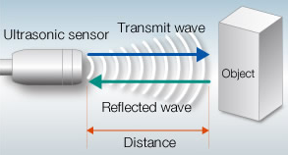
Control Systems
Sensors - Occupancy detectors
Sddfsd
Ultrasonic - similar to a radar. An ultrasonic sensor sends high frequency sound waves in one area and checks for their reflected patterns. If the reflected pattern is changing continuously then it assumes that there is occupancy and the lighting load connected is turned on. If the reflected pattern is the same for a preset time then the sensor assumes there is no occupancy and the load is switched off.
© Copyright CERTUS Project 2017 - All Rights Reserved

Slide 24
Control Systems
E
E
Microwave – Similar to the ultrasonic detector. A microwave sensor sends high frequency microwaves in an area and checks for their reflected patterns. If the reflected pattern is changing continuously then it assumes that there is occupancy. A microwave sensor has high sensitivity as well as detection range compared to other types of sensors.
Sensors - Occupancy detectors
© Copyright CERTUS Project 2017 - All Rights Reserved

Slide 25
Control Systems
Sensors – Daylight detectors
Daylight controls are photoelectric devices that turn off or dim the lights in response to the available natural illumination.
Smooth and continuous dimming is the preferred strategy for automated daylight controls.
© Copyright CERTUS Project 2017 - All Rights Reserved

Slide 26
Control Systems
Sensors – Time Control detectors
Time clocks are devices that can be programmed to turn the lights on or off at designated times.
These are a useful alternative to photoelectric sensors in applications with very predictable usage.
© Copyright CERTUS Project 2017 - All Rights Reserved

Slide 27
Control Systems
Sensors – Dimming Systems
Dimmers
Dimmers are devices used to lower the brightness of a light. By changing the voltage waveform applied to the lamp, it is possible to lower the intensity of the light output. Dimmers are used to control the light output from resistive incandescent, halogen, CFLs and LEDs.
In the professional lighting industry, changes in intensity are called “fades” and can be “fade up” or “fade down”. Dimmers with direct manual control had a limit on the speed they could be varied at but this issue has been largely eliminated with modern digital units (although very fast changes in brightness may still be avoided for other reasons like lamp life).
Modern dimmers are built from semiconductors instead of variable resistors, because they have higher efficiency. A variable resistor would dissipate power as heat and acts as a voltage divider. Since semiconductor or solid-state dimmers switch between a low resistance "on" state and a high resistance "off" state, they dissipate very little power compared with the controlled load.
© Copyright CERTUS Project 2017 - All Rights Reserved

Slide 28
Control Systems
Sensors – Dimming Systems
Examples:
© Copyright CERTUS Project 2017 - All Rights Reserved

Slide 29
Control Systems
Sensors
Light sensors reduce energy consumption by reducing artificial light when there is adequate and suitable natural light, especially when no one is spotted to be in the area.
The following graphic shows the potential savings that different light sensors controls, working together, can achieve in a service building.
© Copyright CERTUS Project 2017 - All Rights Reserved

Slide 30
Luminaires
A luminaire is a complete electric light fixture, including the lamp(s), mechanism for inserting or holding the lamp(s), wiring, socket, control systems (e.g. ballast) and reflector(s) to diffuse the light.
The function of a luminaire is to direct light to desired locations, creating the required visual environment without causing glare or discomfort. Choosing luminaires that efficiently provide appropriate luminance patterns for the application is an important part of energy efficient lighting design.
© Copyright CERTUS Project 2017 - All Rights Reserved

Slide 31
Luminaires
There are many types of luminaires, opaque or translucent to include in a service building, and they can vary a lot concerning the type of light source they have.
Some examples are:
© Copyright CERTUS Project 2017 - All Rights Reserved

Slide 32
Luminaires
Efficacy factors
Luminaire efficiency is provided by all reputable manufacturers in their technical descriptions and is referred to as the Light Output Ratio (LOR) of the luminaire.
LOR is the ratio of the light output of a luminaire to the total light output of the individual lamp it contains. Choose the luminaire with the greatest light output.
$$LOR=\frac{∅_{out of the luminaire}}{∅_{bare naked lamp}}$$
© Copyright CERTUS Project 2017 - All Rights Reserved

Slide 33
Luminaires
Efficacy factors
Luminaire efficacy factor (LEF), also known as luminaire efficacy ratio, measures the lumen output of a fixture as a function of input power, enabling comparisons between fixtures. The higher the LEF, the more efficient the luminaire.
$$LEF=\frac{LOR×∅_{lamp}×BF}{P_{in}}$$
© Copyright CERTUS Project 2017 - All Rights Reserved

Slide 34
Luminaires
Luminaires are often sold with incorporated or accompanying lamps.
The buyer must be informed about compatibility of the luminaire with the efficiency of the lamps that can be used in the luminaire.
It is important to highlight that the label for luminaires does not refer to the efficiency of the luminaire.
Also, the following criteria should be considered for procurement:
• high luminaire operating efficiency level (> 80%)
• optimal lamp reflector
• highest direct ratio possible
© Copyright CERTUS Project 2017 - All Rights Reserved

Slide 35
Luminaires
Labelling
Labelling legend:
Supplier´s name
Supplier’s model identifier
Range of energy-efficiency classes of compatible lamps
Sentence reporting the type of lamp it contains (if any)
© Copyright CERTUS Project 2017 - All Rights Reserved

Slide 36
Training Materials
WP5: Capacity Building in Municipalities
Technologies – Lighting Systems
© Copyright CERTUS Project 2015 - All Rights Reserved Grant agreement no.: 620906

