Slide 1
Training Materials
WP5: Capacity Building in Municipalities
Technologies – Other Control Solutions
© Copyright CERTUS Project 2015 - All Rights Reserved Grant agreement no.: 620906

Slide 2
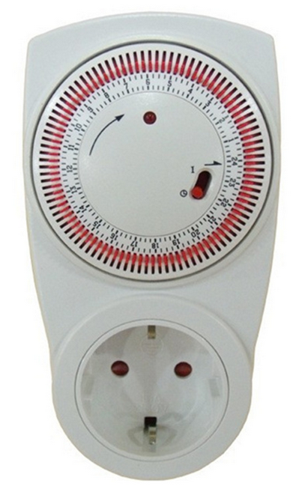
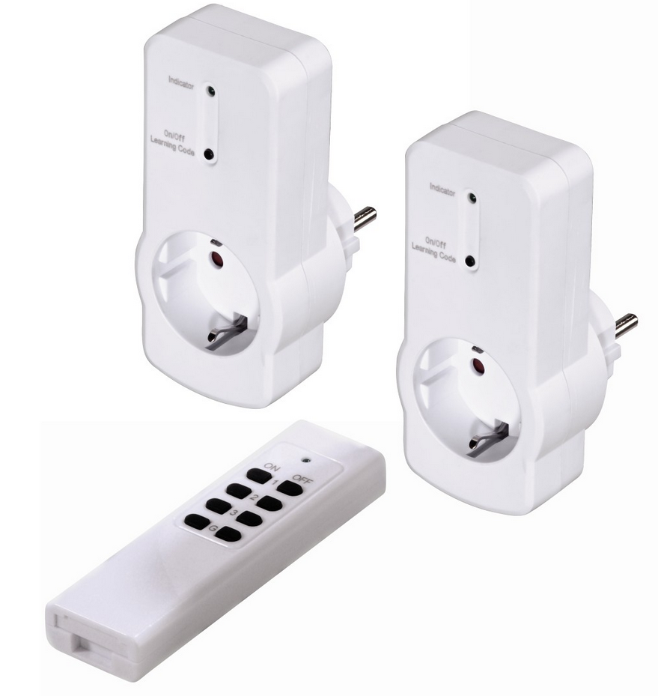
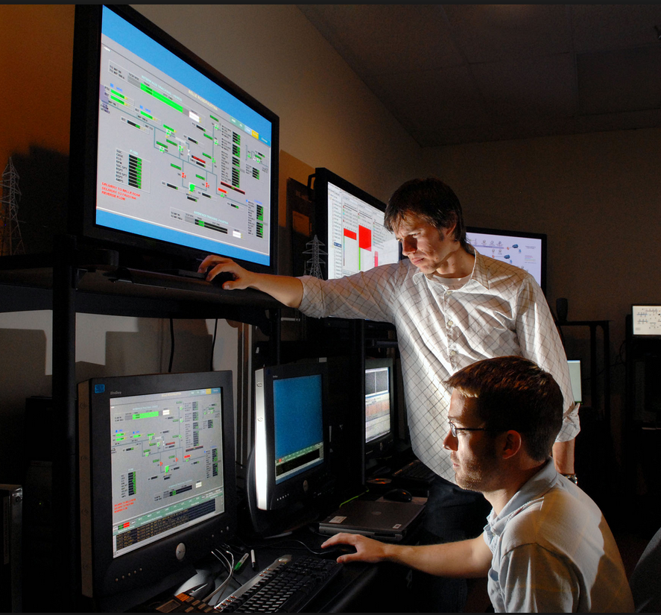
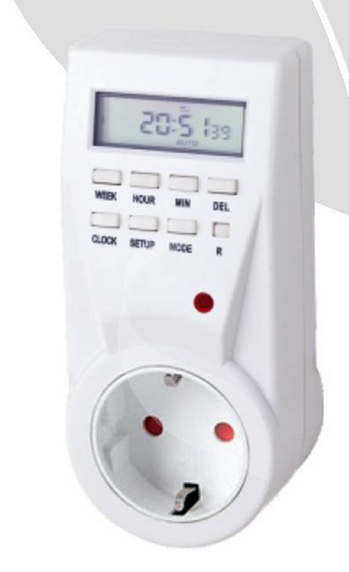
Other Control Solutions
© Copyright CERTUS Project 2017 - All Rights Reserved

Slide 3
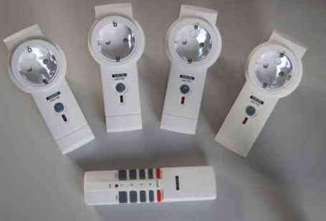
Other Control Solutions
Appliances
Remote Controlled Sockets
Most appliances are not designed to be left on standby mode and others do not need to be in standby. Therefore remote controlled sockets are a good solution to reduce your energy bill and avoid potential fire hazards.
Remote control plugs have a full 30m range and high radio frequency for out of sight appliances. Perfect for plug sockets situated in hard to reach and awkward places, reducing energy wastage.
© Copyright CERTUS Project 2017 - All Rights Reserved

Slide 4
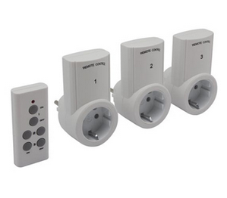
Other Control Solutions
Appliances
Remote Controlled Sockets
In office buildings leaving appliances such as LCD screens and other ICT equipment on standby mode over night can represent more than 10% of the energy bill, but with devices such as remote control plugs it is possible to make sure that everything is switched off properly and without any effort.
Additionally, not all appliances are designed to be left on at night and there are potential fire hazards.
© Copyright CERTUS Project 2017 - All Rights Reserved

Slide 5
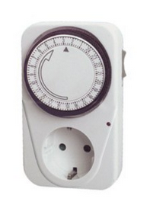
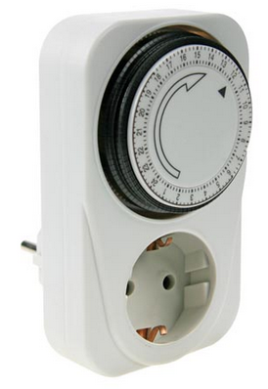
Other Control Solutions
Appliances
Sockets with Timer
The timer may switch equipment on, off, or both, at a preset time or times, after a preset interval, or cyclically. A countdown time switch switches power, usually off, after a preset time.
A cyclical timer switches equipment both on and off at preset times over a period, then repeats the cycle; the period is usually 24 hours or 7 days.
For example, a central heating timer may supply heat for a specified period during the morning and evening every weekday, and all day on weekends
© Copyright CERTUS Project 2017 - All Rights Reserved

Slide 6
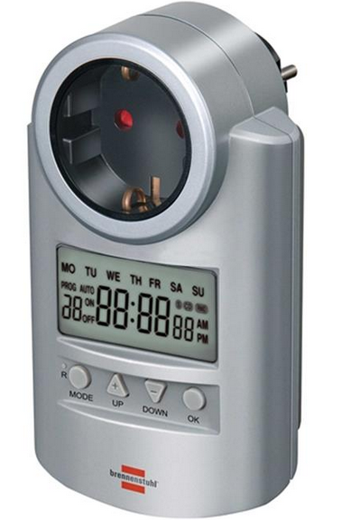
Other Control Solutions
Appliances
Sockets with Timer
Example:
Weekly Digital Programmer
It allows you to program the connection of electrical appliances
Recording of data in case of electrical failure.
It simulates presence thanks to random function
Ability to program up to 20 cycles with one minute duration
LCD screen
12/24 hour mode
Summer/Winter mode
© Copyright CERTUS Project 2017 - All Rights Reserved

Slide 7
Other Control Solutions
Global Monitoring and Control Systems
© Copyright CERTUS Project 2017 - All Rights Reserved

Slide 8
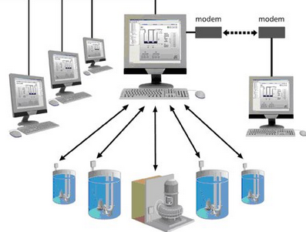
Other Control Solutions
Global Monitoring and Control Systems
Remote monitoring and control (M&C) systems are designed to control large or complex facilities such as factories, power plants, network operations centers, airports, and spacecraft, with some degree of automation.
M&C systems may receive data from sensors, telemetry streams, user inputs, and pre-programmed procedures.
The software may send telecommands to actuators, computer systems, or other devices.
© Copyright CERTUS Project 2017 - All Rights Reserved

Slide 9
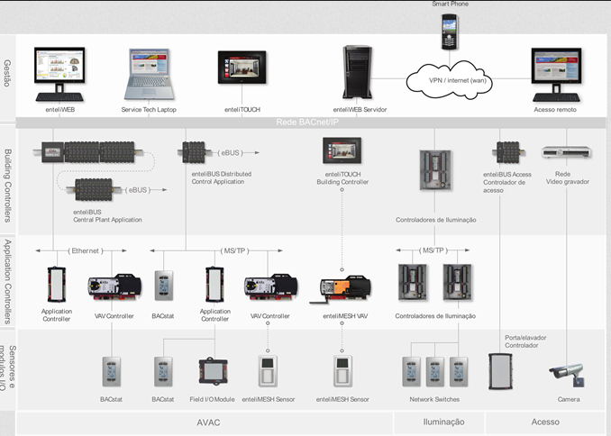
Other Control Solutions
Global Monitoring and Control Systems
Once limited to SCADA (Supervisory Control and Data Acquisition) in industrial settings, remote monitoring and control is now applied in numerous fields, including:
Smart grids
Positive train control
Structural health monitoring
Pipeline sensors
Patient monitoring
Desktop/server monitoring
© Copyright CERTUS Project 2017 - All Rights Reserved

Slide 10
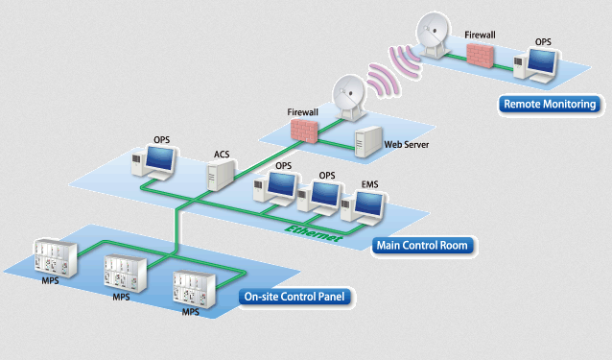
Other Control Solutions
Global Monitoring and Control Systems
Considering building automation, monitoring and control systems are used for:
Ventilation, heating and cooling
A properly designed monitoring and control system should be capable of maintaining preset environmental conditions in the building.
Feeding
Boilers feeding control system requires some way of knowing when to turn feeders on and off. Feed monitoring systems are available to measure the amount of feed consumed by broilers.
© Copyright CERTUS Project 2017 - All Rights Reserved

Slide 11
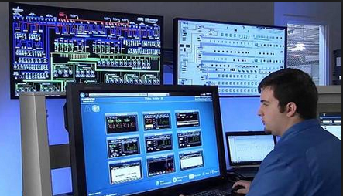
Other Control Solutions
Global Monitoring and Control Systems
Lighting
A monitoring and control system should provide scheduling of lights that is easy to use. A system than can pre-program lighting schedules over the life of the flock is very useful for management. It is also important to provide the desired intensity of light.
© Copyright CERTUS Project 2017 - All Rights Reserved

Slide 12
Other Control Solutions
Global Monitoring and Control Systems
SCADA (Supervisory Control and Data Acquisition)
Is a type of industrial control system (ICS). Industrial control systems are computer controlled systems that monitor and control industrial processes that exist in the physical world. SCADA systems historically distinguish themselves from other ICS systems by being large scale processes that can include multiple sites, and large distances. These processes include industrial, infrastructure, and facility-based processes.
Application:
Industrial processes include those of manufacturing, production, power generation, fabrication, and refining, and may run in continuous, batch, repetitive, or discrete modes. Infrastructure processes may be public or private, and include water treatment and distribution, wastewater collection and treatment, oil and gas pipelines, electrical power transmission and distribution, wind farms, civil defense siren systems, and large communication systems.
© Copyright CERTUS Project 2017 - All Rights Reserved

Slide 13
Other Control Solutions
Global Monitoring and Control Systems
Common SCADA system components:
A human–machine interface or HMI: is the apparatus or device which presents processed data to a human operator, and through this, the human operator monitors and controls the process.
A supervisory (computer) system: gather (acquire) data on the process and sending commands (control) to the process.
Remote terminal units (RTUs): connect to sensors in the process, convert sensor signals to digital data and send digital data to the supervisory system.
Programmable logic controller (PLCs): used as field devices because they are more economical, versatile, flexible, and configurable than special-purpose RTUs.
Communication infrastructure: connect the supervisory system to the remote terminal units.
© Copyright CERTUS Project 2017 - All Rights Reserved

Slide 14
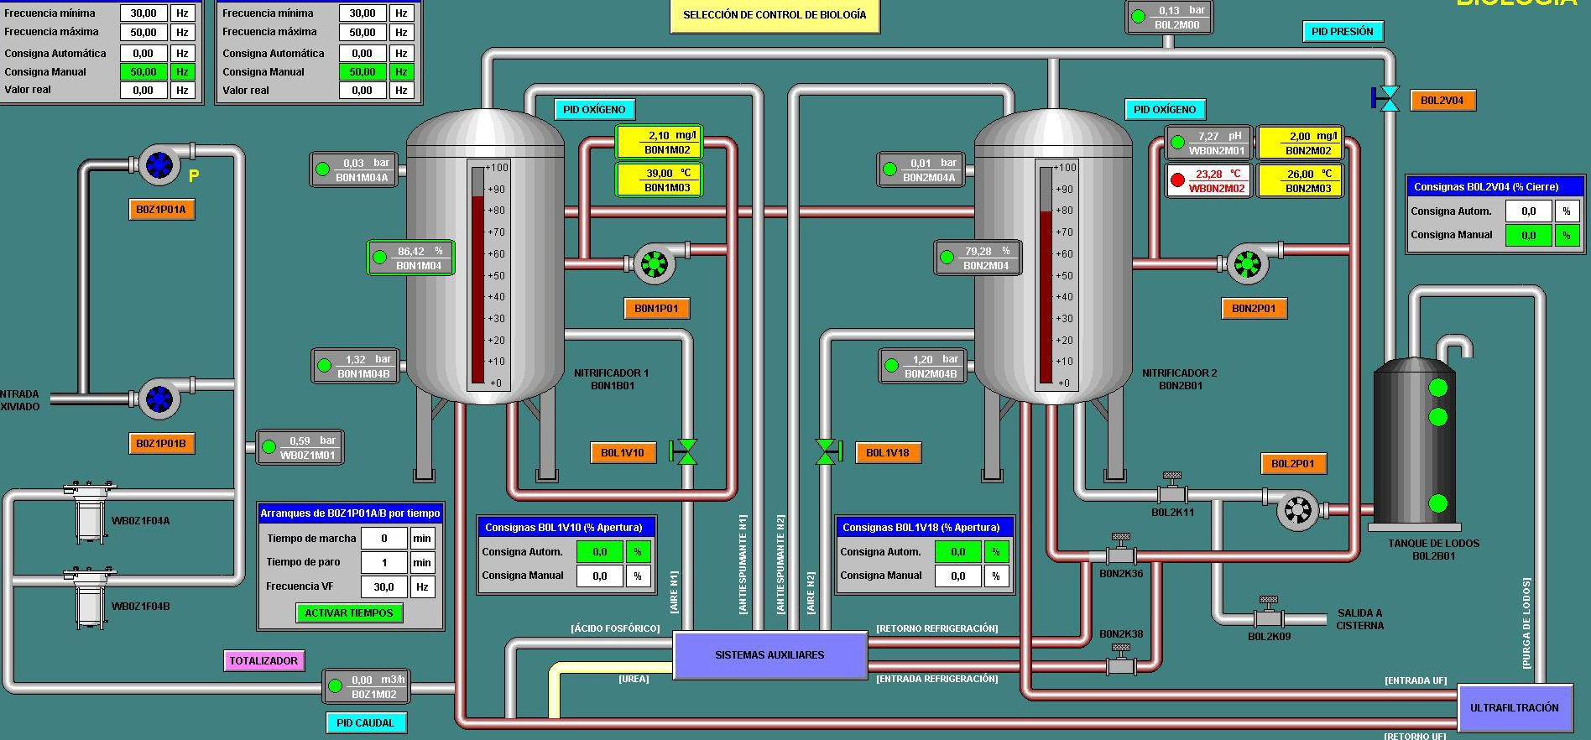
Other Control Solutions
Global Monitoring and Control Systems
Example: SCADA system – Interface console
© Copyright CERTUS Project 2017 - All Rights Reserved

Slide 15
Other Control Solutions
Global Monitoring and Control Systems
There are also ”small” monitoring and control systems for small buildings. There a large variety of products in the market, the next examples can be found in the Portuguese market but also in other countries.
EDP re:dy
Monitors the energy consumption in households, identifies the main equipments consuming energy and estimates total energy consumed and the energy bill value.
Can also switch on/off several appliances in the building.
Additional features have been introduced in this equipments such as solar energy production control and electric vehicle consumption analysis.
© Copyright CERTUS Project 2017 - All Rights Reserved

Slide 16
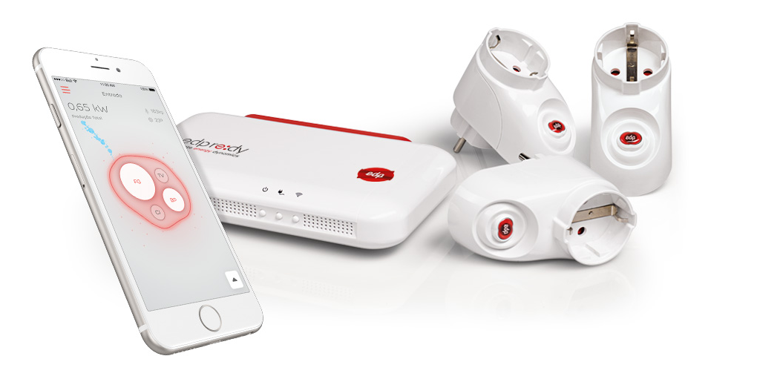
Other Control Solutions
Global Monitoring and Control Systems
EDP re:dy kit
© Copyright CERTUS Project 2017 - All Rights Reserved

Slide 17
Other Control Solutions
Global Monitoring and Control Systems
2. Cloogy
Monitors both electric and gas consumption. Cloogy is a user-friendly solution that helps consumers save energy in their homes. Customers that supply their own home with a gas tank can now take advantage of a solution that allows them to simultaneously optimize the consumption of the tank and the energy consumption throughout the house.
It is possible to connect the heating system to a Cloogy Plug. Then in the Cloogy website, it is possible to set the functioning time period for the heating according to your daily routines. It is possible to remotely monitor the consumption and switch the heating system on and off in real time.
© Copyright CERTUS Project 2017 - All Rights Reserved

Slide 18
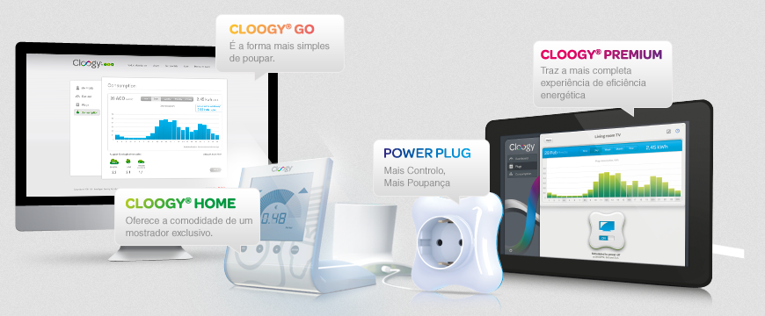
Other Control Solutions
Global Monitoring and Control Systems
It is possible to set a monthly goal for the energy costs and confirm if the electricity consumption is within the goal.
© Copyright CERTUS Project 2017 - All Rights Reserved

Slide 19
Other Control Solutions
Global Monitoring and Control Systems
3. TED Pro Home
The TED Pro Home Energy Monitoring System uses your home’s existing powerlines to monitor energy usage in real-time. It can actually tackle up to 32 individual circuits, as well as individual rooms. That way, you can keep tabs on devices that are energy hogs and unplug them accordingly.
The TED Pro electricity monitor uses measuring devices that clamp onto the main conductors inside your breaker panel. The devices then send measured data over your home’s powerlines. No extra wiring is needed!
The data is collected in a receiving unit, which you can plug into any outlet around the house. Inside, the receiving unit has the company’s Footprints software, which can store and track up to 10 years of energy data. Homeowners can keep tabs on that information via any web-enabled device (e.g. smartphone, tablet, etc.). It is possible to receive customized alerts via text or email messages.
© Copyright CERTUS Project 2017 - All Rights Reserved

Slide 20
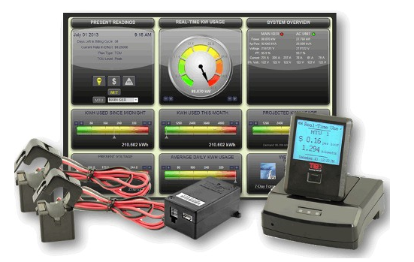
Other Control Solutions
Global Monitoring and Control Systems
© Copyright CERTUS Project 2017 - All Rights Reserved

Slide 21
Other Control Solutions
Global Monitoring and Control Systems
4. Elgato Eve
The Elgato Eve energy monitoring system uses Bluetooth and a variety of different sensors to deliver info on your home’s air quality, temperature, humidity, air pressure, water consumption and more. All of that data can be viewed in the free Eve iOS app.
The Elgato Eve can be operated via Apple’s Siri voice control system. The sensors include Eve Room, Weather, Water, Door & Window, Smoke and Energy. The entire system boasts an easy setup, thanks to the app.
Other app features include info on outdoor temperature, humidity and air pressure, as well as the option to switch devices on or off remotely with one tap.
© Copyright CERTUS Project 2017 - All Rights Reserved

Slide 22
Other Control Solutions
Global Monitoring and Control Systems
© Copyright CERTUS Project 2017 - All Rights Reserved

Slide 23
Training Materials
WP5: Capacity Building in Municipalities
Technologies – Other Control Solutions
© Copyright CERTUS Project 2015 - All Rights Reserved Grant agreement no.: 620906

