Slide 1
Training Materials
WP5: Capacity Building in Municipalities
Technologies – ICT
© Copyright CERTUS Project 2015 - All Rights Reserved Grant agreement no.: 620906

Slide 2
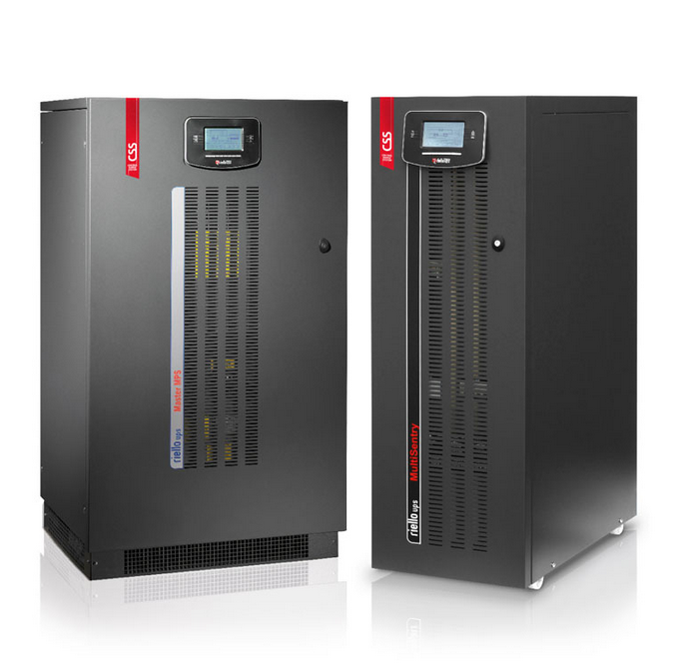
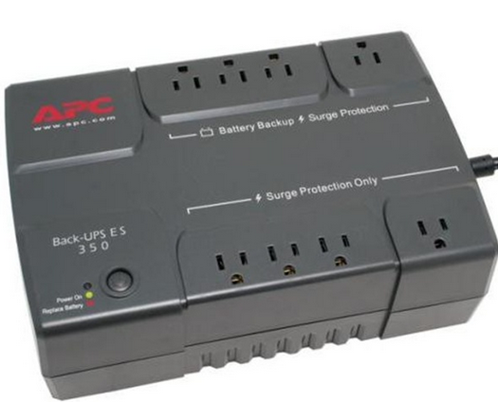
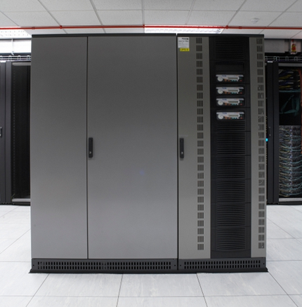
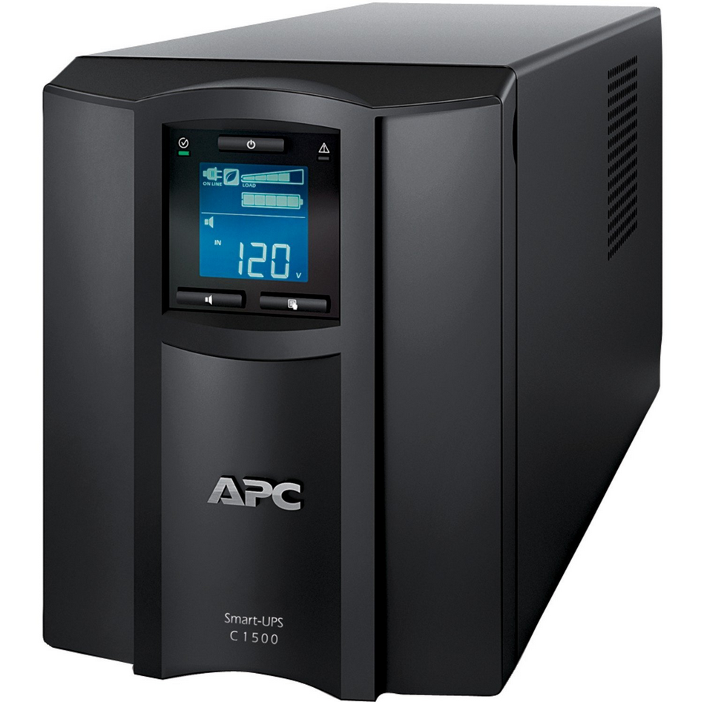
Information and Communications Technology
Uninterruptible power supplies (UPS)
© Copyright CERTUS Project 2017 - All Rights Reserved

Slide 3
Information and Communications Technology
Uninterruptible power supplies (UPS)
“A UPS is a combination of electronic power converters, switches and energy storage devices (such as batteries) constituting a power system for maintaining the continuity of power to a load in the case of input power failure.”
UPS’s are key components of information and communications technologies (ICT) systems, ensuring reliability by maintaining the continuity and quality of the systems power supply. The energy consumption of UPS should be an important consideration due to its high impact on the lifecycle costs, but in most applications of UPS, energy efficiency is not the most important issue, since the operational reliability of the ICT systems and the related security of data processing and storage are the major concerns.
© Copyright CERTUS Project 2017 - All Rights Reserved

Slide 4
Information and Communications Technology
Uninterruptible power supplies (UPS)
Applications:
Data Centers
Whether it is data for healthcare services, banking, insurance companies, data is vital to business. IT down times are problem or can put lives at risk. So UPS systems are essential to allow permanent access to data when power is out.
Healthcare: Hospitals, clinics and retirement homes
In a healthcare setting, reliable power is a matter of life and death. To deliver quality care, you need to be sure that your life-saving machinery will operate properly, without power interruptions.
© Copyright CERTUS Project 2017 - All Rights Reserved

Slide 5
Information and Communications Technology
Uninterruptible power supplies (UPS)
Banks and Insurance
Cut off from the work and customers, IT systems down, Loss of vital data, are all incidents that could lead to potential loss of revenue in a business.
Telecommunications
Guaranteeing 24/7 power for even the toughest, most remote telecommunications sites is essential. Any disruption to the power supply could entail lost revenue and customer dissatisfaction.
Industry
No matter what your facility produces, a stop in production means lost productivity and heavy losses. Not only that, interruptions in the power supply can be harmful to your equipment and dangerous for your employees but also dangerous for the economic stability of companies.
© Copyright CERTUS Project 2017 - All Rights Reserved

Slide 6
Information and Communications Technology
Uninterruptible power supplies (UPS)
Operation:
In the case of a primary AC grid failure, the UPS may run in isolated mode and is not grid-connected on the
supply side.
In standby (when it is not replacing primary grid power), a UPS could operate in on-mode or offmode, as an AC or DC operated device depending on the specific design.
UPS can also be used as transient and Surge suppressors to protect hardware (e.g. computers, data centers, telecommunication equipment or other electrical equipment) where an unexpected power disruption could cause injuries, fatalities, serious business disruption or data loss.
© Copyright CERTUS Project 2017 - All Rights Reserved

Slide 7
Information and Communications Technology
Uninterruptible power supplies (UPS)
Operation (Cont.)
© Copyright CERTUS Project 2017 - All Rights Reserved

Slide 8
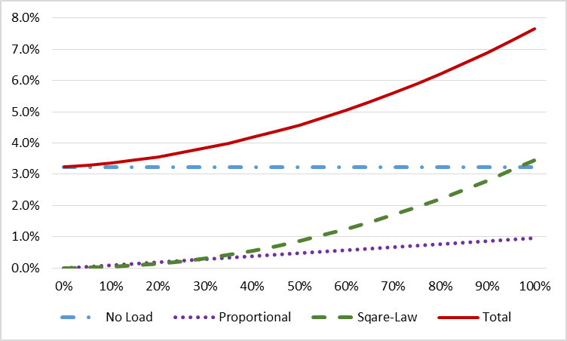
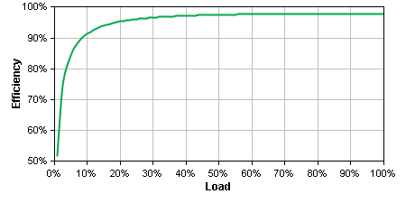
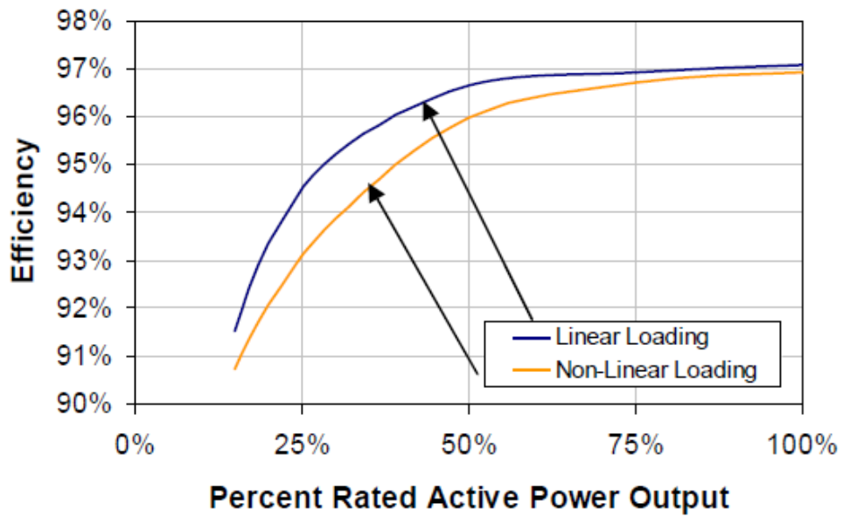
Information and Communications Technology
Uninterruptible power supplies (UPS)
Efficiency of UPS
© Copyright CERTUS Project 2017 - All Rights Reserved

Slide 9
Information and Communications Technology
Uninterruptible power supplies (UPS)
UPS Topology | STRENGTHS | WEAKNESSES
On –Line (Double Conversion) Ultimate Power Protection | Output voltage and frequency regulation. UPS Inverter rated for continuous operation Long runtime battery extension options Automatic bypass for faults and overloads Parallel operation and expansion options | Higher Purchase Price Lower potential efficiency
Line Interactive Intermediate Power Protection | Output Voltage Stabilisation Spike and electrical noise filtering Lower Cost Highest potential Efficiency | More sensitive to mains disturbances Inverter transfer time could compromise load. Waveform suitability
Off-Line (Standby) Basic Power Protection | Spike and electrical noise filtering | No voltage stabilisation Inverter transfer time could compromise load Limited power ratings Waveform Suitability
© Copyright CERTUS Project 2017 - All Rights Reserved

Slide 10
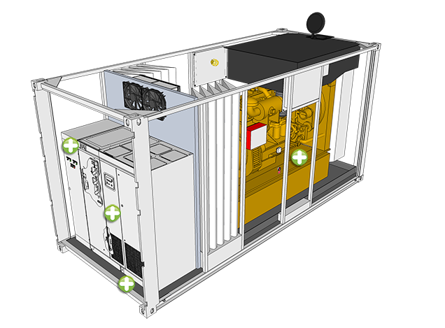
Information and Communications Technology
Uninterruptible power supplies (UPS)
Other UPS Examples:
© Copyright CERTUS Project 2017 - All Rights Reserved

Slide 11
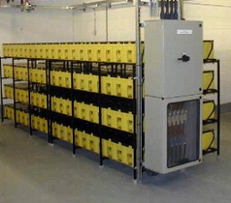
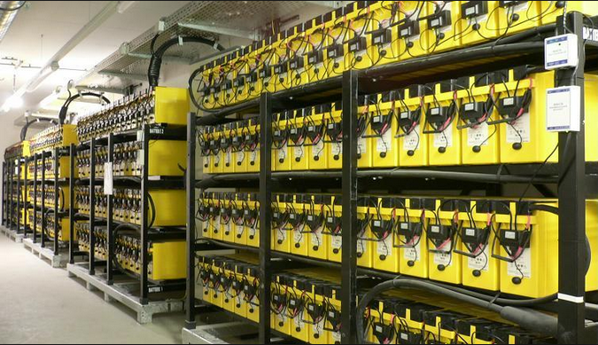
Information and Communications Technology
Uninterruptible power supplies (UPS)
Other UPS Examples (cont.):
© Copyright CERTUS Project 2017 - All Rights Reserved

Slide 12
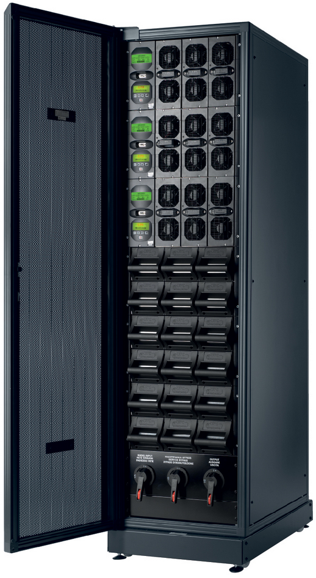
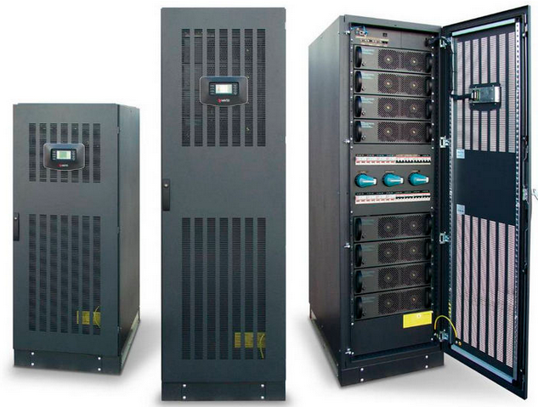
Information and Communications Technology
Uninterruptible power supplies (UPS)
Other UPS Examples (cont.):
© Copyright CERTUS Project 2017 - All Rights Reserved

Slide 13
Training Materials
WP5: Capacity Building in Municipalities
Technologies – ICT
© Copyright CERTUS Project 2015 - All Rights Reserved Grant agreement no.: 620906

