Slide 1
WP5 CAPACITY BUILDING IN MUNICIPALITIES Energy efficiency on the building envelope HANDOUT 1_ 1.7 - part 1
CERtuS project
Cost Efficient Options and Financing Mechanisms for nearly Zero Energy Renovation
of Existing Building Stock
IEE /13/906/SI2.675068

Slide 2
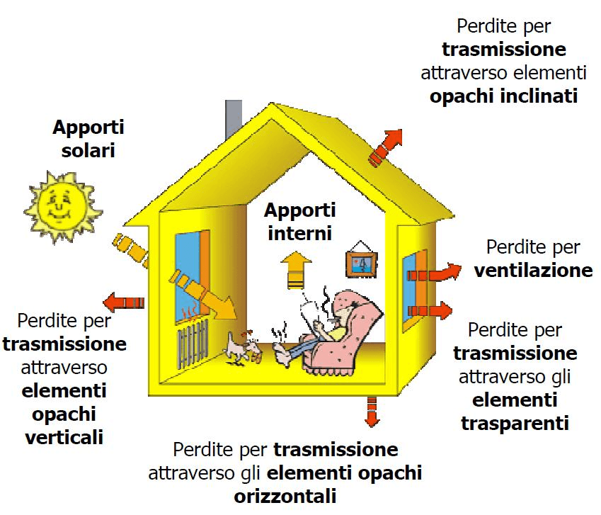
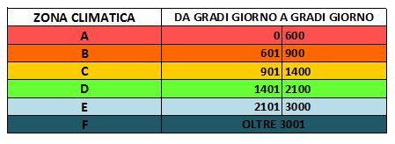
What is a building envelope
A building envelope is the physical separator between the contolled and uncontrolled environment of a building. It includes the resistance to air, water, heat, light, and noise. In other words, it is everything that separates and protects indoors from outdoors, which may include exterior walls and siding, roofing, foundations, windows and doors. These buiding parts are exposed and need proper maintenance, materials, and construction to continue to perform effectively. As these systems age it is normal to have problems such as roof leaks, air infiltration, deterioration and cracked siding.
HEAT GAINS AND HEAT LOSSES THROUGH THE BUILDING ENVELOPE (BOTH OPAQUE AND GLAZED SURFACES)
THE ENVELOPE CHARACTERISTICS DEPENDS ON THE CLIMATIC ZONE
Picture: www.888 software
www.posaqualificata.it
Notes:
NOTE

Slide 3
A building envelope investigation
A building envelope investigation can be as simple as a visual inspection of the exterior of a building (or specific builging parts such as the roof or coating). When visual inspections reveal symptoms of a bigger problem a comprehensive building envelope inspection may involve one or more of the following steps:
A visual and sampling inspection of the exteriors of the building.
An infrared scanning and other NDE-inspections (if needed) of the exteriors of the building to identify further potential problem areas.
Targeted invasive investigation in areas of the building envelope based on the findings from the infrared scan , other methods like knock-tests and visual inspection. "Invasive" typically means the removal (and replacement) of portions of siding and/or roofing to identify the extent of the damage underneath.
A detailed report explaining the current condition of the building envelope and evenctual recommendations for repair if applicable.

Slide 4
A building envelope investigation
The use of in situ tests for the evaluation of buildings’ energy performance.
The thermal-hygrometric characteristics of a building (trasmitance and thermal inertia) become of a growing field of interest and are based on simple calculation under static regime. One of the starting points in this evaluation is the installation of heat flux sensors on the building walls. The measurement of heat flux in walls is comparable to that in soil in many respects. Two major differences however are the fact that the thermal properties of a wall generally do not change (provided its moisture content does not change) and that it is not always possible to insert the heat flux sensor in the wall, so that it has to be mounted on its inner or outer surface. When the heat flux sensor has to be installed on the surface of the wall, one has to take care that the added thermal resistance is not too large. Also the spectral properties should be matching those of the wall as closely as possible. If the sensor is exposed to solar radiation, this is especially important. In this case one should consider painting the sensor in the same color as the wall. The sampling time must be long enough, because of the mass of the wall.
.
Immagine: www.coverd.it
Notes:
NOTE

Slide 5
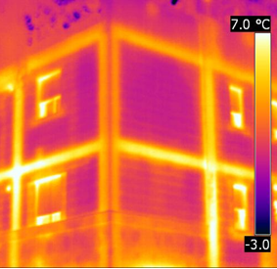
A building envelope investigation
The use of in situ tests for the evaluation of buildings’ energy performance. –
The use of thermal infrared (IR)
Thermography is a valuable tool for:
inspecting and performing non-destructive testing of building elements,
detecting where and how energy is leaking from a building’s envelope,
collecting data for clarifying the operating conditions of hard to reach heating, ventilating and air-conditioning (HVAC) installations,
identifying problems with the electrical and mechanical installations under full-load operating conditions.
IR inspections involve the detection of IR electromagnetic radiation emitted by the inspected object.
The collected information can be used as part of other investigative procedures to identify potential problems, quantify potential energy savings, schedule interventions and set priorities for preventive and predictive maintenance or the need for immediate service to minimise the risk of failure.
Picture:www.ristrutturazioneenergetica.it

Slide 6
A building envelope investigation
The use of in situ tests for the evaluation of buildings’ energy performance. –
The use of thermal infrared (IR)
One of the most important tests is the building thermography. It is based on thermal radiation whose intensity is proportional to the surface temperature of the target. The thermal bridges and heat losses can be detected by thermography but, again, there must be a large enough temperature difference between outdoors and indoors when thermography can be used (>10°C). Also the outdoor weather conditions must be stable enough before performing the thermography, especially sun radiation and heavy wind will cause limitations for outdoor thermography otherwise they may cause problems to carry out the measures. Building thermography is controlled by ISO- and EN-standards where the suitable conditions are set
Thermography is normally carried out both inside the building and outside of the building. The operator must be qualified because the method itself – especially now when the prices of devices have gone down – seems to be deceptively simple but actually the scanning and the interpretation requires high expertise. Indoor (and also outdoor) thermography can be carried out by two stages: in normal operational conditions and in pressurized (outdoor) / depressurized
Following, some investigations concerned the north and the east side of the building Monte dei Pegni, located in the historic center of the City of Vittorio Veneto (TR), Italy. The building was an apartment building, but it has been planned to change to residential and offices use. The building had natural ventilation system and water circulation based radiator heating, partially fan coils. The measurements showed that the exterior wall structures varied a lot also in case of the same buildings. Subsurface constructions, covered openings, thermal bridges, uneven structures etc. were found. Some of these findings have been taken account into renovation design

Slide 7
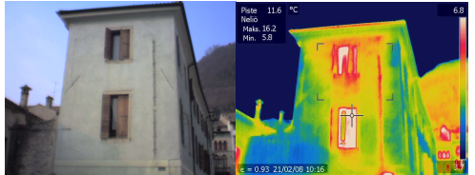
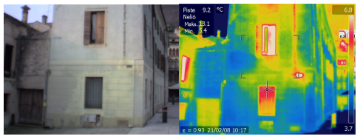
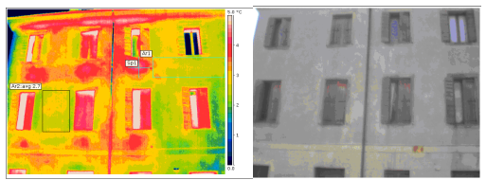
A building envelope investigation
The use of in situ tests for the evaluation of buildings’ energy performance. –
The use of thermal infrared (IR)
Thermal image applied to detect discontinuities beneath the surface, using an inclusive range among 3,7° and 6,8° for the thermographs staircase. It is possible to see a different superficial temperature of materials for that heated places internally. Every combination of masonry structure type to be investigated needs e specific IR calibration.
Moisture distribution and moisture growth detected by thermal scanning.
The upper part facade in the morning, before the sun. The radiators and also the intermediate floors, walls both pipelines are visible

Slide 8
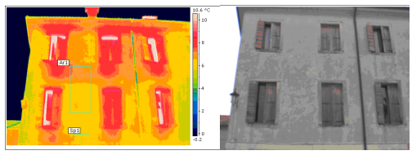
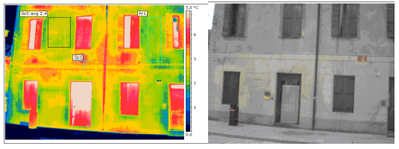
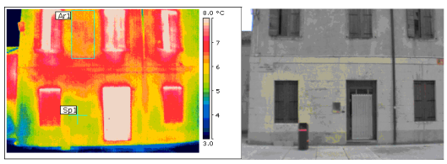
A building envelope investigation
The use of in situ tests for the evaluation of buildings’ energy performance. –
The use of thermal infrared (IR)
The same previous facade during sun radiation. The external heat source removes the structural details.
Lower part of the facade in the morning. An earlier door place can be seen between the window and the door.
Lower part of the facade during sun radiation. The earlier opening in the wall cannot be seen.

Slide 9
A building envelope investigation
The use of in situ tests for the evaluation of buildings’ energy performance. –
OTHER TOOLS
There are available other tools to measure the performance of building envelope – a method is to use heat flux meters, by which is possible to determine the U-value of a wall, supported by thermography. The method gives an approximately value and it has restrictions too.
The thermal scanning must be done before the sun begins to effect on the surfaces. The measurements can be repeated during the heating up period and then during cooling down period – during heating and cooling delamination structures and different structural elements can be seen, depending on the differences of thermal capacities. Using dynamic thermography in changing conditions it is possible to detect delamination phenomena and in some case also moisture distribution in the structures.

Slide 10
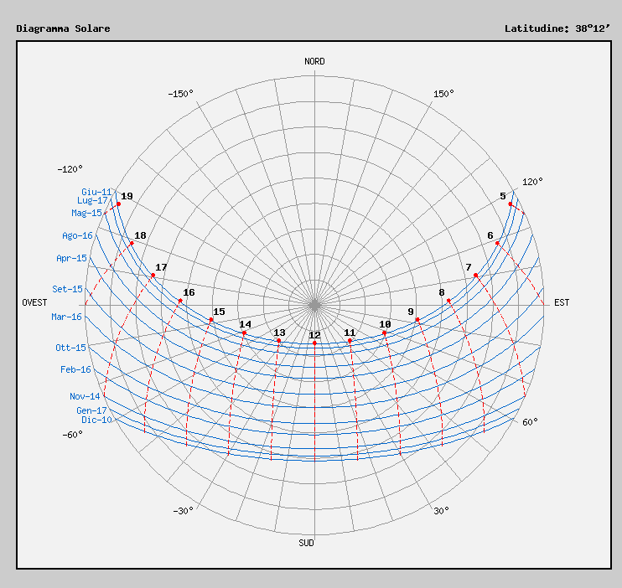
Survey and Analysis of climate Data
Sun Path Diagrams
Proper building envelope design and refurbishment requires careful investigation on how the sun will impact the site and building throughout the year. Stereographic sun path diagrams are used to read the solar azimuth and altitude throughout the day and year for a given position on the earth. They can be likened to a photograph of the sky, taken looking straight up towards the zenith, with a 180° fish-eye lens. The paths of the sun at different times of the year can then be projected onto this flattened hemisphere for any location on Earth.
The climate data are often available on line, as: http://www.solaritaly.enea.it
Notes:
NOTE

Slide 11
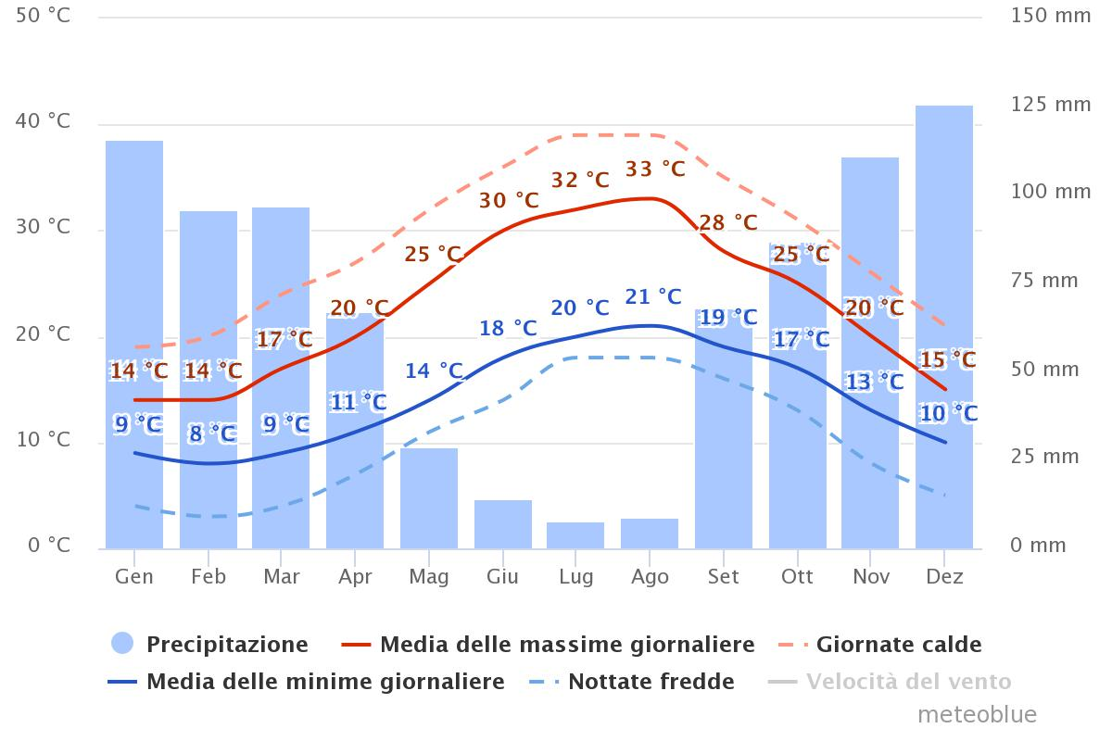
Survey and Analysis of climate Data
The knowledge of microclimate and local temperatures allows to make design decisions. Below are presented two charts that relate to not homogeneous climatically areas: it is obvious the importance that the envelope have for the in the indoor air quality and comfort.
City of Messina
Messina:
Zona climatica B
Alt. 3 m s.l.m.m.
Impianti termici 8 ore/g
Dal 1/12 al 31/3
The information represents the synthesis of the last 30 years of available data and are obtained from the site: www.meteoblue.com
Notes:
NOTE

Slide 12
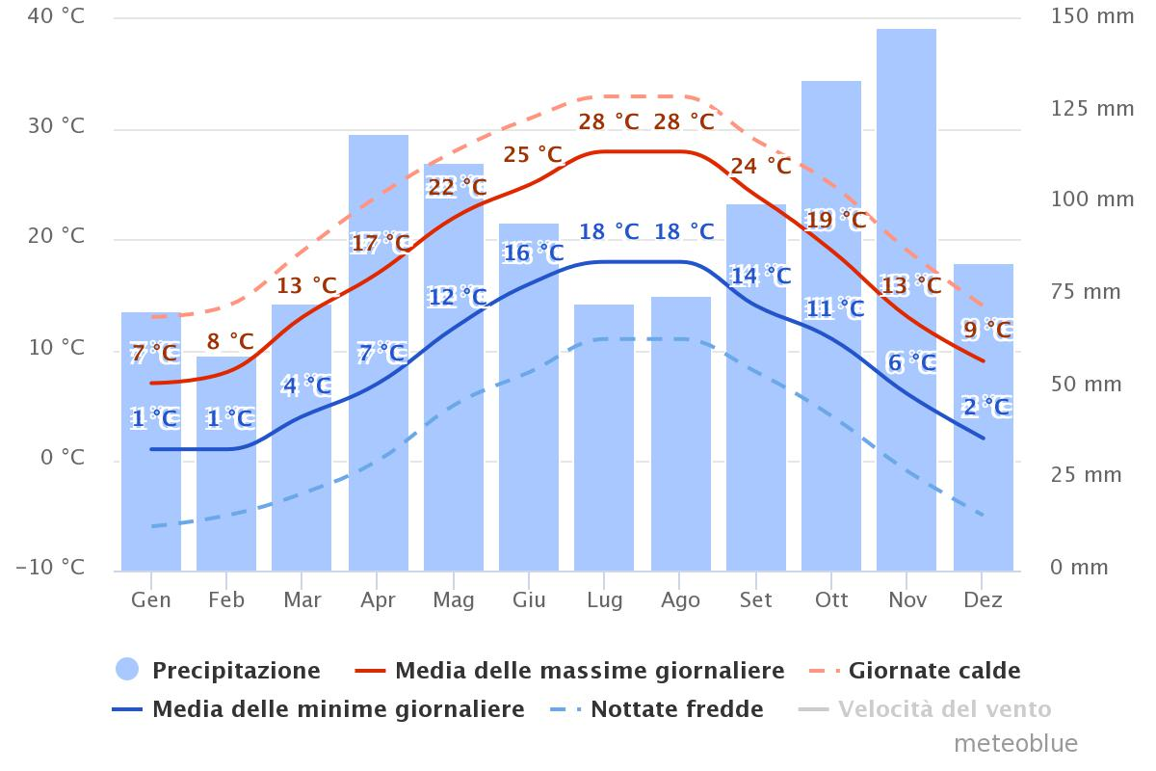
Survey and Analysis of climate Data
Following two cities are compared:
the first Messina in Sicily, of climate zone B,
the second Brescia in the Lombardy region, of climate zone E.
Omitting the precipitation, (which do not affect at this stage), can be observed relevant data such as those relating to minimum and maximum average temperatures.
In fact, in winter the maintenance of 20 °C, as the reference temperature for the IAQ and comfort, in the example of Brescia imposes a particular importance in the envelope performance, which results in the reduction of the annual energy costs, issue that for the city of Mesina relates to the summer period, when it is necessary to cool the indoor environments.
Città di Brescia
Brescia:
Zona climatica E
Alt. 149 m s.l.m.m.
Impianti termici 14 ore/g
Dal 15/10 al 15/4
Notes:
NOTE

Slide 13
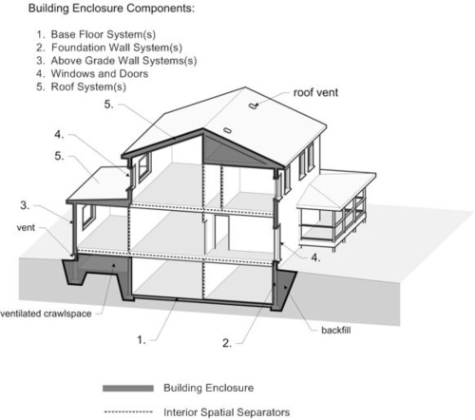
building envelope components
Schermature solari
Strutture orizzontali
Infissi
Coperture
Pareti
http://buildingscience.com.678elmp02.blackmesh.com/sites/default/files/migrate/jpg/BSD018_Figure_01.jpg
Immagine tratta dal sito
www.arredamento.it
Notes:
NOTE

Slide 14
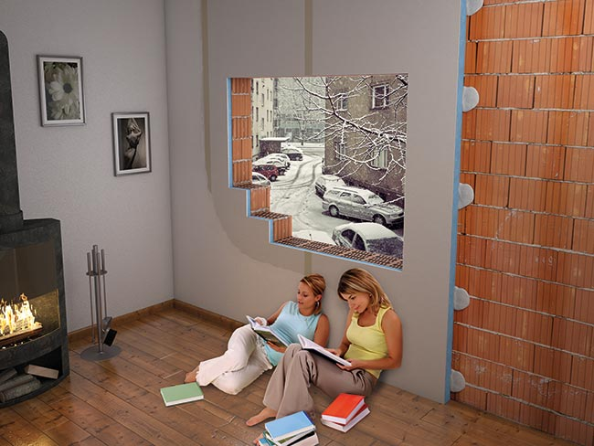
Building Envelope – external walls - Italian drivers
The Italian art. 2 c. of the legislative degree 90/2013, amending the art. 2 of the legislative degree 192/2005 requires the achievement of thermal performance in order to ensure the reduction of energy consumption.
There are available in the market different materials for the insulation of the building envelope, although the optimization of thermal performance can be provided through the thermal mass.
In the case of building renovation is required an accurate diagnosis in addition to climatic factors, and to originally define the use of the building..
For example:
the thermal insulation of buildings used occasionally, (such as gyms, conference rooms, exhibitions etc) provides the use of an insulating material on the inner side of the external tamping to avoid thermal losses in the wall mass which then would be poured later in hours of low use of the building areas. This solution reduces the thermal inertia of the environments, but favors a quick heating and cooling.➔ INTERNAL INSULATION
Picture: www.rifarecasa.com
Notes:
NOTE

Slide 15
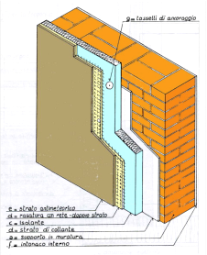
Building Envelope – external walls
B. In climates where it is necessary the air-conditioning (heating and cooling) in a continuous manner (i.e. climate zones E), and the operating cycle of the plant occupies many hours of the day (i.e. 14 h/daily in the case of Brescia), it is convenient to employ the insulating coating on the external side of the wall. This solution allows to ensure thermal inertia to the building, so that, even in the hours of non-ignition of the plants, the walls can transfer heat to the indoor environment, thereby reducing the ∆t and thus the energy consumption. This solution is also useful for homes without air-conditioning and located in ventilated areas, during the summer period, as is allowing an appreciable thermal lag. The insulated walls, do not suffer in excessive way the solar radiation ➔ EXTERNAL INSULATION
Notes:
NOTE

Slide 16
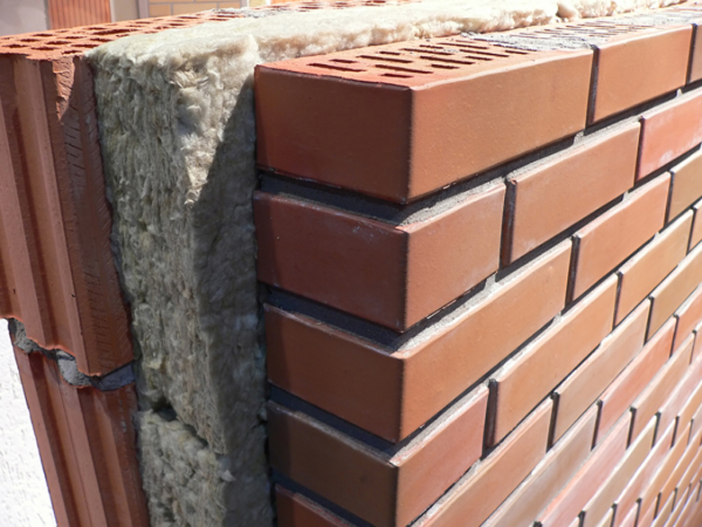
Building Envelope – external walls
C. When the constructions are built with external walls made of two layers with a cavity between them it is possible to isolate from inside of the cavity. It is a compromise solution, which however tends to meet different needs and is more advantageous in the installation.
Cavity wall insulation helps to prevent convection and can keep an indoor environment warm by making sure that less heat is lost through walls; this can also thus be a more cost-efficient way of heating one's house.➔ AIR CAVITY WALL INSULATION
Notes:
NOTE

Slide 17
Building Envelope – external walls
ADDITIONAL EXTERNAL WALL INSULATION 1/3
The pros and cons of external walls insulation:
Additional external wall insulation is the most commonly used energy-related renovation measure dealing with solid external wall. In many European countries, installation of external additional insulation is productized and often supported by the financial system. Replacement of windows belongs to the same concept. The costs of external additional insulation, including scaffolding and other auxiliary works must be compared with energy savings; in some cases, the pay-back time may be relatively long.
External additional insulation covers also thermal bridges of wall structures. The air-tightness of the envelope will increase, and the heat losses caused by infiltration will decrease. External insulation will thicken the wall structure, so the roofing must be able to operate properly, and there must be space enough for eaves. If the structures of external wall are flat, the installation can be carried out relatively easily. There are various technologies and solutions for installation. Generally the insulation layer and external board is coated by plaster, and the color of the plaster influences on the performance of the wall. According to the current practices, light colors absorb less heat and avoid micro-cracks which shorten the life of the wall.
Notes:
NOTE

Slide 18
Building Envelope – external walls
ADDITIONAL EXTERNAL WALL INSULATION 2/3
The pros and cons of external walls insulation:
Additional external insulation cannot be installed, if the building and it`s facades have remarkable historical value or if the building is listed, which means that the ‘aesthetical case’ of a building may not be changed. Depending on the original structures and the height of the building, some strengthening for insulation solutions may be used. Furthermore, depending on the national legislation, if the building is facing public pavement or road, the increase of the wall thickness on the exterior can be considered as an encroachment on public space.
By using additional insulation, it is possible to reduce also the effects of thermal bridges due to the improvement of the air-tightness and achieve energy savings. The common practice is to halve the U-value but it is possible to reach lower U-values, too. The costs of external additional insulation, including scaffolding and other auxiliary works can be compared with energy savings; the pay-back time may be relatively long in some cases. In addition to the improvement of energy efficiency the additional insulation decreases risk for structural damages. In some cases, the repair of structural damages may be the most important reason for carrying out these measures.
In an energy renovation project a systematic and comprehensive approach should be adopted even though the renovation works will take place in several stages.
Notes:
NOTE

Slide 19
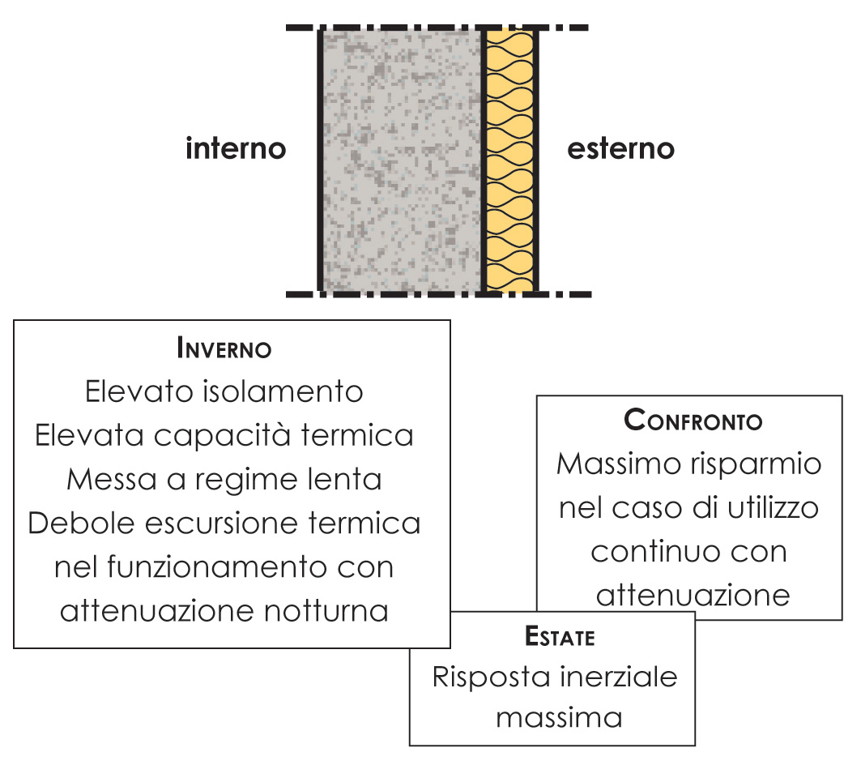
Building Envelope – external walls
ADDITIONAL EXTERNAL WALL INSULATION 3/3
The pros and cons of external walls insulation:
indoor
outdoor
WINDER
High isolation
High thermal capacity
Slow operating speed
Weal thermal excursion during operation with night setback
COMPARISON
Maximum savings in case of continuous use with night setback
SUMMER
Maximum inertial response
S. FANOU, 2009, verso la sostenibilità degli edifici e delle città
Notes:
NOTE

Slide 20
Building Envelope – external walls
INTERNAL INSULATION 1/1
The pros and cons of internal insulation:
Internal additional insulation is also used relatively often, depending on the building type. The biggest difference compared with external insulation is that, the insulation layer has not continuity. It means that e.g. the junction of an outer wall and the floor (or the ceiling) forms a thermal bridge. If the heat flow through walls decrease, the heat losses through this junction relatively will increase, which may cause problems (draft, condensation etc.) especially if there are air leak routes.
The room size will be decreased if one outer wall is insulated. This reduction of floor area is not so significant but the occupant or user can experience it as such. Also the installations of heating system, like radiators and pipelines may cause a problem for insulation. The appearance reasons especially in historical buildings can preclude the use of internal insulation. Internal insulation is a cheaper solution compared with external insulation, so pay-back time could be shorter. The downsides are discontinuity, remaining of thermal bridges and uncertainty of possible air leak routes, if sealing works have not been done in the same connection. To optimize the thermal performance of the building envelope all the structural elements of outer walls that affect the performance must be taken into account. When internal insulation is installed, the temperatures of outer parts of the wall will decrease. This may cause some moisture problems in cold season because of slower drying. In case of external additional insulation, the wall temperatures will increase compared with the previous situation.
Notes:
NOTE

Slide 21
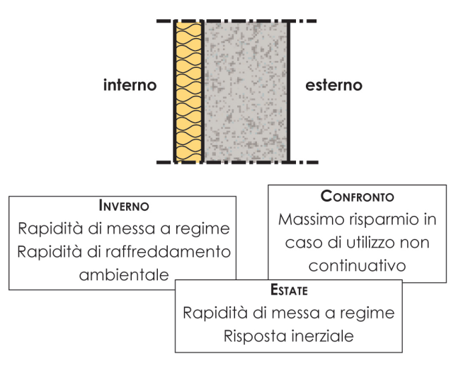
Building Envelope – external walls
INTERNAL INSULATION 1/1
The pros and cons of internal insulation:
indoor
outdoor
WINDER
Rapid operating speed
Rapid cooling of the indoor environment
COMPARISON
Maximum savings in case of non continuous use
SUMMER
Good inertial response
Thermal flow
Thermal flow
Steady state
Dynamic state
S: FANOU, 2009, verso la sostenibilità degli edifici e delle città
Notes:
NOTE

Slide 22
Building Envelope – external walls
AIR CAVITY WALL INSULATION 1/1
The pros and cons of air cavity insulation:
The external walls may have also air gap, which are acting as ventilation space for the structures. In the case of renovation, the air gaps have often been filled using insulation materials. his technique improves the performance of the wall, and its size remains the same. No changes in the appearance of the building. here is also a possibility that due to the decreased air exchange – depending on the structures – and the decreased outer wall temperatures can cause moisture problems can occur. The filling of air gap must be analysed very carefully case by case case (it also includes a risk).
Thermal flow
Thermal flow
indoor
outdoor
Steady state
Dynamic state
S: FANOU, 2009, verso la sostenibilità degli edifici e delle città
Notes:
NOTE

Slide 23
Building Envelope – external walls
INSULATION 1/1
The pros and cons of external walls insulation:
PROS:
MINIMISING DISCONTINUITY OF INSULATION MEANS REDUCTION OF THERMAL BRIDGES, BETTER U-VALUE, BETTER AIRTIGHTNESS, NO CONDENSATION ON THE WALLS, MORE EVEN TEMPERATURE IN NDOOR ENVIRONMENT
INCREMENT THE WALL’S ABILITY TO WITHSTAND THE VARIOUS CONSTITUENT ELEMENTS, IMPROVEMENT OF THE EXTERNAL ASPECT OF THE BUILDING
PREVENTION OF THE DAMP DAMAGES, REDUCTION OF NOISE, AND NO IMPACT TO THE BUILDING USERS.
CONS:
OUTLOOK OF FAÇADE MAY CHANGE, INSTALLATION PROBLEMS MAY OCCUR, ESPECIALLY IN TALL BUILDINGS, THICKNESS INCREASE, OFTEN NOT ALLOWED IN LISTED BUILDINGS.
The pros and cons of internal insulation:
PROS:
RELATIVELY EASY TO INSTALL IN MOST CASES, NO IMPACT ON THE EXTERNAL APPEARANCE OF THE BUILDING
NO ADDED SCAFFOLDING EXPENSES ASSOCIATED WITH INTERNAL INSULATION APPLICATION.
PAYBACK TIME SHORTER IF COMPARED WITH EXTERNAL INSULATION.
CONS:
FLOOR AREA WILL BE REDUCED
THERMAL BRIDGES MAY REMAIN, (RISK OF COLD BRIDGING AT THE WALL-FLOOR JUNCTION IF THE INSULATION BETWEEN THE FLOOR UNLESS IF THE INSULATION IS NOT RUNNING UNINTERRUPTED DOWN THE WALLS).
The pros and cons of air cavity insulation:
PROS:
NO CHANGES IN WALL SIZE
CONS:
MASS TRANSFER PROPERTIES CHANGES,DUE TO NARROW GAPS AND INSULATION LAYERS
Notes:
NOTE

Slide 24
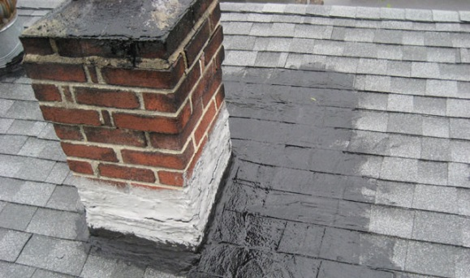
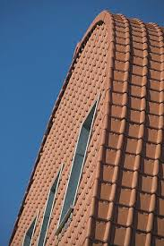
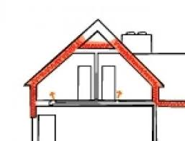
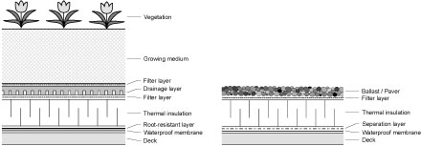
Building Envelope –
ROOFINIG TYPES & INSULATION 1/1
.
Notes:
NOTE

Slide 25
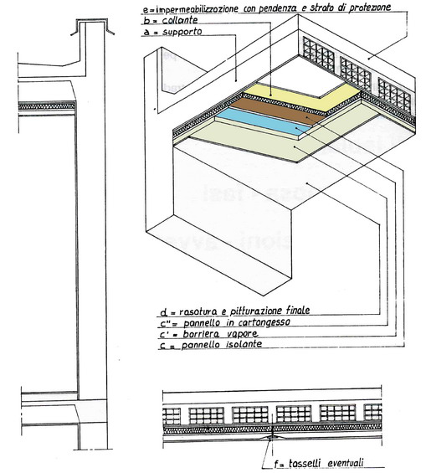
Building Envelope –
FLAT ROOFING INSULATION 1/1
Internal flat roofing insulation
The technique consists in the insulation of the slab from the internal and is especially useful in those cases where it is impossible to perform the insulation on the extrados of the slab.
The technique involves the installation of insulating panels, generally already finished and only to be painted, to paste on the intrados of the slab. In other cases it uses a package made from insulating component and gypsum coated with aluminum. The thickness of the panels depends of the thermal losses of the roof, but in any case it is not less than 2 cm.
Notes:
NOTE

Slide 26
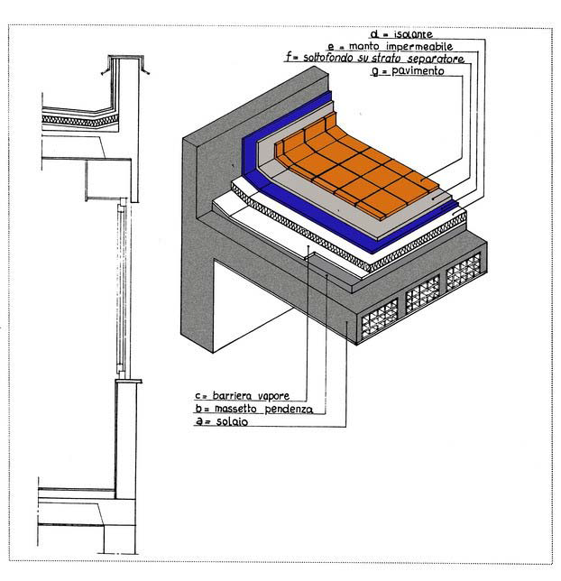
Building Envelope –
FLAT ROOFING INSULATION 1/1
External lat roofing insulation
The external insulation of a flat roof allows to intervene, very effectively, in those roofs which for reasons of age or for technical shortcomings are no more able to ensure the thermal comfort.
The technique involves the application above the existing structure (slab, floor screed to create the needed gradient, waterproof membrane with vapor barrier function), a new insulating layer, of a new waterproof covering and finally, the protection of the liner, according the intended use the roof will have.
Notes:
NOTE

Slide 27
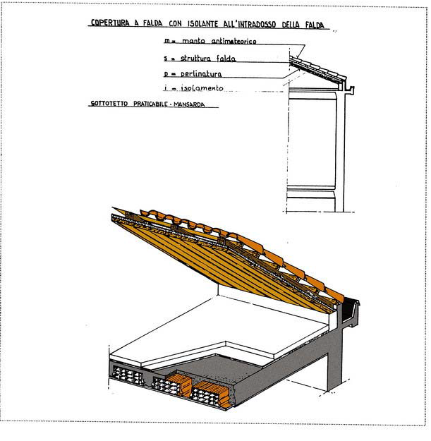
Building Envelope –
SLOPED ROOFING INSULATION 1/1
Intrados insulation flap
The thermal insulation of the intrados slab is one of the most adopted insulation systems in buildings covered with sloped roofs, with attic space.
The system is easy to perform and is used both for new interventions and for refurbishment.
The technique involves the laying of the insulation directly on the structure of the flap, also through the use of elements containing the insulation, pre-finished in plaster that are suitable to be further processed.
Notes:
NOTE

Slide 28
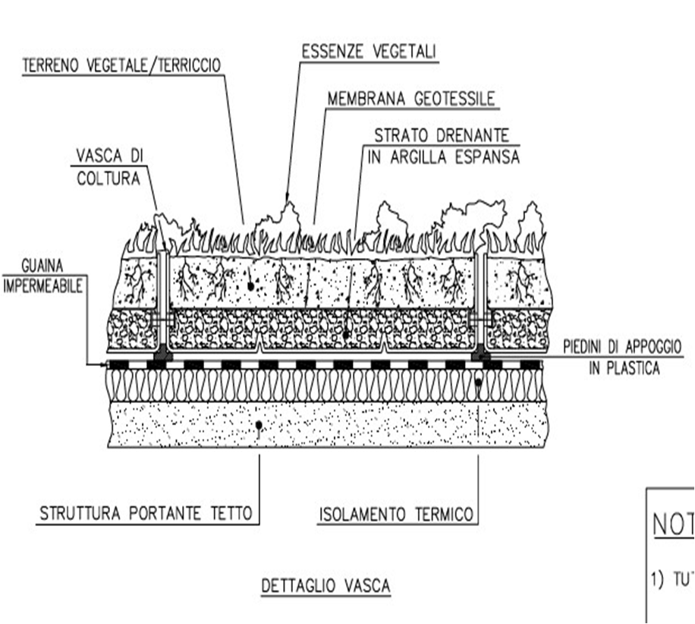
Building Envelope –
GREEN ROOFS
Green roofs
A reduction of the incident solar radiation on the external surfaces of buildings can mitigate the effect of "urban heat island" (Urban Heat Island - UHI). The roofs and green walls can be used as passive systems for energy efficiency in buildings, as:
vegetative layer absorbs the incident solar radiation;
evaporation and transpiration of plants and growing media causes evaporative cooling;
vegetation and growing contribute to thermal insulation;
The plants affect the action of wind on the buildings.
Notes:
NOTE

Slide 29
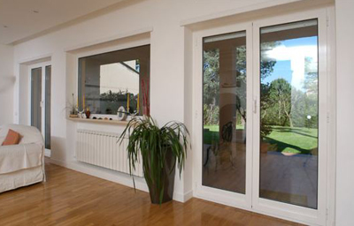
Building Envelope –
WINDOWS & FRAMES
The change of windows is one of the most used renovation measures. In the old building stock, the U-value of windows may be very high and condition and performance can be very low. The U-value of old windows is much be lower than the remaining part of the building envelope.
There are high-performance windows available in the market, which can also reduce the effect of solar radiation and the need of cooling load. The installation of external shading can be carried out together with the change of windows or can be realized separately. Also the lighting conditions are depending on windows, but in renovation the open area of windows do not significantly increase, if new window opening (e.g. on the roof) have not been designed. The reasons for the change of windows are below summarized:
to improve the thermal performance of the building envelope and reduce heat losses through the windows
to reduce cooling load by coatings
to decrease air leak by better tightness
If no changes occurs in ventilation system, both natural and mechanical, the air supply must be ensured to be taken without draft and properly.
The change of windows must be planned carefully also if there are some limitations in changing the look of the facades. The option of the window change is repair and refurbishment (e.g. new sealants etc.). The payback time of investments must be evaluated case by case. The impact on indoor environment and thermal comfort must be taken into account, too.
Notes:
NOTE

Slide 30
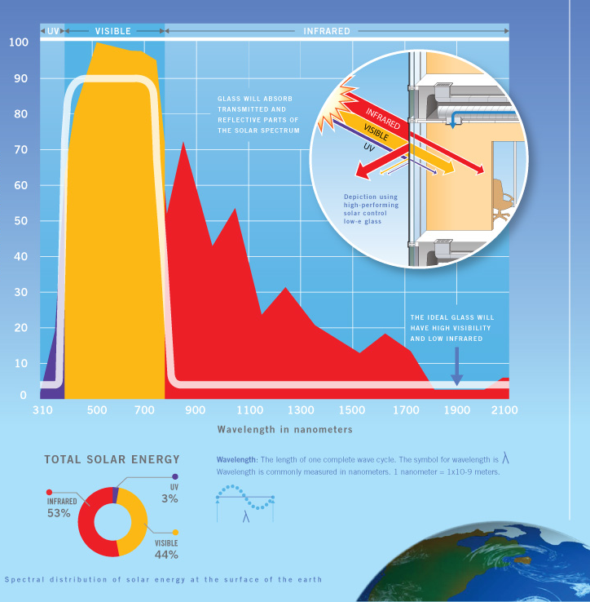
Building Envelope –
WINDOWS & FRAMES
To understand the performance of different types of glasses, it helps to have a basic understanding of the solar energy spectrum:
ultraviolet (UV) light, visible light and Infrared light all occupy different parts of the solar energy spectrum. They are delineated according to their wavelenths:
UV light, which contributes to the fading of interior materials such as fabrics and wall coverings , has a wavelenths of 300 to 380 nanometers
Visible light occupies the part of the spectrum between the IR and UV wavelenths, measuring from about 380 to 780 nanometers
Infrared light (heat energy), which is trasmitted as heat into a building, begins at wavelenths of approximately 780 nanometers
http://glassed.vitroglazings.com/images/glasstopics/LOW-E%20COATING%201.jpg
Notes:
NOTE

Slide 31
Building Envelope –
WINDOWS & FRAMES
Types of glasses used in windows
Single flat glass: It is characterized by a high transparency. It has high thermal transmittance values (5.8 W/m²K) with consequent problems of energy consumption for cooling and heating.
Glasses with selective coatings: "low-E", are glass plates that have thin layers of metal oxides deposited on one of the two main surfaces. The thermal transmittance of this type of glazing is of 1.76 W/m²K, with excellent natural lighting levels and significant savings.
Glasses with reflective films: This type of glasses are constituted by a polyester thin film which becomes highly reflective to solar radiation, while retaining a good transparency.
When heat or light energy is absorbed by glass, it is either shifted away by moving air or re-radiated by the glass surface. The ability of a material to radiate energy is known as emissivity.
In general, highly reflective materials have a low emissivity and dull darker colored materials have a high emissivity. All materials, including windows, radiate heat in the form of long-wave, infrared energy depending on the emissivity and temperature of their surfaces. Radiant energy is one of the important ways heat transfer occurs with windows. Reducing the emissivity of one or more of the window glass surfaces improves a window’s insulating properties.
http://glassed.vitroglazings.com/images/glasstopics/LOW-E%20COATING%201.jpg
Notes:
NOTE

Slide 32
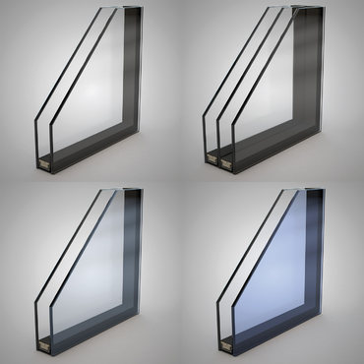
Building Envelope –
WINDOWS & FRAMES
The following performance numbers are used to measure the effectiveness of glass with low-e coatings:
U-Value is the rating given to a window based on how much heat loss it allows.
Visible Light Transmittance is a measure of how much light passes through a window.
Solar Heat Gain Coefficient is the fraction of incident solar radiation admitted through a window, both directly transmitted and that is absorbed and re-radiated inward. The lower a window's solar heat gain coefficient, the less solar heat it transmits.
Light to Solar Gain is the ratio between the window's Solar Heat Gain Coefficient (SHGC) and its visible light transmittance (VLT) rating.
Notes:
NOTE

Slide 33
Building Envelope –
WINDOWS & FRAMES
There are a number of high-tech glasses on the market and others at an advanced stage of development. Contemporary, proven technologies, such as those of low-emissivity glasses, are improving continuously their performance.
Currently it is possible to achieve glasses with emissivity equal to 0.01 compared to standard glasses of 0.89. The main innovations in the field of transparent envelope can be summarized in the following points:
Highly insulating windows: This technology is based on the use of airgel and geoemtric media, ie transparent polycarbonate or polymethylmethacrylate extruded structures, which is included in the cavity of the classic glazing. These products are characterized by very low thermal transmittance values (comparable to those of opaque structures) and high solar gains and light transmittance.
chromogenic glazing: Highly innovative technology that allows to change the colors of the glass and modify the indoor solar and luminous characteristics. The transition from a clear status to a colored one, including the intermediate transitions, can be activated by: (i) electrical pulses, (ii) temperature, (iii) solar radiation. The most advanced technology is the electrochromic one, already present on the construction market although with many high costs.
daylighting systems: the technology involves materials and components capable of intercept the direct solar radiation and direct it outside or, alternatively, to the inland and less bright building areas. The main technologies are: prismatic glasses, holographic films, blind slats with complex profile and with high light reflection.
shading devices: The technology involves both the material and the control system. For the control system s are possible mobile solutions integrated with BEMS or home automation systems. The materials used foresee the use of low emission materials with treated surfaces (to reduce thermal exchange) and high specular reflection surfaces (to optimize the function of redirecting intercepted light.
Window frames: The technology has a continuous development especially for metal and PVC profiles. The possibility of making hollow sections, up to seven areas, increases significantly the insulating power. The latest generation of spacers contribute to limit the heat exchanges along the thermal bridge between frame / glass component.
Notes:
NOTE

Slide 34
Building Envelope –
WINDOWS & FRAMES - Italian regulatory outlines
Permissible limit values that must have the fixtures in case of energy efficiency intervention
VALORI LIMITE
Zona climatica | Trasmittanza termica U(W/m² K)
 | 2015 | 2021
A+B | 3,20 | 3,00
C | 2,40 | 2,00
D | 2,10 | 1,80
E | 1,90 | 1,40
F | 1,70 | 1,00
Notes:
NOTE

Slide 35
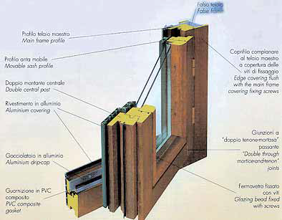
Building Envelope –
WINDOWS & FRAMES
Window technologies : Frame types
Metal Frames:
Metal frames
Metal frames with thermal break
Non metal Frames:
Non metal frames
Non metal frames, thermally improved
Notes:
NOTE

Slide 36
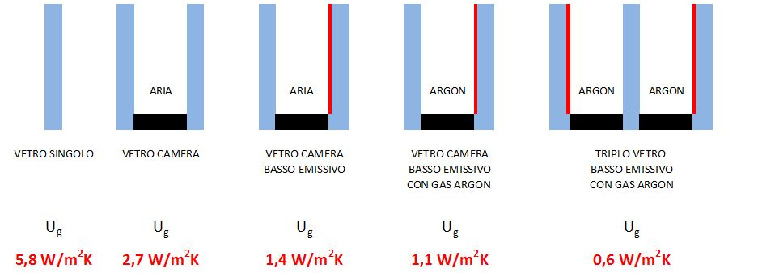
Building Envelope –
WINDOWS & FRAMES
The change of windows must be planned carefully and consider the building typology. Hereinafter are some possible actions for improving energy efficiency of the windows
If the frame is in good condition it is possible to replace the glass with one of a higher insulation capacity, as:
Glasses with a low Solar Heat Gain Coefficient, which are limiting the transmission of solar radiation;
High thermal insulation glass, with high lights and solar and transmission;
Transparent components warm edge for the reduction of the perimetral heat losses;
Glasses with high thermal insulation, high light permeability, low solar gain permeability, suitable for buildings / environments using air conditioning in summer.
Air
Air
Single-glazing
Double-glazing
Thermo-insulating
glass with low
emmissivity
Thermo-insulating
glass of low emmissivity with gas Argon
Triple pane glassof low emmissivity with gas Argon
,
Notes:
NOTE

Slide 37
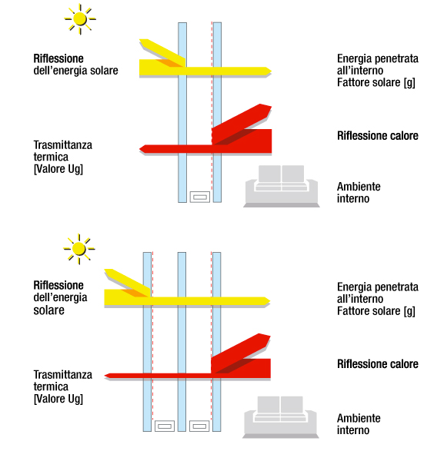
Building Envelope –
WINDOWS & FRAMES
In case of replacement of the whole system (window & frame) there are various types of frame, differ for materials used and for technical characteristics, in which can be added the previously specified types of glass panes, also integrated in the double-glazing unit version.
the main ones are :
PVC multi-frames with insulating foam. They have good characteristics of mechanical and thermal strength and very low values of thermal transmittance. Their look may not be suitable for prestigious properties.
Aluminum frames with thermal break multicam and insulating foams. They are suitable for large doors and windows, have a good air tightness and a low thermal transmittance.
Frames made of low density wood, with internal insulation layer. They offer excellent thermal insulation, excellent aesthetic value, but require periodic maintenance.
reflection
of solar energy
Energy enter
deep into the building
Thermal
transmittance
Heat reflection
indoor
reflection
of solar energy
Energy enter
deep into the building
Thermal
Transmittance
Heat reflection
Indoor
Notes:
NOTE

Slide 38
Building Envelope –
SHIELDING SOLUTIONS
The use of sun control and shading devices is an important aspect of many energy-efficient building design strategies. In warm, sunny climates excess solar gain may result in high cooling energy consumption; in cold and temperate climates winter sun entering south-facing windows can positively contribute to passive solar heating; and in nearly all climates controlling and diffusing natural illumination will improve daylighting.
During cooling seasons, external window shading is an excellent way to prevent unwanted solar heat gain from entering a conditioned space. Shading can be provided by natural landscaping or by building elements such as awnings, overhangs, and trellises. Some shading devices can also function as reflectors, called light shelves, which bounce natural light for daylighting deep into building interiors.
The design of effective shading devices will depend on the solar orientation of a particular building facade. For example, simple fixed overhangs are very effective at shading south-facing windows in the summer when sun angles are high. However, the same horizontal device is ineffective at blocking low afternoon sun from entering west-facing windows during peak heat gain periods in the summer
www.wbdg.org/resources/sun-control-and-shading-devices
Notes:
NOTE

Slide 39
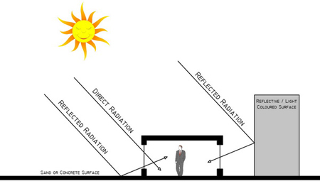
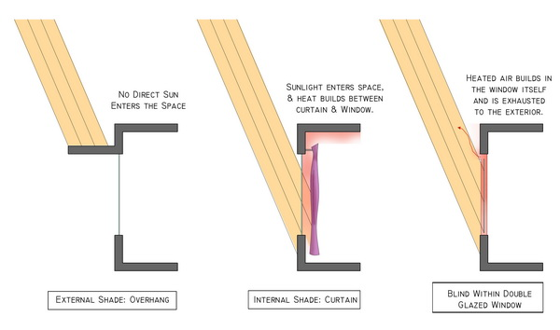
Benefits/Detriments of Shading Locations and Types
Building Envelope –
SHIELDING SOLUTIONS
control of solar radiation through shading
Sources of Solar Radiation
Benefits/Detriments of Shading
Locations and Types
http://tboake.com/carbon-aia/strategies1b.html
Notes:
NOTE

Slide 40
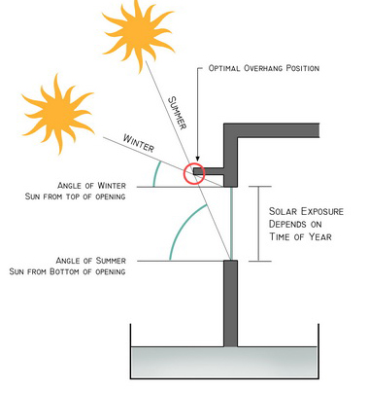
Building Envelope –
SHIELDING SOLUTIONS
Each orientation of the building requires a different approach to the design of shading
Basic Shading Strategy for a South Elevation
http://tboake.com/carbon-aia/strategies1b.html
Notes:
NOTE

Slide 41
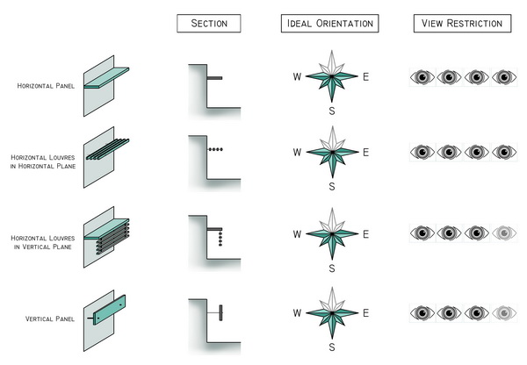
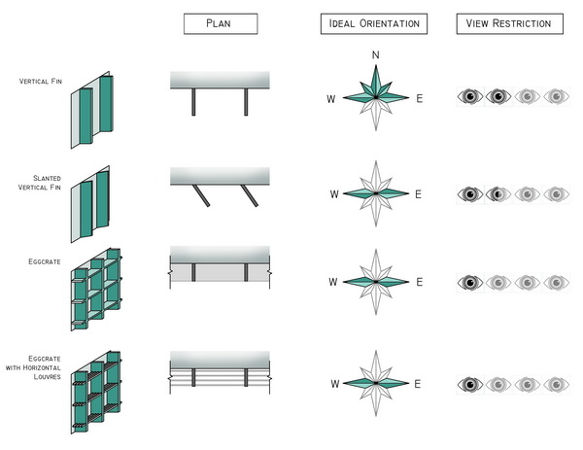
Building Envelope –
SHIELDING SOLUTIONS
General types of shading devices:
Basic Typology of Horizontal Shading Devices
for Southern Exposure Shading
Shading Devices for Non Southern Exposures
http://tboake.com/carbon-aia/strategies1b.html
Notes:
NOTE

Slide 42
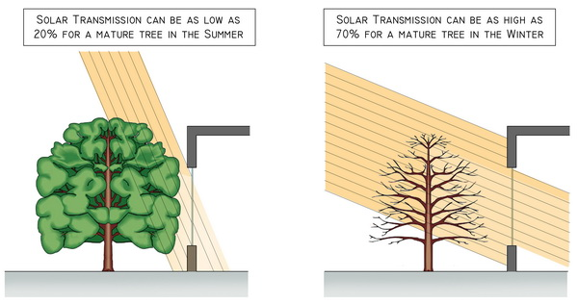
Building Envelope –
SHIELDING SOLUTIONS
Vegetative shading
http://tboake.com/carbon-aia/strategies1b.html
Notes:
NOTE

Slide 43
References
Gabriele Masera – Residenze e Risparmio Energetico – Il Sole 24 Ore, Milano 2004.
Uwe Wienke – Manuale di Bioedilizia – DEI Tipografia del Genio Civile, Roma 2000.
Stefano Bruno – Progettazione Bioclimatica e Bioedilizia – Il Sole 24 Ore, Milano 1999.
Salvatore De Pascalis – Progettazione Bioclimatica – Dario Flaccovio Editore, Palermo 2001.
Stella Fanou, verso la sostenibilità degli edifici e delle città, 2009
Fabio Fantozzi, Carlo Bibbiani, Caterina Gargari – Simulazione del comportamento energetico di un fabbricato-tipo in assenza/presenza di tetto/parete verde per ottimizzare l’efficienza energetica degli edifici, rispetto alle aree climatiche italiane – ENEA in collaborazione con l’Università di Pisa, 2014.
Risparmio Energetico nella Casa – ENEA
Massimiliano Nastri (a cura) – Le Schermature Solari: Tipologie e Criteri di Funzionamento – QUALENERGIA.IT, Roma 2015
Guido Alberti – Le schermature solari – www.posaqualificata.it
http://tboake.com/carbon-aia/strategies1b.html
https://www.wbdg.org/resources/sun-control-and-shading-devices
Notes:
NOTE

Slide 44
WP5 CAPACITY BUILDING IN MUNICIPALITIES Energy efficiency on the building envelope HANDOUT 1_ 1.7 - part 1
CERtuS project
Cost Efficient Options and Financing Mechanisms for nearly Zero Energy Renovation
of Existing Building Stock
IEE /13/906/SI2.675068

