Slide 1



Training Materials
WP5: Capacity Building in Municipalities
Technical Evaluation - Coimbra
© Copyright CERTUS Project 2015 - All Rights Reserved Grant agreement no.: 620906

Slide 2

nZEB Renovation Schemes
Location : Coimbra - Portugal
Coimbra is the largest city in Centro Region of Portugal, with about 101,069 inhabitants in the urban area and 150,000 inhabitants in the area of the municipality. As the largest urban centre of a region of over 2 million inhabitants, Coimbra functions as regional capital. The presence of a university and other institutions of higher education designate Coimbra as “City of Knowledge”.
Surface, population and climate data from Coimbra
Surface Area: | 319.41 km²
Population of the Municipality | 143,396 inhabitants according to census 2011
Annual Heating Degree Days | 1,460, Base Temperature 20 °C
Annual Cooling Degree Days | 1,200, Base Temperature 24 °C
Population Density | 448.94 Inhabitants/km²
Climate Area | Medium, according to DIR.2009/125/CE
Outdoor average T °C in winter | 0-15 °C
Outdoor average T °C in summer | 18-35°C
© Copyright CERTUS Project 2017 - All Rights Reserved

Slide 3
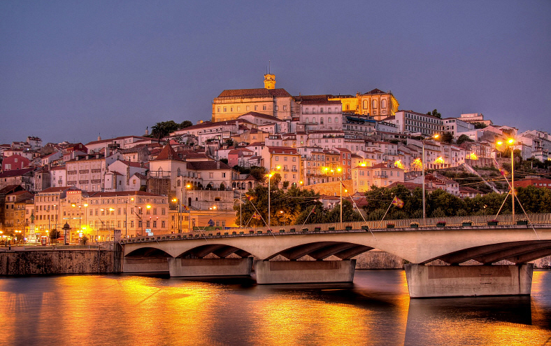
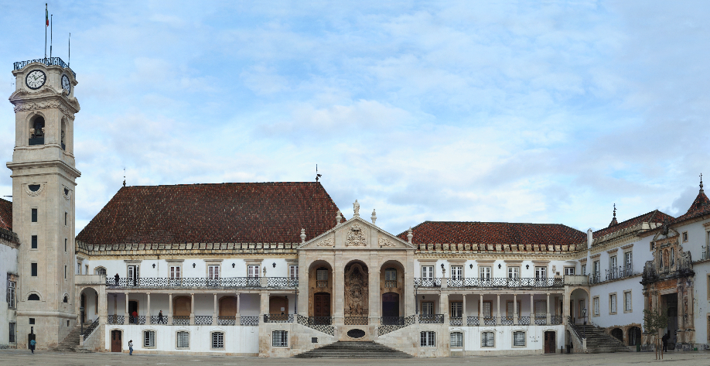
nZEB Renovation Schemes
Location : Coimbra - Portugal
As a historic city Coimbra holds an important cultural and architectural heritage, which added to the fact that the city is being crossed by the River Mondego, gives to Coimbra a distinctive character and make her attractive for tourists. Coimbra's environmental quality is reinforced by a friendly climate, positive indicators on air and noise, a variety of green spaces in the urban centre and the river landscape of the Mondego.
© Copyright CERTUS Project 2017 - All Rights Reserved

Slide 4
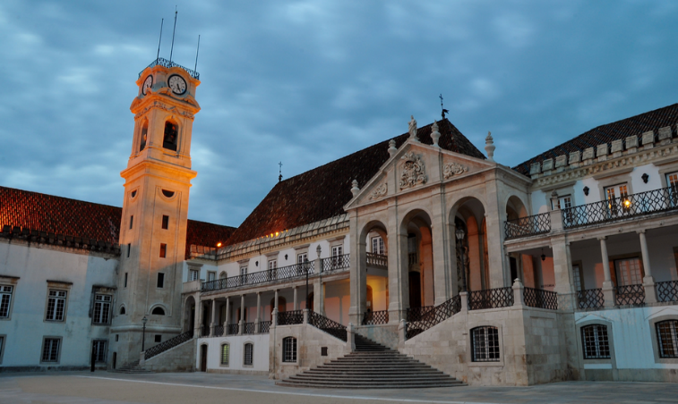
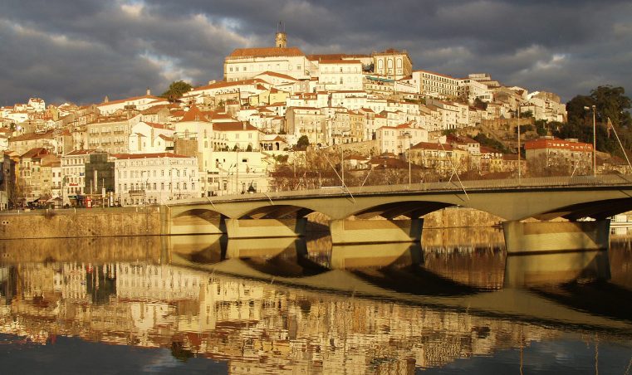
nZEB Renovation Schemes
Location : Coimbra - Portugal
© Copyright CERTUS Project 2017 - All Rights Reserved

Slide 5
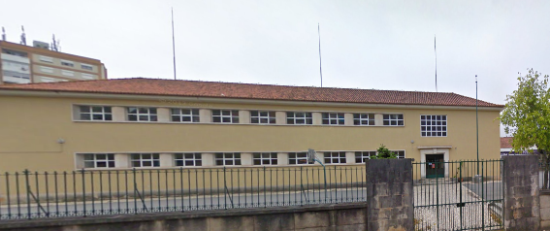
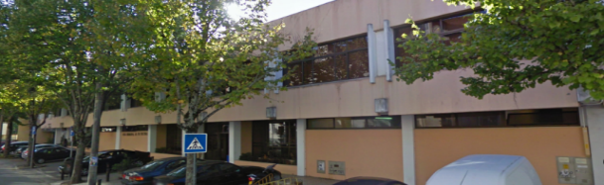

nZEB Renovation Schemes
Analysed Buildings - Elementary School of Solum
Elementary School of Solum
Municipal House of Culture
Coimbra Town Hall
© Copyright CERTUS Project 2017 - All Rights Reserved

Slide 6
nZEB Renovation Schemes
Overall Renovation Options
The selected renovation options are the results of a critical reflection on the balance among energy efficiency, use profile, comfort and conservation. Different scenarios have been simulated in order to reach the optimum renovation design. The selected renovation options are:
Elementary School of Solum: Expansion of the PV system; Replacement of all T8 lamps with electromagnetic ballast by T5 lamps with electronic ballast; Replacement of the gas boiler by a heat pump.
Municipal House of Culture: Installation of PV system; Replacement of all lamps by LEDs; Replacement of the THC and mono-split systems by systems with higher COP/EER.
Coimbra Town Hall: Installation of PV tiles; Replacement of all lamps by LEDs; Replacement of the THC and mono-split systems by systems with higher COP/EER.
© Copyright CERTUS Project 2017 - All Rights Reserved

Slide 7
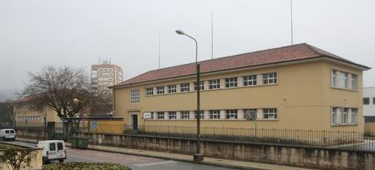
nZEB Renovation Schemes
Analysed Buildings - Elementary School of Solum
Description
© Copyright CERTUS Project 2017 - All Rights Reserved

Slide 8
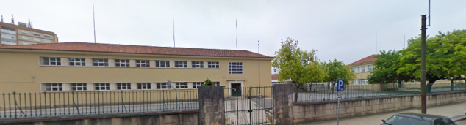
nZEB Renovation Schemes
Analysed Buildings - Elementary School of Solum
Description
The building was built in the 1950s and until the 1970s this was an annex school to the teacher training colleges dedicated to pedagogical training. In the 1990s it was converted into an Elementary School. The construction of refectory and a partial renovation of the building was done 10 years ago.
The building is located in the East side of the city, near to the Stadium and a commercial area.
© Copyright CERTUS Project 2017 - All Rights Reserved

Slide 9
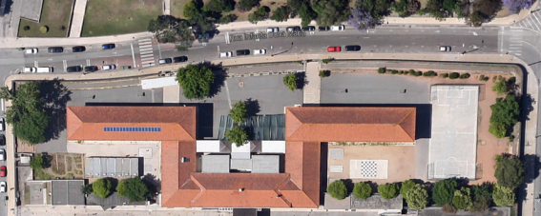

nZEB Renovation Schemes
Analysed Buildings - Elementary School of Solum
Shape and Orientation
The school is constituted by two buildings with 39.8 x 9.5m each and 1 building (refectory) with 2 areas of 9.73 x 6.5 m and one of 7.15 x 2.15 m;
It is oriented along an east–west axis with the main façade in the north.
The roof is of ceramic tile and has a surface of 898 m^{2;}
© Copyright CERTUS Project 2017 - All Rights Reserved

Slide 10
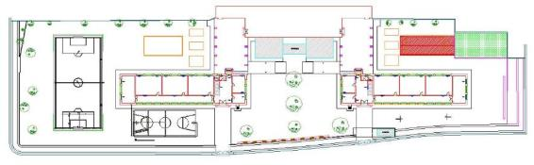

nZEB Renovation Schemes
Analysed Buildings - Elementary School of Solum
Shape and Orientation
The building has two floors in the two main buildings and one floor in the refectory building;
The building has total area of about 1,655 m² (756 m² in each block and 142 m² in the refectory) and a volume of 6,269.21 m³ (2,828.19 m³ in each block and 612.84 m³ in the refectory).
General Data |  | Dimension Parameters
Year of construction | 1950s | Area | 1655 m²
Use | Elementary School | Floors | 2
Officially Protected | No | Volume | 6270 m³
© Copyright CERTUS Project 2017 - All Rights Reserved

Slide 11
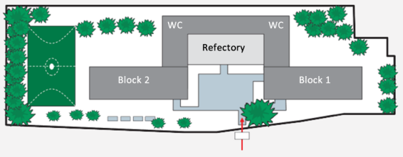
nZEB Renovation Schemes
Analysed Buildings - Elementary School of Solum
Current Use
The building is an elementary school and it is divided in three main areas: two blocks used for classrooms and the refectory.
© Copyright CERTUS Project 2017 - All Rights Reserved

Slide 12
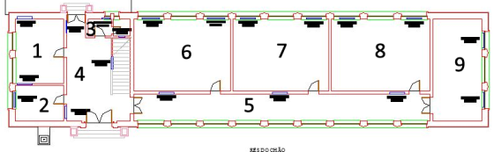
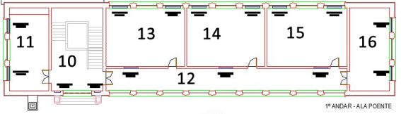
nZEB Renovation Schemes
Analysed Buildings - Elementary School of Solum
Current Use
Block 1 – Floor 0
Block 1:
48 classrooms (6, 7, 8, 11, 13, 14, 15, 16)
Teachers’ room (9)
Special education room (1, 11)
Office of the parents’ association (2)
Bathroom (3)
Block 1 – Floor 1
© Copyright CERTUS Project 2017 - All Rights Reserved

Slide 13
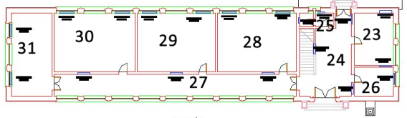
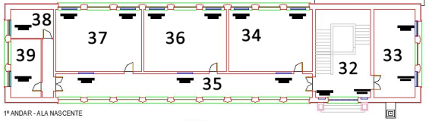
nZEB Renovation Schemes
Analysed Buildings - Elementary School of Solum
Current Use
Block 2 – Floor 0
Block 2:
5 classrooms (28, 29, 34, 36, 37)
Photocopies room (23)
Coordination room (26)
Library (30)
Media library (31)
Office of psychology (38)
Guidance services (39)
Storage room (16)
Block 2 – Floor 1
© Copyright CERTUS Project 2017 - All Rights Reserved

Slide 14
nZEB Renovation Schemes
Analysed Buildings - Elementary School of Solum
Current Use
Block 2 – Floor 0
Refectory and other exterior areas :
Refectory with 2 rooms (40)
4 bathrooms - 2 male and 2 female (17, 19)
Outdoor porch (20, 21, 22)
Reception (41)
Prefabricated building used by the Family Support project (18)
Block 2 – Floor 1
© Copyright CERTUS Project 2017 - All Rights Reserved

Slide 15

nZEB Renovation Schemes
Analysed Buildings - Elementary School of Solum
Current Use
The school has about 300 students.
The schedule of the daily activities (Monday to Friday) is:
Classes – 9h00 to 12h30 and 14h00 to 16h00
Lunch – 12h30 to 14h00
Extra-curricular activities – 16h30 to 17h30
Family support – 7h30 to 9h00 and 17h30 to 19h00
The periods of classes during 2014/2015 are:
1st period – September, 15th to December, 16th
2nd period – January, 5th to March, 20th
3rd period – April, 7th to June, 12th
Outside these periods the use of the building is very low.
© Copyright CERTUS Project 2017 - All Rights Reserved

Slide 16
nZEB Renovation Schemes
Analysed Buildings - Elementary School of Solum
Current Building Conditions – Constructive Characteristics
Envelope Elements - The walls of each block have a total surface of 734 m², of which 182 m² is transparent (24.8%). The walls of the refectory have total surface of 260 m², of which 69 m² is transparent (26.5%). In the total, the walls have a surface of 1,728 m², of which 433 m² is transparent (25%).
The external walls are made of breeze blocks and bricks and have a thickness of 55 to 60 cm in the 2 blocks and of 35 to 55 cm in the refectory.
Structure | Orient. | A | U | Abs. | Α.U.A.Rse | U.A.
 |  | m² | W/m² ºC | α | W/ ºC | W/ ºC
Wall - Block1&2 | N | 295.50 | 0.29 | 0.6 | 2.06 | 85.7
Wall - Refectory | N | 131.20 | 0.29 | 0.6 | 0.91 | 38.0
Wall - Block1&2 | W | 71.50 | 0.29 | 0.4 | 0.33 | 20.7
Wall - Refectory | W | 26.85 | 0.29 | 0.4 | 0.12 | 7.8
Wall - Block1&2 | S | 295.50 | 0.29 | 0.4 | 1.39 | 86.6
Wall - Refectory | S | 131.20 | 0.29 | 0.4 | 0.61 | 38.0
Wall - Block1&2 | E | 71.50 | 0.29 | 0.4 | 0.33 | 20.7
Wall - Refectory | E | 26.85 | 0.29 | 0.4 | 0.12 | 7.8
Roof - Block1&2 | - | 378.10 | 0.50 | 0.4 | 3.02 | 189.1
Roof - Refectory | - | 141.90 | 0.50 | 0.4 | 1.14 | 71.0
© Copyright CERTUS Project 2017 - All Rights Reserved

Slide 17
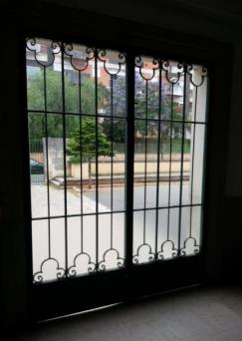
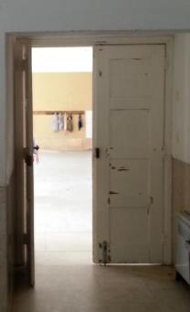
nZEB Renovation Schemes
Analysed Buildings - Elementary School of Solum
Current Building Conditions – Constructive Characteristics
Windows and Doors - All the window frames are aluminium with the exception of 2 windows, which have a wooden frame. These windows are located in the hall of floor 1 of each block. All the windows are double glazed with the exception of 4 windows. These windows are located in the hall of floor 1 of each block and in the lateral of the refectory building.
The total number of windows is:
72 operable of 2.10 x 1.80 m
16 operable of 1.60 x 1.80 m
8 operable of 2.10 x 1.80 m
2 fixed of 2.90 x 2.55 m
1 fixed of 0.40 x 0. 45 m
2 operable of 2.00 x 1.73 m
2 operable of 6.00 x 1.60 m
2 operable of 2.00 x 2.68 m
2 fixed of 1.16 x 2.64 m
4 fixed (they belong to other building) of 2.00 x 1.60 m
7 fixed (they belong to other building) of 1.15 x 1.60 m
The total number of doors: Each block has one door in iron with glass of 2.34 x 2.78 m (front) and one door in wood (back) of 1.65 x 2.10 m. The refectory has a door in aluminum of glass with 2.00 x 2.83 m.
© Copyright CERTUS Project 2017 - All Rights Reserved

Slide 18
nZEB Renovation Schemes
Analysed Buildings - Elementary School of Solum
Current Building Conditions – Constructive Characteristics
Windows
Structure | Orient. | A | U | F_{g} | Α_{eq} | U.A.
 |  | m² | W/m² ºC |  | m² | W/ ºC
Windows - Block1&2 | N | 75.44 | 2.8 | 0.67 | 50.5 | 211.2
Windows - Refectory | N | 36.82 | 2.8 | 0.67 | 24.7 | 103.1
Windows - Block1&2 | W | 19.08 | 2.8 | 0.67 | 12.8 | 53.4
Windows - Refectory | W | 3.060 | 2.8 | 0.67 | 2.1 | 8.6
Windows - Block1&2 | S | 68.40 | 2.8 | 0.67 | 45.8 | 191.5
Windows - Refectory | S | 25.68 | 2.8 | 0.67 | 17.2 | 71.9
Windows - Block1&2 | E | 19.08 | 2.8 | 0.67 | 12.8 | 53.4
Windows - Refectory | E | 3.060 | 2.8 | 0.67 | 2.1 | 8.6
© Copyright CERTUS Project 2017 - All Rights Reserved

Slide 19
nZEB Renovation Schemes
Analysed Buildings - Elementary School of Solum
Current Building Conditions – Constructive Characteristics
Airtightness and Pathologies
The doors of the 2 blocks present airtightness problems. However, the circulation areas do not have any HVAC source.
The building does not present relevant pathologies.
© Copyright CERTUS Project 2017 - All Rights Reserved

Slide 20
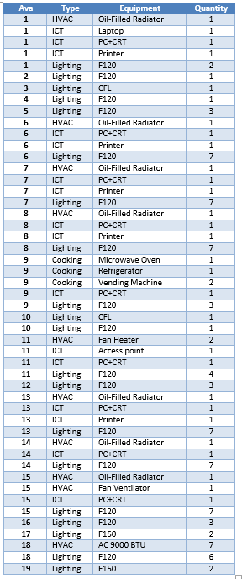
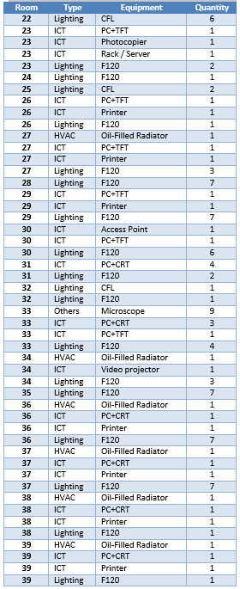
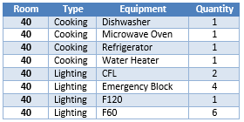

nZEB Renovation Schemes
Analysed Buildings - Elementary School of Solum
Current Building Conditions – Existent Energy Systems
Available electrical equipment in each room/area
Refectory
Block 1
Block 2
Refectory
© Copyright CERTUS Project 2017 - All Rights Reserved

Slide 21
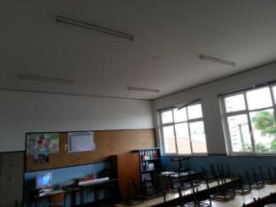
nZEB Renovation Schemes
Analysed Buildings - Elementary School of Solum
Current Building Conditions – Existent Energy Systems
Lighting
The lighting system is mainly constituted by fluorescent linear T8 (F120-Fluorescent lamps with a length of 120 cm and F60-Fluorescent lamps with a length of 60 cm) lamps with electromagnetic ballast.
Each classroom has 7 florescent T8 lamps, one or more Compact Fluorescent Lamp (CFL) and emergency lighting, but
usually each luminary has just one lamp working.
The exception are the F60 lamps (used in the refectory), since each luminaire have 2 lamps.
In the exterior of the buildings the lighting is ensured by T8 lamps (F120) and CFLs.
© Copyright CERTUS Project 2017 - All Rights Reserved

Slide 22
nZEB Renovation Schemes
Analysed Buildings - Elementary School of Solum
Current Building Conditions – Existent Energy Systems
Lighting - Types and quantities of lamps
Lamp Type | Quantity n | Power W
Fluorescent Linear T8 F150 | 4 | 270.4
Fluorescent Linear T8 F120 | 127 | 5,943.6
Fluorescent Linear T8 F60 | 12 | 280.8
Compact Fluorescent | 28 | 504
Emergency | 4 | 48
Total | 175 | 7,046.8
© Copyright CERTUS Project 2017 - All Rights Reserved

Slide 23
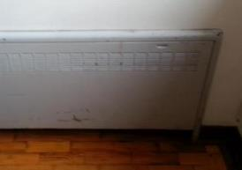
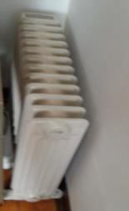
nZEB Renovation Schemes
Analysed Buildings - Elementary School of Solum
Current Building Conditions – Existent Energy Systems
HVAC – Air Conditioning or Heating Systems
The 2 main blocks have old wall radiators with circulation of hot water. However, the system is no longer operational and therefore these buildings do not have any source of central heating.
To ensure the heating during the coldest days the classrooms have one oil-filled radiator.
Only one classroom has a fan ventilator to be used during summer.
The type and quantity of HVAC devices available in blocks 1 and 2 is:
  9 oil-filled radiators of 1 kW
  4 oil-filled radiators of 2 kW
  1 fan heater of 1 kW
  1 fan ventilator
© Copyright CERTUS Project 2017 - All Rights Reserved

Slide 24
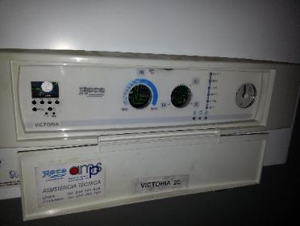
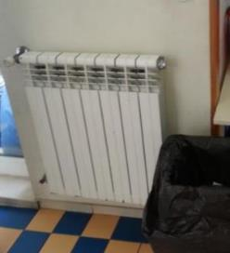
nZEB Renovation Schemes
Analysed Buildings - Elementary School of Solum
Current Building Conditions – Existent Energy Systems
HVAC - Heating and Hot Water systems
The refectory building have central heating ensured by a boiler using natural gas. The combustion takes place in an open chamber and the air required is taken from the boiler room itself. However, the boiler is not installed in the refectory building, it is installed inside the reception (room 41), which is 30 meters away (straight-line distance) from the refectory.
The water heating is mainly ensured by a solar thermal system ), being the electric water heater just a backup. The electric water heater (Videira MULTI-F Vertical model) has a capacity of 50 litters and a power of 1200 W The hot water consumption is very low because the food is not prepared in the school.
© Copyright CERTUS Project 2017 - All Rights Reserved

Slide 25
nZEB Renovation Schemes
Analysed Buildings - Elementary School of Solum
Current Building Conditions – Existent Energy Systems
HVAC - Heating and Hot Water systems
The total heating power in the building is 41.3 kW.
Central Heating Mode
Heat Output | Adjustable from 7,000 kcal/h (8.1 kW) to 20,000 kcal/h (23.3 kW)
Maximum circuit pressure | 3 bar
Maximum working temperature | 90 °C
Filling pressure | 1.5 bar
Domestic Hot Water (DHW) Mode
Heat Output | Adjustable from 7,000 kcal/h to 20,000 kcal/h.
Maximum circuit pressure | 7 bar
Maximum working temperature | 60 °C
DHW production | Δt Þ 25 °C Þ 13.3 l/min Δt Þ 30 °C Þ 11.1 l/min Δt Þ 35 °C Þ 9.5 l/min
Minimum operating pressure and flow rate for ignition | 0.2 bar and 3 l/min
© Copyright CERTUS Project 2017 - All Rights Reserved

Slide 26
nZEB Renovation Schemes
Analysed Buildings - Elementary School of Solum
Current Building Conditions – Existent Energy Systems
HVAC – Air Conditioning or Cooling Systems
No HVAC systems is present at the school.
The prefabricated building from the Family Support project (area 18) has air conditioning, however, such devices are not owned or managed by the Municipality.
© Copyright CERTUS Project 2017 - All Rights Reserved

Slide 27
nZEB Renovation Schemes
Analysed Buildings - Elementary School of Solum
Current Building Conditions – Existent Energy Systems
ICT - Information and Communications Technologies
The communication devices but also other electronic devices, such as computers, printers, etc. are considered as ICT Each classroom has at least one computer with one monitor (CRT or TFT). Some offices also have computers as well as printers. There are also access points and a rack/server to the wireless network and one classroom have a video projector. In terms of energy consumption the main device is a photocopier.
The type and quantity of ICT devices available in the two blocks is:
  15 PC + CRT
  6 PC + TFT
  1 laptop
  12 printers
  1 video projector
  2 access points
  1 Rack/Server
  1 Photocopier
  9 microscopes
© Copyright CERTUS Project 2017 - All Rights Reserved

Slide 28
nZEB Renovation Schemes
Analysed Buildings - Elementary School of Solum
Current Building Conditions – Existent Energy Systems
Others
In the refectory there are cooking appliances. The equipment available in the refectory is just a refrigerator, a microwave oven, a dishwasher and a water heater.
The main consumption is due to the dishwasher (Comenda LF322M model) which has a maximum power of 5.45 kW.
There is also some cooking equipment in the teachers’ room, such as a refrigerator, a microwave oven and 2 vending machines.
© Copyright CERTUS Project 2017 - All Rights Reserved

Slide 29
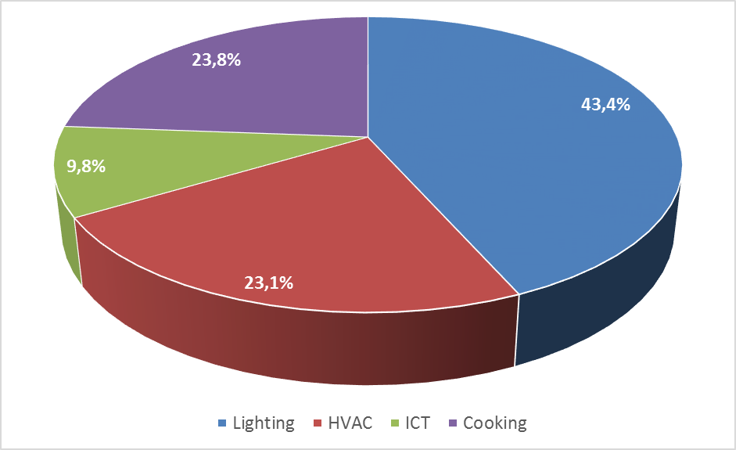
nZEB Renovation Schemes
Analysed Buildings - Elementary School of Solum
Current Building Conditions – Energy Consumption And Energy Generation
Energy Consumption - Present Scenario
Electricity Consumption | 30.7 MWh
Electricity Cost | 6.7 k€
Gas Consumption | 16.7 MWh
Gas Cost | 1.8 k€
© Copyright CERTUS Project 2017 - All Rights Reserved

Slide 30
nZEB Renovation Schemes
Analysed Buildings - Elementary School of Solum
Current Building Conditions – Energy Consumption And Energy Generation
Baseline - Present Scenario
 | Final Energy kWh | Energy Dens. kWh/m² | Primary Energy kWh | CO₂ Emissions kg CO₂ /kWh
Electricity | 22516 | 13.60 | 56290 | 3149.8
Gas | 16775 | 10.14 | 16775 | 3388.6
Generation | -6100 | -3.69 | 2320 | -853.3
Total | 33191 | 20.05 | 75385 | 5685.1
© Copyright CERTUS Project 2017 - All Rights Reserved

Slide 31
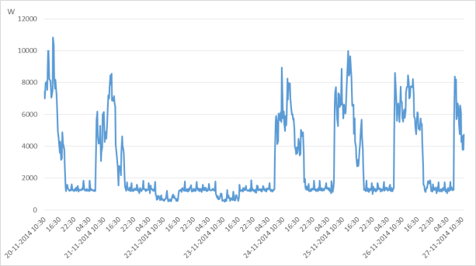
nZEB Renovation Schemes
Analysed Buildings - Elementary School of Solum
Current Building Conditions –Energy Consumption And Energy Generation
Energy Consumption -Present Scenario
On-Peak | 18.4%
Mid-Peak | 58.0%
Off-Peak | 23.6%
© Copyright CERTUS Project 2017 - All Rights Reserved

Slide 32
nZEB Renovation Schemes
Analysed Buildings - Elementary School of Solum
Current Building Conditions –Energy Consumption And Energy Generation
Energy Generation with RES - Present Scenario
  PV system with 4230 W – 18 modules with 235 Wp each
  Generation of 6100 kWh (20% of the consumption in 2013).
  Solar thermal concentrator with 2 m² (supply hot water to the refectory).
Quantity of modules | 18
Type of modules | Polycrystalline Silicon
Total power | 4230 W
Total area | 29.18 m²
© Copyright CERTUS Project 2017 - All Rights Reserved

Slide 33
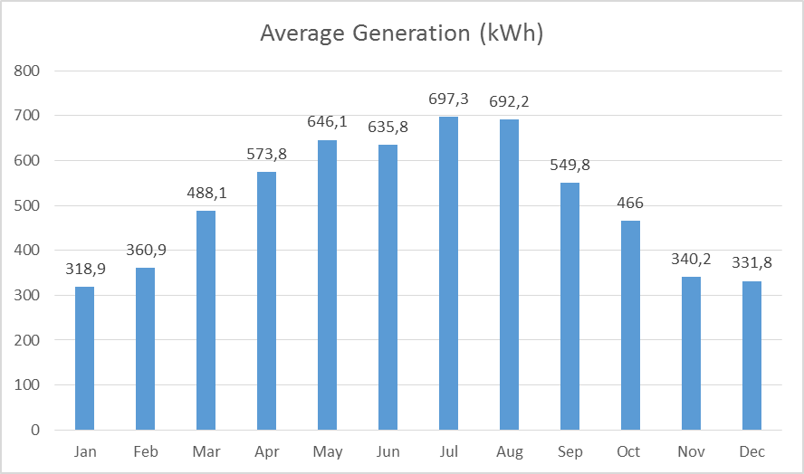
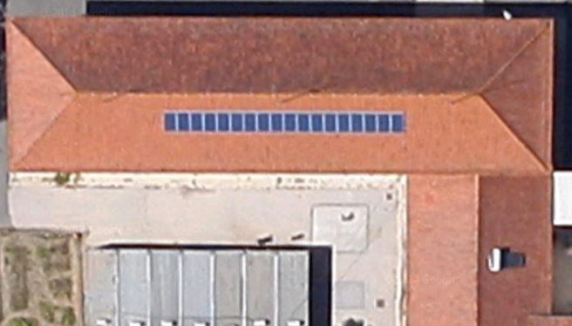
nZEB Renovation Schemes
Analysed Buildings - Elementary School of Solum
Current Building Conditions –Energy Consumption And Energy Generation
Energy Generation with RES - Present Scenario
Other Generation Sources - Not present at this building
© Copyright CERTUS Project 2017 - All Rights Reserved

Slide 34
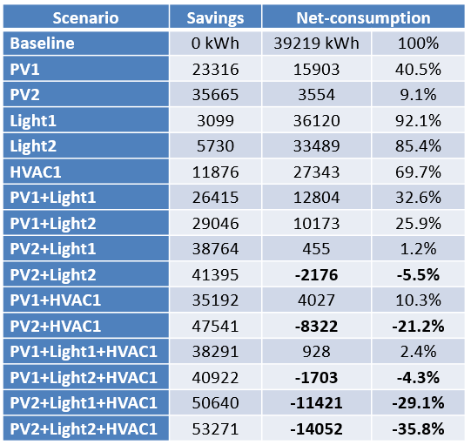
nZEB Renovation Schemes
Analysed Buildings - Elementary School of Solum
Current Building Conditions –Final Energy Consumption And Energy Generation
Future Scenarios – After the renovation
Main assessed scenarios:
    PV1 – 72 PV panels
    PV2 – 108 PV panels;
    Light1 – replacement of all T8 lamps with electromagnetic ballast by T5 lamps with electronic ballast
    Light2 – replacement of all lamps by LEDs
    HVAC1 – replacement of the gas boiler by a heat pump.
© Copyright CERTUS Project 2017 - All Rights Reserved

Slide 35
nZEB Renovation Schemes
Analysed Buildings - Elementary School of Solum
Current Building Conditions –Final Energy Consumption And Energy Generation
Selected Scenario
PV1+Light1+HVAC1 (near to a zero net-consumption with a good balance between technologies):
    Installation of 12.69 kWp of PV modules (54 modules)
    Installation of 143 T5 lamps and luminaries with electronic ballast
    Installation of heat pump with 11 kW to replace a gas boiler
© Copyright CERTUS Project 2017 - All Rights Reserved

Slide 36
nZEB Renovation Schemes
Analysed Buildings - Elementary School of Solum
Current Building Conditions –Final Energy Consumption And Energy Generation
  Final Energy, Primary Energy and CO₂ Emissions
 | Final Energy kWh | Energy Dens. kWh/m² | Primary Energy kWh | CO₂ Emissions kg CO₂ /kWh
Electricity base. | 22516 | 13.60 | 56290 | 3149.8
Gas base. | 16775 | 10.14 | 16775 | 3388.6
Total base. | 39291 | 23.74 | 73065 | 6538.3
Electricity renov. | 928 | 0.56 | 2320 | 129.8
Gas renov. | 0 | 0 | 0 | 0
Total renov. | 928 | 0.56 | 2320 | 129.8
Savings | 38363 | 23.18 | 70745 | 6408.5
Savings (%) | 97.6% | 97.6% | 96.8% | 98.0%
© Copyright CERTUS Project 2017 - All Rights Reserved

Slide 37
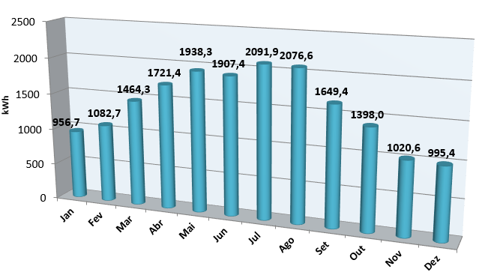
nZEB Renovation Schemes
Analysed Buildings - Elementary School of Solum
Current Building Conditions –Final Energy Consumption And Energy Generation
  Final Energy Generation
Final Energy Generation kWh by Year
18 303
© Copyright CERTUS Project 2017 - All Rights Reserved

Slide 38
nZEB Renovation Schemes
Analysed Buildings - Elementary School of Solum
Renovation Scheme - Aim
Aim of the Renovation Plan - is to achieve an average primary energy reduction between 75% and 80% of the current demand and to ensure that between 50% and 90% of the consumed energy is generated by renewable energy sources installed in the building.
Since there is enough available roof area without shadings and with a good solar radiation levels the aim was redefined to achieve a minimum primary energy reduction of 95%, ensuring, at least, 95% of the consumption with renewable energy sources, therefore achieving almost a Zero Energy Level.
Constraints: There are 7 prefabricated buildings in the exterior area of the school. Such buildings are not permanent constructions and do not belong to the Municipality, being managed by the Family Support project. However, they receive electricity from the school without any individual metering. Therefore, its consumption is included in the total consumption of the building, but such energy consumption cannot be considered as a consumption of the studied building. The consumption of the prefabricated buildings was assessed (considered to be 27% of the total energy consumption) and subtracted from the total considered for the building. Therefore, the consumption level considered in the renovation plan excludes the consumption of the prefabricated buildings.
© Copyright CERTUS Project 2017 - All Rights Reserved

Slide 39
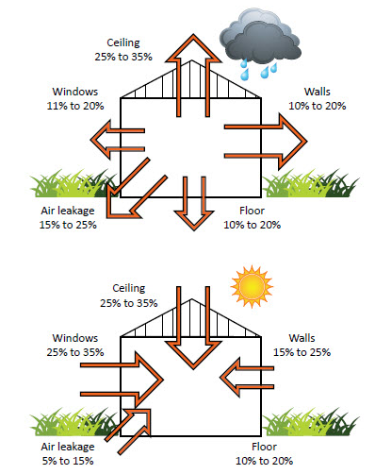
nZEB Renovation Schemes
Analysed Buildings - Elementary School of Solum
Renovation Scheme – Energy Demand Reduction
Opaque Envelope
The building was recently renovated and therefore the opaque envelope does not present major problems.
Since the building does not have any centralized HVAC system the improvement of the envelope would not lead to a major reduction of energy consumption in heating and cooling.
Therefore, the improvement of the opaque envelope was not considered in the renovation plan.
© Copyright CERTUS Project 2017 - All Rights Reserved

Slide 40
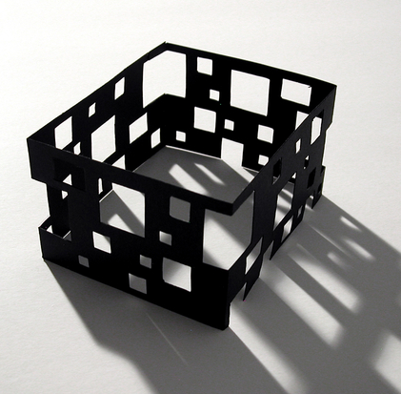
nZEB Renovation Schemes
Analysed Buildings - Elementary School of Solum
Renovation Scheme – Energy Demand Reduction
Openings
The main entrance doors of the 2 blocks are not airtight and present unintentional infiltration of air into the building. However, the circulation areas do not have any HVAC source and its replacement is not traduced in any energy saving. Therefore, the improvement of openings was not considered in the renovation plan.
© Copyright CERTUS Project 2017 - All Rights Reserved

Slide 41


nZEB Renovation Schemes
Analysed Buildings - Elementary School of Solum
Renovation Scheme – Energy Demand Reduction
Other Strategies
There are no other strategies considered in the renovation for the energy demand reduction.
© Copyright CERTUS Project 2017 - All Rights Reserved

Slide 42
nZEB Renovation Schemes
Analysed Buildings - Elementary School of Solum
Renovation Scheme – Energy Systems
Lighting System
The actual lighting system is mainly constituted by fluorescent linear T8 lamps with electromagnetic ballast
Lamp Type | Quantity N | Power W
Fluorescent Linear T8 F150 | 4 | 270.4
Fluorescent Linear T8 F120 | 127 | 5,943.6
Fluorescent Linear T8 F60 | 12 | 280.8
Compact Fluorescent | 28 | 504
Emergency | 4 | 48
Total | 175 | 7,046.8
© Copyright CERTUS Project 2017 - All Rights Reserved

Slide 43
nZEB Renovation Schemes
Analysed Buildings - Elementary School of Solum
Renovation Scheme – Energy Systems
Lighting System (cont.)
Regarding the retrofit of the lighting system 2 scenarios were considered:
Scenario 1 - Replacement of all T8 lamps with electromagnetic ballast by T5 lamps with electronic ballast;
Scenario 2 - Replacement of all lamps by LEDs.
In scenario 1:
143 lamps and ballasts have to be replaced. The next table presents each lamp type and its correspondent power.
Lamp Type | Quantity n | Lamp W | Lamp+Ballast W
Fluorescent Linear T5 F150 | 4 | 49 | 56
Fluorescent Linear T5 F120 | 127 | 28 | 30
Fluorescent Linear T5 F60 | 12 | 14 | 17
© Copyright CERTUS Project 2017 - All Rights Reserved

Slide 44
nZEB Renovation Schemes
Analysed Buildings - Elementary School of Solum
Renovation Scheme – Energy Systems
Lighting System (cont.)
In scenario 1: The next table show the new distribution of lamps. As can be seen the total power decreases to 4790 W (reduction of 32%).
Lamp Type | Quantity n | Total Power W
Fluorescent Linear T5 F150 | 4 | 224
Fluorescent Linear T5 F120 | 127 | 3,810
Fluorescent Linear T5 F60 | 12 | 204
Compact Fluorescent | 28 | 504
Emergency | 4 | 48
Total | 175 | 4,790
© Copyright CERTUS Project 2017 - All Rights Reserved

Slide 45
nZEB Renovation Schemes
Analysed Buildings - Elementary School of Solum
Renovation Scheme – Energy Systems
Lighting System (cont.)
In Scenario 2:
In scenario 2, all the 175 lamps have to be replaced. The next table presents the lamps to be installed.
Lamp Type | Quantity n | Lamp W
LED Linear F150 | 4 | 24
LED Linear F120 | 127 | 20
LED Linear F60 | 12 | 10
LED Bulb | 28 | 9.5
LED Emergency | 4 | 1.1
© Copyright CERTUS Project 2017 - All Rights Reserved

Slide 46
nZEB Renovation Schemes
Analysed Buildings - Elementary School of Solum
Renovation Scheme – Energy Systems
Lighting System (cont.)
In Scenario 2: The next table presents the new lamp distribution. As can be seen the total power decreases to 3,026.4 W (reduction of 57%).
Lamp Type | Quantity n | Total Power W
LED Linear F150 | 4 | 96
LED Linear F120 | 127 | 2,540
LED Linear F60 | 12 | 120
LED Bulb | 28 | 266
LED Emergency | 4 | 4.4
Total | 175 | 3,026.4
© Copyright CERTUS Project 2017 - All Rights Reserved

Slide 47
nZEB Renovation Schemes
Analysed Buildings - Elementary School of Solum
Renovation Scheme – Energy Systems
Lighting System (cont.)
Yearly consumption with lighting in the 2 scenarios
Such energy consumptions were simulated considering the actual usage profile for each lamp type and room of the building.
Scenario 1 ensures 31.3% and Scenario 2 ensures 57.9% of energy savings.
 | Actual | Scenario 1 | Scenario 2
Consumption (kWh) | 9,897 | 6,798 | 4,167
Savings (kWh) | - | 3,099 | 5,730
Savings (%) | - | 31.3% | 57.9%
© Copyright CERTUS Project 2017 - All Rights Reserved

Slide 48
nZEB Renovation Schemes
Analysed Buildings - Elementary School of Solum
Renovation Scheme – HVAC Systems
HVAC System– The Best Solution is the direct replacement of the gas boiler used in the central heating of the refectory. It was considered that the actual boiler has a COP of 0.90, replaced by a heat pump of 11 kW with a COP of 3.57.
The next table presents the yearly consumption in the refectory heating in the actual and retrofit scenarios. As can be seen, the retrofit ensures 70.8% of energy savings.
 | Actual | Scenario 1
Consumption (kWh) | 16,775 | 4,901.8
Savings (kWh) | - | 11,873.2
Savings (%) | - | 70.8%
% Energy Cons. excl PF | 42.8% | 17.9%
% Energy Cons. incl. PF | 35.3% | 13.8%
© Copyright CERTUS Project 2017 - All Rights Reserved

Slide 49
nZEB Renovation Schemes
Analysed Buildings - Elementary School of Solum
Renovation Scheme – HVAC Systems
Other areas of the building do not have central heating, the heating in the classrooms during the coldest days is ensured by one oil-filled radiator.
The building does not have cooling, but this is not a major problem since in the months with higher temperatures the building is not used (there are no classes).
However, the option to replace such oil-filled radiators by heat pumps, which can also be used for cooling, would create new energy consumption.
This renovation could increase the comfort in the building. However, it cannot be considered as an option to increase the energy efficiency, since the total energy consumption would increase and therefore it is not included in the renovation plan.
© Copyright CERTUS Project 2017 - All Rights Reserved

Slide 50


nZEB Renovation Schemes
Analysed Buildings - Elementary School of Solum
Renovation Scheme – ICT and Other
ICT and other appliances (mainly PCs, monitors and printers) do not represent individually a large share of energy consumption and therefore the achieved savings with such appliances would not have a major impact on the total energy consumption.
The replacement of such appliances by new devices is not cost-effective just from the energy savings point of view and therefore this is not considered in the renovation plan.
However, in the regular replacement of ICT appliances it is recommended to install just ICT appliances with lower energy consumption.
© Copyright CERTUS Project 2017 - All Rights Reserved

Slide 51

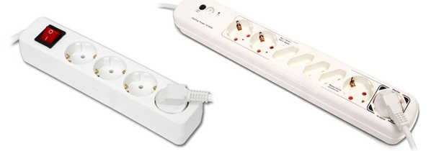
nZEB Renovation Schemes
Analysed Buildings - Elementary School of Solum
Renovation Scheme – ICT and Other
From the energy savings point of view, the most cost-effective solution is the installation of devices to reduce the standby consumption of ICT appliances, the so called standby killers.
The potential savings achieved with such devices do not depend on the technology, but on the users' behaviour. Therefore, such measure is not included in the renovation plan, but its implementation is recommended.
The cooking appliances also do not have a major impact on the total energy consumption and the quantity of equipment is low. Its renovation was not included in the plan. However, in the regular replacement of such appliances it is recommended to install just appliances with lower energy consumption (with label A+ or better).
© Copyright CERTUS Project 2017 - All Rights Reserved

Slide 52
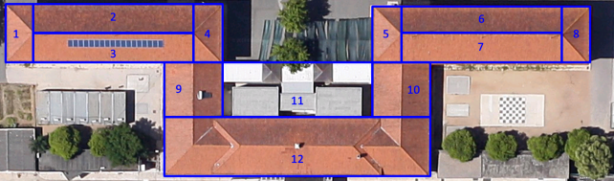
nZEB Renovation Schemes
Analysed Buildings - Elementary School of Solum
Renovation Scheme – Renewable Energy Sources (RES)
PV Generation - The figure below presents the different roof areas of the building. Area 12 belongs to other building and cannot be considered. In area 11 there is some shading due to the other building (area 12) and therefore this is not a good location to implement PV panels. Areas 1, 2, 4, 5, 6, 8, 9, 10 do not have a good orientation and the implementation of PV panels in such areas will require additional structures to improve the orientation of the panels which would have a high visual impact. Therefore, only areas 3 and 7 were selected to the implementation of PV panels.
© Copyright CERTUS Project 2017 - All Rights Reserved

Slide 53
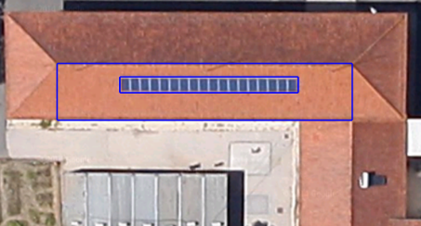
nZEB Renovation Schemes
Analysed Buildings - Elementary School of Solum
Renovation Scheme – Renewable Energy Sources (RES)
PV Generation (cont.) - In area 3 there is already a PV system and the best solution is to keep such system and to increase the number of PV panels using the available area.
The actual PV system has 18 panels and since area 3 has 30.33 x 5.19 m it would be possible to install 90 PV panels (3 rows with 30 PV panels). However, to do it, the actual PV system would have to be moved and the installation and maintenances of panels would be difficult due to the reduced area between the rows of panels.
© Copyright CERTUS Project 2017 - All Rights Reserved

Slide 54
nZEB Renovation Schemes
Analysed Buildings - Elementary School of Solum
Renovation Scheme – Renewable Energy Sources (RES)
PV Generation (cont.)
Therefore, 2 scenarios were considered:
Scenario 1: duplicate the row of 18 panels and use the same structure in area 7 (total of 72 panels).
Scenario 2: increase the row for 27 panels, duplicate the row and repeat the structure in the area 7 (total of 108 panels).
Both scenarios were simulated with PVSYST using the following parameters for the site and simulation:
Geographical Site | Coimbra
Country | Portugal
Latitude | 40.1°N
Longitude | 8.3°W
Time | Defined as Legal Time
Time zone | UT+1
Altitude | 141 m
Albedo | 0.20
Meteo data | Coimbra, Synthetic Hourly data
Collector Plane Orientation | Tilt 30° Azimuth -15°
Horizon | Free Horizon
Near Shadings | No Shadings
© Copyright CERTUS Project 2017 - All Rights Reserved

Slide 55
nZEB Renovation Schemes
Analysed Buildings - Elementary School of Solum
Renovation Scheme – Renewable Energy Sources (RES)
PV Generation (cont.) - Scenario 1 (72 modules)– Simulation
It was considered series of 18 modules and 4 strings in parallel with 4 inverters. The next table present this data:
PV module | Si-poly
Model | SINPRIME PREMIUM 235
Manufacturer | SINERGIAE
Number of PV modules | In series 18 modules In parallel 4 strings
Total number of PV modules | 72
Unit Nom. Power | 235 Wp
Array global power | Nominal (STC) 16.92 kWp At operating cond. 15.21 kWp (50°C)
Array operating characteristics (50°C) | U mpp 485 V I mpp 31 A
Total area | Module area 117 m² Cell area 43.2 m²
Model | Powador 4200
Manufacturer | KACO new energy
Characteristics | Operating Voltage 350-600 V Unit Nom. Power 3.45 kW AC
Inverter pack | Number of Inverter 4 units Total Power 13.80 kW AC
© Copyright CERTUS Project 2017 - All Rights Reserved

Slide 56
nZEB Renovation Schemes
Analysed Buildings - Elementary School of Solum
Renovation Scheme – Renewable Energy Sources (RES)
PV Generation (cont.) - Scenario 1 (72 modules)– Simulation
This scenario ensures a generation of 23.32 MWh/year, with a specific production of 1,378 kWh/kWp/year and a performance ratio of 78.3 %.
Produced Energy | 23.32 MWh/year
Specific prod. | 1,378 kWh/kWp/year
Performance Ratio PR | 78.3 %
© Copyright CERTUS Project 2017 - All Rights Reserved

Slide 57
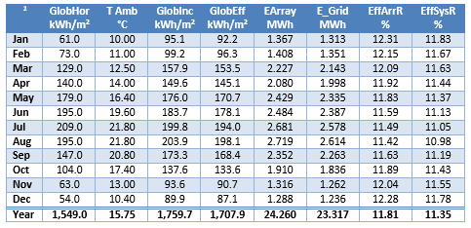
nZEB Renovation Schemes
Analysed Buildings - Elementary School of Solum
Renovation Scheme – Renewable Energy Sources (RES)
PV Generation (cont.) - Scenario 1 (72 modules)– Simulation
This table presents the variation during the whole year of the irradiation, temperature, energy and efficiency.
© Copyright CERTUS Project 2017 - All Rights Reserved

Slide 58
nZEB Renovation Schemes
Analysed Buildings - Elementary School of Solum
Renovation Scheme – Renewable Energy Sources (RES)
PV Generation (cont.) - Scenario 2 (108 modules)– Simulation
It was considered series of 18 modules and 6 strings in parallel with 6 inverters. The next table present this data:
PV module | Si-poly
Model | SINPRIME PREMIUM 235
Manufacturer | SINERGIAE
Number of PV modules | In series 18 modules In parallel 6 strings
Total number of PV modules | 108
Unit Nom. Power | 235 Wp
Array global power | Nominal (STC) 25.38 kWp At operating cond. 22.81 kWp (50°C)
Array operating characteristics (50°C) | U mpp 485 V I mpp 47 A
Total area | Module area 175 m² Cell area 64.8 m²
Model | Powador 4200
Manufacturer | KACO new energy
Characteristics | Operating Voltage 350-600 V Unit Nom. Power 3.45 kW AC
Inverter pack | Number of Inverter 6 units Total Power 20.70 kW AC
© Copyright CERTUS Project 2017 - All Rights Reserved

Slide 59
nZEB Renovation Schemes
Analysed Buildings - Elementary School of Solum
Renovation Scheme – Renewable Energy Sources (RES)
PV Generation (cont.) - Scenario 2 (108 modules)– Simulation
This scenario ensures a generation of 35.67 MWh/year, with a specific production of 1,405 kWh/kWp/year and a performance ratio of 79.9 %.
Produced Energy | 35.67 MWh/year
Specific prod. | 1,405 kWh/kWp/year
Performance Ratio PR | 79.9 %
© Copyright CERTUS Project 2017 - All Rights Reserved

Slide 60
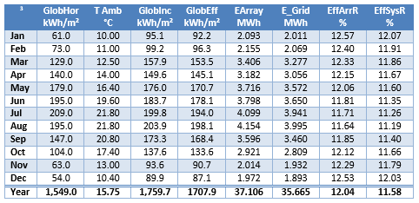
nZEB Renovation Schemes
Analysed Buildings - Elementary School of Solum
Renovation Scheme – Renewable Energy Sources (RES)
PV Generation (cont.) - Scenario 2 (108 modules)– Simulation
This table presents the variation during the whole year of the irradiation, temperature, energy and efficiency.
© Copyright CERTUS Project 2017 - All Rights Reserved

Slide 61
nZEB Renovation Schemes
Analysed Buildings - Elementary School of Solum
Renovation Scheme – Renewable Energy Sources (RES)
PV Generation (cont.) - Resuming
The next table presents the yearly generation in the 2 scenarios, as well as the percentage of consumption that can be ensured with such generation level.
As can be seen, excluding the consumption of the prefabricated building, both scenarios ensure more generation than the actual electricity consumption and scenario 2 ensures almost (90.8%) all the actual energy needs.
 | Actual 18 panels | Scenario 1 72 panels | Scenario 2 108 panels
Generation (kWh) | 6,100.9 | 23,316 | 35,665
% Electricity Cons. excl PF | 27.1% | 103.6% | 158.4%
% Electricity Cons. incl. PF | 19.8% | 75.8% | 116.0%
% Energy Cons. excl PF | 15.5% | 59.3% | 90.8%
% Energy Cons. incl. PF | 12.8% | 49.1% | 75.0%
© Copyright CERTUS Project 2017 - All Rights Reserved

Slide 62
nZEB Renovation Schemes
Analysed Buildings - Elementary School of Solum
Renovation Scheme – Renewable Energy Sources (RES)
Solar Thermal Collectors
The building already has a solar thermal collector and since the use of hot water is low, its increase was not considered in the renovation plan.
CHP
The building does not have a constant need of heating and therefore the installation of CHP technologies was not considered in the renovation plan.
© Copyright CERTUS Project 2017 - All Rights Reserved

Slide 63
nZEB Renovation Schemes
Analysed Buildings - Elementary School of Solum
Renovation Scheme – Total Impact – Energy Performance
In the assessment of the total impact the following 5 individual scenarios were considered:
PV1 – 72 PV panels;
PV2 – 108 PV panels;
Light1 – replacement of all T8 lamps with electromagnetic ballast by T5 lamps with electronic ballast;
Light2 – replacement of all lamps by LEDs.
HVAC1 – replacement of the gas boiler by a heat pump.
Additionally, it was considered the aggregation of scenarios.
The next table presents the achievable yearly savings, as well as the net energy consumption (difference between the energy consumption and generation) in each scenario.
© Copyright CERTUS Project 2017 - All Rights Reserved

Slide 64
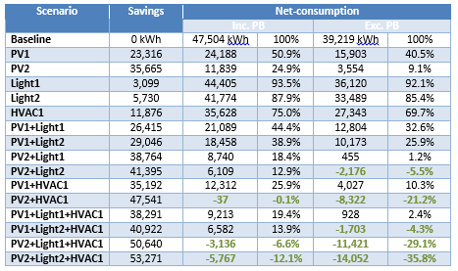
nZEB Renovation Schemes
Analysed Buildings - Elementary School of Solum
Renovation Scheme – Total Impact – Energy Performance
The negative values (green) represent situations where the energy generation is higher than the energy consumption.
© Copyright CERTUS Project 2017 - All Rights Reserved

Slide 65
nZEB Renovation Schemes
Analysed Buildings - Elementary School of Solum
Renovation Scheme – Total Impact – Energy Performance
There are several scenarios ensuring a negative net energy consumption (scenarios PV2+Light2, PV2+HVAC1, PV1+Light2+HVAC1, PV2+Light1+HVAC1, PV2+Light2+HVAC1), even including the consumption of the prefabricated building (scenarios PV2+HVAC1, PV2+Light1+HVAC1, PV2+Light2+HVAC1).
However, several scenarios result in negative net energy consumption, i.e. more PV-production than needed, since the ideal is to have almost zero net energy consumption in order to avoid unnecessary investments.
The scenarios that are closer to achieve a zero net energy consumption are scenarios PV2+Light1 (1.2%) and PV1+Light1+HVAC1 (2,4%).
Scenario PV1+Light1+HVAC1 has a good balance between the increase of PV generation level and the increase of efficiency in the two main systems (lighting and HVAC) and is therefore the best solution for achieve a Zero Energy Building.
© Copyright CERTUS Project 2017 - All Rights Reserved

Slide 66
nZEB Renovation Schemes
Analysed Buildings - Elementary School of Solum
Renovation Scheme – Total Impact – Energy Performance
Therefore, the selected scenario is constituted by:
Increase the PV system to 72 PV panels;
Replacement of all T8 lamps with electromagnetic ballast by T5 lamps with electronic ballast;
Replacement of the gas boiler by a heat pump.
© Copyright CERTUS Project 2017 - All Rights Reserved

Slide 67
nZEB Renovation Schemes
Analysed Buildings - Elementary School of Solum
Renovation Scheme – Total Impact – Energy Performance
Selected Scenario:
  HVAC
 | Baseline | Renovation
Consumption (kWh) | 16775 | 4901.8
Savings (kWh) | - | 11873.2
Savings (%) | - | 70.8%
  Lighting
 | Baseline | Renovation
Consumption (kWh) | 9897 | 6798
Savings (kWh) | - | 3099
Savings (%) | - | 31.3%
  PV
 | Baseline 18 panels | Renovation 72 panels
Generation (kWh) | 6100.9 | 23316
% Electricity Cons. | 27.1% | 103.6%
% Energy Cons. | 15.5% | 59.3%
© Copyright CERTUS Project 2017 - All Rights Reserved

Slide 68
nZEB Renovation Schemes
Analysed Buildings - Elementary School of Solum
Renovation Scheme – Total Impact – Environmental Performance
With the renovation 96.2% of the consumed energy is ensured by renewable energy sources, therefore achieving the aim of 95% renewable energy sources.
 | Energy Consumption kWh | Energy Generation kWh | Energy Generation %
Renovation | 24,244 | 23,316 | 96.2%
The results were also assessed in terms of final energy, primary energy and CO₂ emissions considering the following conversion factors:
electricity to primary energy - 2.5 (standard value approved for Portugal);
natural gas to primary energy - 1.0 (standard value);
electricity to CO₂ emissions - 139.89 g/kWh (average emissions associated with the electricity consumed in Portugal during 2013);
natural gas to CO₂ emissions - 202 g/kWh (standard value).
© Copyright CERTUS Project 2017 - All Rights Reserved

Slide 69
nZEB Renovation Schemes
Analysed Buildings - Elementary School of Solum
Renovation Scheme – Total Impact – Environmental Performance
The renovation plan can ensure 97.6% savings in final energy, 96.8% savings in primary energy and 98.0% savings in CO₂ emissions, therefore achieving the aim of 95% of primary energy reduction.
 | Final Energy kWh | Energy Dens. kWh/m² | Primary Energy kWh | CO₂ Emissions kg CO₂ /kWh
Electricity base. | 22,516 | 13.60 | 56,290 | 3,149.8
Gas base. | 16,775 | 10.14 | 16,775 | 3,388.6
Total base. | 39,291 | 23.74 | 73,065 | 6,538.3
Electricity renov. | 928 | 0.56 | 2,320 | 129.8
Gas renov. | 0 | 0 | 0 | 0
Total renov. | 928 | 0.56 | 2,320 | 129.8
Savings | 38,363 | 23.18 | 70,745 | 6,408.5
Savings (%) | 97.6% | 97.6% | 96.8% | 98.0%
© Copyright CERTUS Project 2017 - All Rights Reserved

Slide 70
nZEB Renovation Schemes
Analysed Buildings - Elementary School of Solum
Economic Evaluation of the Proposed Renovation Scheme – Assumptions and Cost Figures
The costs of the selected renovation options were determined by consulting catalogues and installers and considering a typical reduction of costs due to the quantity.
Costs for the following renovation options:
Installation of 12.69 kWp of PV panels (54 panels);
Installation of 143 T5 lamps and luminaries with electronic ballast;
Installation of heat pump with 11 kW to replace a gas boiler.
Renovation Option | Equipment € | Installation € | Total €
PV | 16,922 | 5,071 | 21,993
Lighting | 2,205 | 715 | 2,920
HVAC | 5,306 | 1,250 | 6,556
Total | 24,433 | 7,036 | 31,469
© Copyright CERTUS Project 2017 - All Rights Reserved

Slide 71
nZEB Renovation Schemes
Analysed Buildings - Elementary School of Solum
Economic Evaluation of the Proposed Renovation Scheme – Assumptions and Cost Figures
The next table presents the actual tariffs of the consumed electricity in the building, disaggregated by period.
Period | Energy €/kWh | Taxes €/kWh | Total €/kWh
On-Peak | 0.2938 | 0.0686 | 0.3624
Mid-Peak | 0.1477 | 0.0350 | 0.1827
Off-Peak | 0.0845 | 0.0204 | 0.1049
Considering the actual distribution of the consumption between periods, the average costs were obtained using 2 scenarios, considering just the daylight hours (to be used in the evaluation of PV generation) and considering all the periods.
Period | Cost €/kWh | Consumption % | Day €/kWh | Total €/kWh
On-Peak | 0.3624 | 18.4% | 0.2260 | 0.1974
Mid-Peak | 0.1827 | 58.0%
Off-Peak | 0.1049 | 23.6%
© Copyright CERTUS Project 2017 - All Rights Reserved

Slide 72
nZEB Renovation Schemes
Analysed Buildings - Elementary School of Solum
Economic Evaluation of the Proposed Renovation Scheme – Results
PV Generation Results
In the evaluation of the PV generation it was considered the self-consumption of 90% of the energy, since in a working day during the period of classes, the additional consumption of the pre-fabricated building ensures that all the generation can be consumed locally.
The exceptions are the weekends and periods without classes, since the consumption is low and therefore part of the energy should be injected into grid.
In the economic evaluation, the self-consumption was considered to avoid the average cost of energy during the daylight hours (0.2260 €/kWh), the energy injected into the grid, with the new Portuguese regulation for self-consumption, is paid with 90% of the average cost of the electricity in the Electricity Market during the correspondent month (it was considered as 0.05 €/kWh).
With such conditions the renovation options ensures savings of 3,588 €/year and has a simple payback period of 6.1 years.
© Copyright CERTUS Project 2017 - All Rights Reserved

Slide 73
nZEB Renovation Schemes
Analysed Buildings - Elementary School of Solum
Economic Evaluation of the Proposed Renovation Scheme – Results
Lighting Results
In the evaluation of the lighting savings it was considered the average cost of the electricity. The lifetime was assessed considering the average hours of use for the lamps and its maximum total hours of operation.
With such conditions the renovation options ensures savings of 612 €/year and has a simple payback period of 4.8 years.
HVAC Results
In the evaluation of the HVAC savings it was considered the cost of the electricity during the mid-peak period (the period of operation matches such period) and the saving of the actual natural gas costs.
With such conditions the renovation options ensures savings of 882 €/year and has a simple payback period of 7.4 years.
© Copyright CERTUS Project 2017 - All Rights Reserved

Slide 74
nZEB Renovation Schemes
Analysed Buildings - Elementary School of Solum
Economic Evaluation of the Proposed Renovation Scheme – Results
PV generation – Economic Parameters
HVAC – Economic Parameters
Energy Generation | 17,216 kWh
Energy - Self-Consumption | 90%
Energy - Injected Into Grid | 10%
Price – Self-Consumption | 0.2260 €/kWh
Price - Injected Into Grid | 0.05 €/kWh
Costs | 21,993 €
Savings | 3,588 €/year
Simple Payback | 6.1 years
Lifetime | 30 years
CO₂ Savings | 2.41 tons/year
Lighting – Economic Parameters
Energy Savings | 11,876 kWh
Gas Costs (before) | 1,778 €
Price - Electricity | 0.1827 €/kWh
Electricity Costs (after) | 896 €
Costs | 6,556 €
Savings | 882 €/year
Simple Payback | 7.4 years
Lifetime | 20 years
CO₂ Savings | 2.70 tons/year
Energy Savings | 3,099 kWh
Price - Saved Energy | 0,1974 €/kWh
Costs | 2,920 €
Savings | 612 €/year
Simple Payback | 4.8 years
Lifetime | 13 years
CO₂ Savings | 0.43 tons/year
© Copyright CERTUS Project 2017 - All Rights Reserved

Slide 75
nZEB Renovation Schemes
Analysed Buildings - Elementary School of Solum
Economic Evaluation of the Proposed Renovation Scheme – Results
The next table presents the aggregation of the renovation option. As can be seen, the total of the renovation plan ensures savings of 5,082 €/year and has a simple payback period of 6.19 years
Energy Savings | 32,191 kWh
Costs | 31,469 €
Savings | 5,082 €/year
Simple Payback | 6.19 years
CO₂ Savings | 5.54 tons/year
© Copyright CERTUS Project 2017 - All Rights Reserved

Slide 76

nZEB Renovation Schemes
Analysed Buildings - Municipal House of Culture
Description
© Copyright CERTUS Project 2017 - All Rights Reserved

Slide 77
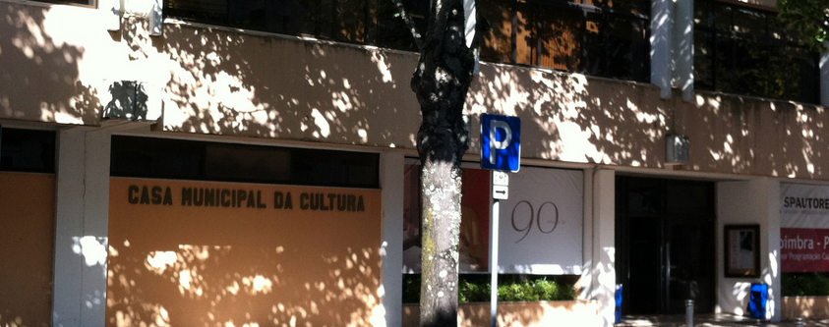
nZEB Renovation Schemes
Analysed Buildings - Municipal House of Culture
Description
Municipal House of Culture: The building was built in 1991-1993 and opened on October, 26th 1993. The building is located near to the city centre and near to the University. It is used as Municipal House of Culture and has several cultural equipment, such as library, auditorium and art gallery, as well as several offices.
© Copyright CERTUS Project 2017 - All Rights Reserved

Slide 78
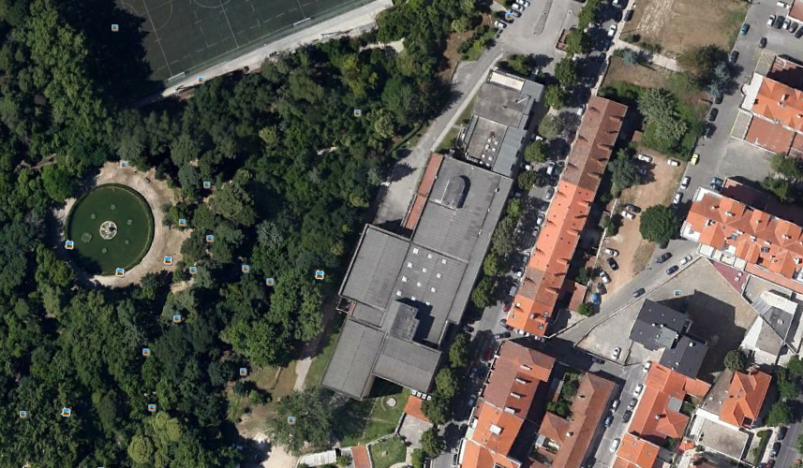
nZEB Renovation Schemes
Analysed Buildings - Municipal House of Culture
Shape and Orientation
The building has total area of about 13,225 m² with a total used surface of about 9,862 m² .
It is oriented along an Southwest axis with the main façade in the east.
The roof is is flat without tiles and has a surface of 2,565 m². The roof is now constituted by asbestos-cement slabs. However, it will soon be replaced by a sandwich panel constituted by two thermolacquered metal sheets with 80 mm of polyurethane insulation.
© Copyright CERTUS Project 2017 - All Rights Reserved

Slide 79
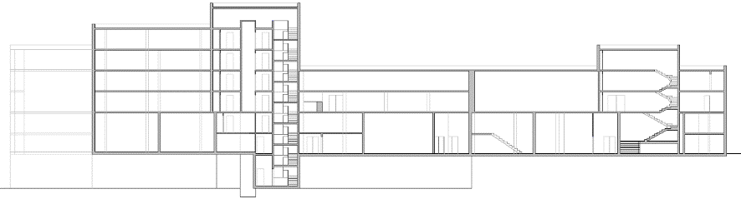
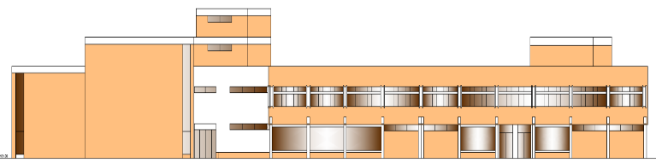
nZEB Renovation Schemes
Analysed Buildings - Municipal House of Culture
Shape and Orientation
The building has has 8 floors, with 3 floors below and 4 floors above the ground floor;
The building has total area of about 13,225 m² and a volume of 39,944 m³
General Data |  | Dimension Parameters
Year of construction | 1959-1993 | Area | 13 225 m²
Use | Library, Auditorium, Art gallery, etc. | Floors | 8
Officially Protected | No | Volume | 39 944 m³
© Copyright CERTUS Project 2017 - All Rights Reserved

Slide 80
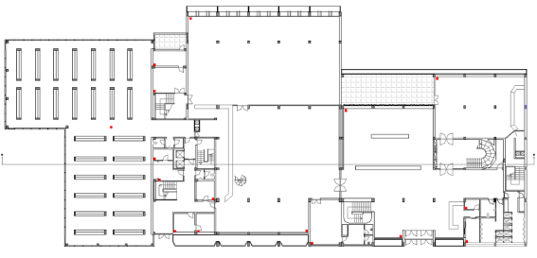
nZEB Renovation Schemes
Analysed Buildings - Municipal House of Culture
Current Use
The users have access to the rooms of public use only after 10h00.
The refectory works between 8h30 and 17h00 (Monday to Friday), with the lunches served between 12h00 and 15h00. In the periods 09h00-11h00 and 12h00-16h45 the refectory works as cafeteria. The refectory is closed during August and during the Christmas and Easter holidays.
The CAPC has not had any regular activity.
© Copyright CERTUS Project 2017 - All Rights Reserved

Slide 81
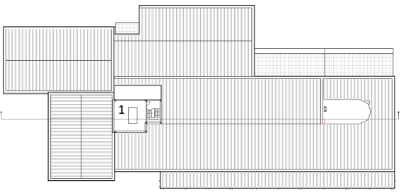
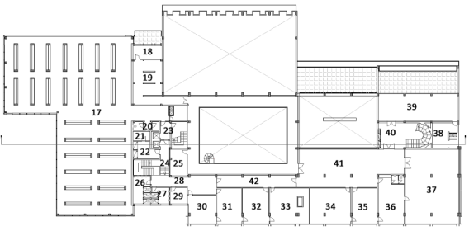
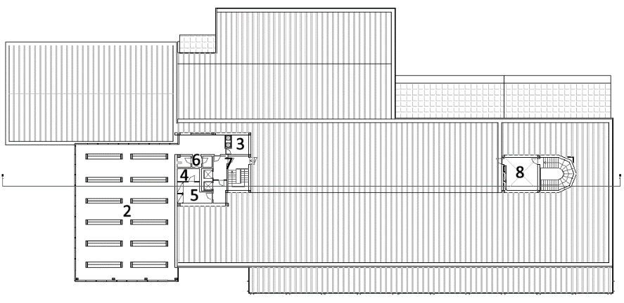
nZEB Renovation Schemes
Analysed Buildings - Municipal House of Culture
Current Use
Floor 4
Floor 1
Floor 3
© Copyright CERTUS Project 2017 - All Rights Reserved

Slide 82
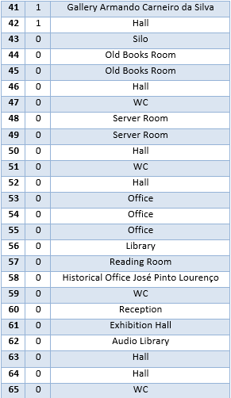
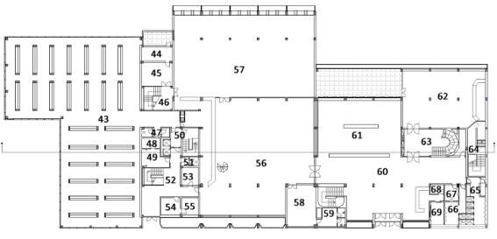
nZEB Renovation Schemes
Analysed Buildings - Municipal House of Culture
Current Use
Floor 0 (example):
© Copyright CERTUS Project 2017 - All Rights Reserved

Slide 83
nZEB Renovation Schemes
Analysed Buildings - Municipal House of Culture
Current Use
The building is the Municipal House of Culture and has several cultural equipment, such as library, auditorium and art gallery.
There are two areas of the building loaned to other entities:
Part of floor -2 is one refectory used by the University of Coimbra;
Part of floor -3 is used by the CAPC - Círculo de Artes Plásticas de Coimbra (cultural association of contemporary art).
These spaces are managed by such entities, but they receive electricity from the main board of the building, being the electricity paid by the Municipality .
The building has 80 employees and is visited by 17,500 users/year and works with the following schedule:
July 15th to September 15° -> Monday to Friday: 9h00 – 18h30
September 16th to July 14° -> Monday to Friday: 9h00 – 19h30 and Saturday: 11h00 – 13h00 and 14h00 and 19h00
© Copyright CERTUS Project 2017 - All Rights Reserved

Slide 84
nZEB Renovation Schemes
Analysed Buildings - Municipal House of Culture
Current Building Conditions – Constructive Characteristics
Envelope Elements
The walls of the front have a total surface of 800 m² of which 184 m² is transparent (22.9%), the back walls have a total surface of 1,415 m², of which 610 m² is transparent (43.1%) and the lateral south walls have a total surface of 343 m², of which 50 m² is transparent (14.6%). The lateral North just have a small window, since it is connected with other building.
The external walls are made of breeze blocks and bricks and have a thickness of 20 to 55 cm.
Structure | Orient. | A | U | Abs. | Α.U.A.Rse | U.A.
 |  | m² | W/m² ºC | α | W/ ºC | W/ ºC
Wall - Back | NW | 1,415 | 0.29 | 0.6 | 9.85 | 410.4
Wall - Lateral | SW | 343 | 0.29 | 0.6 | 2.39 | 99.5
Wall - Front | SE | 800 | 0.29 | 0.6 | 5.57 | 232.0
Wall - Lateral | NW | 10 | 0.29 | 0.6 | 0.07 | 2.9
Roof | - | 2,565 | 0.5 | 0.4 | 20.52 | 1282.5
© Copyright CERTUS Project 2017 - All Rights Reserved

Slide 85
nZEB Renovation Schemes
Analysed Buildings - Municipal House of Culture
Current Building Conditions – Constructive Characteristics
Windows and Doors - All the windows are of single glazing with aluminium frames. The doors have the same characteristics of the windows and therefore they were grouped.
In the front there are the following windows/doors:
12 operable of 1.55 x 0.50 m
2 operable of 1.45 x 0.50 m
6 operable of 1.67 x 0.60 m
4 operable of 1.6 x 0.60 m
10 operable of 4.4 x 1.70 m
5 fixed of 4.7 x 2.2 m
1 fixed of 1.06 x 9.55 m
1 fixed of 1.10 x 7.05 m
1 door of 4.25 x 2.90 m
1 door of 2.90 x 2.50 m
In the back there are the following windows/doors:
1 operable of 4.75 x 1.50 m
1 operable of 4.75 x 1.80 m
2 operable of 4.75 x 2.20 m
1 operable of 25.00 x 3.30 m
1 operable of 4.65 x 2.20 m
12 operable of 4.65 x 1.90 m
4 operable of 1.60 x 0.60 m
6 fixed of 4.65 x 4.65 m
4 fixed of 4.95 x 1.95 m
1 fixed of 21.40 x 2.80 m
5 fixed of 4.65 x 3.30 m
2 fixed of 0.80 x 2.44 m
3 fixed of 0.80 x 2.34 m
1 fixed of 0.80 x 2.24 m
1 door of 4.60 x 2.90 m
© Copyright CERTUS Project 2017 - All Rights Reserved

Slide 86
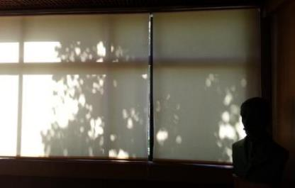
nZEB Renovation Schemes
Analysed Buildings - Municipal House of Culture
Current Building Conditions – Constructive Characteristics
Windows and Doors (cont.) - Almost all the windows have interior shutters (figure bellow), the exceptions is the front of floor 0 where darkened windows are used.
In the lateral South there are the following windows/doors:
1 fixed of 1.10 x 12.50 m
1 fixed of 1.10 x 10.00 m
1 fixed of 1.10 x 7.50 m
1 fixed of 1.10 x 1.10 m
1 fixed of 3.30 x 1.10 m
1 door of 2.90 x 2.50 m
1 door of 2.80 x 1.80 m
In the lateral
1 fixed window of 1.70 x 1.10 m.
© Copyright CERTUS Project 2017 - All Rights Reserved

Slide 87
nZEB Renovation Schemes
Analysed Buildings - Municipal House of Culture
Current Building Conditions – Constructive Characteristics
Windows
Structure | Orient. | A | U | F_{g} | Α_{eq} | U.A.
 |  | m² | W/m² ºC |  | m² | W/ ºC
Windows - Back | NW | 610 | 5.7 | 0.84 | 512.4 | 3,477.0
Windows - Lateral | SW | 50 | 5.7 | 0.84 | 42.0 | 285.0
Windows - Front | SE | 184 | 5.7 | 0.84 | 154.6 | 1,048.8
© Copyright CERTUS Project 2017 - All Rights Reserved

Slide 88

nZEB Renovation Schemes
Analysed Buildings - Municipal House of Culture
Current Building Conditions – Constructive Characteristics
Airtightness and Pathologies
The building does not present major airflows;
On the back façade there are condensations, mainly in areas covered with vegetation.
© Copyright CERTUS Project 2017 - All Rights Reserved

Slide 89






nZEB Renovation Schemes
Analysed Buildings - Municipal House of Culture
Current Building Conditions – Existent Energy Systems
Lighting
The lighting is usually ensured by fluorescent lamps. Most of the rooms have a false roof in wood with small square holes, being the luminaries installed above the false roof ;
The lighting fixtures are open luminaires with double reflector and have 2 or 3 lamps;
The installation of the lamps above the false roof causes a high loss of luminosity, which is aggravated by the difficulty of maintenance of such luminaries, being very common to find faulty lamps. These situations lead to a low visibility in some areas;
In the rooms without false roof, such as offices and circulation areas there are several types of luminaires;
In the silos and storage areas, the lighting fixtures are usually open luminaires without reflector.
© Copyright CERTUS Project 2017 - All Rights Reserved

Slide 90



nZEB Renovation Schemes
Analysed Buildings - Municipal House of Culture
Current Building Conditions – Existent Energy Systems
Lighting (cont.)
In the circulation areas the lamps are usually of 18 W and in the remaining areas are of 58 W. Almost all the lamps are T8 with ferromagnetic ballasts. The exception is just one circulation area where T5 lamps with electronic ballasts (stairs of area 52 – floor 0 to -2) are already used.;
Some rooms with double height ceiling use incandescent and halogen lamps;
The bathrooms had incandescent lamps. However, some lamps were already replaced by CFL and one bathroom (near to the reception on floor 0), recently renovated, already have LED lamps;
The control of the lighting in the circulation areas, bathrooms and rooms receiving public is directly ensured in the electrical board. This is a major problem in circulation areas, since areas with reduced utilization (in parts of the building not receiving public) have the lightning permanently turned ON during the working hours. In offices and other rooms the control is ensured locally by switches/commutators.
© Copyright CERTUS Project 2017 - All Rights Reserved

Slide 91
nZEB Renovation Schemes
Analysed Buildings - Municipal House of Culture
Current Building Conditions – Existent Energy Systems
Lighting - Types and quantities of lamps
Lamp Type | Quantity n | Power W
Fluorescent Linear T8 F60 | 9 | 211
Fluorescent Linear T8 F120 | 803 | 37,580
Fluorescent Linear T8 F150 | 312 | 21,091
Fluorescent Linear T5 F60 | 8 | 136
Incandescent | 23 | 1,380
Halogen Projector | 24 | 7,200
Halogen Spot | 5 | 250
Compact Fluorescent | 70 | 1,260
LED Spot | 12 | 66
Total | 1,266 | 69,174
© Copyright CERTUS Project 2017 - All Rights Reserved

Slide 92

nZEB Renovation Schemes
Analysed Buildings - Municipal House of Culture
Current Building Conditions – Existent Energy Systems
HVAC – Air Conditioning or Heating Systems
Almost all working rooms, as well as all the rooms receiving have acclimatization. The circulation areas do not have acclimatization. The total acclimatized area is about 6,900 m².
The building does not have a centralized HVAC system. It has several mono-split units, which were gradually installed.
The exception to it, are the silos / storage areas which have systems (one in each silo) of temperature and humidity control with pipelines to protect the publications.
The total number of HVAC devices is:
9 systems of temperature and humidity control with pipelines with a total power of 301 kW
36 mono-split systems with heat pumps installed in the wall or roof with a total power of 239.27 kW
© Copyright CERTUS Project 2017 - All Rights Reserved

Slide 93
nZEB Renovation Schemes
Analysed Buildings - Municipal House of Culture
Current Building Conditions – Existent Energy Systems
HVAC - Air Conditioning or Ventilation Systems– Technical Data
The system of temperature and humidity control uses units CIATESA ISW-120
The control of the temperature and humidity control systems is ensured in an electrical board near to each system. The control of the split systems in directly ensured in the device or using an infrared remote control.
P_{cooling-ther} (kW) | P_{cooling-elect} (kW) | EER | P_{heating-ther} (kW) | P_{heating-elect} (kW) | COP | P_{compressor} (kW) | P_{ventilator} (kW)
29.7 | 12.2 | 2.43 | 30.3 | 10.2 | 2.97 | 7.5 | 1.1
© Copyright CERTUS Project 2017 - All Rights Reserved

Slide 94
nZEB Renovation Schemes
Analysed Buildings - Municipal House of Culture
Current Building Conditions – Existent Energy Systems
HVAC - Air Conditioning or Ventilation Systems– Technical Data
The bathrooms in floor 0 (areas 65 and 66) have ventilation which is permanently connected.
It was detected that 4 of the 9 systems of temperature and humidity control are not working (the employees working in the library do not know the reason to it). These systems control the conditions in the silos situated in the front of the building.
The total power of the HVAC systems is 540.27 kW.
© Copyright CERTUS Project 2017 - All Rights Reserved

Slide 95
nZEB Renovation Schemes
Analysed Buildings - Municipal House of Culture
Current Building Conditions – Existent Energy Systems
ICT - Information and Communications Technologies
The communication devices but also other electronic devices, such as computers, printers, etc. are considered as ICT
In this case there are also access points and a rack/server to the wireless network.
Most of the offices and rooms have computers and printers and there is a room with servers and an internal circuit of CCTV for security.
There are photocopier machines and video projectors in some rooms.
Due to fact that ICT equipments exist in large number they are not listed here.
© Copyright CERTUS Project 2017 - All Rights Reserved

Slide 96
nZEB Renovation Schemes
Analysed Buildings - Municipal House of Culture
Current Building Conditions – Existent Energy Systems
Others
The cooking equipment is just used in the University refectory. Since this space is not managed by the Municipality, such equipment cannot be changed and therefore is not considered in the renovation plan;
Near to the reception in floor 0 there are 2 vending machines;
The building has 2 lifts (e.g. areas 78 and 79 of floor -1). The use of such lifts is low since they serve areas without public;
There are 2 small goods lifts to ensure the transportation of books between silos (e.g. area 74 of floor -1).
© Copyright CERTUS Project 2017 - All Rights Reserved

Slide 97

nZEB Renovation Schemes
Analysed Buildings - Municipal House of Culture
Current Building Conditions – Energy Consumption And Energy Generation
Energy Consumption -Present Scenario (excluding the refectory)
Electricity Consumption | 521 MWh
Electricity Cost | 84 k€
Gas Consumption | 0 MWh
Gas Cost | 0 k€
Voltage Level | Medium Voltage (15 kV)
Contracted Power | 292.95 kW
Tariff Option | Energy + Grid + MV
Cycle | Weekly + public holidays
© Copyright CERTUS Project 2017 - All Rights Reserved

Slide 98
nZEB Renovation Schemes
Analysed Buildings - Municipal House of Culture
Current Building Conditions – Energy Consumption And Energy Generation
Baseline - Present Scenario
In 2013 the building had an electricity consumption of about 521 MWh and an associated cost of about 84 k€.
The energy audit confirmed that the consumption have been decreasing during the last 2 years.
This is not due to any major replacement of equipment or reduction of use. The main reasons for such decrease is that at the present time refectory just serves lunches and works as cafeteria (until 2011 it used to serve dinners); there are several lamps burned out and some incandescent lamps were replaced by CFLs; 4 of the 9 systems of temperature and humidity control are not working.
 | Final Energy kWh | Energy Dens. kWh/m² | Primary Energy kWh | CO₂ Emissions kg CO₂ /kWh
Electricity | 487229 | 49.4 | 1218073 | 68158.5
Gas | 0 | 0 | 0 | 0
Generation | 0 | 0 | 0 | 0
Total | 487229 | 49.4 | 1218073 | 68158.5
© Copyright CERTUS Project 2017 - All Rights Reserved

Slide 99

nZEB Renovation Schemes
Analysed Buildings - Municipal House of Culture
Current Building Conditions –Energy Consumption And Energy Generation
Energy Consumption -Present Scenario
On-Peak | 21.2%
Mid-Peak | 63.1%
Normal Off-Peak | 11.3%
Super Off-Peak | 4.3%
© Copyright CERTUS Project 2017 - All Rights Reserved

Slide 100
nZEB Renovation Schemes
Analysed Buildings - Municipal House of Culture
Current Building Conditions –Energy Consumption And Energy Generation
Energy Generation with RES - Present Scenario
  No generation systems installed in the buildings at the present time.
Other Energy Generation or Backup systems without RES - Present Scenario
  The building has a backup diesel generator with 80 kVA.
© Copyright CERTUS Project 2017 - All Rights Reserved

Slide 101
nZEB Renovation Schemes
Analysed Buildings - Municipal House of Culture
Current Building Conditions –Final Energy Consumption And Energy Generation
Future Scenarios – After the renovation
Main assessed scenarios:
    PV – 770 PV panels;
    Light1 – replacement of all T8 lamps with electromagnetic ballast by T5 lamps with electronic ballast and replacement of the incandescent lamps by CFLs;
    Light2 - Replacement of all lamps by LEDs;
    HVAC – Replacement of the THC and mono-split system by systems with higher COP/EER.
Scenario | Savings | Net-consumption
Baseline | 0 kWh | 487229 kWh | 100%
PV | 254200 | 233029 | 47.8%
Light1 | 43400 | 443829 | 91.1%
Light2 | 101157 | 386072 | 79.2%
HVAC | 118393 | 368836 | 75.7%
PV+Light1 | 297600 | 189629 | 38.9%
PV+Light2 | 355357 | 131872 | 27.1%
PV+HVAC1 | 372593 | 114636 | 23.5%
PV+Light1+HVAC | 415993 | 71236 | 14.6%
PV+Light2+HVAC | 473750 | 13479 | 2.8%
© Copyright CERTUS Project 2017 - All Rights Reserved

Slide 102
nZEB Renovation Schemes
Analysed Buildings - Municipal House of Culture
Current Building Conditions –Final Energy Consumption And Energy Generation
Selected Scenario
PV1+Light2+HVAC (near to a zero net-consumption with a good balance between technologies):
    Installation of 181 kWp of PV panels (770 panels)
    Installation of 1254 LED lamps
    Installation of high efficiency multi and mono-split HVAC systems with a total power of 494.5 kW
© Copyright CERTUS Project 2017 - All Rights Reserved

Slide 103
nZEB Renovation Schemes
Analysed Buildings - Municipal House of Culture
Renovation Scheme - Aim
Aim of the Renovation Plan - an average primary energy reduction between 75% and 80% of the current demand and to ensure that between 50% and 90% of the consumed energy is generated by renewable energy sources installed in the building
Since there is enough available roof area without shadings and with a good solar radiation levels the aim was redefined to achieve a minimum primary energy reduction of 95%, ensuring, at least, 95% of the consumption with renewable energy sources, therefore achieving almost a Zero Energy Level.
© Copyright CERTUS Project 2017 - All Rights Reserved

Slide 104
nZEB Renovation Schemes
Analysed Buildings - Municipal House of Culture
Renovation Scheme - Aim
Constraints:
Part of floor -2 is a refectory from the University of Coimbra. However, this refectory receives electricity from the municipal house of culture without any individual metering. Therefore, its consumption is included in the total consumption of the building, but such energy consumption cannot be considered as a consumption of the studied building. The consumption of the refectory was assessed (considered to be 17% of the total energy consumption) and subtracted from the total considered for the building. Therefore, the consumption level considered in the renovation plan excludes the consumption of the refectory.
It was detected that 4 of the 9 systems of temperature and humidity control (THC) are not working and therefore the baseline was corrected to take into account the consumption of all 9 systems. Therefore, the consumption level considered in the renovation plan includes the consumption of 9 THC systems.
The building has an intensive utilization, receiving a large number of visitors, and is the working place for a large number of Municipal employees and such activities cannot be interrupted since it is not easy to temporarily move the services to another building. Therefore, renovation options requiring major construction works, incompatible with the normal activities of the building, were avoided in the renovation plan.
© Copyright CERTUS Project 2017 - All Rights Reserved

Slide 105

nZEB Renovation Schemes
Analysed Buildings - Municipal House of Culture
Renovation Scheme – Energy Demand Reduction
Opaque Envelope
The roof has already been renovated (replacement of the asbestos-cement slabs by a sandwich panel constituted by two thermolacquered metal sheets with 80 mm of polyurethane insulation).
Other renovation options, requiring construction works in the façades were considered. However, the renovation options requiring major construction works, incompatible with the normal activities of the building, should be avoided due to the incompatibility between use and renovation works.
Since the other solutions (efficiency of the energy systems and renewable energy resources) present enough potential to achieve the objectives and ensure higher cost-effectiveness, the renovation of the envelope was not considered in the renovation plan.
© Copyright CERTUS Project 2017 - All Rights Reserved

Slide 106

nZEB Renovation Schemes
Analysed Buildings - Municipal House of Culture
Renovation Scheme – Energy Demand Reduction
Openings
Due to the same reasons as in the opaque envelope (incompatibility between use and renovation works and availability of other solutions with higher cost-effectiveness) the improvement of openings was not considered in the renovation plan.
© Copyright CERTUS Project 2017 - All Rights Reserved

Slide 107


nZEB Renovation Schemes
Analysed Buildings - Municipal House of Culture
Renovation Scheme – Energy Demand Reduction
Other Strategies
There are no other strategies considered in the renovation for the energy demand reduction.
© Copyright CERTUS Project 2017 - All Rights Reserved

Slide 108
nZEB Renovation Schemes
Analysed Buildings - Municipal House of Culture
Renovation Scheme – Energy Systems
Lighting System
The actual lighting system is mainly constituted by fluorescent linear T8 lamps with electromagnetic ballast.
Lamp Type | Quantity n | Power W
Fluorescent Linear T8 F60 | 9 | 211
Fluorescent Linear T8 F120 | 803 | 37,580
Fluorescent Linear T8 F150 | 312 | 21,091
Fluorescent Linear T5 F60 | 8 | 136
Incandescent | 23 | 1,380
Halogen Projector | 24 | 7,200
Halogen Spot | 5 | 250
Compact Fluorescent | 70 | 1,260
LED Spot | 12 | 66
Total | 1,266 | 69,174
© Copyright CERTUS Project 2017 - All Rights Reserved

Slide 109
nZEB Renovation Schemes
Analysed Buildings - Municipal House of Culture
Renovation Scheme – Energy Systems
Lighting System (cont.)
Regarding the retrofit of the lighting system 2 scenarios were considered:
Scenario 1 - Replacement of all T8 lamps with electromagnetic ballast by T5 lamps with electronic ballast and replacement of the incandescent lamps by CFLs;
Scenario 2 - Replacement of all lamps by LEDs.
© Copyright CERTUS Project 2017 - All Rights Reserved

Slide 110
nZEB Renovation Schemes
Analysed Buildings - Municipal House of Culture
Renovation Scheme – Energy Systems
Lighting System (cont.)
In scenario 1:
1,146 lamps and 1,124 ballasts have to be replaced. The next table presents each lamp type and its correspondent power.
Lamp Type | Quantity n | Lamp W | Lamp+Ballast W
Fluorescent Linear T5 F150 | 312 | 49 | 56
Fluorescent Linear T5 F120 | 803 | 28 | 30
Fluorescent Linear T5 F60 | 9 | 14 | 17
Compact Fluorescent | 23 | 18 | -
© Copyright CERTUS Project 2017 - All Rights Reserved

Slide 111
nZEB Renovation Schemes
Analysed Buildings - Municipal House of Culture
Renovation Scheme – Energy Systems
Lighting System (cont.)
In scenario 1: The next table show the new distribution of lamps. As can be seen the total power decreases to 51,041 W (reduction of 26%).
Lamp Type | Quantity n | Total Power W
Fluorescent Linear T8 F150 | 312 | 17,472
Fluorescent Linear T8 F120 | 803 | 24,090
Fluorescent Linear T8 F60 | 17 | 289
Compact Fluorescent | 93 | 1,674
Halogen Projector | 24 | 7,200
Halogen Spot | 5 | 250
LED Spot | 12 | 66
Total | 1,266 | 51,041
© Copyright CERTUS Project 2017 - All Rights Reserved

Slide 112
nZEB Renovation Schemes
Analysed Buildings - Municipal House of Culture
Renovation Scheme – Energy Systems
Lighting System (cont.)
In Scenario 2:
1,254 lamps have to be replaced. The next table presents the lamps to be installed.
Lamp Type | Quantity n | Lamp W
LED Linear F150 | 312 | 24.0
LED Linear F120 | 803 | 20.0
LED Linear F60 | 17 | 10.0
LED Bulb | 93 | 9.5
LED Projector | 24 | 100.0
LED Spot | 5 | 5.5
© Copyright CERTUS Project 2017 - All Rights Reserved

Slide 113
nZEB Renovation Schemes
Analysed Buildings - Municipal House of Culture
Renovation Scheme – Energy Systems
Lighting System (cont.)
In Scenario 2: The next table presents the new lamp distribution. As can be seen the total power decreases to 27,095 W (reduction of 61%).
Lamp Type | Quantity n | Total Power W
LED Linear F150 | 312 | 7,488.0
LED Linear F120 | 803 | 16,060.0
LED Linear F60 | 17 | 170.0
LED Bulb | 93 | 883.5
LED Projector | 24 | 2,400.0
LED Spot | 17 | 93.5
 | 1,266 | 27,095
© Copyright CERTUS Project 2017 - All Rights Reserved

Slide 114
nZEB Renovation Schemes
Analysed Buildings - Municipal House of Culture
Renovation Scheme – Energy Systems
Lighting System (cont.)
Yearly consumption with lighting in the 2 scenarios
Such energy consumptions were simulated considering the actual usage profile for each lamp type and room of the building.
Scenario 1 ensures 26% and Scenario 2 ensures 61% of energy savings.
 | Actual | Scenario 1 | Scenario 2
Consumption (kWh) | 166,930 | 123,530 | 65,773
Savings (kWh) | - | 43,400 | 101,157
Savings (%) | - | 26.0% | 60.6%
© Copyright CERTUS Project 2017 - All Rights Reserved

Slide 115
nZEB Renovation Schemes
Analysed Buildings - Municipal House of Culture
Renovation Scheme – HVAC Systems
The HVAC system is constituted by two main types of technologies: multi-split systems systems of temperature and humidity control; mono-split systems with heat pumps. The systems of temperature and humidity (THC) control are constituted by 9 units ( 4 are out of service for unknown reasons) wich originally had EER of 2.43 and COP of 2.97.
Since the system has more than 20 years old it was considered a reduction of efficiency, decreasing the EER to 2.0 and the COP to 2.2.
In the renovation plan the replacement of such systems by new ones with higher efficiency was considered, being selected a system with EER of 5.2 and COP of 5.74 .
Regarding the mono-split systems with heat pumps installed in the wall or roof with a total power of 239.27 kW. Most of the systems are old and do not present technical data to characterize its efficiency. Therefore, it was considered an average EER of 2.0 and a COP of 2.2. The replacement of the several mono-split systems by multi-split systems was not considered (due to the already mentioned building constraints).
Therefore, it was considered the replacement by other mono-split systems with higher efficiency, keeping the same total amount of power.
© Copyright CERTUS Project 2017 - All Rights Reserved

Slide 116
nZEB Renovation Schemes
Analysed Buildings - Municipal House of Culture
Renovation Scheme – HVAC Systems
Existent HVAC system Technical data
New HVAC system Technical data
P_{cooling-ther} (kW) | P_{cooling-elect} (kW) | EER | P_{heating-ther} (kW) | P_{heating-ther} (kW) | COP | P_{compressor} (kW) | P_{ventilator} (kW)
29.7 | 12.2 | 2.43 | 30.3 | 10.2 | 2.97 | 7.5 | 1.1
P_{cooling-ther} (kW) | EER | P_{heating-ther} (kW) | COP | Quantity
28 | 5.2 | 31.5 | 5.74 | 9
New Mono-split systems Technical data
P_{ind} (kW) | EER | COP | Quantity | P_{total} (kW)
2.5 | 9.1 | 5.2 | 5 | 12.5
3.5 | 8.9 | 5.1 | 10 | 35.0
5.2 | 6.1 | 3.8 | 16 | 83.2
6.8 | 6.1 | 3.8 | 16 | 108.8
 | 6.7 | 4.1 | 47 | 239.5
© Copyright CERTUS Project 2017 - All Rights Reserved

Slide 117
nZEB Renovation Schemes
Analysed Buildings - Municipal House of Culture
Renovation Scheme – HVAC Systems
 |  | Actual | Scenario 1
Considering the operation of 5 THC
THC | Consumption (kWh) | 75,000 | 28,793
 | Savings (kWh) | - | 46,207
 | Savings (%) | - | 61.6%
Mono | Consumption (kWh) | 68,932 | 26,982
 | Savings (kWh) | - | 41,950
 | Savings (%) | - | 60.9%
Total | Consumption (kWh) | 143,932 | 55,775
 | Savings (kWh) | - | 88,157
 | Savings (%) | - | 61.2%
Considering the operation of 9 THC
THC | Consumption (kWh) | 124,078 | 47,635
 | Savings (kWh) | - | 76,443
 | Savings (%) | - | 61.6%
Mono | Consumption (kWh) | 68,932 | 26,982
 | Savings (kWh) | - | 41,950
 | Savings (%) | - | 60.9%
Total | Consumption (kWh) | 193,010 | 74,617
 | Savings (kWh) | - | 118,393
 | Savings (%) | - | 61.3%
HVAC System– The Best Solution ensures 61,3% of energy savings
The next table presents the yearly consumption in the buildings HVAC with 5 and 9 THC systems operation in the actual and retrofit scenarios.
© Copyright CERTUS Project 2017 - All Rights Reserved

Slide 118
nZEB Renovation Schemes
Analysed Buildings - Municipal House of Culture
Renovation Scheme – HVAC Systems
Notes:
All the windows used in the building are of single glazing with aluminium frames. The replacement of windows by double glazing windows was not considered in this plan since the option to replace the HVAC system present higher cost-effectiveness and is more easily assessed and monitored.
Such replacement should be considered in future renovations of the building.
© Copyright CERTUS Project 2017 - All Rights Reserved

Slide 119
nZEB Renovation Schemes
Analysed Buildings - Municipal House of Culture
Renovation Scheme – ICT and Other
ICT appliances (mainly PCs, monitors and printers) represent an important share of the consumption
The replacement of such appliances by new devices is not cost-effective just from the energy savings point of view and therefore this is not considered in the renovation plan.
However, in the regular replacement of ICT appliances it is recommended to install just ICT appliances with lower energy consumption.
© Copyright CERTUS Project 2017 - All Rights Reserved

Slide 120
nZEB Renovation Schemes
Analysed Buildings - Municipal House of Culture
Renovation Scheme – ICT and Other
From the energy savings point of view, the most cost-effective solution is the installation of devices to reduce the standby consumption of ICT appliances, the so called standby killers.
The potential savings achieved with such devices do not depend on the technology, but on the users' behaviour. Therefore, such measure is not included in the renovation plan, but its implementation is recommended.
The building also has 2 lifts and 2 small goods lifts. However, the use of such lifts is low since they serve areas without public and therefore the replacement of such lifts by systems with higher efficiency is not cost-effective.
© Copyright CERTUS Project 2017 - All Rights Reserved

Slide 121

nZEB Renovation Schemes
Analysed Buildings - Municipal House of Culture
Renovation Scheme – Renewable Energy Sources (RES)
PV Generation - The figure below presents the different roof areas of the building.
© Copyright CERTUS Project 2017 - All Rights Reserved

Slide 122
nZEB Renovation Schemes
Analysed Buildings - Municipal House of Culture
Renovation Scheme – Renewable Energy Sources (RES)
PV Generation – The roof presents the following constraints:
Area 3 due to a negative slope of the roof, to install PV panels a larger structure with high visual impact would be required;
Area 4 reduced potential due to the shading caused by the additional floor in area 5;
Area 5 reduced potential due to the shading caused by area 3 and part of this area is constituted by an additional floor;
Area 7 the installation of PV panels would cause shading on the skylights;
Area 10 reduced potential due to the shading caused by the additional floor.
In the remaining areas, it was considered the installation of PV panels oriented to south, but keeping the orientation of the building (azimuth of 20º) in order to minimize the visual impact of the PV panels.
© Copyright CERTUS Project 2017 - All Rights Reserved

Slide 123

nZEB Renovation Schemes
Analysed Buildings - Municipal House of Culture
Renovation Scheme – Renewable Energy Sources (RES)
Considering the available area, the needed spacing between the panels and the restriction to have a total number of panels that can be associated in series and parallel, the number of PV panels with tilted structure (figure below) that can be installed in each area are the following:
Area 1 – 154 modules
Area 2 – 34 modules
Area 6 – 224 modules
Area 8 – 108 modules
Area 9 – 168 modules
Area 11 – 60 modules
Area 12 – 22 modules
Therefore, it was considered the installation of 770 PV panels, ensuring an installed power of 181 kWp.
© Copyright CERTUS Project 2017 - All Rights Reserved

Slide 124
nZEB Renovation Schemes
Analysed Buildings - Municipal House of Culture
Renovation Scheme – Renewable Energy Sources (RES)
PV Generation (cont.)
Scenario 1: Installation of 770 panels with tilted support structure in the roof.
This scenario was simulated with PVSYST using the following parameters for the site and simulation:
Geographical Site | Coimbra
Country | Portugal
Latitude | 40.1°N
Longitude | 8.2°W
Time | Defined as Legal Time
Time zone | UT+1
Altitude | 141 m
Albedo | 0.20
Meteo data | Coimbra, Synthetic Hourly data
Collector Plane Orientation | Tilt 30° Azimuth 20°
Horizon | Free Horizon
Near Shadings | No Shadings
© Copyright CERTUS Project 2017 - All Rights Reserved

Slide 125
nZEB Renovation Schemes
Analysed Buildings - Municipal House of Culture
Renovation Scheme – Renewable Energy Sources (RES)
PV Generation (cont.) - Scenario 1 (72 modules)– Simulation
It was considered series of 22 modules and 35 strings in parallel with 5 inverters. The next table present this data:
PV module | Si-poly
Model | SINPRIME PREMIUM 235
Manufacturer | SINERGIAE
Number of PV modules | In series 22 modules In parallel 35 strings
Total number of PV modules | 770
Unit Nom. Power | 235 Wp
Array global power | Nominal (STC) 181 kWp At operating cond. 163 kWp (50°C)
Array operating characteristics (50°C) | U mpp 593 V I mpp 274 A
Total area | Module area 1248 m² Cell area 462 m²
Model | Powador 36 TL3 M
Manufacturer | KACO new energy
Characteristics | Operating Voltage 200-800 V Unit Nom. Power 30 kW AC
Inverter pack | Number of Inverter 5 units Total Power 150 kW AC
© Copyright CERTUS Project 2017 - All Rights Reserved

Slide 126
nZEB Renovation Schemes
Analysed Buildings - Municipal House of Culture
Renovation Scheme – Renewable Energy Sources (RES)
PV Generation (cont.) - Scenario 1 (770 modules)– Simulation
This scenario ensures a generation of 254.2 MWh/year, with a specific production of 1,405 kWh/kWp/year and a performance ratio of 80.8 %.
Produced Energy | 254.2 MWh/year
Specific prod. | 1,405 kWh/kWp/year
Performance Ratio PR | 80.8 %
© Copyright CERTUS Project 2017 - All Rights Reserved

Slide 127

nZEB Renovation Schemes
Analysed Buildings - Municipal House of Culture
Renovation Scheme – Renewable Energy Sources (RES)
PV Generation (cont.) - Scenario 1 (72 modules)– Simulation
This table presents the variation during the whole year of the irradiation, temperature, energy and efficiency.
© Copyright CERTUS Project 2017 - All Rights Reserved

Slide 128
nZEB Renovation Schemes
Analysed Buildings - Municipal House of Culture
Renovation Scheme – Renewable Energy Sources (RES)
PV Generation (cont.) - Resuming
The next table presents the yearly generation, as well as the percentage of consumption that can be ensured.
Excluding the consumption of the refectory, The PV system ensures about 59% of the actual energy needs and 53% of the consumption if the operation of the 9 THC is considered.
 | Including Refectory | Excluding Refectory
Considering the operation of the 5 THC
Consumption (kWh) | 520,584 | 432,084
Generation (kWh) | 254,200 | 254,200
Generation (% of Cons.) | 48.8% | 58.8%
Considering the operation of the 9 THC
Consumption (kWh) | 575,729 | 487,229
Generation (kWh) | 254,200 | 254,200
Generation (% of Cons.) | 44.2% | 52.2%
© Copyright CERTUS Project 2017 - All Rights Reserved

Slide 129
nZEB Renovation Schemes
Analysed Buildings - Municipal House of Culture
Renovation Scheme – Renewable Energy Sources (RES)
Solar Thermal Collectors
The building does not have a regular need of hot water and therefore the installation of solar thermal collectors was not considered in the renovation plan.
CHP
The building does not have a constant need of heating and therefore the installation of CHP technologies was not considered in the renovation plan.
© Copyright CERTUS Project 2017 - All Rights Reserved

Slide 130
nZEB Renovation Schemes
Analysed Buildings - Municipal House of Culture
Renovation Scheme – Total Impact – Energy Performance
In the assessment of the total impact the following 4 individual scenarios were considered:
PV – 770 PV panels;
Light1 – replacement of all T8 lamps with electromagnetic ballast by T5 lamps with electronic ballast and replacement of the incandescent lamps by CFLs;
Light2 - Replacement of all lamps by LEDs;
HVAC – Replacement of the THC and mono-split system by systems with higher COP/EER.
Additionally, it was considered the aggregation of scenarios.
The next table presents the achievable yearly savings, as well as the net energy consumption (difference between the energy consumption and generation) in each scenario.
© Copyright CERTUS Project 2017 - All Rights Reserved

Slide 131

nZEB Renovation Schemes
Analysed Buildings - Municipal House of Culture
Renovation Scheme – Total Impact – Energy Performance
The negative values (green) represent situations where the energy generation is higher than the energy consumption.
Considering 5 THC systems in operation
© Copyright CERTUS Project 2017 - All Rights Reserved

Slide 132

nZEB Renovation Schemes
Analysed Buildings - Municipal House of Culture
Renovation Scheme – Total Impact – Energy Performance
The negative values (green) represent situations where the energy generation is higher than the energy consumption.
Considering 9 THC systems in operation
© Copyright CERTUS Project 2017 - All Rights Reserved

Slide 133
nZEB Renovation Schemes
Analysed Buildings - Municipal House of Culture
Renovation Scheme – Total Impact – Energy Performance
Considering the use of 5 THC systems one scenario ensures a negative net energy consumption (scenario PV+Light2+HVAC).
Only the scenarios with the use of 9 THC systems should be considered, since the actual use of just 5 THC systems is not the normal operation of the building.
Considering the use of 9 THC systems and including the consumption of the refectory the best scenario reduces the net energy consumption for 17.7%.
However, as previously explained the scenario to be considered should not include the refectory since such area is not managed by the Municipality.
In this situation one scenario (scenario PV+Light1+HVAC) ensures a low net energy consumption (14.6%) and other scenario (scenario PV+Light2+HVAC) ensures almost a zero net energy consumption (2.8%), being the selected scenario.
© Copyright CERTUS Project 2017 - All Rights Reserved

Slide 134
nZEB Renovation Schemes
Analysed Buildings - Municipal House of Culture
Renovation Scheme – Total Impact – Energy Performance
Scenario PV+Light2+HVAC is the best solution for achieve a Zero Energy Building.
Therefore, the selected scenario is constituted by:
Installation of 770 PV panels;
Replacement of all lamps by LEDs;
Replacement of the THC and mono-split systems by systems with higher COP/EER.
© Copyright CERTUS Project 2017 - All Rights Reserved

Slide 135
nZEB Renovation Schemes
Analysed Buildings - Municipal House of Culture
Renovation Scheme – Total Impact – Energy Performance
Selected Scenario:
  HVAC
 | Baseline | Renovation
Consumption (kWh) | 193010 | 74617
Savings (kWh) | - | 118393
Savings (%) | - | 61.3%
  Lighting
 | Baseline | Renovation
Consumption (kWh) | 166930 | 65773
Savings (kWh) | - | 101157
Savings (%) | - | 60.6%
  PV
 | Baseline 0 panels | Renovation 770 panels
Generation (kWh) | 0 | 254200
% Electricity Cons. | 0% | 52.2%
% Energy Cons. | 0% | 52.2%
© Copyright CERTUS Project 2017 - All Rights Reserved

Slide 136
nZEB Renovation Schemes
Analysed Buildings - Municipal House of Culture
Renovation Scheme – Total Impact – Environmental Performance
With the renovation 95.1% of the consumed energy is ensured by renewable energy sources, therefore achieving the aim of 95% renewable energy sources.
 | Energy Consumption kWh | Energy Generation kWh | Energy Generation %
Renovation | 267 279 | 254 200 | 95.1%
The results were also assessed in terms of final energy, primary energy and CO₂ emissions considering the following conversion factors:
electricity to primary energy - 2.5 (standard value approved for Portugal);
electricity to CO₂ emissions - 139.89 g/kWh (average emissions associated with the electricity consumed in Portugal during 2013);
© Copyright CERTUS Project 2017 - All Rights Reserved

Slide 137
nZEB Renovation Schemes
Analysed Buildings - Municipal House of Culture
Renovation Scheme – Total Impact – Environmental Performance
The renovation plan can ensure 97.2% savings in final energy, 96.8% savings in primary energy and CO₂ emissions, therefore achieving the aim of 95% of primary energy reduction.
 | Final Energy kWh | Energy Dens. kWh/m² | Primary Energy kWh | CO₂ Emissions kg CO₂ /kWh
Electricity base. | 487,229 | 49.4 | 1,218,073 | 68,158.5
Gas base. | 0 | 0 | 0 | 0
Total base. | 487,229 | 49.4 | 1,218,073 | 68,158.5
Electricity renov. | 13,479 | 1.4 | 33,697.5 | 1,885.6
Gas renov. | 0 | 0 | 0 | 0
Total renov. | 13,479 | 1.4 | 33,697.5 | 1,885.6
Savings | 473,750 | 48.0 | 1,184,375 | 66,272.9
Savings (%) | 97.2% | 97.2% | 97.2% | 97.2%
© Copyright CERTUS Project 2017 - All Rights Reserved

Slide 138
nZEB Renovation Schemes
Analysed Buildings - Municipal House of Culture
Economic Evaluation of the Proposed Renovation Scheme – Assumptions and Cost Figures
The costs of the selected renovation options were determined by consulting catalogues and installers and considering a typical reduction of costs due to the quantity.
Costs for the following renovation options:
Installation of 181 kWp of PV panels (770 panels);
Installation of 1,254 LED lamps;
Installation of high efficiency multi and mono-split HVAC systems with a total power of 494.5 kW.
Renovation Option | Equipment € | Installation € | Total €
PV | 188,122 | 31,343 | 219,455
Lighting | 17,494 | 3,565 | 21,059
HVAC | 144,989 | 11,153 | 156,142
Total | 350,605 | 46,061 | 396,656
© Copyright CERTUS Project 2017 - All Rights Reserved

Slide 139
nZEB Renovation Schemes
Analysed Buildings - Municipal House of Culture
Economic Evaluation of the Proposed Renovation Scheme – Assumptions and Cost Figures
The next table presents the actual tariffs of the consumed electricity in the building, disaggregated by period.
Period | Energy €/kWh | Grid €/kWh | Peak-Power €/kWh | Taxes €/kWh | Total €/kWh
On-Peak | 0.0688 | 0.0338 | 0.0957 | 0.0458 | 0.2452
Mid-Peak | 0.0651 | 0.0290 | - | 0.0219 | 0.1170
Normal Off-Peak | 0.0486 | 0.016 | - | 0.0151 | 0.0807
Super Off-Peak | 0.0479 | 0.0153 | - | 0.0148 | 0.0790
Considering the actual distribution of the consumption between periods, the average costs were obtained using 2 scenarios, considering just the daylight hours (to be used in the evaluation of PV generation) and considering all the periods.
Period | Cost €/kWh | Consumption % | Day €/kWh | Total €/kWh
On-Peak | 0.2452 | 21,2% | 0.1492 | 0.1382
Mid-Peak | 0.1170 | 63,1%
Normal Off-Peak | 0.0807 | 4,3%
Super Off-Peak | 0.0790 | 11,3%
© Copyright CERTUS Project 2017 - All Rights Reserved

Slide 140
nZEB Renovation Schemes
Analysed Buildings - Municipal House of Culture
Economic Evaluation of the Proposed Renovation Scheme – Results
PV Generation Results
In the evaluation of the PV generation it was considered the self-consumption of 90% of the energy, since in a working day during the period of classes, the additional consumption of the pre-fabricated building ensures that all the generation can be consumed locally.
The exceptions are the weekends and periods without classes, since the consumption is low and therefore part of the energy should be injected into grid.
In the economic evaluation, the self-consumption was considered to avoid the average cost of energy during the daylight hours (0.1492 €/kWh), the energy injected into the grid, with the new Portuguese regulation for self-consumption, is paid with 90% of the average cost of the electricity in the Electricity Market during the correspondent month (it was considered as 0.05 €/kWh).
With such conditions the renovation options ensures savings of 35,405 €/year and has a simple payback period of 6.2 years.
© Copyright CERTUS Project 2017 - All Rights Reserved

Slide 141
nZEB Renovation Schemes
Analysed Buildings - Municipal House of Culture
Economic Evaluation of the Proposed Renovation Scheme – Results
Lighting Results
In the evaluation of the lighting savings it was considered the average cost of the electricity. The lifetime was assessed considering the average hours of use for the lamps and its maximum total hours of operation.
With such conditions the renovation options ensures savings of 13,978 €/year and has a simple payback period of 1.5 years.
HVAC Results
In the evaluation of the HVAC savings it was considered the cost of the electricity during the mid-peak period (the period of operation matches such period) and the saving of the actual natural gas costs.
With such conditions the renovation options ensures savings of 16,359 €/year and has a simple payback period of 9.5 years.
© Copyright CERTUS Project 2017 - All Rights Reserved

Slide 142
nZEB Renovation Schemes
Analysed Buildings - Municipal House of Culture
Economic Evaluation of the Proposed Renovation Scheme – Results
PV generation – Economic Parameters
Energy Generation | 254,200 kWh
Energy - Self-Consumption | 90%
Energy - Injected Into Grid | 10%
Price – Self-Consumption | 0.1492 €/kWh
Price - Injected Into Grid | 0.05 €/kWh
Costs | 219,455 €
Savings | 35,405 €/year
Simple Payback | 6.2 years
Lifetime | 30 years
CO₂ Savings | 35.56 tons/year
Lighting – Economic Parameters
HVAC – Economic Parameters
Energy Savings | 101,157 kWh
Price - Saved Energy | 0,1382 €/kWh
Costs | 21,059 €
Savings | 13,978 €/year
Simple Payback | 1.5 years
Lifetime | 10 years
CO₂ Savings | 14.15 tons/year
Energy Savings | 118,393 kWh
Price - Saved Energy | 0,1382 €/kWh
Costs | 156,142 €
Savings | 16,359 €/year
Simple Payback | 9.5 years
Lifetime | 20 years
CO₂ Savings | 16.56 tons/year
© Copyright CERTUS Project 2017 - All Rights Reserved

Slide 143
nZEB Renovation Schemes
Analysed Buildings - Municipal House of Culture
Economic Evaluation of the Proposed Renovation Scheme – Results
The next table presents the aggregation of the renovation option. As can be seen, the total of the renovation plan ensures savings of 65,742 €/year and has a simple payback period of 6.03 years
Energy Savings | 473,750 kWh
Costs | 396,655 €
Savings | 65,742 €/year
Simple Payback | 6.03 years
CO₂ Savings | 66.27 tons/year
© Copyright CERTUS Project 2017 - All Rights Reserved

Slide 144

nZEB Renovation Schemes
Analysed Buildings - Coimbra Town Hall
Description
© Copyright CERTUS Project 2017 - All Rights Reserved

Slide 145

nZEB Renovation Schemes
Analysed Buildings - Coimbra Town Hall
Description
Coimbra Town Hall: The building was built after the demolition of part of the old Monastery of Santa Cruz. The demolitions works and construction was carried out mainly between 1876 and 1879, but some construction works were developed gradually until the beginning of the 20th century. The building is used as the town hall of the Municipality of Coimbra, being mainly constituted by offices and storage areas.
© Copyright CERTUS Project 2017 - All Rights Reserved

Slide 146

nZEB Renovation Schemes
Analysed Buildings - Coimbra Town Hall
Shape and Orientation
The building has total area of about 5,880 m² with a total used surface of about 3,711 m² and a volume of 40,575 m³.
The building is oriented with an axis of 10º, with the main façade oriented to West.
The roof is made of ceramic tile and has a surface of 1,974 m².
© Copyright CERTUS Project 2017 - All Rights Reserved

Slide 147

nZEB Renovation Schemes
Analysed Buildings - Coimbra Town Hall
Shape and Orientation
The building has 3 floors and 2 intermediate floors.
The building has total area of about 5,880 m² and a volume of 40,575 m³.
General Data |  | Dimension Parameters
Year of construction | 1876-1879 | Area | 5 880 m²
Use | Offices, Public services, etc. | Floors | 3
Officially Protected | Yes | Volume | 39 944 m³
© Copyright CERTUS Project 2017 - All Rights Reserved

Slide 148


nZEB Renovation Schemes
Floor 0
Analysed Buildings - Coimbra Town Hall
Current Use
The location is used as the town hall of the Municipality of Coimbra.
The building is mainly constituted by:
Offices (total of 3,395.8 m²)
Storage areas (total of 315.2 m²).
Intermediate floor entre flor 0 and 1
© Copyright CERTUS Project 2017 - All Rights Reserved

Slide 149



nZEB Renovation Schemes
Floor 1
Analysed Buildings - Coimbra Town Hall
Current Use
Floor 2
Intermediate floor between floor 1 and 2
© Copyright CERTUS Project 2017 - All Rights Reserved

Slide 150

nZEB Renovation Schemes
Analysed Buildings - Coimbra Town Hall
Floor 0 (example):
Current Use
© Copyright CERTUS Project 2017 - All Rights Reserved

Slide 151

nZEB Renovation Schemes
Analysed Buildings - Coimbra Town Hall
Current Use
The building usually has occupation between 7h30 and 19h30 (Monday to Friday).
The public only have access between 9h00 and 17h00.
The building has 220 employees and is visited by more than 25,000 users/year.
© Copyright CERTUS Project 2017 - All Rights Reserved

Slide 152
nZEB Renovation Schemes
Analysed Buildings - Coimbra Town Hall
Current Building Conditions – Constructive Characteristics
Envelope Elements
The walls of the front have a total surface of 751 m², of which 89 m² is transparent (11.9%). The lateral walls on the left has a total surface 1,234 m², of which 113 m² is transparent (9.1%).The back and lateral on the right of the building are connected with other buildings, excepting a small area which have an interior garden.
The external walls are made of stone masonry and have a thickness of 90 to 145 cm.
Structure | Orient. | A | U | Abs. | Α.U.A.Rse | U.A.
 |  | m² | W/m² ºC | α | W/ ºC | W/ ºC
Wall - Lateral | N | 1,239.00 | 0.29 | 0.6 | 8.62 | 359.3
Wall - Front | W | 751.24 | 0.29 | 0.6 | 5.23 | 217.9
Wall - Lateral | S | 424.83 | 0.29 | 0.6 | 2.96 | 121.2
Wall - Back | E | 187.43 | 0.29 | 0.6 | 1.30 | 54.4
Roof | - | 1,974.00 | 0.50 | 0.4 | 15.79 | 987.0
© Copyright CERTUS Project 2017 - All Rights Reserved

Slide 153
nZEB Renovation Schemes
Analysed Buildings - Coimbra Town Hall
Current Building Conditions – Constructive Characteristics
Windows and Doors - All the windows and balcony doors are of single glazing with wood frames.
In the front there are the following windows/doors:
8 operable of 1.4 x 3.4 m
8 operable of 1.4 x 2.2 m
3 operable of 1.4 x 2.6 m
8 balcony doors of 1.4 x 3.7 m
3 wood doors of 2.0 x 4.5 m
In the lateral on the left of the building there are the following windows:
4 fixed of 1.2 x 5.3 m
7 operable of 1.4 x 3.4 m
7 operable of 1.4 x 2.2 m
2 operable of 1.6 x 2.8 m
7 operable of 0.9 x 1.2 m
7 operable of 2.0 x 2.2 m
3 operable of 1.0 x 1.4 m
3 operable of 1.3 x 2.0 m
one wood door of 1.6 x 4.2 m
There are also the following windows directed to the interior garden:
7 operable of 0.9 x 1.2 m
1 operable of 2.0 x 2.2 m
3 operable of 1.3 x 4.5 m
1 operable of 1.3 x 3.8 m
1 operable of 1.3 x 3.4 m
1 operable of 1.3 x 4.9 m
1 operable of 1.3 x 4.7 m
1 operable of 1.3 x 4.5 m
1 operable of 1.3 x 3.1 m
1 operable of 1.3 x 3.0 m
© Copyright CERTUS Project 2017 - All Rights Reserved

Slide 154
nZEB Renovation Schemes
Analysed Buildings - Coimbra Town Hall
Current Building Conditions – Constructive Characteristics
Windows
Structure | Orient. | A | U | F_{g} | Α_{eq} | U.A.
 |  | m² | W/m² ºC |  | m² | W/ ºC
Windows - Lateral | N | 113.24 | 5.7 | 0.84 | 95.1 | 645.5
Windows - Front | W | 89.18 | 5.7 | 0.84 | 74.9 | 508.3
Windows - Back | S | 38.81 | 5.7 | 0.84 | 32.6 | 221.2
Windows - Back | E | 26.28 | 5.7 | 0.84 | 22.1 | 149.8
© Copyright CERTUS Project 2017 - All Rights Reserved

Slide 155
nZEB Renovation Schemes
Analysed Buildings - Coimbra Town Hall
Current Building Conditions – Constructive Characteristics
Airtightness and Pathologies
The building does not present major pathologies, such as condensations or mould growth.
In the main façade walls present good thermal performance
The windows, with single glazing with wood frames, present insulation problems.
© Copyright CERTUS Project 2017 - All Rights Reserved

Slide 156
nZEB Renovation Schemes
Analysed Buildings - Coimbra Town Hall
Current Building Conditions – Constructive Characteristics
Airtightness and Pathologies (cont.)
This image presents the thermal losses due to the thermal bridges near to windows, which contribute to increase the losses.
© Copyright CERTUS Project 2017 - All Rights Reserved

Slide 157
nZEB Renovation Schemes
Analysed Buildings - Coimbra Town Hall
Current Building Conditions – Constructive Characteristics
Airtightness and Pathologies (cont.)
Some characteristics of the building contribute to a bad thermal performance:
The orientation is not ideal, requiring additional energy consumption with heating during the winter (mainly in the north areas) and with cooling during the summer (mainly in the west areas without any direct protection from the direct radiation).
The walls with high thermal inertia and large ceiling height provide advantages during the summer, but disadvantages during winter, since the building does not have users in the night period and weekends which leads to a significant decrease in temperature.
The windows have a low level of air-tightness, resulting in a high level of air infiltration, which is not controllable and undesirable especially during the winter.
© Copyright CERTUS Project 2017 - All Rights Reserved

Slide 158

nZEB Renovation Schemes
Analysed Buildings - Coimbra Town Hall
Current Building Conditions – Existent Energy Systems
Lighting
The lighting is ensured by several different types of lamps and luminaires, including fluorescent linear T8 and T5 lamps, several types of compact fluorescent lamps, incandescent lamps, halogen spots and projectors and metal halide lamps.
The control is mainly ensured locally without any automatic control, which allows that some lighting circuits remain turned on without being needed.
Circulation areas, where usually there is enough natural lighting, the lamps are almost always turned on.
© Copyright CERTUS Project 2017 - All Rights Reserved

Slide 159
nZEB Renovation Schemes
Analysed Buildings - Coimbra Town Hall
Current Building Conditions – Existent Energy Systems
Lighting - Types and quantities of lamps
Lamp Type | Quantity n | Power W
Compact Fluorescent E27 | 139 | 2,502
Compact Fluorescent E14 | 156 | 1,404
Compact Fluorescent 2G11 | 182 | 4,914
Incandescent | 34 | 2,040
Fluorescent Linear T8 F30 | 6 | 70
Fluorescent Linear T8 F60 | 69 | 1,615
Fluorescent Linear T8 F120 | 242 | 11,326
Fluorescent Linear T8 F150 | 195 | 13,202
Fluorescent Linear T5 F120 | 20 | 600
Fluorescent Linear T5 F150 | 56 | 3,136
Halogen Spot | 4 | 200
Halogen Projector | 22 | 4,400
Halogen Projector | 18 | 9,000
Metal Halide | 10 | 5,000
Total | 1,153 | 58,008
© Copyright CERTUS Project 2017 - All Rights Reserved

Slide 160
nZEB Renovation Schemes
Analysed Buildings - Coimbra Town Hall
Current Building Conditions – Existent Energy Systems
HVAC – Air Conditioning or Heating Systems
The HVAC is ensured with several heat pumps, which were being installed gradually. Therefore, there are several equipment with different characteristics and performance. In total, there are 8 multi-split units (on the left) and 21 mono-split units (on the right). Almost all the areas of permanent use have HVAC systems. The control of the HVAC systems is ensured locally with units of individual control.
© Copyright CERTUS Project 2017 - All Rights Reserved

Slide 161
nZEB Renovation Schemes
Analysed Buildings - Coimbra Town Hall
Current Building Conditions – Existent Energy Systems
HVAC - Air Conditioning or Ventilation Systems– Technical Data
Mono-split units
Brand | Model | P_{cooling} (kW) | P_{heating} (kW) | Quantity
FNAC | C09 F-L | 2.58 | 3.52 | 1
FNAC | C17 F-L | 4.92 | 3.02 | 1
Fuji | RO-93RN | 3.31 | 3.98 | 2
Fuji | RO-93RN | 2.64 | 3.34 | 6
Mitsubishi | FDFL 254 HENZ | 5.60 | 6.30 | 1
Mitsubishi | SCT 323 HENF-L | 1.29 | 1.37 | 2
Olimpia | MATRIC–U2108hB | 1.30 | 1.30 | 1
Sanyo | SAP-CR184EH | 5.15 | 5.70 | 2
Sanyo | SAP-K76GF55 | 2.15 | 2.40 | 1
Sanyo | SPW-C253GH8 | 2.63 | 2.74 | 3
Tensai | PTAH-9001 | 2.64 | 3.22 | 1
Total |  | 62.42 | 70.12 | 21
© Copyright CERTUS Project 2017 - All Rights Reserved

Slide 162
nZEB Renovation Schemes
Analysed Buildings - Coimbra Town Hall
Current Building Conditions – Existent Energy Systems
HVAC - Air Conditioning or Ventilation Systems– Technical Data
Multi-split units
Brand | Model | P_{cooling} (kW) | P_{heating} (kW) | Quantity
Daikin | RSXY – 10K7W1 | 28.0 | 31.5 | 6
Mitsubishi | FDCA 140HKXES4 | 14.6 | 16.6 | 1
Mitsubishi | FDCA 280HKXE4 | 28.0 | 31.5 | 1
Total |  | 210.6 | 237.1 | 8
© Copyright CERTUS Project 2017 - All Rights Reserved

Slide 163

nZEB Renovation Schemes
Analysed Buildings - Coimbra Town Hall
Current Building Conditions – Existent Energy Systems
HVAC - Air Conditioning or Ventilation Systems– Technical Data
In some rooms, there are electric oil-filled radiators and foot warmers..
The air circulation and renewal is ensured naturally through the doors and windows.
There are only 2 systems of forced ventilation in specific rooms(both systems are just used in very cold days):
  Hall of the Municipal Council (area 61) – system of insufflation and extraction with heating resistors with 1.5 kW.
  Reprography (area 8) – system of air renewal with heat recovery (Mitsubishi LGH-25RX4-E) with 140 W.
The HVAC systems have a total power of 273 kW in cooling and 307 kW in heating.
© Copyright CERTUS Project 2017 - All Rights Reserved

Slide 164
nZEB Renovation Schemes
Analysed Buildings - Coimbra Town Hall
Current Building Conditions – Existent Energy Systems
ICT - Information and Communications Technologies
The communication devices but also other electronic devices, such as computers, printers, etc. are considered as ICT
The main ICT systems receive power from 3 groups of UPS, located in different rooms:
- 2 UPS CHLORIDE Linear Plus (2 x 10 kVA);
- 2 UPS CLORIDE Power El (2 x 6 kVA);
- 1 UPS Merlin Gerin (7 kVA).
In this case there are also access points and a rack/server to the wireless network.
Most of the offices and rooms have computers and printers and there is a room with servers and an internal circuit of CCTV for security.
There are photocopier machines and video projectors in some rooms.
Due to fact that ICT equipments exist in large number they are not listed here.
© Copyright CERTUS Project 2017 - All Rights Reserved

Slide 165
nZEB Renovation Schemes
Analysed Buildings - Coimbra Town Hall
Current Building Conditions – Existent Energy Systems
Others
It was considered as “others” the lift and other small appliances connected to plugs such as individual electric heaters, vending machines, photocopier machines, computers and printers (when not connected to the UPSs), etc.
The lift (manufactured by OTIS) is hydraulic and has capacity for 630 kg (8 users) and a power of 11 kW.
© Copyright CERTUS Project 2017 - All Rights Reserved

Slide 166

nZEB Renovation Schemes
Analysed Buildings - Coimbra Town Hall
Current Building Conditions – Energy Consumption And Energy Generation
Energy Consumption -Present Scenario
Electricity Consumption | 305 MWh
Electricity Cost | 60 k€
Gas Consumption | 0 MWh
Gas Cost | 0 k€
Voltage Level | Special Low-Voltage
Contracted Power | 148 kW
Tariff Option | Energy + Grid + SLV
Cycle | Diary
© Copyright CERTUS Project 2017 - All Rights Reserved

Slide 167
nZEB Renovation Schemes
Analysed Buildings - Coimbra Town Hall
Current Building Conditions – Energy Consumption And Energy Generation
Baseline - Present Scenario
In 2013 the building had an electricity consumption of about 305 MWh and an associated cost of about 60 k€.
The energy audit confirmed that the consumption have been decreasing during the last 2 years.
In the energy audit it was possible to observe that different years present a similar variation of consumption between months, with a higher consumption during winter.
 | Final Energy kWh | Energy Dens. kWh/m² | Primary Energy kWh | CO₂ Emissions kg CO₂ /kWh
Electricity | 305107 | 51.9 | 762767.5 | 42681.4
Gas | 0 | 0 | 0 | 0
Generation | 0 | 0 | 0 | 0
Total | 305107 | 51.9 | 762767.5 | 42681.4
© Copyright CERTUS Project 2017 - All Rights Reserved

Slide 168

nZEB Renovation Schemes
Analysed Buildings - Coimbra Town Hall
Current Building Conditions –Energy Consumption And Energy Generation
Energy Consumption - Present Scenario
On-Peak | 18.6%
Mid-Peak | 53.4%
Normal Off-Peak | 19.4%
Super Off-Peak | 8.5%
© Copyright CERTUS Project 2017 - All Rights Reserved

Slide 169
nZEB Renovation Schemes
Analysed Buildings - Coimbra Town Hall
Current Building Conditions –Energy Consumption And Energy Generation
Energy Generation with RES - Present Scenario
  No generation systems installed in the building at the present time.
Other Energy Generation or Backup systems without RES - Present Scenario
The building does not have any other source of generation.
© Copyright CERTUS Project 2017 - All Rights Reserved

Slide 170
nZEB Renovation Schemes
Analysed Buildings - Coimbra Town Hall
Current Building Conditions –Final Energy Consumption And Energy Generation
Future Scenarios – After the renovation
Main assessed scenarios:
Scenario | Savings | Net-consumption
Baseline | 0 kWh | 305107 kWh | 100%
PV | 143311 | 161796 | 53.0%
Light1 | 12938 | 292169 | 95.8%
Light2 | 48916 | 256191 | 84.0%
HVAC | 57372 | 247735 | 81.2%
Light1+HVAC | 70310 | 234797 | 77.0%
Light2+HVAC | 106288 | 198819 | 65.2%
PV+Light1 | 156249 | 148858 | 48.8%
PV+Light2 | 185570 | 119537 | 39.2%
PV+Light1+HVAC | 213621 | 91486 | 30.0%
PV+Light2+HVAC | 242942 | 62165 | 20.4%
    PV – 126.1 kWp of PV tiles
    Light1 – Replacement of all T8 lamps with electromagnetic ballast by T5 lamps with electronic; and replacement of the incandescent lamps by CFLs
    Light2 - Replacement of all lamps by LEDs;
    HVAC – Replacement of the THC and mono-split system by systems with higher COP/EER
© Copyright CERTUS Project 2017 - All Rights Reserved

Slide 171
nZEB Renovation Schemes
Analysed Buildings - Coimbra Town Hall
Current Building Conditions –Final Energy Consumption And Energy Generation
Selected Scenario
PV+Light2+HVAC (near to a zero net-consumption with a good balance between technologies):
    Installation of 126.1 kWp of PV tiles
    Replacement of all lamps by LEDs
    Replacement of the THC and mono-split systems by systems with higher COP/EER
© Copyright CERTUS Project 2017 - All Rights Reserved

Slide 172
nZEB Renovation Schemes
Analysed Buildings - Coimbra Town Hall
Renovation Scheme - Aim
Aim of the Renovation Plan - An average primary energy reduction between 75% and 80% of the current demand and to ensure that between 50% and 90% of the consumed energy is generated by renewable energy sources installed in the building.
Constraints:
Since the building is part of the property “University of Coimbra — Alta and Sofia” inscribed on the World Heritage List of UNESCO several strong restrictions are applied in the renovation of such building due to the protection rules, since it is not possible to implement any change in the building envelope that causes a visual impact. Therefore, renovation options with a high visual impact are avoided in the renovation plan.
The building has an intensive utilization, receiving a large number of visitors, and is the working place for a large number of Municipal employees and such activities cannot be interrupted since it is not easy to temporarily move the services to another building. Therefore, renovation options requiring major construction works, incompatible with the normal activities of the building, were avoided in the renovation plan.
© Copyright CERTUS Project 2017 - All Rights Reserved

Slide 173
nZEB Renovation Schemes
Analysed Buildings - Coimbra Town Hall
Renovation Scheme – Energy Demand Reduction
Opaque Envelope
Regarding the insulation, as previously explained the walls present a good thermal performance. The roof is to undergo an already planned renovation soon.
Therefore, the improvement of the opaque envelope was not considered in the renovation plan.
© Copyright CERTUS Project 2017 - All Rights Reserved

Slide 174

nZEB Renovation Schemes
Analysed Buildings - Coimbra Town Hall
Renovation Scheme – Energy Demand Reduction
Openings
The windows present high thermal losses. However, since the building is part of the property “University of Coimbra — Alta and Sofia” inscribed on the World Heritage List of UNESCO several strong restrictions are applied in the renovation of such buildings
Therefore, it is not possible to replace the windows by double glazed windows using standard solutions, since the original frame must be maintained (the usual solution is to implement other window in the interior).
Since these frames have to be specifically designed to this building, this cannot be ensured with standard solutions available in the market, and would have a high cost. Therefore, the improvement of openings was not considered in the renovation plan.
© Copyright CERTUS Project 2017 - All Rights Reserved

Slide 175


nZEB Renovation Schemes
Analysed Buildings - Coimbra Town Hall
Renovation Scheme – Energy Demand Reduction
Other Strategies
There are no other strategies considered in the renovation for the energy demand reduction.
© Copyright CERTUS Project 2017 - All Rights Reserved

Slide 176
nZEB Renovation Schemes
Analysed Buildings - Coimbra Town Hall
Renovation Scheme – Energy Systems
Lamp Type | Quantity n | Power W
Compact Fluorescent E27 | 139 | 2,502
Compact Fluorescent E14 | 156 | 1,404
Compact Fluorescent 2G11 | 182 | 4,914
Incandescent | 34 | 2,040
Fluorescent Linear T8 F30 | 6 | 70
Fluorescent Linear T8 F60 | 69 | 1,615
Fluorescent Linear T8 F120 | 242 | 11,326
Fluorescent Linear T8 F150 | 195 | 13,202
Fluorescent Linear T5 F120 | 20 | 600
Fluorescent Linear T5 F150 | 56 | 3,136
Halogen Spot | 4 | 200
Halogen Projector | 22 | 4,400
Halogen Projector | 18 | 9,000
Metal Halide | 10 | 5,000
Total | 1,153 | 58,008
Lighting System
The actual lighting system is constituted by several types of lamps, but the most used are also the fluorescent linear T8 with electromagnetic ballast.
© Copyright CERTUS Project 2017 - All Rights Reserved

Slide 177
nZEB Renovation Schemes
Analysed Buildings - Coimbra Town Hall
Renovation Scheme – Energy Systems
Lighting System (cont.)
Regarding the retrofit of the lighting system 2 scenarios were considered:
Scenario 1 - Replacement of all T8 lamps with electromagnetic ballast by T5 lamps with electronic ballast and replacement of the incandescent lamps by CFLs;
Scenario 2 - Replacement of all lamps by LEDs.
© Copyright CERTUS Project 2017 - All Rights Reserved

Slide 178
nZEB Renovation Schemes
Analysed Buildings - Coimbra Town Hall
Renovation Scheme – Energy Systems
Lighting System (cont.)
In scenario 1:
1 546 lamps and 512 ballasts have to be replaced. The next table presents each lamp type and its correspondent power.
Lamp Type | Quantity n | Lamp W | Lamp+Ballast W
Fluorescent Linear T5 F150 | 195 | 49 | 56
Fluorescent Linear T5 F120 | 242 | 28 | 30
Fluorescent Linear T5 F60 | 69 | 14 | 17
Fluorescent Linear T5 F30 | 6 | 7 | 9
Compact Fluorescent E27 | 34 | 18 | -
© Copyright CERTUS Project 2017 - All Rights Reserved

Slide 179
nZEB Renovation Schemes
Analysed Buildings - Coimbra Town Hall
Renovation Scheme – Energy Systems
Lighting System (cont.)
In scenario 1: The next table show the new distribution of lamps. As can be seen the total power decreases to 49,775 W (reduction of 15.1%).
Lamp Type | Quantity n | Power W
Compact Fluorescent E27 | 173 | 3,114
Compact Fluorescent E14 | 156 | 1,404
Compact Fluorescent 2G11 | 182 | 4,914
Fluorescent Linear T5 F30 | 6 | 54
Fluorescent Linear T5 F60 | 69 | 1,173
Fluorescent Linear T5 F120 | 89 | 1,773
Fluorescent Linear T5 F150 | 251 | 14,056
Halogen Spot | 4 | 200
Halogen Projector | 22 | 4,400
Halogen Projector | 18 | 9,000
Metal Halide | 10 | 5,000
Total | 1,153 | 49,775
© Copyright CERTUS Project 2017 - All Rights Reserved

Slide 180
nZEB Renovation Schemes
Analysed Buildings - Coimbra Town Hall
Renovation Scheme – Energy Systems
Lighting System (cont.)
In Scenario 2: 1 153 lamps have to be replaced. The next table presents the lamps to be installed.
Lamp Type | Quantity n | Lamp W
LED E27 | 173 | 9.5
LED E14 | 156 | 3
LED 2G11 | 182 | 18
LED Linear F30 | 6 | 6
LED Linear F60 | 69 | 10
LED Linear F120 | 262 | 20
LED Linear F150 | 251 | 24
LED Spot | 4 | 5,5
LED Projector | 22 | 100
LED Projector | 18 | 200
LED Projector | 10 | 80
© Copyright CERTUS Project 2017 - All Rights Reserved

Slide 181
nZEB Renovation Schemes
Analysed Buildings - Coimbra Town Hall
Renovation Scheme – Energy Systems
Lighting System (cont.)
In Scenario 2: The next table presents the new lamp distribution. As can be seen the total power decreases to 24,000 W (reduction of 57.0%).
Lamp Type | Quantity n | Total Power W
LED E27 | 173 | 1,644
LED E14 | 156 | 468
LED 2G11 | 182 | 3,276
LED Linear F30 | 6 | 36
LED Linear F60 | 69 | 690
LED Linear F120 | 262 | 5,240
LED Linear F150 | 251 | 6,024
LED Spot | 4 | 22
LED Projector | 22 | 2,200
LED Projector | 18 | 3,600
LED Projector | 10 | 800
 | 1,153 | 24,000
© Copyright CERTUS Project 2017 - All Rights Reserved

Slide 182
nZEB Renovation Schemes
Analysed Buildings - Coimbra Town Hall
Renovation Scheme – Energy Systems
Lighting System (cont.)
Yearly consumption with lighting in the 2 scenarios
Such energy consumptions were simulated considering the actual usage profile for each lamp type and room of the building.
Scenario 1 ensures 15,1% and Scenario 2 ensures 57% of energy savings.
 | Actual | Scenario 1 | Scenario 2
Consumption (kWh) | 85,818 | 72,880 | 36,901
Savings (kWh) | - | 12,938 | 48,916
Savings (%) | - | 15.1% | 57.0%
© Copyright CERTUS Project 2017 - All Rights Reserved

Slide 183
nZEB Renovation Schemes
Analysed Buildings - Coimbra Town Hall
Renovation Scheme – HVAC Systems
As previously presented the HVAC system is constituted by 8 multi-split units and 21 mono-split units with a total cooling power of 273.02 kW (210.6 kW in multi-split and 62.42 kW in mono-split systems).
Most of the systems are old and do not present technical data to characterize its efficiency. Therefore, it was considered an average EER of 2.0 and a COP of 2.2.
In the renovation plan the replacement of such systems by new ones with higher efficiency was considered, being selected Multi split systems with EER of 5.2 and COP of 5.68 and Mono-split systems with EER 5,16 and COP 4,7.
The replacement of mono-split systems by multi-split systems and the concentration of multi-split systems in less units was not considered, since the impact of the installation process on the building operation would be much higher.
© Copyright CERTUS Project 2017 - All Rights Reserved

Slide 184
nZEB Renovation Schemes
Analysed Buildings - Coimbra Town Hall
Renovation Scheme – HVAC Systems
Existent Mono-split systems Technical data
Brand | Model | P_{cooling} (kW) | P_{heating} (kW) | Quantity
FNAC | C09 F-L | 2.58 | 3.52 | 1
FNAC | C17 F-L | 4.92 | 3.02 | 1
Fuji | RO-93RN | 3.31 | 3.98 | 2
Fuji | RO-93RN | 2.64 | 3.34 | 6
Mitsubishi | FDFL 254 HENZ | 5.60 | 6.30 | 1
Mitsubishi | SCT 323 HENF-L | 1.29 | 1.37 | 2
Olimpia | MATRIC–U2108hB | 1.30 | 1.30 | 1
Sanyo | SAP-CR184EH | 5.15 | 5.70 | 2
Sanyo | SAP-K76GF55 | 2.15 | 2.40 | 1
Sanyo | SPW-C253GH8 | 2.63 | 2.74 | 3
Tensai | PTAH-9001 | 2.64 | 3.22 | 1
Total |  | 62.42 | 70.12 | 21
© Copyright CERTUS Project 2017 - All Rights Reserved

Slide 185
nZEB Renovation Schemes
Analysed Buildings - Coimbra Town Hall
Renovation Scheme – HVAC Systems
Existent Multi-split systems Technical data
Brand | Model | P_{cooling} (kW) | P_{heating} (kW) | Quantity
Daikin | RSXY – 10K7W1 | 28.0 | 31.5 | 6
Mitsubishi | FDCA 140HKXES4 | 14.6 | 16.6 | 1
Mitsubishi | FDCA 280HKXE4 | 28.0 | 31.5 | 1
Total |  | 210.6 | 237.1 | 8
© Copyright CERTUS Project 2017 - All Rights Reserved

Slide 186
nZEB Renovation Schemes
Analysed Buildings - Coimbra Town Hall
Renovation Scheme – HVAC Systems
New Mono-split systems Technical data
New Multi-split systems Technical data
P_{ind} (kW) | EER | COP | Quantity | P_{total} (kW)
1.3 | 9.1 | 5.2 | 3 | 3.9
2.5 | 9.1 | 5.2 | 12 | 30
3.5 | 8.9 | 5.1 | 2 | 7
5.2 | 6.1 | 3.8 | 4 | 20.8
 | 8.1 | 4.7 | 21 | 61.7
P_{ind} (kW) | EER | COP | Quantity | P_{total} (kW)
28 | 5.20 | 5.74 | 7 | 196.0
14.6 | 4.68 | 4.92 | 1 | 14.6
 | 5.16 | 5.68 | 8 | 210.6
© Copyright CERTUS Project 2017 - All Rights Reserved

Slide 187
nZEB Renovation Schemes
Analysed Buildings - Coimbra Town Hall
Renovation Scheme – HVAC Systems
HVAC System– The Best Solution ensures 62,6% of energy savings
The table presents the yearly consumption with HVAC in the actual and retrofit scenarios. Such energy consumptions were simulated considering the actual usage profile and the change of COP/EER.
 |  | Actual | Scenario 1
Mono | Consumption (kWh) | 20,946 | 6,882
 | Savings (kWh) | - | 14,064
 | Savings (%) | - | 67.1%
Multi | Consumption (kWh) | 70,670 | 27,362
 | Savings (kWh) | - | 43,308
 | Savings (%) | - | 61.3%
Total | Consumption (kWh) | 91,616 | 34,244
 | Savings (kWh) | - | 57,372
 | Savings (%) | - | 62.6%
© Copyright CERTUS Project 2017 - All Rights Reserved

Slide 188
nZEB Renovation Schemes
Analysed Buildings - Coimbra Town Hall
Renovation Scheme – ICT and Other
ICT appliances (mainly PCs, monitors and printers) represent an important share of the consumption.
The replacement of such appliances by new devices is not cost-effective just from the energy savings point of view and therefore this is not considered in the renovation plan.
However, in the regular replacement of ICT appliances it is recommended to install just ICT appliances with lower energy consumption.
© Copyright CERTUS Project 2017 - All Rights Reserved

Slide 189

nZEB Renovation Schemes
Analysed Buildings - Coimbra Town Hall
Renovation Scheme – ICT and Other
From the energy savings point of view, the most cost-effective solution is the installation of devices to reduce the standby consumption of ICT appliances, the so called standby killers.
The potential savings achieved with such devices do not depend on the technology, but on the users' behaviour. Therefore, such measure is not included in the renovation plan, but its implementation is recommended.
The building also has 2 lifts and 2 small goods lifts. However, the use of such lifts is low since they serve areas without public and therefore the replacement of such lifts by systems with higher efficiency is not cost-effective.
© Copyright CERTUS Project 2017 - All Rights Reserved

Slide 190

nZEB Renovation Schemes
Analysed Buildings - Coimbra Town Hall
Renovation Scheme – ICT and Other
The main ICT systems receive power from 3 groups of UPS with a total power of 39 kVA.
These UPS have a weighted efficiency of 92% and nowadays there are available in the market products with higher efficiency (weighted efficiency of 95% or higher).
The replacement of a UPS before the end of its lifetime is not cost-effective.
However, in the processes of renovation due to the end of lifetime or due to needed upgrades on the ICT system, such UPS should be replaced by high efficient UPS systems.
© Copyright CERTUS Project 2017 - All Rights Reserved

Slide 191
nZEB Renovation Schemes
Analysed Buildings - Coimbra Town Hall
Renovation Scheme – ICT and Other
The next table presents the potential impact on the consumption with ICT achieve with the replacement of PCs and monitors and UPS. As can be seen, such replacement ensures about 52,7% of energy savings.
 |  | Actual | Scenario 1
PC+M. | Consumption (kWh) | 76,041 | 30,416
 | Savings (kWh) | - | 45,625
 | Savings (%) | - | 60%
UPS | Consumption (kWh) | 7,347 | 4,592
 | Savings (kWh) | - | 2,755
 | Savings (%) | - | 37.5%
Other | Consumption (kWh) | 8,450 | 8,450
 | Savings (kWh) | - | -
 | Savings (%) | - | -
Total | Consumption (kWh) | 91,837 | 43,457
 | Savings (kWh) | - | 48,380
 | Savings (%) | - | 52.7%
© Copyright CERTUS Project 2017 - All Rights Reserved

Slide 192
nZEB Renovation Schemes
Analysed Buildings - Coimbra Town Hall
Renovation Scheme – Renewable Energy Sources (RES)
PV Generation
Since the building is part of the property “University of Coimbra — Alta and Sofia” inscribed on the World Heritage List of UNESCO several strong restrictions are applied in the renovation.
Therefore it is not possible to install standard PV panels or wind power on the roof or facades. However, it is not possible to achieve a Zero Energy Building without generation and since there are no other available options, the use of PV power must be considered, being just considered options with a small visual impact. Therefore, it was considered the use of solar tiles, to replace the actual roof.
A solar roof has to be black. However, a margin can be keep in order to keep the original colour in the visible areas. There are also new available options to integrate the PV cell in traditional tiles to keep the original colour.
However, they reduce the area of PV cells and present a much higher cost.
© Copyright CERTUS Project 2017 - All Rights Reserved

Slide 193




nZEB Renovation Schemes
Analysed Buildings - Coimbra Town Hall
Renovation Scheme – Renewable Energy Sources (RES)
PV Generation – Examples of solar tiles.
The selected option is highlighted in the figure below, where it was considered the use of PV tiles with thin films keeping a margin in the visible areas.
© Copyright CERTUS Project 2017 - All Rights Reserved

Slide 194
nZEB Renovation Schemes
Analysed Buildings - Coimbra Town Hall
Renovation Scheme – Renewable Energy Sources (RES)
PV Generation – The considered areas of PV tiles in the different directions of the roof (all with an azimuth of -10º) are presented in the next table, as well as the PV power that can be installed. Therefore, it was considered the installation of 2,102 m² of thin film PV panels, ensuring an installed power of 126.1 kWp.
 | Area m² | Power kW
North | 564 | 33.8
South | 767 | 46.0
East | 468 | 28.1
West | 303 | 18.2
Total | 2,102 | 126.1
© Copyright CERTUS Project 2017 - All Rights Reserved

Slide 195
nZEB Renovation Schemes
Analysed Buildings - Coimbra Town Hall
Renovation Scheme – Renewable Energy Sources (RES)
PV Generation (cont.)
Scenario 1: Installation of 2,102 m² of thin film PV panels (tiles) maintaining the roof tilt and orientation.
This scenario was simulated with PVSYST using the following parameters for the site and simulation:
Geographical Site | Coimbra
Country | Portugal
Latitude | 40.1°N
Longitude | 8.2°W
Time | Defined as Legal Time
Time zone | UT+1
Altitude | 141 m
Albedo | 0.20
Meteo data | Coimbra, Synthetic Hourly data
Collector Plane Orientation | Tilt 30° Azimuth -10°
Horizon | Free Horizon
Near Shadings | No Shadings
© Copyright CERTUS Project 2017 - All Rights Reserved

Slide 196


nZEB Renovation Schemes
Analysed Buildings - Coimbra Town Hall
Renovation Scheme – Renewable Energy Sources (RES)
PV Generation (cont.) - Scenario 1 (2,102 m² of thin film PV panels, ensuring an installed power of 126.1 kWp)– Simulation
With these parameters, the following irradiation levels (on the left) and system output energy (on the right) where obtained.
© Copyright CERTUS Project 2017 - All Rights Reserved

Slide 197
nZEB Renovation Schemes
Analysed Buildings - Coimbra Town Hall
Renovation Scheme – Renewable Energy Sources (RES)
PV Generation (cont.) - Scenario 1 (2,102 m² of thin film PV panels, ensuring an installed power of 126.1 kWp)- Simulation
This scenario ensures a generation of 143.3 MWh/year, with a specific production of 1,136 kWh/kWp/year.
Produced Energy | 143,3 MWh/year
Specific prod. | 1,136 kWh/kWp/year
© Copyright CERTUS Project 2017 - All Rights Reserved

Slide 198

nZEB Renovation Schemes
Analysed Buildings - Coimbra Town Hall
Renovation Scheme – Renewable Energy Sources (RES)
PV Generation (cont.) - Scenario 1 (2,102 m² of thin film PV panels, ensuring an installed power of 126.1 kWp)- Simulation
This table presents the variation during the whole year of the irradiation, temperature, energy and efficiency.
© Copyright CERTUS Project 2017 - All Rights Reserved

Slide 199
nZEB Renovation Schemes
Analysed Buildings - Coimbra Town Hall
Renovation Scheme – Renewable Energy Sources (RES)
PV Generation (cont.) - Resuming
As can be seen, the PV tile ensures about 47% of the actual energy needs.
Consumption (kWh) | 305,107
Generation (kWh) | 143,311
Generation (% of Cons.) | 47%
© Copyright CERTUS Project 2017 - All Rights Reserved

Slide 200
nZEB Renovation Schemes
Analysed Buildings - Coimbra Town Hall
Renovation Scheme – Renewable Energy Sources (RES)
Solar Thermal Collectors
The building does not have a regular need of hot water and therefore the installation of solar thermal collectors was not considered in the renovation plan.
CHP
The building does not have a constant need of heating and therefore the installation of CHP technologies was not considered in the renovation plan.
© Copyright CERTUS Project 2017 - All Rights Reserved

Slide 201
nZEB Renovation Schemes
Analysed Buildings - Coimbra Town Hall
Renovation Scheme – Total Impact – Energy Performance
In the assessment of the total impact the following individual scenarios were considered:
PV – 126.1 kWp of PV tiles;
Light1 – Replacement of all T8 lamps with electromagnetic ballast by T5 lamps with electronic; and replacement of the incandescent lamps by CFLs;
Light2 - Replacement of all lamps by LEDs;
HVAC – Replacement of the THC and mono-split system by systems with higher COP/EER.
Additionally, it was considered the aggregation of scenarios.
© Copyright CERTUS Project 2017 - All Rights Reserved

Slide 202
nZEB Renovation Schemes
Analysed Buildings - Coimbra Town Hall
Renovation Scheme – Total Impact – Energy Performance
The next table presents the achievable yearly savings, as well as the net energy consumption (difference between the energy consumption and generation) in each scenario.
Scenario | Savings | Net-consumption
Baseline | 0 kWh | 305,107 kWh | 100%
PV | 143,311 | 161,796 | 53.0%
Light1 | 12,938 | 292,169 | 95.8%
Light2 | 48,916 | 256,191 | 84.0%
HVAC | 57,372 | 247,735 | 81.2%
Light1+HVAC | 70,310 | 234,797 | 77.0%
Light2+HVAC | 106,288 | 198,819 | 65.2%
PV+Light1 | 156,249 | 148,858 | 48.8%
PV+Light2 | 185,570 | 119,537 | 39.2%
PV+Light1+HVAC | 213,621 | 91,486 | 30.0%
PV+Light2+HVAC | 242,942 | 62,165 | 20.4%
© Copyright CERTUS Project 2017 - All Rights Reserved

Slide 203
nZEB Renovation Schemes
Analysed Buildings - Coimbra Town Hall
Renovation Scheme – Total Impact – Energy Performance
The next table presents the achievable savings, as well as the net energy in each scenario, considering the additional impact of the renovation of ICT.
Scenario | Savings | Net-consumption
Baseline | 0 kWh | 305,107 kWh | 100%
ICT | 48,380 | 256,727 | 84.1%
PV+Light2+HVAC+ICT | 262,001 | 43,106 | 14.1%
PV+Light2+HVAC+ICT | 291,322 | 13,785 | 4.5%
© Copyright CERTUS Project 2017 - All Rights Reserved

Slide 204
nZEB Renovation Schemes
Analysed Buildings - Coimbra Town Hall
Renovation Scheme – Total Impact – Energy Performance
Scenario PV+Light2+HVAC is the best solution for achieve a Zero Energy Building. It ensures a net energy consumption of 20.4% and including the impact of the renovation of ICT the net energy consumption is reduced to 4.5%.
Therefore, the selected scenario is constituted by:
Installation of 126.1 kWp of PV tiles;
Replacement of all lamps by LEDs;
Replacement of the THC and mono-split systems by systems with higher COP/EER.
© Copyright CERTUS Project 2017 - All Rights Reserved

Slide 205
nZEB Renovation Schemes
Analysed Buildings - Coimbra Town Hall
Renovation Scheme – Total Impact – Energy Performance
Selected Scenario:
  HVAC
 | Baseline | Renovation
Consumption (kWh) | 91616 | 34244
Savings (kWh) | - | 57372
Savings (%) | - | 62.6%
  Lighting
 | Baseline | Renovation
Consumption (kWh) | 85818 | 36901
Savings (kWh) | - | 48916
Savings (%) | - | 57.0%
  PV
 | Baseline 0kWp | Renovation 126 kWp
Generation (kWh) | 0 | 143311
% Electricity Cons. | 0% | 47%
% Energy Cons. | 0% | 47%
© Copyright CERTUS Project 2017 - All Rights Reserved

Slide 206
nZEB Renovation Schemes
Analysed Buildings - Coimbra Town Hall
Renovation Scheme – Total Impact – Environmental Performance
With the renovation 69.7% of the consumed energy is ensured by renewable energy sources, therefore achieving the aim of 50-95% renewable energy sources.
 | Energy Consumption kWh | Energy Generation kWh | Energy Generation %
Renovation | 205 476 | 143 311 | 69.7%
The results were also assessed in terms of final energy, primary energy and CO₂ emissions considering the following conversion factors:
electricity to primary energy - 2.5 (standard value approved for Portugal);
electricity to CO₂ emissions - 139.89 g/kWh (average emissions associated with the electricity consumed in Portugal during 2013);
© Copyright CERTUS Project 2017 - All Rights Reserved

Slide 207
nZEB Renovation Schemes
Analysed Buildings - Coimbra Town Hall
Renovation Scheme – Total Impact – Environmental Performance
The renovation plan can ensure 79.6% savings in final energy, primary energy and CO₂ emissions, therefore achieving the aim of 75-80% of primary energy reduction.
 | Final Energy kWh | Energy Dens. kWh/m² | Primary Energy kWh | CO₂ Emissions kg CO₂ /kWh
Electricity base. | 305,107 | 51.9 | 762,767.5 | 42,681.4
Gas base. | - | - | - | -
Total base. | 305,107 | 51.9 | 762,767.5 | 42,681.4
Electricity renov. | 62,165 | 10.6 | 155,412.5 | 8,696.3
Gas renov. | - | - | - | -
Total renov. | 62,165 | 10.6 | 155,412.5 | 8,696.3
Savings | 242,942 | 41,3 | 60,7355 | 33,985.2
Savings (%) | 79.6% | 79.6% | 79.6% | 79.6%
© Copyright CERTUS Project 2017 - All Rights Reserved

Slide 208
nZEB Renovation Schemes
Analysed Buildings - Coimbra Town Hall
Economic Evaluation of the Proposed Renovation Scheme – Assumptions and Cost Figures
The costs of the selected renovation options were determined by consulting catalogues and installers and considering a typical reduction of costs due to the quantity.
Costs for the following renovation options:
Installation of 126.1 kWp of PV tiles;
Installation of 1153 LED lamps;
Installation of high efficiency multi and mono-split HVAC systems with a total power of 272.3 kW.
Renovation Option | Equipment € | Installation € | Total €
PV | 499,961 | 104,523 | 604,484
Lighting | 19,125 | 1,683 | 20,808
HVAC | 91,610 | 7,047 | 98,657
Total | 610,696 | 113,253 | 723,949
© Copyright CERTUS Project 2017 - All Rights Reserved

Slide 209
nZEB Renovation Schemes
Analysed Buildings - Coimbra Town Hall
Economic Evaluation of the Proposed Renovation Scheme – Assumptions and Cost Figures
The next table presents the actual tariffs of the consumed electricity in the building, disaggregated by period.
Period | Energy €/kWh | Grid €/kWh | Peak-Power €/kWh | Taxes €/kWh | Total €/kWh
On-Peak | 0.0685 | 0.0489 | 0.1634 | 0.0648 | 0.3466
Mid-Peak | 0.0678 | 0.0424 | - | 0.0256 | 0.1368
Normal Off-Peak | 0.0654 | 0.0211 | - | 0.0201 | 0.1076
Super Off-Peak | 0.0501 | 0.0199 | - | 0.0163 | 0.0873
Considering the actual distribution of the consumption between periods, the average costs were obtained using 2 scenarios, considering just the daylight hours (to be used in the evaluation of PV generation) and considering all the periods.
Period | Cost €/kWh | Consumption % | Day €/kWh | Total €/kWh
On-Peak | 0.3466 | 18.6% | 0.1910 | 0.1636
Mid-Peak | 0.1368 | 53.4%
Normal Off-Peak | 0.1076 | 8.5%
Super Off-Peak | 0.0873 | 19.4%
© Copyright CERTUS Project 2017 - All Rights Reserved

Slide 210
nZEB Renovation Schemes
Analysed Buildings - Coimbra Town Hall
Economic Evaluation of the Proposed Renovation Scheme – Results
PV Generation Results
In the evaluation of the PV generation it was considered the self-consumption of 90% of the generated energy, since the PV system only generates about 80% of the needed energy after the renovation and therefore in a working day all the generation can be consumed locally.
The exceptions are the weekends and periods without classes, since the consumption is low and therefore part of the energy should be injected into grid.
In the economic evaluation, the self-consumption was considered to avoid the average cost of energy during the daylight hours (0.1533 €/kWh), the energy injected into the grid, with the new Portuguese regulation for self-consumption, is paid with 90% of the average cost of the electricity in the Electricity Market during the correspondent month (it was considered as 0.05 €/kWh).
With such conditions the renovation options ensures savings of 25 352 €/year and has a simple payback period of 23.8 years.
© Copyright CERTUS Project 2017 - All Rights Reserved

Slide 211
nZEB Renovation Schemes
Analysed Buildings - Coimbra Town Hall
Economic Evaluation of the Proposed Renovation Scheme – Results
Lighting Results
In the evaluation of the lighting savings it was considered the average cost of the electricity. The lifetime was assessed considering the average hours of use for the lamps and its maximum total hours of operation.
With such conditions the renovation options ensures savings of 8 002 €/year and has a simple payback period of 2.6 years.
HVAC Results
In the evaluation of the HVAC savings it was considered the the average cost of the electricity.
With such conditions the renovation options ensures savings of 9 385 €/year and has a simple payback period of 10.5 years.
© Copyright CERTUS Project 2017 - All Rights Reserved

Slide 212
nZEB Renovation Schemes
Analysed Buildings - Coimbra Town Hall
Economic Evaluation of the Proposed Renovation Scheme – Results
PV generation – Economic Parameters
Energy Generation | 143,311 kWh
Energy - Self-Consumption | 90%
Energy - Injected Into Grid | 10%
Price – Self-Consumption | 0.1910 €/kWh
Price - Injected Into Grid | 0.05 €/kWh
Costs | 604,484 €
Savings | 25,352 €/year
Simple Payback | 23.8 years
Lifetime | 30 years
CO₂ Savings | 20.05 tons/year
Lighting – Economic Parameters
HVAC – Economic Parameters
Energy Savings | 48,916kWh
Price - Saved Energy | 0,1636 €/kWh
Costs | 20,808 €
Savings | 8,002 €/year
Simple Payback | 2.6 years
Lifetime | 16 years
CO₂ Savings | 6.84 tons/year
Energy Savings | 57,372 kWh
Price - Saved Energy | 0,1636 €/kWh
Costs | 98,657 €
Savings | 9,385 €/year
Simple Payback | 10.5 years
Lifetime | 20 years
CO₂ Savings | 8.03 tons/year
© Copyright CERTUS Project 2017 - All Rights Reserved

Slide 213
nZEB Renovation Schemes
Analysed Buildings - Coimbra Town Hall
Economic Evaluation of the Proposed Renovation Scheme – Results
The next table presents the aggregation of the renovation option. As can be seen, the total of the renovation plan ensures savings of 42,739 €/year and has a simple payback period of 16.94 years
Energy Savings | 249,599kWh
Costs | 723,949 €
Savings | 42,739 €/year
Simple Payback | 16.94 years
CO₂ Savings | 34.92 tons/year
© Copyright CERTUS Project 2017 - All Rights Reserved

Slide 214
Training Materials
WP5: Capacity Building in Municipalities
Technical Evaluation - Coimbra
© Copyright CERTUS Project 2015 - All Rights Reserved Grant agreement no.: 620906

