Slide 1
Training Materials
WP5: Capacity Building in Municipalities
Economic Evaluation
© Copyright CERTUS Project 2015 - All Rights Reserved Grant agreement no.: 620906

Slide 2
Training Materials
Simplified economic evaluation
Economic evaluation methodology
© Copyright CERTUS Project 2015 - All Rights Reserved Grant agreement no.: 620906

Slide 3
Training Materials
Simplified economic evaluation
© Copyright CERTUS Project 2015 - All Rights Reserved Grant agreement no.: 620906

Slide 4
Economic evaluation
Who is interesting?
The final economic evaluation of the Project will be done by each investor or financial institution separately in order to decide their potential involvement or to control project ‘s implementation during the investment period.
Investors are usually highly interested about building’s owner credibility and the bankability of the deep energy renovation projects.
© Copyright CERTUS Project 2017 - All Rights Reserved

Slide 5
Economic evaluation
Who is interesting?
Even, so economic evaluation is something that has to be done also from the building owner in order to decide the mix of the appropriate technical solutions and the optimum financing schemes that provide him/she the highest potential benefits.
The current presentation handles issues related to the economic evaluation of the project from building’s owner view.
© Copyright CERTUS Project 2017 - All Rights Reserved

Slide 6
Economic evaluation
From building owners’ view
Furthermore, it is assumed that the building owner is
a municipality that desires the deep energy renovation
of the building and moreover to become nZEB.
The municipality prefers of not having any
contribution to the capital cost of the investment.
© Copyright CERTUS Project 2017 - All Rights Reserved

Slide 7
Economic evaluation
Building’s owner expectations
Ensuring good indoor environment
Increase or retain the asset’s value
Reduction of environmental impact
Implemented
it without contributing to the capital cost
Reduction of running cost (energy and maintenance)
Reliable technical solutions
Improving functionality and aesthetic
Compliance to existing legislation and voluntary agreements
© Copyright CERTUS Project 2017 - All Rights Reserved

Slide 8
Economic evaluation
Building’s owner expectations
Some of building’s owner expectations could be answered through the technical evaluation. For example, the proposed solutions:
Ensure the good indoor environment?
Reduce the running cost (energy and maintenance)?
Reduce the environmental impact?
Are reliable for the their expected lifetime?
Improve building’s functionality?
© Copyright CERTUS Project 2017 - All Rights Reserved

Slide 9
Economic evaluation
Building’s owner expectations
The economic evaluation should answer in two critical questions:
which is the optimum financial scheme for implementing the project?
does the proposed renovation Increase or at least retain the asset’s value?
© Copyright CERTUS Project 2017 - All Rights Reserved

Slide 10
Economic evaluation
Asset value
As long as the renovation achieves the main scope to have the building nearly zero energy consumption (nZEB) and this is achieved without:
reducing the available useful area of the building and
making significant changes to building’s envelope,
then it is assumed that there is not negative effect to building’s asset value
© Copyright CERTUS Project 2017 - All Rights Reserved

Slide 11
Economic evaluation
Asset value
In case that the proposed renovation measures affect building’s useful area or / and its façade, then the most appropriate action is to request an evaluation from professional real estate evaluator.
© Copyright CERTUS Project 2017 - All Rights Reserved

Slide 12
Economic evaluation
Optimum financial scheme
The building owner, but the investors too, are expecting the project to be repaid by the reduction of the running cost and especially from the energy cost.
Therefore, it is crucial to determine the energy and maintenance cost before the renovation and estimate them after the renovation with sufficient accuracy.
© Copyright CERTUS Project 2017 - All Rights Reserved

Slide 13
Economic evaluation
Before the renovation
In order to determine the energy and maintenance cost
before the renovation, a lot of information should be carefully collected and a number of preliminary checks should be done.
© Copyright CERTUS Project 2017 - All Rights Reserved

Slide 14
Economic evaluation
Before the renovation
The energy cost for heating, cooling, ventilation, lighting and hot water depend highly on the climatic data condition and building’s use.
The energy cost for movement into the building (elevators, mechanical staircases) is related directly with building’s use and it is assumed that it is easier to be predicted.
© Copyright CERTUS Project 2017 - All Rights Reserved

Slide 15
Economic evaluation
Before the renovation – required info
Which is the baseline of the energy demand of the building?
Which is the actual energy cost of thermal (per fuel) and electricity consumption, preferable the last five years?
Which is the use and time schedule of each area of the building?
Which are the ordinary and extraordinary maintenance requirements and how much does it cost?
Which are the energy tariffs according to the existing contracts?
© Copyright CERTUS Project 2017 - All Rights Reserved

Slide 16
Economic evaluation
After the renovation
The energy and maintenance cost after the renovation is expected to be reduced significantly, so the project to be repaid in total from the money savings in acceptable time period.
Even the energy cost for heating, cooling, ventilation, lighting and hot water depend highly on the climatic data conditions, a detailed and thoroughly estimations is needed.
© Copyright CERTUS Project 2017 - All Rights Reserved

Slide 17
Economic evaluation
After the renovation – required info
Which are the proposed measures (make a list)?
Which is the expected average lifetime for each measure?
Which is the guarantee period provided by the local vendor or subcontractor?
Which is the cost of each measure, separately for equipment, labor cost, taxes or other charges?
The implementation of the measures requires the interruption of building’s use?
© Copyright CERTUS Project 2017 - All Rights Reserved

Slide 18
Economic evaluation
After the renovation – required info
For implementing each specific proposed measures are any prerequisite actions or even non listed measures?
The proposed time schedule and task sequences are logical and support the scope of the renovation, meaning to become the building nZEB?
© Copyright CERTUS Project 2017 - All Rights Reserved

Slide 19
Economic evaluation
After the renovation – required info
Moreover, for each proposed measure, more information are needed in order to define operational expenses (OPEX) and following be able to estimate the potential cost reduction during the lifetime of the project.
Following is given the a non exclusive list of required OPEX information.
© Copyright CERTUS Project 2017 - All Rights Reserved

Slide 20
Economic evaluation
After the renovation – required info
For each energy renovation measure the following information is required.
Energy consumption
Fuel source
Unit of measure
Estimated cost per unit (tariff)
Estimated annual consumption
© Copyright CERTUS Project 2017 - All Rights Reserved

Slide 21
Economic evaluation
After the renovation – required info
Labor/Management and ordinary maintenance contracts
Cost of components
Cost of personnel
Extraordinary maintenance
Frequency
Cost of intervention
Cost of personnel
© Copyright CERTUS Project 2017 - All Rights Reserved

Slide 22
Economic evaluation
After the renovation – required info
Potential energy savings expected from the intervention
Electricity consumption
as %, for the first year
in kWhe/year, for the first year
as %, for the last year
in kWhe/year, for the last year
Decrease characteristics (linear, nonlinear, etc.)
© Copyright CERTUS Project 2017 - All Rights Reserved

Slide 23
Economic evaluation
After the renovation – required info
Potential expected energy savings
Thermal energy consumption
as %, for the first year
in kWhth/year, for the first year
as %, for the last year
in kWhth/year, for the last year
Decrease characteristics (linear, nonlinear, etc.)
Potential savings from maintenance
as % for the time period of the Project
in average expected € per year
© Copyright CERTUS Project 2017 - All Rights Reserved

Slide 24
Economic evaluation
Handling information
The CERtuS Input Matrix tool can help you to
organize the required information.
The CERtuS Input Matrix tool is available to CERtuS website
© Copyright CERTUS Project 2017 - All Rights Reserved

Slide 25
Economic evaluation
Handling partners
A good agreement is the one that all parts take a reasonable profit
© Copyright CERTUS Project 2017 - All Rights Reserved

Slide 26
Economic evaluation
Optimum financial scheme
It is obvious that the Project should be profitable for all potential investors, but not all of them have the same economic expectations or are ready to accept the same risk.
The most critical economic parameters for investors are:
the investing period
the economic performance of the project in terms of interest rate or Internal Rate of Return (IRR)
the expected risks
© Copyright CERTUS Project 2017 - All Rights Reserved

Slide 27
Economic evaluation
Optimum financial scheme
The economic evaluation from building owners view is finally focus to identify the most efficient financial scheme that has the highest potential cash flow for an acceptable time period.
As already mentioned, critical parameters for estimating the potential most efficient financial scheme are related with project’s CAPEX and OPEX, but building’s energy performance too.
© Copyright CERTUS Project 2017 - All Rights Reserved

Slide 28
Economic evaluation
Appropriate financial schemes
CERtuS SE²T is a great tool for the preliminary stages of the project planning, as it can provide an indication of the appropriate financial schemes and adjust the size of the expectations of buildings’ owners.
CERtuS SE²T results may be used as a starting point between the building owner and the investors, as it may give useful and reliable information on the expected simple payback period of the project, the economic savings and the expected cash flow .
CERtuS SE²T tool is available to CERtuS website
© Copyright CERTUS Project 2017 - All Rights Reserved

Slide 29
Training Materials
WP5: Capacity Building in Municipalities
Economic evaluation methodology
© Copyright CERTUS Project 2015 - All Rights Reserved Grant agreement no.: 620906

Slide 30
WP5 CAPACITY BUILDING IN MUNICIPALITIES Economic evaluation methodology
CERtuS project
Cost Efficient Options and Financing Mechanisms for nearly Zero Energy Renovation
of Existing Building Stock
IEE /13/906/SI2.675068

Slide 31
CONTENTS
AIM OF THE PRESENTATION
PREMISES
OWERVIEW OF PROJECT SUSTAINABILITY EVALUATION METHODOLOGY
DESCRIPTION OF THE ECONOMIC EVALUATION PROCESS
INPUT DATA TOOLS – CERtuS nZEB SUSTAINABLE MATRIX
RISK BREAKDOWN STRUCTURE
SUSTAIBABILITY VS NZEB SAVINGS GRAPH
SOME FINANCIAL INDICATORS
KEY FUNDING AND RECCOMENDATION (D.2.5.)
FINANCING OPPORTUNITIES
KEY FUNDING AND RECCOMENDATION (D.3.7.)

Slide 32
AIM OF THE PRESENTATION
Methodology
Provide an evaluation methodology to be applied to energy efficiency projects and in particular nZEB project developed in ESCo logic
Key aspects
Provide key aspects about the sustainability of a project and its market attractiveness
Provide some tools for the economic evaluation
Tools

Slide 33
PREMISES
The methodology emphasizes a very important aspect for the evaluation of projects and their sustainability: the continuous dialogue between the team dedicate to design and the Municipalities interested into developing the initiative
The development of an energy efficiency project has many objectives:
Needs of the municipality in terms of energy expenditure restraint
Optimization services for citizens
Compliance with national and European regulations and goals;
Improvement of public facilities and heritage
Reduction of costs of public administration in favor of services to citizens
…

Slide 34
PREMISES - WHO
Municipality
verify the sustainability and benefits for the Municipality after the signing of an EPC contract
ESCo
verify the sustainability of the projects for an ESCo
Financial Institution
Others
verify the mix of source to finance the project

Slide 35
PREMISES - WHAT
MUNICIPALITY | ESCO | Financial institutions
Technical, urban and environmental feasibility Design quality Functionality | Technical, urban and environmental feasibility Market feasibility | Technical, urban and environmental feasibility Market feasibility
Legal feasibility | Legal feasibility | Legal feasibility
Fiancial sustainability Maintenance costs Work lifetime Contract terms and conditions | Financial sustainability Pay-back period IRR | Financial sustainability (DSCR, LLCR, Covenants..) Other financial contract conditions

Slide 36
PREMISES - WHEN
MUNICIPALITY | ESCO | Financial institutions
EPC Contract Duration and even after the expiry contract date | EPC Contract duration | EPC Contract duration Financial contract duration

Slide 37
PREMISES – HOW – Economic and financial Plan
Economic and Financial Plan is one of the tools used to verify the sustainability of a project
The Economic and Financial Plan (PEF) is the part of quantitative analysis of the projects:
INPUT
ELABORAZIONI
OUTPUT
Economics
Financial
Fiscal
Macro-economics
Timelines and deadlines
Construction
Depretation
EBITDA
Tax
Profit&Loss
Balance Sheet
Cash Flow
Indicators
Sensitivity analysis
Graphs
Usually it is articulated file into multiple worksheets (one for each sub-phase) interconnected by mathematical formulas
The model is developed for the duration of the specific contract

Slide 38
PREMISES – What has been developed in CERtuS
The project partners has developed :
a concept framework to check at the same time the sustainability and the nZEB profile of an energy efficiency project
a multidisciplinary analysis process and a set of data sharing and modeling tools capable of sharing in an efficient way the project variables and to evaluate the projects from every single point of view. Thus, the conceptual matrixes were developed. These matrixes were designed on the basis of the previous experiences of the Partners in energy efficiency projects
The methodology:
simulates the market practice and it can be understood by the market operators
is based on analysis/communication standards commonly used in the market and, if used in a widespread way, it may facilitate the comparison between the interested subjects such as municipalities, construction and management companies (including ESCos) and financial institutions

Slide 39
OWERVIEW OF PROJECT SUSTAINABILITY EVALUATION METHODOLOGY
The identified sustainability evaluation methodology takes into account several aspects:
The choice about the renovation project and goals → n ZEB project in this case
Analysis of the context framework and the variables that impact on the economic, financial and risk analysis
Analysis of project features, obtained savings and achieved performances, pay-back period, etc…
Given project features and performances, the identification of the best ways to develop project and management by an ESCo
On the basis of project features, the implementation of a financial structure to support the development of the project

Slide 40
OWERVIEW OF PROJECT SUSTAINABILITY EVALUATION METHODOLOGY
The aim of the process analysis, based on market practice, is to help the Municipality to define:
Costs and benefits from the implementation of the project
Sustainability of the project
Correct identification and calibration, where needed or appropriate, possible kinds of subsides for the project/single intervention/layer (facilities, energy efficiency funds, regional, national and European funds or financial sources provided by the Municipality itself)
The aim is also to show how an adequate financial and contractual structure may improve the sustainability of nZEB projects, thus facilitating their realisation through the involvement of an ESCo

Slide 41
DESCRIPTION OF THE ECONOMIC EVALUATION PROCESS
The economic evaluation methodology is based on the following main working steps and tools:
1 - Sharing of the main project variables
CerTus Matrix
2 - Elaboration and analysis of the project data
Internal analysis
3 - Analysis of the project’s main risks and identification of the mitigation instruments
Risk Breakdown structure
4 - Identification of the optimal EPC Contract option even using the "Risks and EPC Contracts" Matrix
Risks vs EPC Matrix
5 - Identification of the optimal financial resources on the basis of the identified technological solutions and the results of the risk analysis
Internal Analysis
6 - Development and finalization of the model with output evidence
Internal Analysis
7 – Presentation of the outputs (es. key indicators and of the optimal financial structure)
Output templates

Slide 42
DESCRIPTION OF THE ECONOMIC EVALUATION PROCESS
Let us look in more details the methodology's steps:
Sharing of data input projects →
the sending of the CERtuS matrixes to the technical designers and the receipt of the project data
Definition of economic and financial data input →
the selection of the economic and financial input variables, both at specific country level and at European level (market, economic and financial variables)
Definition of the EPC contract →
the identification of the EPC standardized model, mainly implemented in the 4 countries under evaluation “energy savings EPC”

Slide 43
DESCRIPTION OF THE ECONOMIC EVALUATION PROCESS
Financial modelling → Implementation of a cash flows’ analysis for each project, developed following these steps :
The identification of the optimal financial structure thanks to the development of the economic and financial analysis. This analysis allows us to put ideally the projects in the graph «Sustainability vs nZEB Energy Savings»
A layers’ analysis in order to confirm the share of the investment undertaken that has not been repaid in the time window considered and hence not able to be attractiveness to market conditions
The identification of further financial sources (such as grants or subsided funds) if required by the project analyzed, after the evaluation of the project only financed with the senior debt and equity
Projects Results → Once implemented this sustainability evaluation methodology, some summary indicators are defined reflecting the overall evaluation of the project, through some output tables

Slide 44
INPUT DATA TOOLS – CERtuS nZEB SUSTAINABLE MATRIX
INPUT
One of the key issues for a successful evaluation methodology is the applicability of replication and standardization. Achieving this conditions in quite challenging since all building projects differ in various technical and financial parameters
The technical, financial and qualitative information was collected in three excel files, called Matrixes. These files are not interrelated in the entered information but they share a common format and structure in order to be easily read and processed by all Partners.
The reason for choosing three distinct matrixes is expressed in the following stepped approach:
File_1: Mapping of the current use
File_2: Mapping of proposed renovation actions
File_3: Quality characteristics of the proposed actions
http://www.certus-project.eu/index.php/download-2/download-file.html?path=WP%2B2%2BTechnical%2Band%2BEconomic%2BValidation%2Bof%2Bthe%2BnZEB%2BRenovation%2BSchemes%252FCERtuS%2BProject%2BInput%2BMatrices%2B-%2Bexcel.xlsx

Slide 45
INPUT DATA TOOLS – CERtuS nZEB SUSTAINABLE MATRIX
INPUT
File 1_CERtuS_Buildings Input Database_Current Status_(building name).xls
The first Matrix contains information on the current use and condition of the building and the relevant systems. This file requires information about:
Building identification (Property, Building name, Address)
Building features (Main intended use, Heating degree day, Year of construction, etc..)
▪Energy data (Description of the HVAC [1]systems, Heating - Cooling - Electrical power of the installed system, Average consumption, Presence of management/maintenance contracts, etc..)
Look at the Excel File 1…

Slide 46
INPUT DATA TOOLS – CERtuS nZEB SUSTAINABLE MATRIX
INPUT
File_2: CERtuS_Renovation options matrix_(building name).xls
The File 2: “CERTUS Renovation options matrix Project” is structured in two sheet:
The sheet “Renovation options building” should be replicated for each building.
For each Renovation option (and thus for each layer) it’s required information about:
Installed power or size of intervention/layer
Working timing (Start date/Final date, Construction period, Compulsory connection with other technologies/layers, etc..)
CAPEX - CAPital EXpenditure (Investment cost, Investment payback period, Lifetime)
OPEX - OPerating EXpenditure (Energy consumption (after energy renovation options), Labor/Management and ordinary maintenance contracts, Extraordinary maintenance)
Savings (Potential energy savings expected from the intervention/layer both Electric and thermal, Potential savings from maintenance post intervention, Potential savings of CO2)
The sheet “Summary” summarizes the identified renovation options for each building.

Slide 47
INPUT DATA TOOLS – CERtuS nZEB SUSTAINABLE MATRIX
INPUT
The outcome of Matrix_2 is a decisive step forward, towards clarifying the technical solutions that will need to be applied in order for the municipal buildings under consideration to become nZEB. It is a tool that allows the engineering services of a municipality to place into context the research and the technical information they have collected and relate it to the relevant cost parameters.
If we would like to summarize the information recorded in the matrix File_2, we would say that is the tool which gives three key figures for the next steps:
i) Initial Consumption
ii) Final Consumption
iii) CAPEX &OPEX costs related to these actions
Look at the Excel File 2…

Slide 48
INPUT DATA TOOLS – CERtuS nZEB SUSTAINABLE MATRIX
File 3_CERtuS_Qualitative Elements Project_(building name).xls
This matrix provides a platform to the technical partners to present the renovation options in relation to the technology’s maturity and also relate them to each country’s current supporting scheme.
This file requires information about:
Presence of bonds by type of intervention (Architectural, etc.)
Level of spread of technology (pilot, available in the market, widespread, mature)
Presence or absence of incentives
Building identification (Property, Building name, Address)
Building features (Main intended use, Heating degree day, Year of construction, etc..)
Energy data (Description of the HVAC systems, Heating - Cooling - Electrical power of the installed system, Average, Presence of management/maintenance contracts, etc..)
Look at the Excel File 3…

Slide 49
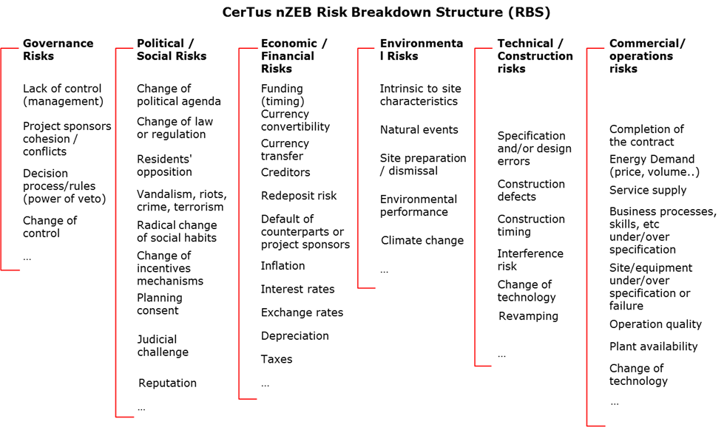
RISK BREAK DOWN STRUCTURE
The risk matrix is one of the tools used to identify the risks associated with the development of a project. It identifies both the risk cluster and the types of risks. The various risks contain more risk drivers that may compromise the economic and financial viability of a project

Slide 50
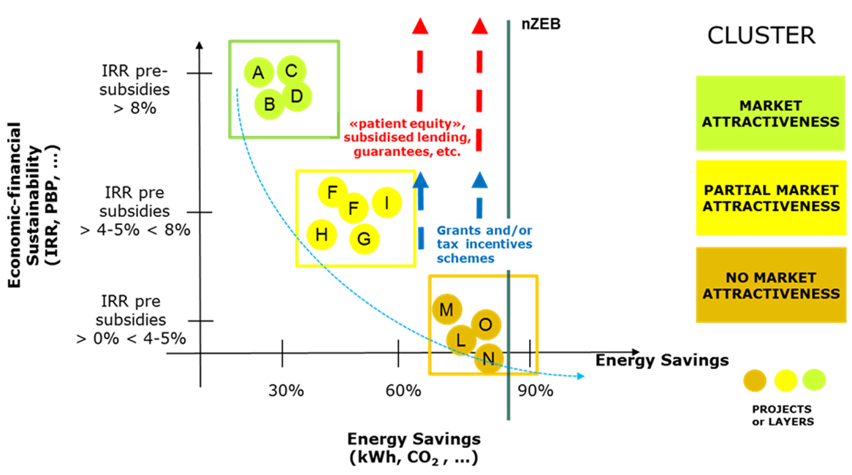
Sustainability vs nZEB Energy Savings
The conceptual graph "Sustainability vs nZEB Energy Savings" was adopted on the basis of previous experience gained in the evaluation of energy efficiency projects

Slide 51
Sustainability vs nZEB Energy Savings
The graph aims to compare the three main factors that characterize nZEB project:
the energy efficiency achieved in the nZEB projects: " Energy Savings "
the sustainability of the project in terms of profitability for the ESCo that will take charge of the project: "IRR for the ESCo"
the placement of the project in market: 3 Cluster were identified (Cluster 1 Market attractiveness – Cluster 2 Partial market attractiveness – Cluster 3 No market attractiveness) and, consequently
assumptions or expectations of investors who can effectively use their resources for the realization of the specific project

Slide 52
Sustainability vs nZEB Energy Savings
An explanation of each variable is as follows:
"Energy Savings": the horizontal axis shows the results in terms of the energy savings achieved by the project. The vertical line is the threshold over which the project achieves nZEB level of efficiency “i.e. 75% to 80% improvement over the current operation as indicated by the national regulation for nZEB”
"IRR for the ESCo": The Internal rate of return for an ESCo was identified as one of the variables for placing the projects in the matrix. This indicator describes the shareholder returns that develops the project and then, in the final synthesis, the attractiveness of the initiative for a potential investor. The IRR was calculated on cash flows for the ESCo within the project during the construction and management period (contract duration EPC). Different ranges of IRR were identified and, as explained in the following paragraphs, a value equal to or greater than 8% was considered to be the target IRR for the ESCo under market condition. see paragraph 3. PROJECT EVALUATION.

Slide 53
Sustainability vs nZEB Energy Savings
c) “Sustainability profile Cluster”: this variable is ideally located on a third axis (as seen from the next graph). In order to classify nZEB projects achievable on a building, it was decided to locate them on the basis of their placement relative to the market. For simplicity purpose, three Cluster were identified (but some more clusters may also be identified):
1) Cluster 1- Market attractiveness: Energy saving solutions fully capable to attract private sector investors and financiers and provide them with sustainable return on investment made; This type of project could be financed directly on the market (bank, private capital, etc.)
2) Cluster 2 - Partial market attractiveness: energy saving solutions only partially capable to attract private sector investors and financiers and provide them with sustainable return on investment made. This type of project should be financed through bank resources and subsidized funds / Guarantees, etc. These kind of projects may be included into Cluster 1 just with a small aid.
3) Cluster 3 - No market attractiveness: energy saving solutions not capable to provide private sector investors and financiers with a sustainable return on investment because they show high investment cost. These types of intervention need a strong support in term of grant funds.

Slide 54
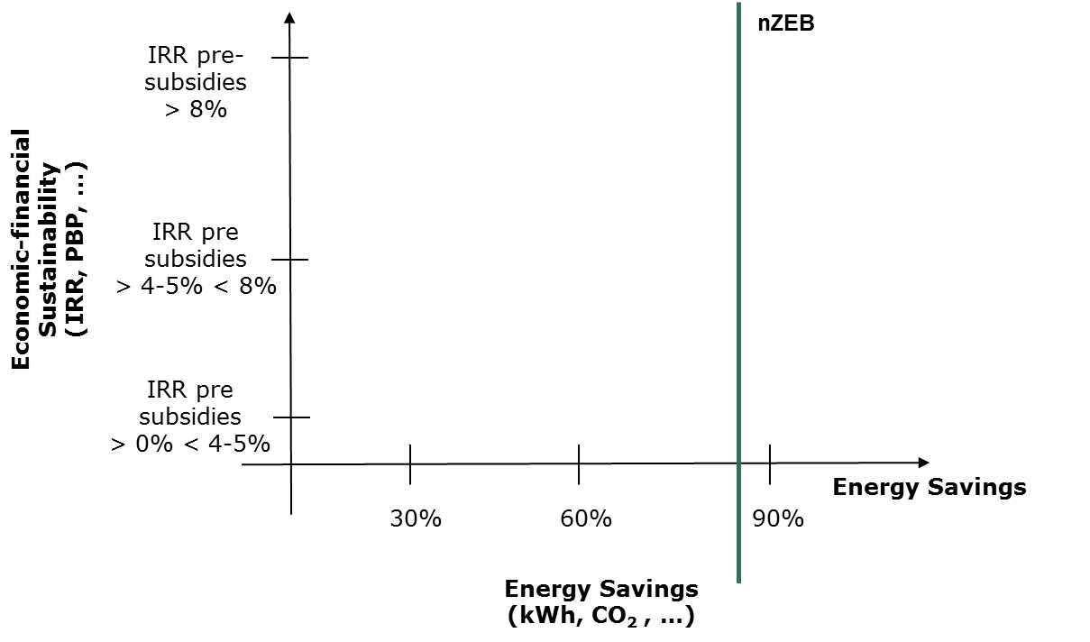
Sustainability vs nZEB Energy Savings
The first logical step is the identification of the observation parameters for the evaluation of the project. The vertical line represents the ideal threshold of energy efficiency for nZEB projects
FIRST STEP
nZEB Energy savings goals

Slide 55
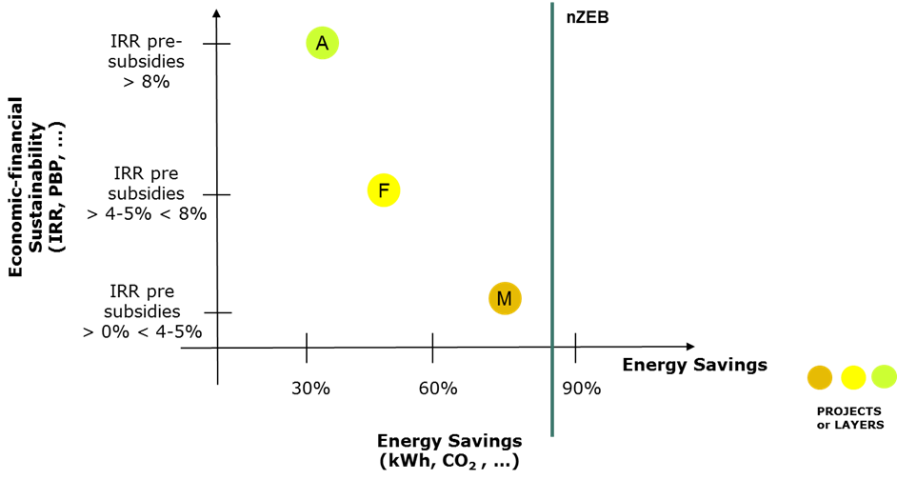
Sustainability vs nZEB Energy Savings
A second step consists of placing, after having carried out the economic and financial evaluation, the projects or the layers inside the graph according to the relation between IRR and Energy Savings. Indeed, the analysis, as explained, may be carried out at both overall project and single intervention (layer) level
SECOND STEP
How is the IRR of the projects/layers

Slide 56
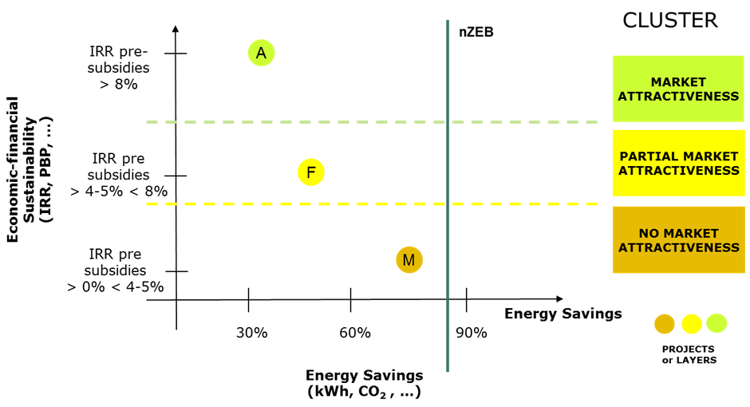
Sustainability vs nZEB Energy Savings
The Third step is the matching/placing of each project/layer inside one of the identified Clusters according to its pre-subsidies IRR
THIRD STEP
CLUSTER

Slide 57
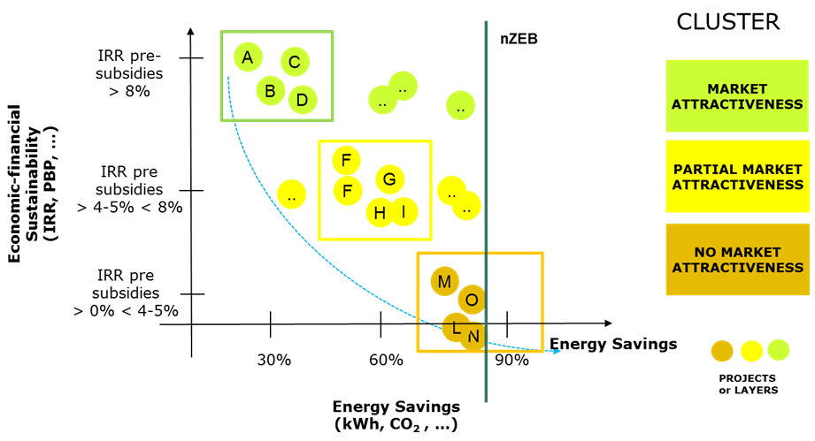
Sustainability vs nZEB Energy Savings
Another step is the analysis of the sample of the projects and their placing into the graph. On the basis of previous experiences and under actual market conditions, the evaluation of a large sample allows to plot, even with regression tools, a curve that may describe the allocation of the projects into the graph. As an example, given the small sample of the CERtuS projects, an ideal blue line was plotted in the following graph
FOUR STEP
PROJECT ALLOCATIONS

Slide 58
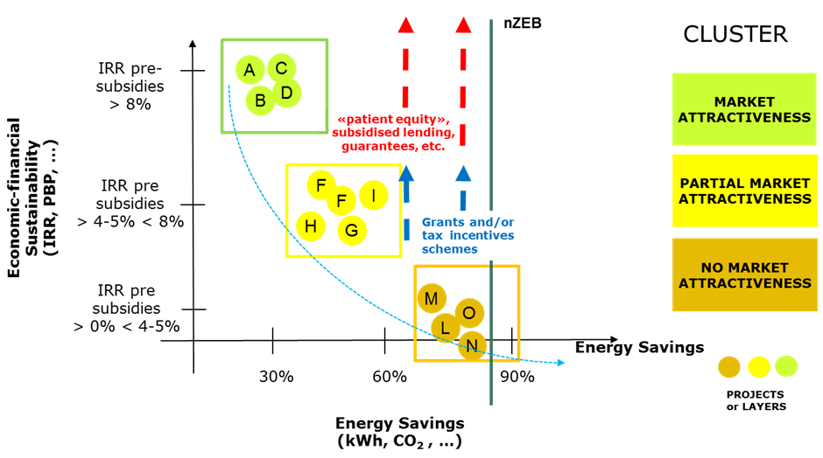
Sustainability vs nZEB Energy Savings
The last step (see red and blue arrows) shows how the identification and use of some financial support instruments (such as subsides funds, grant, fiscal incentives as it will be explained later) could make projects realizable for the market
FINAL STEP
MATCH
FUNDING

Slide 59
KEY FINANCIAL INDICATORS
The conceptual graph can be utilized by placing on the ordinate axis the indicator that it is able to calculate with greater confidence
Layers Cost/Savings
Project Costs/Savings
Equity/Dividends
PAY BACK PERIOD
LAYERS
PROJECT
INVESTORS
CF of Layers
Project CF
Equity CF
IRR
LAYERS
PROJECT
INVESTORS

Slide 60
KEY FINDINGS AND RECOMMENDATION (D.2.5.)
We underlined some recommendations for nZEB projects:
A well-defined baseline of energy consumption and maintenance costs must be clearly-defined
Layers/project must have a short pay back period
Sometimes the municipality should aggregate projects in order to reach a critical mass especially when their size is small
When it is possible, increase the use of public buildings during the daytime by additional activities in order to have more cash flow
Increase ESCo services could offer them the possibility to carry out auxiliary services such as soft facility management, (e.g. cleaning services, green care, reception). This would provide additional revenues to the ESCOs, and would make it more attractive

Slide 61
KEY FINDINGS AND RECOMMENDATION (D.2.5)
Financing energy efficiency initiatives in public buildings, and in particular nZEB initiatives, is a complex and challenging activity
We know that the building energy efficiency market is characterized by:
Fragmented and peculiar initiatives
each project has its own peculiar features (difficult to standardize)
buildings are usually located in different areas and they have several uses
Different counterparts: building users can be private citizens, Public Authorities, Companies, etc.
Non standardized EPC (Energy Performing Contracts) because energy performance (and underlying financial cash flows) are related to the specific building and standard security packages do not cover all risk areas
High performance risk, in fact energy savings can be quantified only ex post
Different counterpart risk, in particular in some circumstances the risk of the building owner will not be able pay back the fee is real
…

Slide 62
FINANCING OPPORTUNITIES
NZEB interventions represent a challenge with respect to traditional energy savings technologies. The financial system, although many dedicated tools were implemented, it turns out to be still in a testing phase …
As reported in previous experience of the project Partners, the typical energy savings threshold coherent with market conditions is around 30%-40%, this is due to the non-linear relationship between investment and savings
Investments for further energy savings can be financed only with specific ad-hoc financial instruments or public grant. Typically, to make a nZEB financially viable, several mechanisms must be activated:
Match funding between different financing sources (i.e. market, subsidized resources and grant) trying to reduce the grant contribution to the minimum needed level
Increase the investment size summing up several buildings, in order to reduce (on average) the incidence of structuring costs

Slide 63
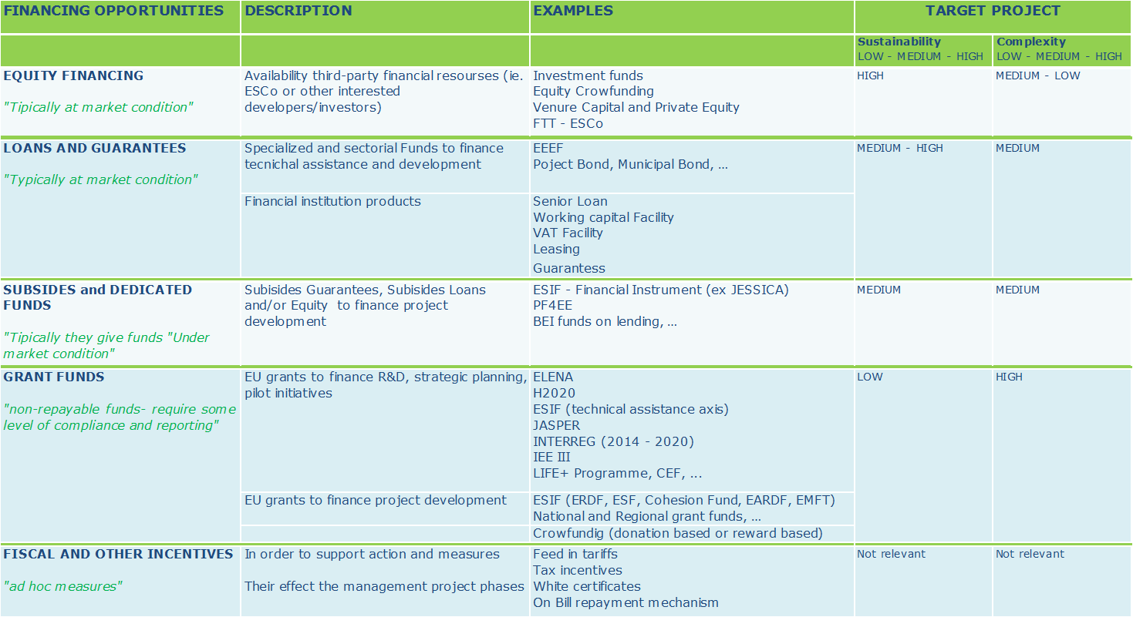
FINANCING OPPORTUNITIES
CERtuS project investigated also on the financing opportunities available …

Slide 64
FINANCING OPPORTUNITIES
In order to optimize the allocation of Public resources and to maximize the number of feasible projects, Municipalities may/should consider the following logic steps:
Identify the need for infrastructure, starting from an analysis of the existing demand and offer (definition of a planning of infrastructures)
Define a ranking of priorities of the social needs
Identify available financial sources for new investments, in terms of cash available owned by the Municipality or coming from transfers and borrowing capability
Separate “non financially viable” initiatives and those which may be financed totally/partially by private capitals
Allocate resources to the different projects on the basis of their financial needs

Slide 65
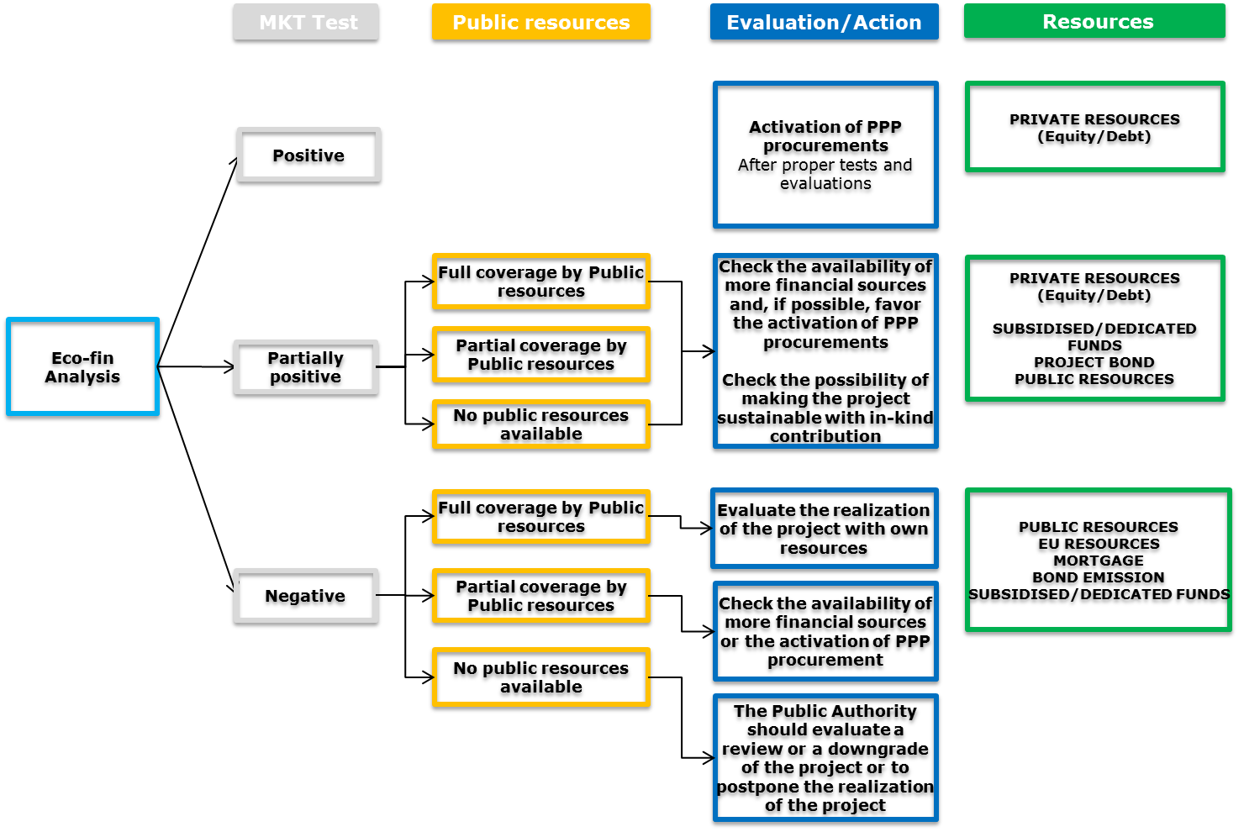
FINANCING OPPORTUNITIES
A brief scheme of the methodology as follows:

Slide 66
FINANCING OPPORTUNITIES
Usually Local Authorities provide finance to investments in the following ways:
Using resources transferred from other Public Entities (mainly the EU and the State);
Using resources coming from a surplus of current revenues on current costs;
Borrowing money from the debt market in the different ways allowed;
Activating private investments through public-private partnership mechanisms
With a combination of the above
The choice depends on a series of factors such as, firstly, the availability of resources, the conditions in terms of duration, interest rates, etc. and the consequent check of constraints the Authority undergoes to concerning the possibility of using resources, the project’s features and its compliance to the strategic choices of the Authority

Slide 67
FINANCING OPPORTUNITIES
In order to check the availability of the resources it is possible to think about the following relevant questions:
Who are the subjects that manage the resources? What are the ways to contact it?
What are the procedures to ask for the activation of a specific resources? Is the procedure simple or not? It is necessary to ask for a technical assistance?
When the project will be realized? Is the instrument or resource available during the project's development period?
Who are the beneficiaries? Could they guarantee a payment for the intervention and its benefit – energy savings?
What are the main features of the project in order to ask for its candidature?
What are the eligible investments? And what are the percentage to finance?
What are the documents to produce in order to ask for the instrument/resources?
What are the rules for the use and the project's reporting? Are they compliant with internal rules for procedures, budgeting and reports?

Slide 68
KEY FINDINGS AND RECOMMENDATION (D.3.7.)
It is important to:
Activate Technical Assistance in order to structure projects that can meet the needs of the stakeholders concerned, both public and private;
Consider that the financial viability of these projects must result from a in-depth analysis of the available resources at the Municipal, Regional, European level and banking and private market. Each project, according to their distinctive characteristics, at the time in which will be realized may have or not a certain mix of funding instruments. Search for the right mix of funding sources is a process that requires the interaction of stakeholders with different roles and skills;
Identify forms of development for the realization of these projects that encourage the use of Public Private Partnership;
Provide for adequate project monitoring tools involving the entire project process, from the “idea”, to the construction phase until the management phase in order to verify energye efficiency obtained;
Activate an important communication’s action about the project’s results and activate training courses about energy efficiency and nZEB projects.

