Slide 1
Training Materials
WP5: Capacity Building in Municipalities
Obstacles and Risks
© Copyright CERTUS Project 2015 - All Rights Reserved Grant agreement no.: 620906

Slide 2
Obstacles and Risks
Common Risks, difficulties and constrains
The common risks, difficulties and constrains of nZEB renovations recognised in previous studies and reports from forerunning initiatives and programmes are:
Financial – Cost of the renovation, financial schemes and incentives and payback period;
Technical – Selection of the solutions in relation to existing systems, availability of reliable data, use of innovative solutions, maintenance and complexity of commissioning, cultural heritage;
Organizational & Legal – Legislation, governance, policy and dialogue among stakeholders;
Social & Environmental – Life cycle perspective, indoor quality, users’ behaviour awareness and commitment.
© Copyright CERTUS Project 2017 - All Rights Reserved

Slide 3
Obstacles and Risks
Common Risks, difficulties and constrains
Financial Risks – Cost of the renovation, financial schemes and incentives and payback period.
© Copyright CERTUS Project 2017 - All Rights Reserved

Slide 4
Obstacles and Risks
Common Risks, difficulties and constrains
Financial Risks, Difficulties and Constrains
Demonstrating the cost-effectiveness of energy efficiency projects is generally problematic;
Public entities often encounter difficulties in raising finance for investments, as they may not be able to finance their whole investment programme directly from public funding;
Difficult to convince managers to undertake projects which might become uneconomic when energy prices decline for a limited period.
© Copyright CERTUS Project 2017 - All Rights Reserved

Slide 5
Obstacles and Risks
Common Risks, difficulties and constrains
Financial Risks, Difficulties and Constrains
The private investment market for energy efficiency is undeveloped, and needs public actors’ support to reach self-sustaining size;
Public Banks’ objectives and offers on energy efficiency are frequently determined by mix of idiosyncratic institutional arrangements, varied information sets and personal factors, not only by public policy goals;
The level of public financing going into support of the finance market for energy efficiency is often held back by an under-estimation within governments and public banks of the economic and social benefits that it would bring.
© Copyright CERTUS Project 2017 - All Rights Reserved

Slide 6
Obstacles and Risks
Common Risks, difficulties and constrains
Financial Risks, Difficulties and Constrains
Investors perceive the risks of investing in energy efficiency to be higher than real estate stakeholders believe;
Energy efficiency investments may be delivered over long time-periods (up to 25 years), it is recommended that investors have confidence that there is a robust, stable and consistent regulatory framework underpinning energy efficiency investments;
The lack of visibility of energy efficiency finance, as these projects often represent a relatively small niche business for major banks and the high upfront costs which often reduce the number of implemented projects.
© Copyright CERTUS Project 2017 - All Rights Reserved

Slide 7
Obstacles and Risks
Common Risks, difficulties and constrains
Technical Risks – Selection of the solutions in relation to existing systems, availability of reliable data, use of innovative solutions, maintenance and complexity of commissioning, cultural heritage
© Copyright CERTUS Project 2017 - All Rights Reserved

Slide 8
Obstacles and Risks
Common Risks, difficulties and constrains
Technical Risks, Difficulties and Constrains
One of the main technical difficulties is still related to the need of developing breakthrough affordable solutions at building and district scale.
Several research projects have surveyed this matter, and the conclusions are:
Both contracting and consulting actors highlight the existence of poor on-site execution and the need for improvement regarding quality assurance;
The consulting actors see the need for energy performance guarantees and requirements for testing;
The long realisation processes is still a problem;
The previous problems can be avoided with knowledge transfer during construction and planning processes and/or optimizing the information flow between professionals;
The market for nZEB SFH renovation is still small and the nZEB concept is yet to be defined.
© Copyright CERTUS Project 2017 - All Rights Reserved

Slide 9
Obstacles and Risks
Common Risks, difficulties and constrains
Technical Risks, Difficulties and Constrains
The main barriers identified are:
Insufficient knowledge about existing technologies that can be used to renovate buildings up to nZEB in Mediterranean climate and inefficient tools for public sector to achieve nZEB renovation;
National markets lack familiarity and expertise with integrated design process and interventions and there is an inadequate number of qualified craftsmen and designers for nZEB;
The nZEB concept is not yet understood by the majority of providers/suppliers;
Even the nZEB early adopters cannot easily find the appropriate technical actors.
© Copyright CERTUS Project 2017 - All Rights Reserved

Slide 10
Obstacles and Risks
Common Risks, difficulties and constrains
Technical Risks, Difficulties and Constrains
Lack of standard solutions and technological solutions;
Lack of existing expertise and skills and lack of training and certification of companies;
Lack of cooperation among different segments of the construction industry and lack of initiative in innovation, due to the conservative character of the construction industry;
Special emphasis should be given to the importance of cultural heritage;
It is important to establish a connection between conservation and energy efficiency through the development and demonstration of new solutions, adapted to historic buildings and districts, as well as on the implementation of new tools for the decision making process.
© Copyright CERTUS Project 2017 - All Rights Reserved

Slide 11
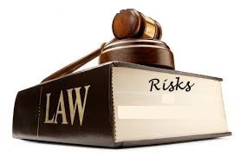
Obstacles and Risks
Common Risks, difficulties and constrains
Organisational and legal Risks – Legislation, governance, policy and dialogue among stakeholders
© Copyright CERTUS Project 2017 - All Rights Reserved

Slide 12
Obstacles and Risks
Common Risks, difficulties and constrains
Organisational and legal Risks, Difficulties and Constrains
Policies, regulations and standards are not been established in all Member States or are still under development, thus representing one of most legislative barriers;
Municipalities are constrained by a lack of technical expertise to be able to identify and develop projects and by a lack of financial resources to pay for the costs of such expertise in order to develop financeable business plans;
Current rules on public procurement rules are onerous and create barriers to investment.
© Copyright CERTUS Project 2017 - All Rights Reserved

Slide 13
Obstacles and Risks
Common Risks, difficulties and constrains
Organisational and legal Risks, Difficulties and Constrains
The public sector is ruled by annual budget cycle and multiannual savings cash flow, thus making difficult for public entities to finance energy efficiency;
There is often no incentive to save when budgets are allocated on an annual basis;
decentralisation and the energy-related statutory tasks of local authorities, ambiguous ownership and operation of major energy assets (e.g. public lighting), inability of local authorities to retain the monetary savings due to efficiency improvements (if the energy costs are reduced the total budget of the local authority will also decrease).
© Copyright CERTUS Project 2017 - All Rights Reserved

Slide 14
Obstacles and Risks
Common Risks, difficulties and constrains
Social and Environmental Risks, Difficulties and Constrains
The lack of reliable evidence of the energetic performances, leads to poor awareness on what can be achieved and lack of confidence of various stakeholders;
There are too few examples of nearly zero energy buildings being developed, with the majority of working examples being demonstration projects;
The lack of a common definition of nZEB and an understanding of the terminology contributes to worsen the problem of poor visibility and credibility,
© Copyright CERTUS Project 2017 - All Rights Reserved

Slide 15
Obstacles and Risks
Common Risks, difficulties and constrains of nZEB renovations
Social and Environmental Risks, Difficulties and Constrains
The acceptance of what is considered an adequate level of thermal comfort varies widely with differing personal and cultural standards;
There is poor dialogue between users and solution providers and usually the real behaviour is not considered in building information models;
Saving energy is not a simple technical issue, but it also depends on the users’ lifestyle.
© Copyright CERTUS Project 2017 - All Rights Reserved

Slide 16
Obstacles and Risks
Common Risks, difficulties and constrains
Portugal - Situation and Questionnaire outcomes
© Copyright CERTUS Project 2017 - All Rights Reserved

Slide 17
Obstacles and Risks
Risks, difficulties and constrains of nZEB renovations in Portugal
In Portugal there are no previous projects with relevant information about barriers in nZEB renovations.
Therefore, it was used a online questionnaire (SurveyMonkey) to identify the main barriers in nZEB renovation in Portugal.
The questionnaire was sent to all Portuguese Municipalities, Energy Agencies, registered ESCOs and some other stakeholders.
The questionnaire was answered by 95 stakeholders.
© Copyright CERTUS Project 2017 - All Rights Reserved

Slide 18
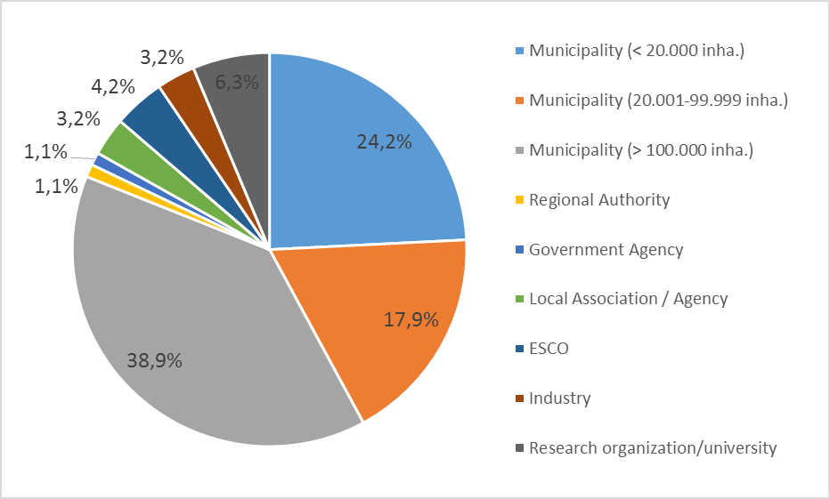
Obstacles and Risks
Risks, difficulties and constrains of nZEB renovations in Portugal
Most of the answers were received from:
Municipalities (81.1%)
ESCOs and industry (7.4%)
Research organizations (7.4%)
The number of answers received from regional authorities, governmental agencies and local agencies was low.
© Copyright CERTUS Project 2017 - All Rights Reserved

Slide 19
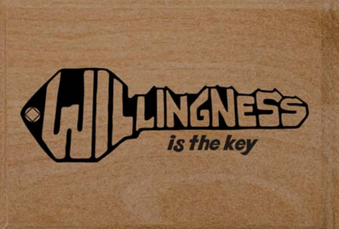
Obstacles and Risks
Risks, difficulties and constrains of nZEB renovations in Portugal
Relevant results from the questionnaires:
Barriers and obstacles for the achievement of nZEB renovation projects in public buildings identified by stakeholders:
Financial barriers - 71,3%
Willingness and political decision - 21,3%
The technical barriers and the legal framework are therefore not considered strong barriers;
Two stakeholders identified as main barriers: preservation of the historic value of buildings; and simultaneously financial barriers and lack of willingness and political decision.
© Copyright CERTUS Project 2017 - All Rights Reserved

Slide 20
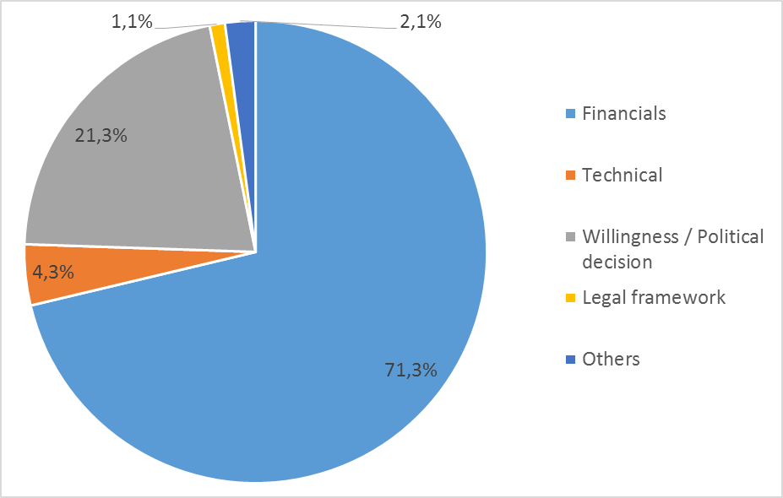
Obstacles and Risks
Risks, difficulties and constrains of nZEB renovations in Portugal
© Copyright CERTUS Project 2017 - All Rights Reserved

Slide 21
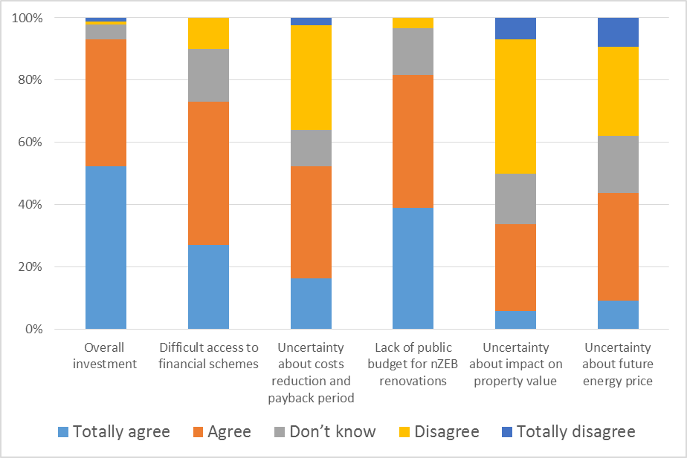
Obstacles and Risks
Risks, difficulties and constrains of nZEB renovations in Portugal
Relevant results from the questionnaires regarding Financial barriers:
What aspects represent the most important financial barrier or obstacle preventing nZEB renovation of public buildings, the stakeholders identified:
Overall investment;
Lack of public budget for nZEB renovations (74.4% consider the Portuguese government does not support energetic renovation);
Difficulties in the access to financial schemes.
© Copyright CERTUS Project 2017 - All Rights Reserved

Slide 22
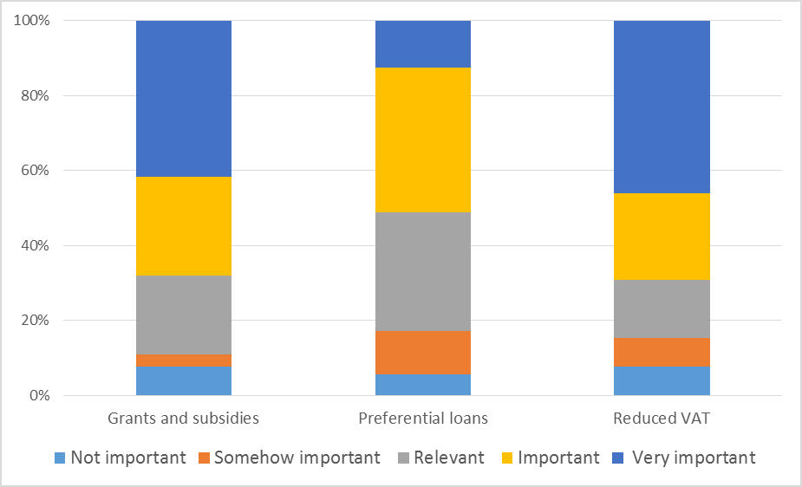
Obstacles and Risks
Risks, difficulties and constrains of nZEB renovations in Portugal
Relevant results from the questionnaires regarding Financial barriers:
Regarding the most appropriate mechanism to boost energetic renovation, stakeholders answered:
Reduction in VAT;
Grants/subsidies;
Preferential loans;
A mechanism to promote Energy Performance Contracts (EPC) was suggested by the stakeholders.
© Copyright CERTUS Project 2017 - All Rights Reserved

Slide 23
Obstacles and Risks
Risks, difficulties and constrains of nZEB renovations in Portugal
Relevant results from the questionnaires regarding Financial barriers:
Suggestions made by stakeholders:
More support is needed (VAT reduction and preferential loans, investments should be partly supported by State budget and EU funds);
Better distribution of the available funds (European and national funding);
More technical support and training for the Municipalities;
Improve the governmental support (reduction of bureaucracy, more articulation between the national and local authorities and a better dissemination of the information about the available support schemes).
© Copyright CERTUS Project 2017 - All Rights Reserved

Slide 24
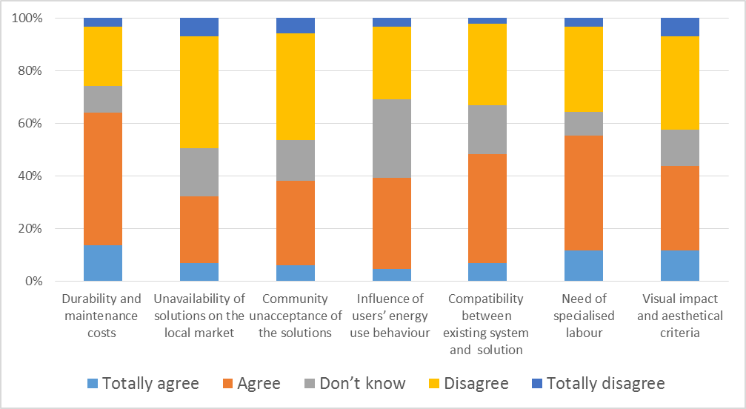
Obstacles and Risks
Risks, difficulties and constrains of nZEB renovations in Portugal
Relevant results from the questionnaires regarding Technical barriers:
Technical barrier or obstacle preventing nZEB renovation of public buildings, the stakeholders identified by the stakeholders :
Lack of reliable data on durability maintenance costs and timing;
Lack of reliable data on savings in real operational conditions;
Complexity of the installation and commissioning of the renovation process;
Need of specialised labour;
Lack of technical knowledge for the selection of the best renovation options;
Lack of knowledge on the compatibility between existing system and new solution.
© Copyright CERTUS Project 2017 - All Rights Reserved

Slide 25
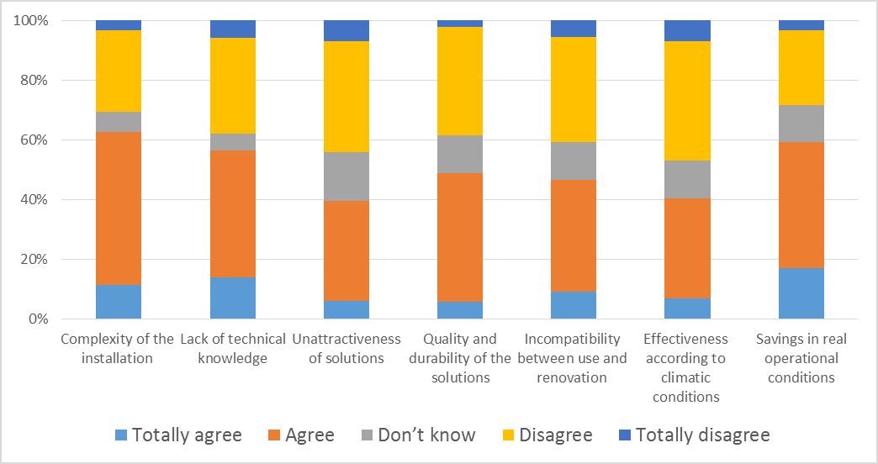
Obstacles and Risks
Risks, difficulties and constrains of nZEB renovations in Portugal
Relevant results from the questionnaires regarding Technical barriers:
Lack of knowledge/data on quality and durability of the solutions; lack of reliable data on the influence of users’ energy use behaviour with respect to the solutions selected;
Incompatibility between use and renovation works;
Visual impact and aesthetical criteria.
© Copyright CERTUS Project 2017 - All Rights Reserved

Slide 26
Obstacles and Risks
Risks, difficulties and constrains of nZEB renovations in Portugal
Relevant questionnaires outcomes :
Regarding the influence of the desired energetic performance level of the technical solutions choice when compared to other aspects, such as financial or social ones:
68.3% of the stakeholders say that systems are designed according to the desired performance but adjusted to planned budget;
3.7% of the stakeholders consider that the desired energetic performance level does not need to be established prior to renovation;
7,3% - the system is designed according to its visibility and political priorities, independently of the costs and energetic performance);
12,2% - that systems are designed according to the desired performance;
8,5% - the system is calculated according to the renovation budget, independently of the energetic performance level.
© Copyright CERTUS Project 2017 - All Rights Reserved

Slide 27
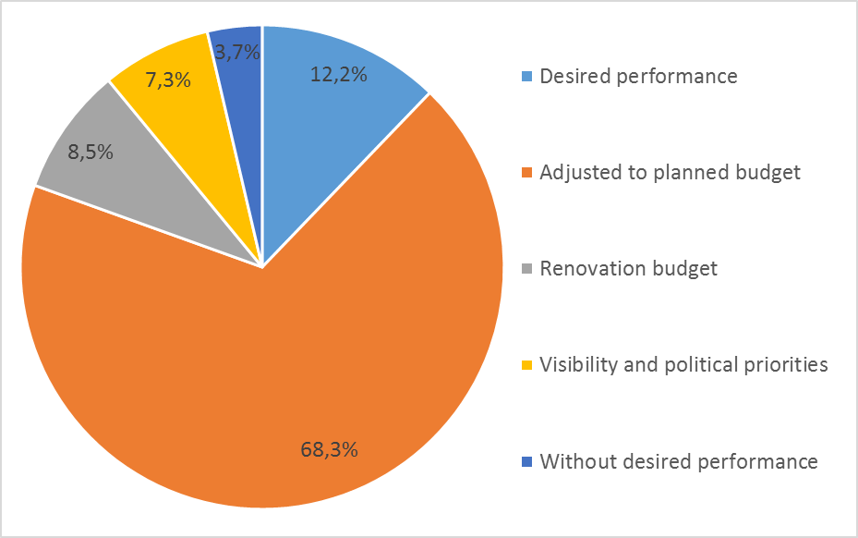
Obstacles and Risks
Risks, difficulties and constrains of nZEB renovations in Portugal
© Copyright CERTUS Project 2017 - All Rights Reserved

Slide 28
Obstacles and Risks
Risks, difficulties and constrains of nZEB renovations in Portugal
Relevant questionnaires outcomes :
The most important organizational and/or legal barrier or obstacle preventing nZEB renovation of public buildings identified by stakeholders are:
Lack of political commitment as main barrier;
Rough decision making chain to decide which buildings should be renovated and which are the energetic objectives to be achieved;
Poor communication/dialogue among stakeholders;
Energy reduction policies are not considered as a priority;
Lack of awareness on energy reduction needs;
Conflict among competences and responsibilities of different bodies;
Laws and regulations.
© Copyright CERTUS Project 2017 - All Rights Reserved

Slide 29
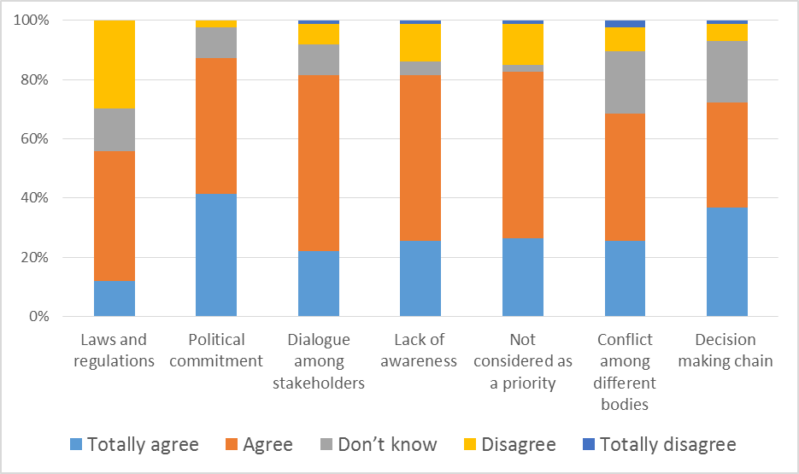
Obstacles and Risks
Risks, difficulties and constrains of nZEB renovations in Portugal
Relevant questionnaires outcomes :
Legal barrier or obstacle preventing nZEB renovation of public buildings identified by stakeholders
© Copyright CERTUS Project 2017 - All Rights Reserved

Slide 30
Obstacles and Risks
Risks, difficulties and constrains of nZEB renovations in Portugal
Additional information:
92% of the stakeholders agreed with the use of new and innovative products in the renovation process, but at the same time the stakeholders presented their concerns about the cost, performance and reliability of some innovative products;
65,95% of the stakeholders confirmed that life cycle assessment (LCA) is part of the evaluation of the energy performance in buildings;
It is also pointed out that traditional solutions, which have presented good results, should not be forgotten.
Additionally 97.8% of the stakeholders consider that citizenship is not aware of the energetic renovation promoted by public authorities. Some stakeholders provided additional comments to reinforce that there is not enough information provided to citizenship.
© Copyright CERTUS Project 2017 - All Rights Reserved

Slide 31
Obstacles and Risks
Risks, difficulties and constrains of nZEB renovations in Portugal
Main conclusions from the questionnaires:
The main obstacles identified for the nZEB renovations in the municipal buildings in Portugal are the financial barriers;
The overall investment is the strongest barrier, which is aggravated by the lack of public budget for nZEB renovations and the difficult access to financial schemes;
There are also important organizational barriers such as the lack of political commitment and the rough decision making chain to decide which buildings should be renovated and which are the energetic objectives to be achieved;
The technical obstacles are not as strong as the financial and organizational, but the lack of reliable data on durability and maintenance costs and timing is also an important barrier or the nZEB renovations in the municipal buildings.
© Copyright CERTUS Project 2017 - All Rights Reserved

Slide 32
Obstacles and Risks
Risks, difficulties and constrains of nZEB renovations in Portugal
© Copyright CERTUS Project 2017 - All Rights Reserved

Slide 33
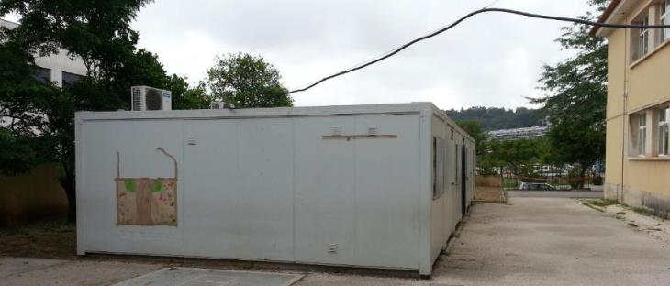
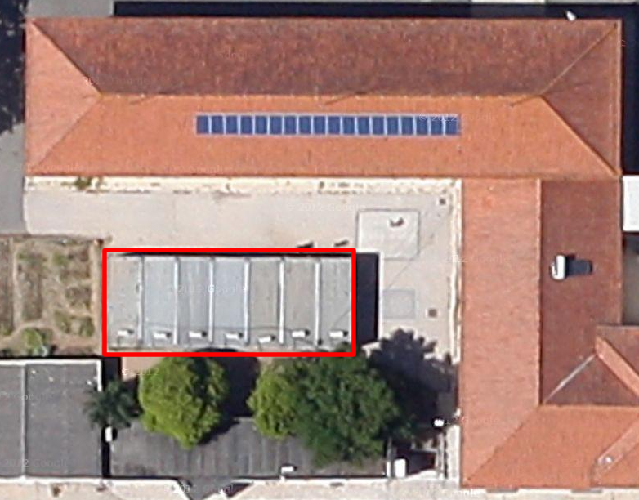
Obstacles and Risks
Elementary School of Solum
Technical Difficulties
General
There are 7 prefabricated buildings in the exterior area of the school.
Such buildings are not a permanent construction and do not belong to the Municipality, being managed by the Family Support project.
However, they receive electricity from the school without any individual metering.
Therefore, its consumption is included in the total consumption of the building, but such energy consumption cannot be considered as a consumption of the studied building.
© Copyright CERTUS Project 2017 - All Rights Reserved

Slide 34
Obstacles and Risks
Elementary School of Solum
PV
Since the building already has a PV system, the best solution is to keep such system and to increase the number of PV panels using the available area.
Envelope
Since most of the buildings do not have any regular source of heating or cooling, the improvement of the envelope would not bring relevant energy savings.
© Copyright CERTUS Project 2017 - All Rights Reserved

Slide 35
Obstacles and Risks
Elementary School of Solum
HVAC
The heating in classrooms is ensured by one oil-filled radiator during the coldest days. However, the option to replace such oil-filled radiators by heat pumps is not cost-effective since the replacement would increase the available thermal power and use (cooling).
Appliances
ICT appliances (mainly PCs, monitors and printers) represent an important share of the consumption. The replacement of such appliances by new devices is not cost-effective just from the energy savings point of view.
© Copyright CERTUS Project 2017 - All Rights Reserved

Slide 36
Obstacles and Risks
Elementary School of Solum
Economic/Financial Risks
The main economic barrier to the implementation of the renovation plan is the high overall investment, which is aggravated by the lack of public budget and the low availability of financial schemes.
The main economic risk is the reliability of the value considered to the total investment needed to the implementation, due to the following reasons:
The prices of the technologies present variations over time, and in some technologies such as photovoltaic the oscillations of prices can be high.
The percentage of price reduction obtained in the public procurement process is uncertain.
© Copyright CERTUS Project 2017 - All Rights Reserved

Slide 37
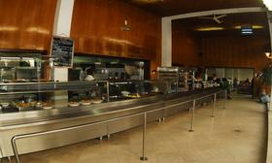
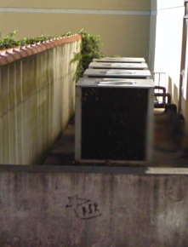
Obstacles and Risks
Municipal House of Culture
Technical Difficulties
General
Part of floor -2 is a refectory from the University of Coimbra. However, this refectory receives electricity from the Municipal House of Culture without any individual metering.
It was detected that 4 of the 9 systems of temperature and humidity control are not working and since this is not the normal mode of operation the electricity consumption for the baseline was corrected to take into account the consumption of the 9 systems.
© Copyright CERTUS Project 2017 - All Rights Reserved

Slide 38
Obstacles and Risks
Municipal House of Culture
PV
Some areas of the roof have shading due to a small extra floor (floor 4) and in other area the installation of PV panels would cause shading on the skylights.
The building is not perfectly oriented to south, presenting an azimuth of 20º.
Envelope
Renovation options requiring major construction works, incompatible with the normal activities of the building, should be avoided.
Lighting
Some rooms have a false roof in wood with small square holes, being the luminaries installed above the false roof. This causes a high loss of luminosity and difficulty of maintenance of such luminaries. Move the luminaires to below the false roof ensure a better distribution of light and would facilitate the maintenance, but it would not bring a major reduction of energy consumption.
© Copyright CERTUS Project 2017 - All Rights Reserved

Slide 39
Obstacles and Risks
Municipal House of Culture
HVAC
The replacement of the several mono-split systems by multi-split systems was not considered, since despite the potential lower purchase cost of multi-split systems the costs of installation would be higher and mainly the impact of the installation process on the building operation would be much higher.
Appliances
ICT appliances (mainly PCs, monitors and printers) represent an important share of the consumption. The replacement of such appliances by new devices is not cost-effective just from the energy savings point of view.
© Copyright CERTUS Project 2017 - All Rights Reserved

Slide 40
Obstacles and Risks
Municipal House of Culture
Economic/Financial Risks
The main economic barrier to the implementation of the renovation plan is the high overall investment, which is aggravated by the lack of public budget and the low availability of financial schemes.
The main economic risk is the reliability of the value considered to the total investment needed to the implementation, due to the following reasons:
The prices of the technologies present variations over time, and in some technologies such as photovoltaic the oscillations of prices can be high.
The percentage of price reduction obtained in the public procurement process is uncertain.
© Copyright CERTUS Project 2017 - All Rights Reserved

Slide 41
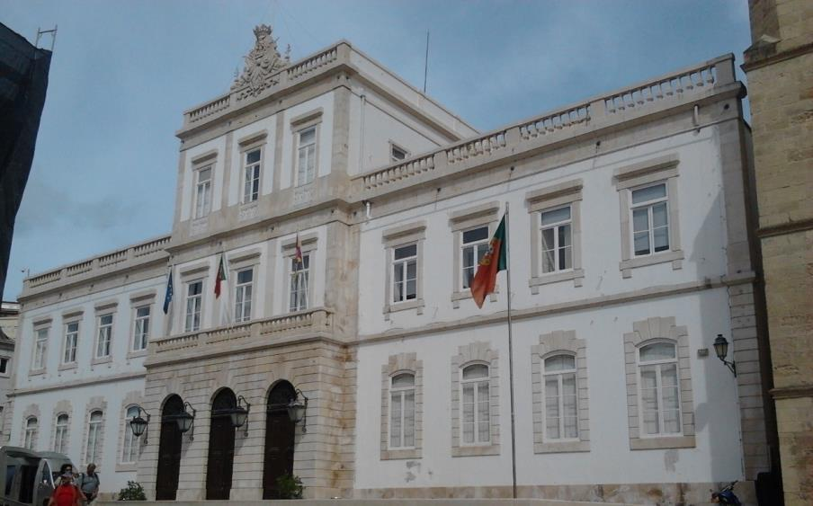
Obstacles and Risks
Coimbra Town Hall
Technical Difficulties
General
The general technical difficulties are imposed by the protection rules. Since the building is part of the property “University of Coimbra — Alta and Sofia” inscribed on the World Heritage List of UNESCO several strong restrictions are applied in the renovation of such building due to the protection rules.
It is not possible to implement any change in the building envelope able to cause any visual impact.
© Copyright CERTUS Project 2017 - All Rights Reserved

Slide 42
Obstacles and Risks
Coimbra Town Hall
PV
The orientation of the building is not the optimum, since it presents an azimuth of -10º, and mainly due to the orientation to west of the larger faced.
Due to the protection rules, it is not possible to implement any change in the building envelope able to cause any visual impact, the use of traditional PV panels was not considered due to its high visual impact.
Envelope
Renovation options requiring major construction works, incompatible with the normal activities of the building, should be avoided.
Lighting
The building uses a large number of different formats of lamps and luminaires and for some formats (e.g. 2G11 or F30) the availability in the market and quality of solutions is lower.
© Copyright CERTUS Project 2017 - All Rights Reserved

Slide 43
Obstacles and Risks
Coimbra Town Hall
HVAC
The replacement of the several mono-split systems by multi-split systems was not considered, since despite the potential lower purchase cost of multi-split systems the costs of installation would be higher and mainly the impact of the installation process on the building operation would be much higher.
Appliances
ICT appliances (mainly PCs, monitors and printers) represent an important share of the consumption. The replacement of such appliances by new devices is not cost-effective just from the energy savings point of view.
© Copyright CERTUS Project 2017 - All Rights Reserved

Slide 44
Obstacles and Risks
Coimbra Town Hall
Economic/Financial Risks
The main economic barrier to the implementation of the renovation plan is the high overall investment, which is aggravated by the lack of public budget and the low availability of financial schemes.
The main economic risk is the reliability of the value considered to the total investment needed to the implementation, due to the following reasons:
The prices of the technologies present variations over time, and in some technologies such as photovoltaic the oscillations of prices can be high.
The percentage of price reduction obtained in the public procurement process is uncertain.
© Copyright CERTUS Project 2017 - All Rights Reserved

Slide 45
Obstacles and Risks
Coimbra Town Hall
Legislative Obstacles
Coimbra - part of the historic city center, older University buildings and other urban structures - is since June 22th 2013 inscribed on the World Heritage List of UNESCO. The Property inscribed is called University of Coimbra — Alta and Sofia and is composed of a set of buildings whose history has been associated to the academic institution, either through participation in the process of knowledge production and dissemination, or through contribution to the creation of unique cultural and identitarian traditions.
The Coimbra Town Hall is included in this area and therefore strong restrictions are applied in the renovation of such building due to the protection rules.
© Copyright CERTUS Project 2017 - All Rights Reserved

Slide 46
Training Materials
WP5: Capacity Building in Municipalities
Obstacles and Risks
© Copyright CERTUS Project 2015 - All Rights Reserved Grant agreement no.: 620906

